Slide 1
Paul Scherrer Institute, Switzerland
Stefan Ritt
Fast Wave-form Sampling Front-end Electronics

Slide 2
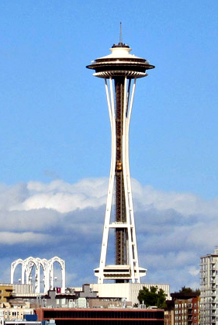
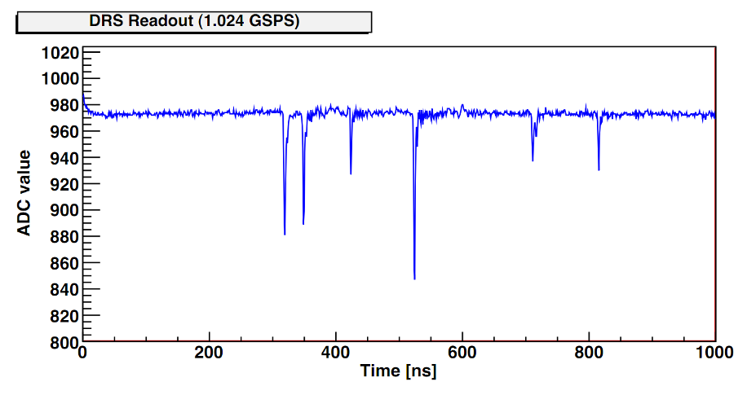
Prologue
RTSD Luncheon

Slide 3


Slide 4
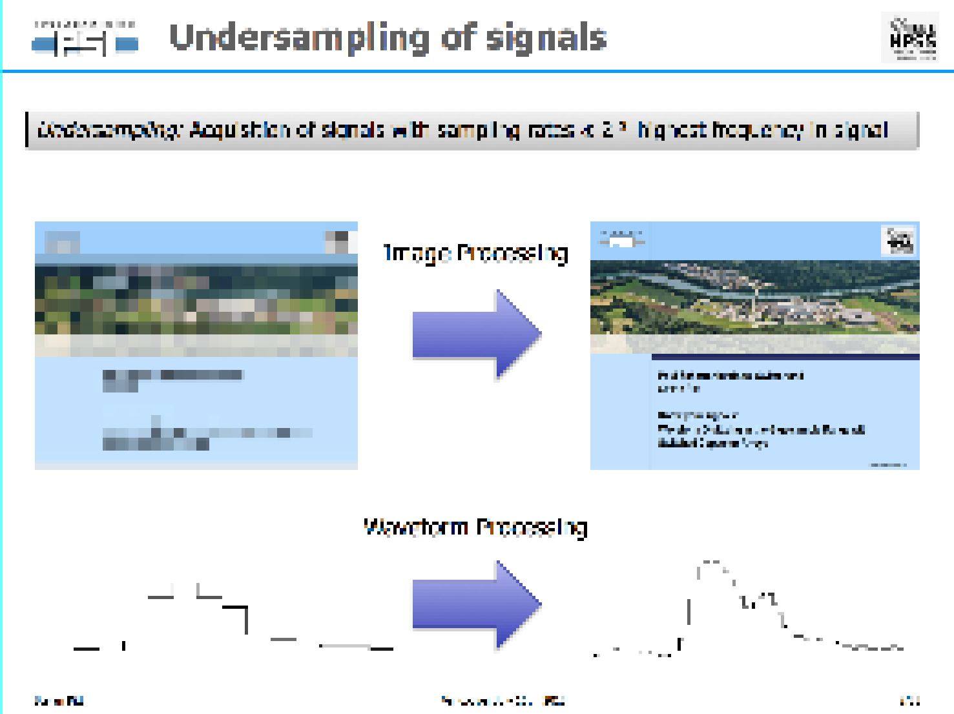

Slide 5

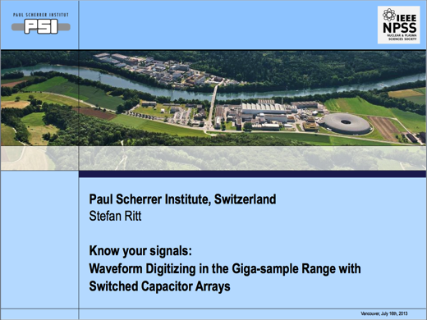
Undersampling of signals
Undersampling: Acquisition of signals with sampling rates ≪ 2 * highest frequency in signal
Image Processing
Waveform Processing

Slide 6
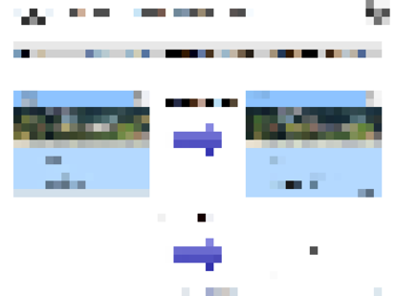
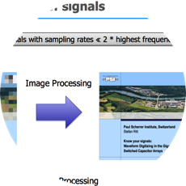
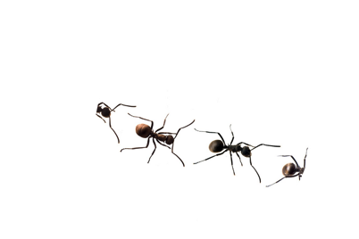

Agenda
What is the problem?
Tool to solve it
1
2
3
What else can we
do with that tool?

Slide 7
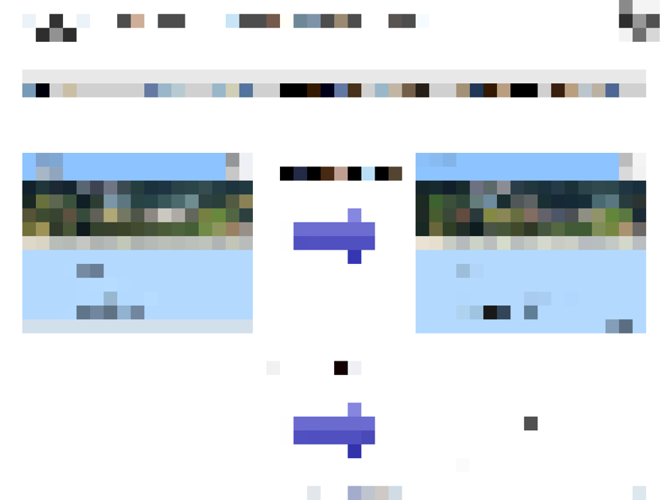
What is the problem?
1

Slide 8
Signals in particle physics
Scintillators
(Plastic, Crystals,
Noble Liquids, …)
Photomultiplier (PMT)
Scintillator
Particle
HV
10 – 100 ns
Wire chambers
Straw tubes
HV
Silicon
Germanium
1 – 10 μs

Slide 9
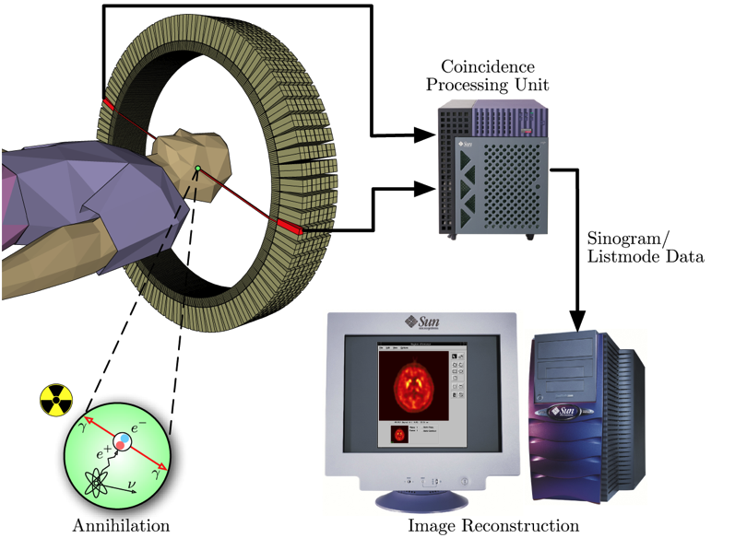
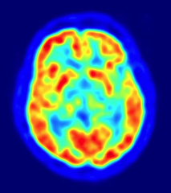
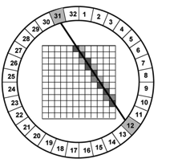
Measure precise timing: ToF-PET
Positron Emission Tomography
Time-of-Flight PET
d
Δt
d ~ c/2 * Δt
e.g.
d=1 cm → Δt = 67 ps

Slide 10
Traditional DAQ in Particle Physics
Threshold
ADC
~MHz
+
-
TDC
(Clock)
Threshold

Slide 11
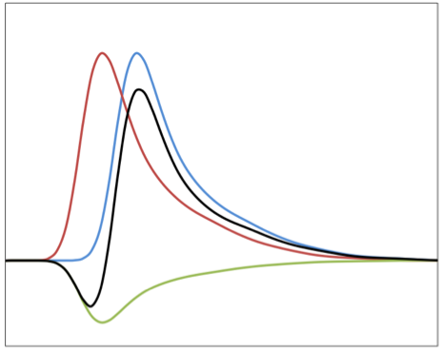
Signal discrimination
Single Threshold
Multiple Thresholds
Constant Fraction (CFD)
Inverter & Attenuator
T1
Threshold
Σ
T2
0
Adder
T3
Delay
“Time-Walk”
T1
T2
T3

Slide 12
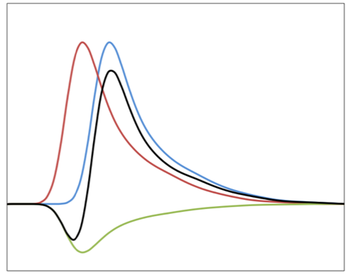
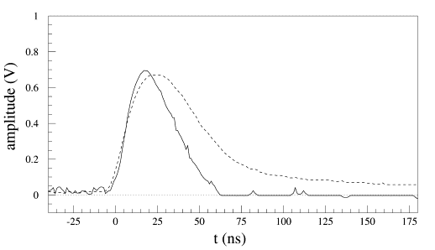

Influence of noise
Voltage noise causes
timing jitter !
Signal
Low pass filter
Noise
Fourier Spectrum
Low pass filter (shaper) reduces noise while maintaining most of the signal

Slide 13
Noise limited time accuracy
All values in this talk are σ (RMS) !
FHWM = 2.35 x σ
U [mV] | ΔU [mV] | t_{r} | Δt
100 | 1 | 1 ns | 10 ps
10 | 1 | 3 ns | 300 ps
Most today’s TDCs have ~20 ps LSB
How can we do better ?

Slide 14
Noise limited time accuracy

Slide 15
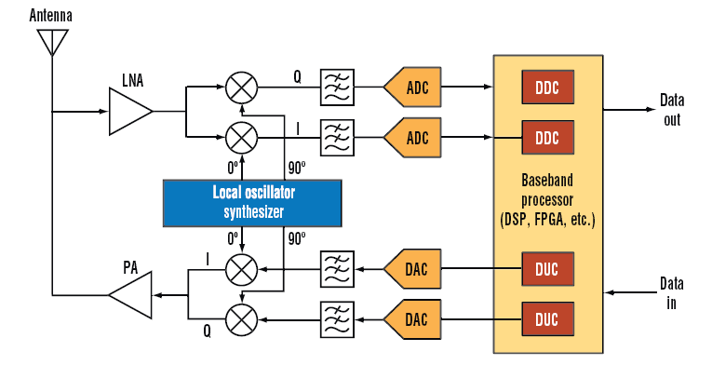
Switching to Waveform digitizing
Advantages:
General trend in signal processing (“Software Defined Radio”)
Less hardware (Only ADC and FPGA)
Algorithms can be complex (peak finding, peak counting, waveform fitting)
Algorithms can be changed without changing the hardware
Storage of full waveforms allow elaborate offline analysis
SDR
ADC
~100 MHz
FPGA

Slide 16
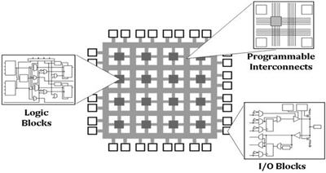
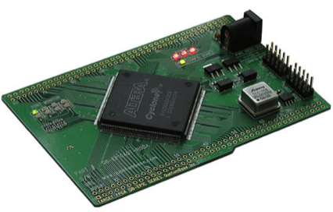

Example: CFG in FPGA
FPGA
Σ
Adder
0
Delay
* (-0.3)
Adder
Look-up Table
(LUT)
8-bit address
8-bit data
+
>0
Latch
AND
≤ 0
Clock
Delay

Slide 17
Nyquist-Shannon Sampling Theorem
f_{signal} < f_{sampling} /2
f_{signal} > f_{sampling} /2

Slide 18
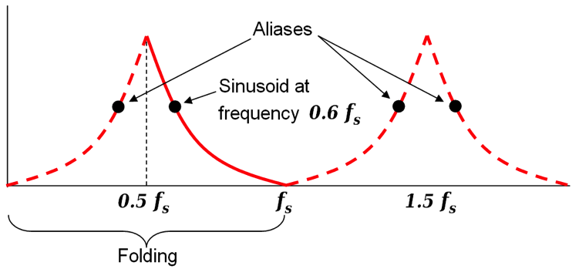
Limits of waveform digitizing
Aliasing Occurs if f_{signal} > 0.5 * f_{sampling}
Features of the signal can be lost (“pile-up”)
Measurement of time becomes hard
ADC resolution limits energy measurement
Need very fast high resolution ADC

Slide 19
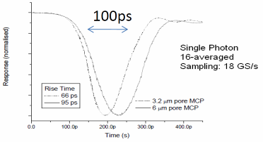
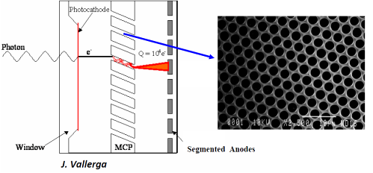
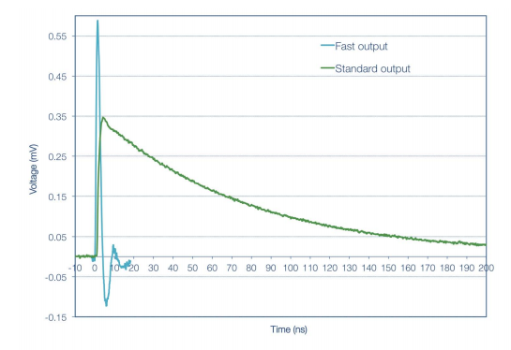
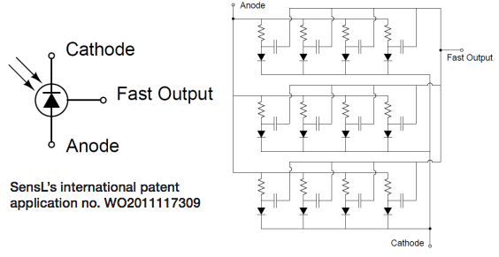
What are the fastest detectors?
Micro-Channel-Plates (MCP)
      Photomultipliers with thousands of tiny channels (3-10 μm)
      Typical gain of 10,000 per plate
      Very fast rise time down to 70 ps
70 ps rise time → 4-5 GHz BW → 10 GSPS
SiPMs (Silicon PMTs) are also getting < 100 ps
J. Milnes, J. Howoth, Photek

Slide 20
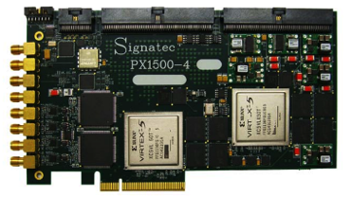
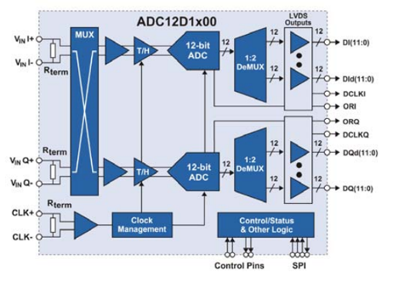
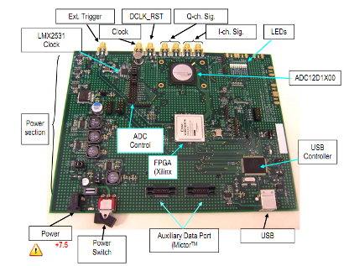

Can it be done with FADCs?
8 bits – 3 GS/s – 1.9 W → 24 Gbits/s
10 bits – 3 GS/s – 3.6 W → 30 Gbits/s
12 bits – 3.6 GS/s – 3.9 W → 43.2 Gbits/s
14 bits – 0.4 GS/s – 2.5 W → 5.6 Gbits/s
PX1500-4:
2 Channel
3 GS/s
8 bits
24x1.8 Gbits/s
1.8 GHz!
1-10 k$ / channel
What about 1000+ Channels?
Requires high-end FPGA
Complex board design
High FPGA power
ADC12D1X00RB:
1 Channel
1.8 GS/s
12 bits
V1761: 2 Channels, 4 GS/s, 10 bits

Slide 21
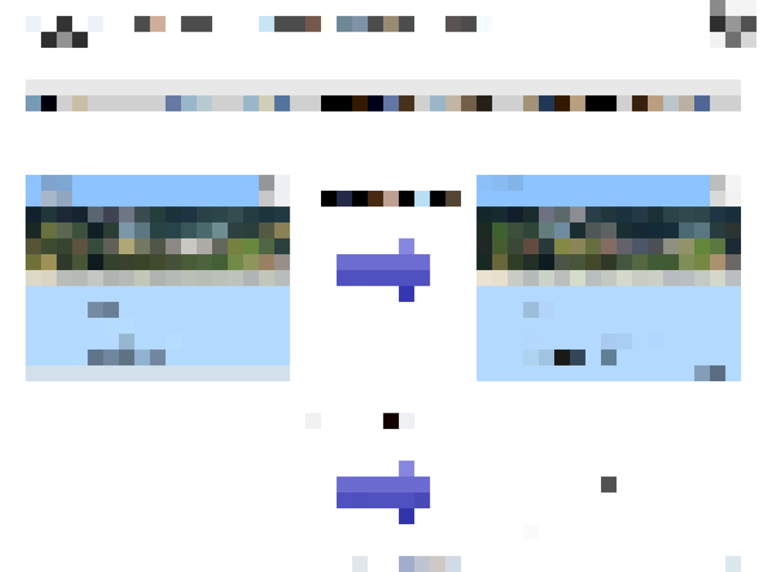
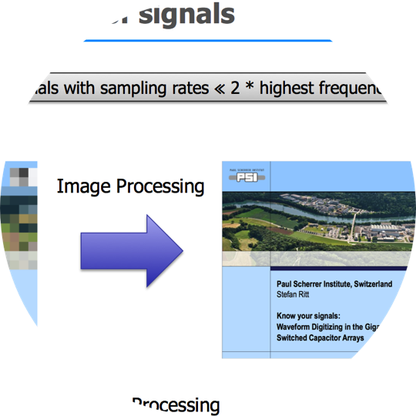
Tool to solve it
2

Slide 22
Switched Capacitor Array (Analog Memory)
0.2-2 ns
10-100 mW
Inverter “Domino” ring chain
IN
Waveform
stored
Out
FADC
33 MHz
Clock
Shift Register
“Time stretcher” GHz → MHz

Slide 23
Time Stretch Ratio (TSR)
δt_{s}
IN
Clock
Out
Typical values:
δt_{s} = 0.5 ns (2 GSPS)
δt_{d} = 30 ns (33 MHz)
→ TSR = 60
δt_{d}

Slide 24
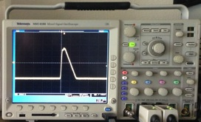
Triggered Operation
sampling
digitization
sampling
digitization
Sampling Windows * TSR
lost events
Dead time =
Sampling Window ∙ TSR
(e.g. 100 ns ∙ 60 = 6 μs)
Chips usually cannot sample during readout ⇒ “Dead Time”
Technique only works for “events” and “triggers”

Slide 25
Time resolution limit of SCA
PCB
Chip
Det.
C_{par}

Slide 26
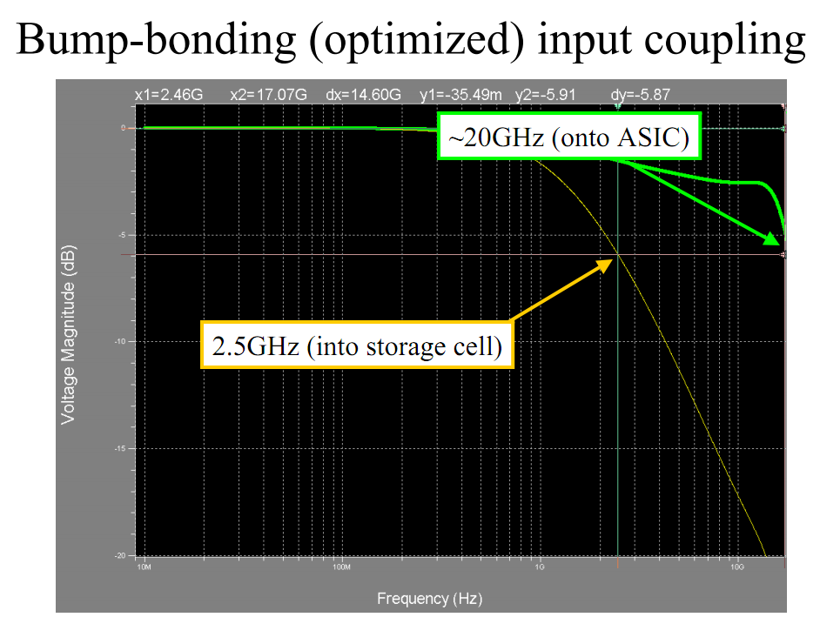
Bandwidth STURM2 (32 sampling cells)
G. Varner, Dec. 2009

Slide 27
How is timing resolution affected?
U | Δu | f_{s} | f_{3db} | Δt
100 mV | 1 mV | 2 GSPS | 300 MHz | ∼10 ps
1 V | 1 mV | 2 GSPS | 300 MHz | 1 ps
100 mV | 1 mV | 10 GSPS | 3 GHz | 1 ps
today:
optimized SNR:
next generation:
- high frequency noise
- quantization noise

Slide 28
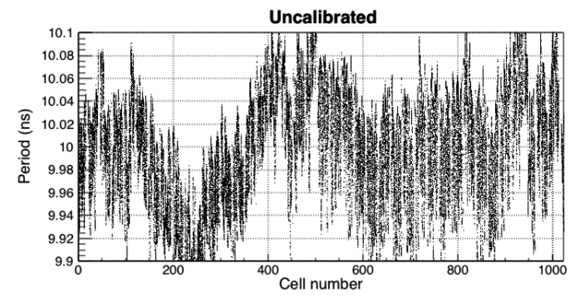
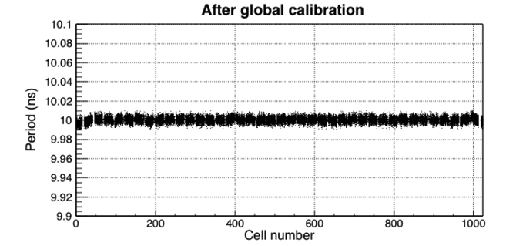
Timing Nonlinearity
Δt
Δt
Δt
Δt
Δt
Bin-to-bin variation:
“differential timing nonlinearity”
Difference along the whole chip:
“integral timing nonlinearity”
Nonlinearity comes from size (doping)
of inverters and is stable over time
→ can be calibrated
Residual random jitter:
1-2 ps RMS beats best TDC
Recently achieved with new calibration
method http://arxiv.org/abs/1405.4975

Slide 29
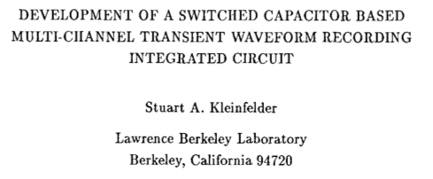
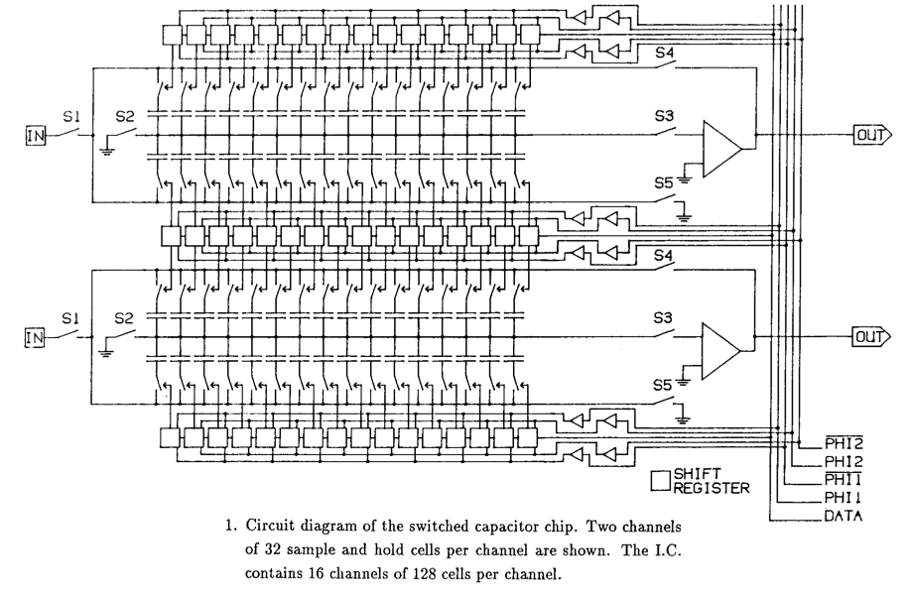
First Switched Capacitor Arrays
IEEE Transactions on Nuclear Science,
Vol. 35, No. 1, Feb. 1988
50 MSPS in
3.5 μm CMOS process

Slide 30
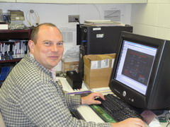
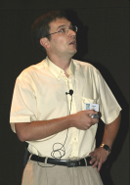

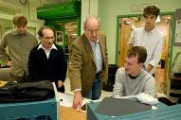






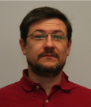

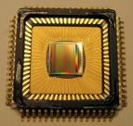
Switched Capacitor Arrays for Particle Physics
E. Delagnes
D. Breton
CEA Saclay
G. Varner, Univ. of Hawaii
H. Frisch et al., Univ. Chicago
STRAW3
LABRADOR3
TARGET
AFTER
SAM
NECTAR0
PSEC1 - PSEC4
0.13 μm IBM
Large Area Picosecond Photo-Detectors Project (LAPPD)
0.25 μm TSMC
Many chips for different projects
(Belle, Anita, IceCube …)
0.35 μm AMS
T2K TPC, Antares, Hess2, CTA
www.phys.hawaii.edu/~idlab/
matacq.free.fr
psec.uchicago.edu
DRS1
DRS2
DRS3
DRS4
0.25 μm UMC
Universal chip for many applications
MEG experiment, MAGIC, Veritas,
TOF-PET
SR
R. Dinapoli
PSI, Switzerland
2002
2004
2007
2008
drs.web.psi.ch

Slide 31
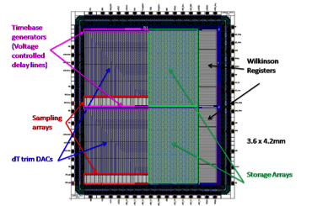
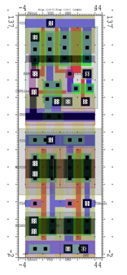
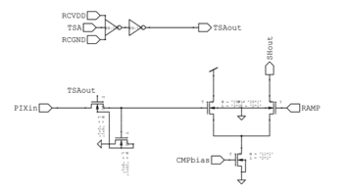
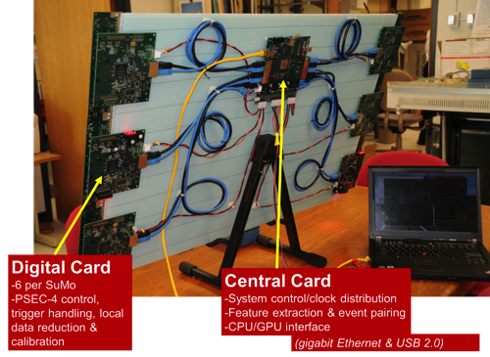
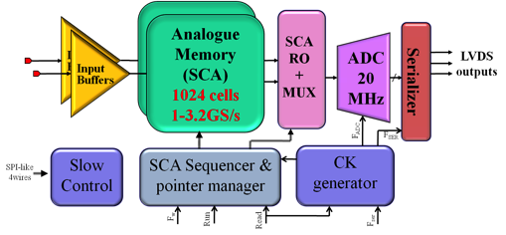
Some specialities
LAB Chip Family (G. Varner)
  Deep buffer (BLAB Chip: 64k)
  Double buffer readout (LAB4)
  Wilkinson ADC
NECTAR0 Chip (E. Delagnes)
  Matrix layout (short inverter chain)
  Input buffer (300-400 MHz)
  Large storage cell (>12 bit SNR)
  20 MHz pipeline ADC on chip
PSEC4 Chip (E. Oberla, H. Grabas)
  15 GSPS
  1.6 GHz BW
  @ 256 cells
  Wilkinson ADC
6 μm
16 μm
Cell contents
Ramp
Wilkinson-ADC:
measure time

Slide 32

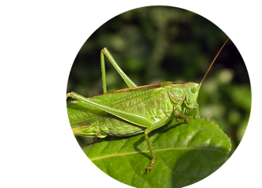
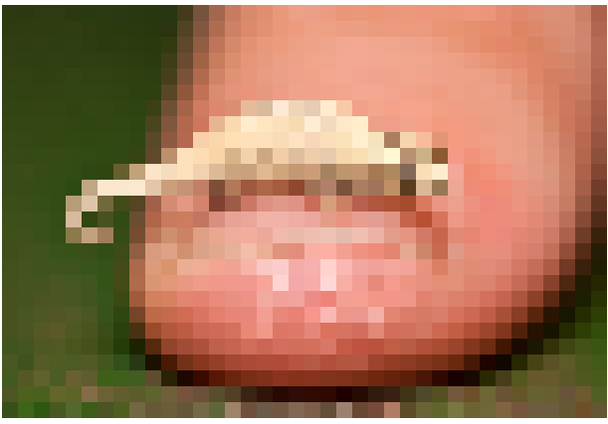
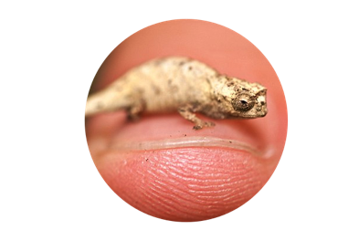
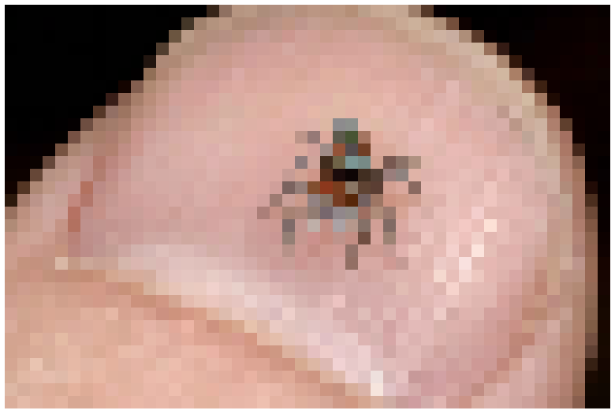
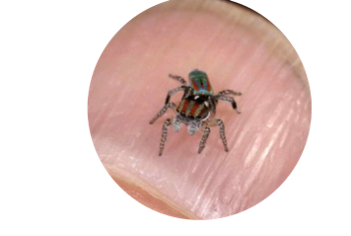
What can we do with that tool?
3

Slide 33
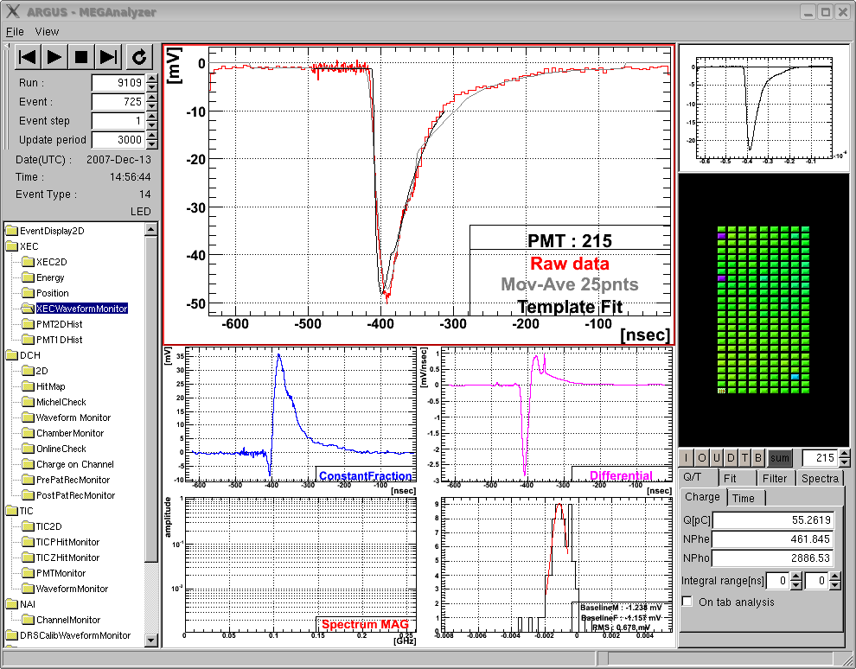
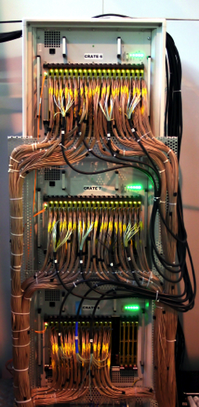
MEG On-line waveform display
“virtual oscilloscope”
γ
Σ848
PMTs
Liq. Xe
μ
template
fit
PMT
1.5m
μ⁺→e⁺γ
At 10⁻¹³ level
3000 Channels
Digitized with
DRS4 chips at
1.6 GSPS
Drawback: 400 TB data/year

Slide 34



Pulse shape discrimination
μ
γ
γ
α
α
μ
Events found and correctly processed 2 years (!) after the were acquired

Slide 35
Readout of Straw Tubes
HV
d ~ c/2 * Δt
Readout of straw tubes or drift chambers usually with “charge sharing”: 1-2 cm resolution
Readout with fast timing: 10 ps / √10 = 3 ps → 0.5 mm
Currently ongoing research project at PSI

Slide 36



A first test
Speed: 266 mm/ns (7.5 ps/mm)
Accuracy: 4.2 ps or 0.5 mm

Slide 37



MAGIC Telescope
http://ihp-lx.ethz.ch/Stamet/magic/magicIntro.html
La Palma, Canary Islands, Spain, 2200 m above sea level
https://wwwmagic.mpp.mpg.de/

Slide 38


MAGIC Readout Electronics
Old system:
2 GHz flash (multiplexed)
512 channels
Total of five racks, ~20 kW
New system:
2 GHz SCA (DRS4 based)
2000 channels
4 VME crates
Channel density 10x higher

Slide 39

Digital Pulse Processing (DPP)
C. Tintori (CAEN)
V. Jordanov et al., NIM A353, 261 (1994)

Slide 40



Template Fit
πβ Experiment
500 MHz sampling
14 bit
60 MHz
www.southerninnovation.com
Determine “standard” PMT pulse by
averaging over many events → “Template”
  Find hit in waveform
  Shift (“TDC”) and scale (“ADC”)
  template to hit
  Minimize χ²
  Compare fit with waveform
  Repeat if above threshold
Store ADC & TDC values

Slide 41







Other Applications
Gamma-ray astronomy
CTA
320 ps
Magic
Antares
(Mediterranian)
Antarctic Impulsive
Transient Antenna
(ANITA)
IceCube
(Antarctica)
ToF PET (Siemens)

Slide 42


High speed USB oscilloscope
4 channels
5 GSPS
1 GHz BW
8 bit (6-7)
15k€
4 channels
5 GSPS
1 GHz BW
11.5 bits
900€
USB Power
Demo

Slide 43

SCA Usage

Slide 44





Things you can buy
DRS4 chip (PSI)
32+2 channels
12 bit 5 GSPS
> 500 MHz analog BW
1024 sample points/chn.
110 μs dead time
MATACQ chip (CEA/IN2P3)
4 channels
14 bit 2 GSPS
300 MHz analog BW
2520 sample points/chn.
650 μs dead time
SAM Chip (CEA/IN2PD)
2 channels
12 bit 3.2 GSPS
300 MHz analog BW
256 sample points/chn.
On-board spectroscopy
DRS4 Evaluation Board
4 channels
12 bit 5 GSPS
750 MHz analog BW
1024 sample points/chn.
500 events/sec over USB 2.0

Slide 45
Next Generation SCA
Short sampling depth
Deep sampling depth
Low parasitic input capacitance
Wide input bus
Low R_{on} write switches
→ High bandwidth
Digitize long waveforms
Accommodate long trigger delay
Faster sampling speed for a given trigger latency
How to combine
best of both worlds?

Slide 46
Cascaded Switched Capacitor Arrays
input
shift register
32 fast sampling cells (10 GSPS)
100 ps sample time, 3.1 ns hold time
Hold time long enough to transfer voltage to secondary sampling stage with moderately fast buffer (300 MHz)
Shift register gets clocked by inverter chain from fast sampling stage
. . . . . . . . . . . . . . . . . . . . . . . . . . . . . . . . .
fast sampling stage
secondary sampling stage

Slide 47
The dead-time problem
sampling
digitization
sampling
digitization
Sampling Windows * TSR
lost events
Only short segments of waveform are of interest

Slide 48
FIFO-type analog sampler
digitization
FIFO sampler becomes immediately active after hit
Samples are digitized asynchronously
“De-randomization” of data
Can work dead-time less up to
average rate = 1/(window size * TSR)
Example: 2 GSPS, 10 ns window size, TSR = 60 → rate up to 1.6 MHz

Slide 49

DRS5
Self-trigger writing of 128 short 32-bin segments (4096 bins total)
Storage of 128 events
  Accommodate long trigger latencies
  Quasi dead time-free up to a few MHz,
  Possibility to skip segments
  → second level trigger
Attractive replacement for CFG+TDC
Delay chain tested in 0.11 μm UMC process
First version planned for 2016

Slide 50

SAMPIC Chip (E. Delagnes et al)
“Waveform TDC”: Coarse timing by TDC + interpolation by waveform digitizing of 64 analog sampling cells + ADC readout
Simultaneous write & read
5 ps (RMS) time resolution at 2 MHz event rate
Planned for ATLAS AFP and SuperB TOF

Slide 51








Conclusions
SCA technology offers tremendous opportunities
Several chips and boards are on the market for evaluation
New series of chips on the horizon might change front-end electronics significantly

