Slide 1

Future Prospects of AI in Nuclear Engineering Including Modelling of Nuclear Accidents
Christopher Pain, Ali Tehrani, Boyang Chen, Claire Heaney, Toby Phillips, Linfeng Li, Jiansheng Xiang, Steven Dargaville, Omar Matar, Kene Nwegbu, Paul Smith (Imperial College London) Andrew Buchan (Queen Mary University of London) Moji Moatamedi (New York University London)
Presentation to: EMUG 14th April 2023

Slide 2
Objective:
Provide an overview of AI capability, the recent developments and explore how these can support the nuclear industry.
What can AI do?
Automatic code generation e.g. define eqns.
A significant improvements in reliability of data, including uncertainty quantification and statistical methodologies,
An improved understanding of the overall risks,
Support operational requirements e.g. control a reactor or nuclear plant.

Slide 3
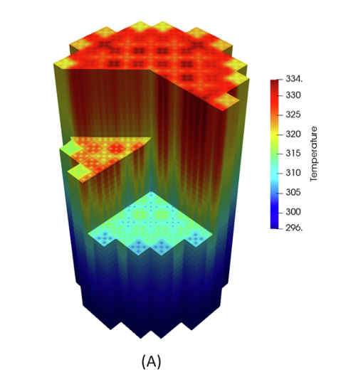
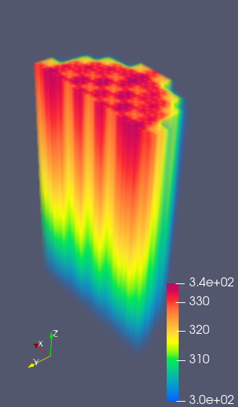
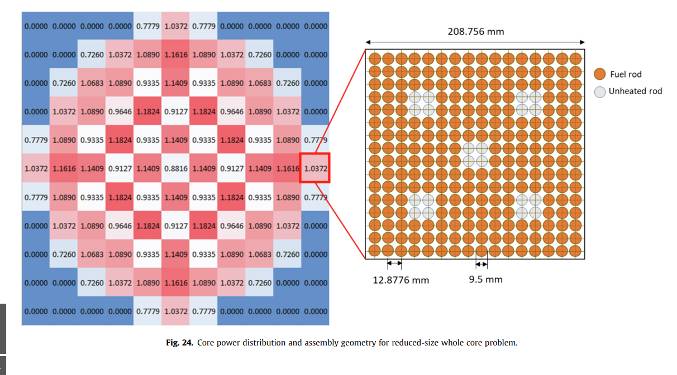
Automatic code generation PWR: Top –others work, bottom left - Schematic, bottom right – DEVITO

Slide 4
Reduced Order Modelling and AI

Slide 5
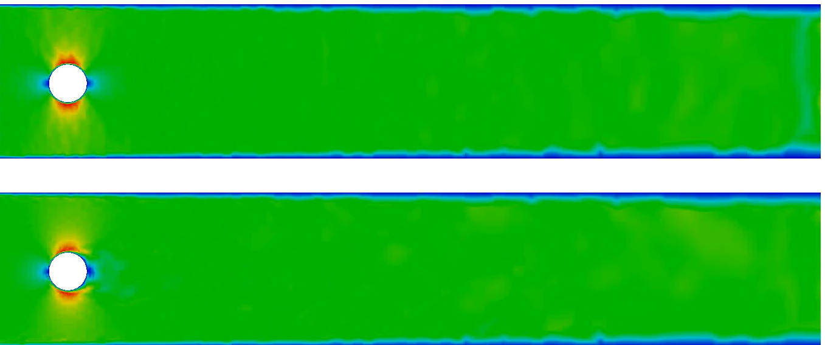
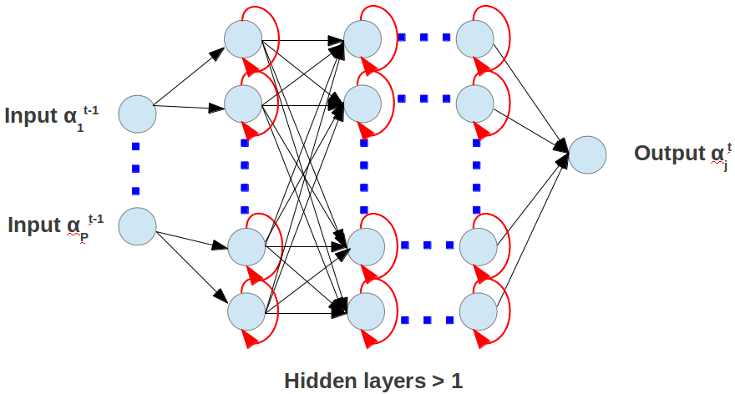
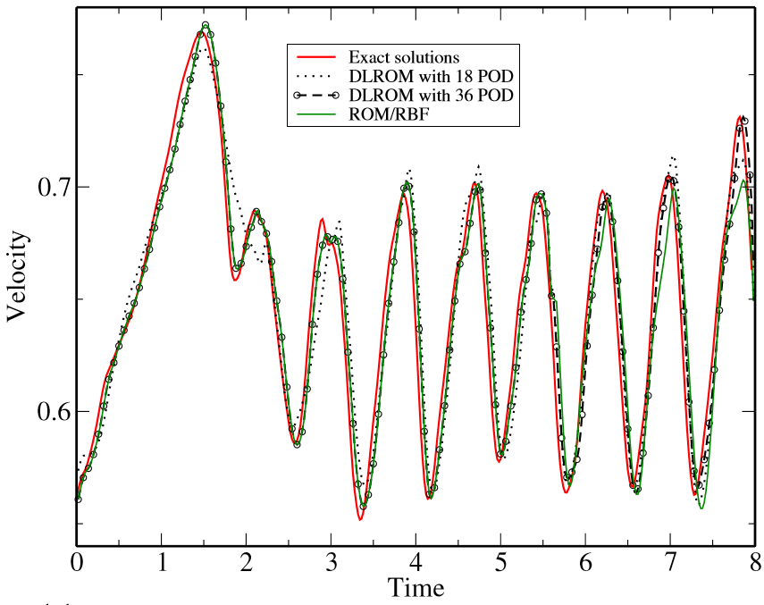
Example: Reduced Order Modelling and AI
Top panel: Full modelling, bottom panel: Reduced order modelling
Notes:
To keep

Slide 6
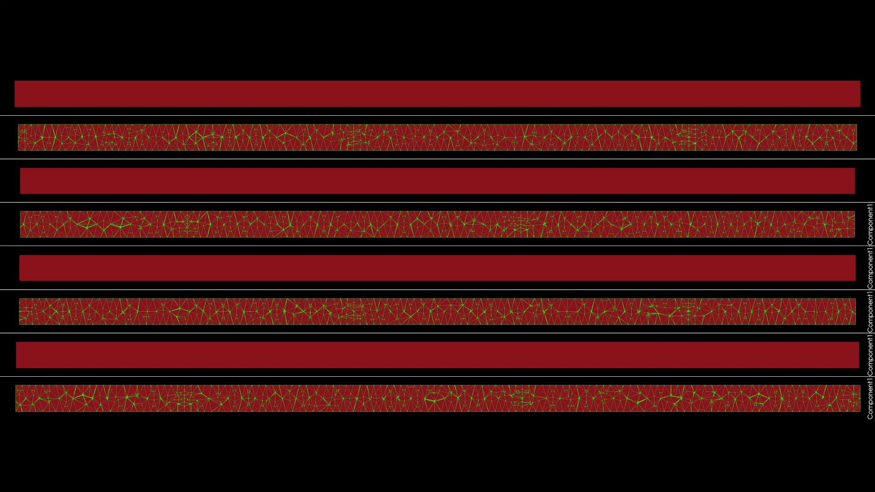
Slug flow, rapid modelling case study
Slide 6
Notes:
6

Slide 7
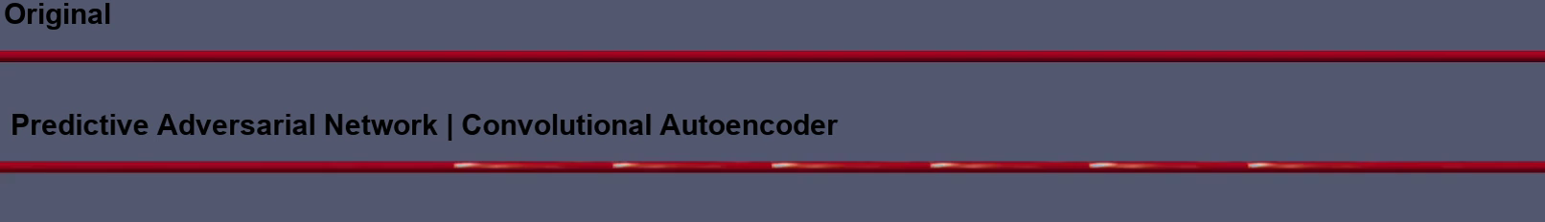
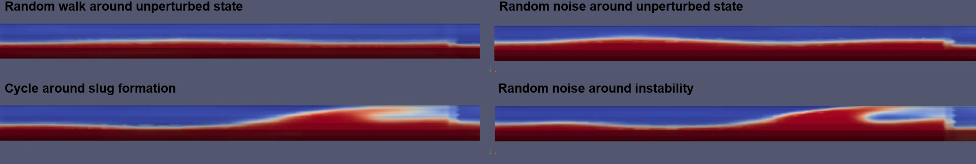
Slug flow, rapid modelling case study
TOP: comparison of AI-model with CFD
BOTTOM: different boundary conditions
Slide 7
Notes:
7

Slide 8
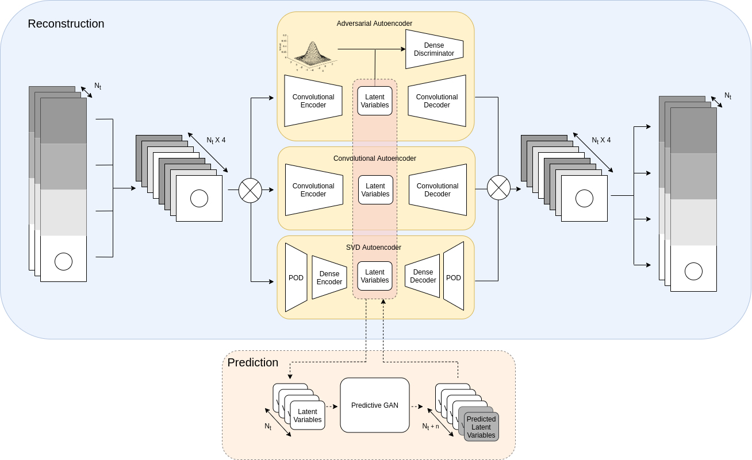
Neural Network Architecture

Slide 9
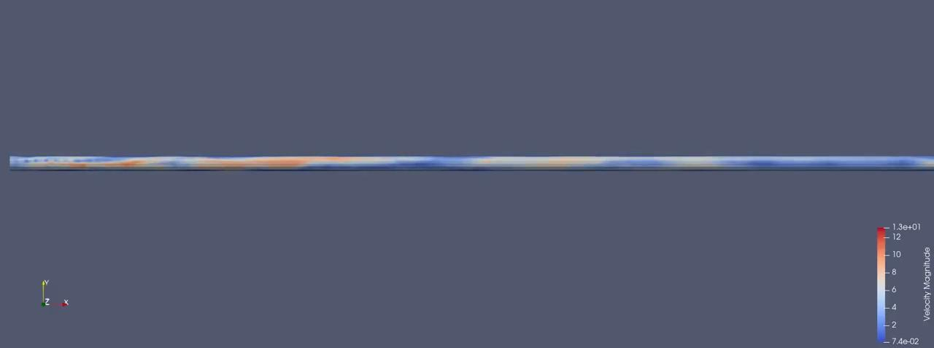
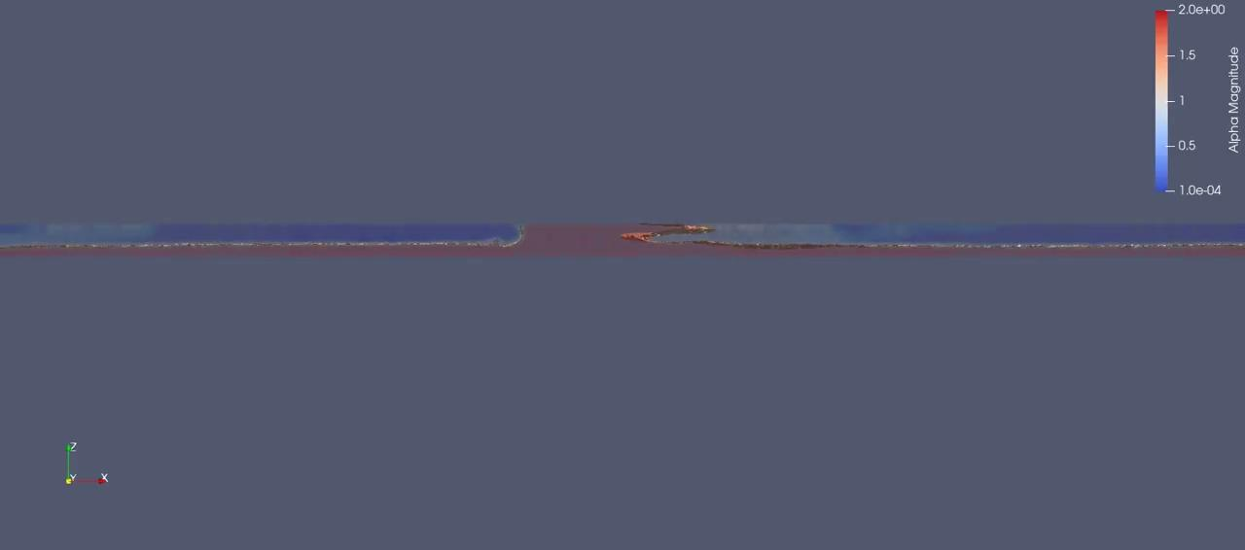

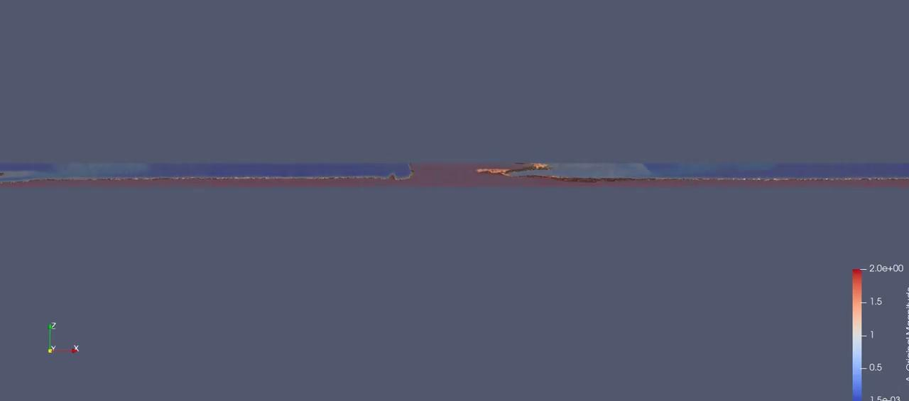
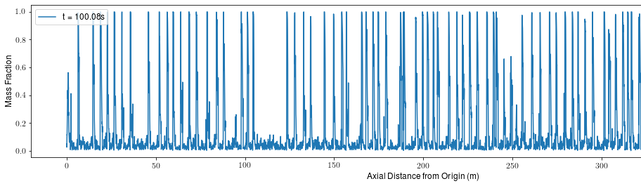
Slug flow - Results: Auto-Encoder Compression (using Domain Decomposition combined) then prediction in 1000m pipeline (volume frac at pt)

Slide 10
Uncertainty Quantification (UQ) and Data Assimilation (DA)

Slide 11
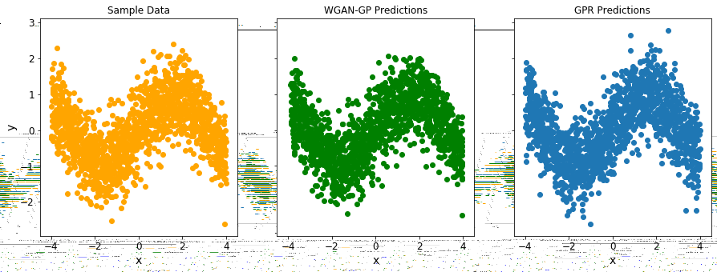
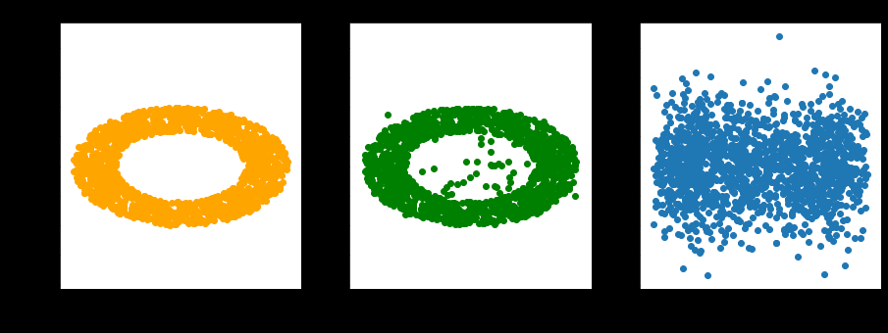
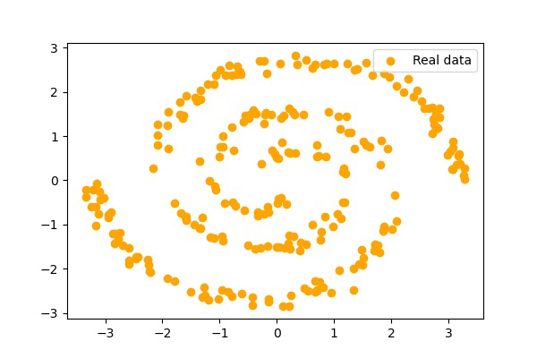
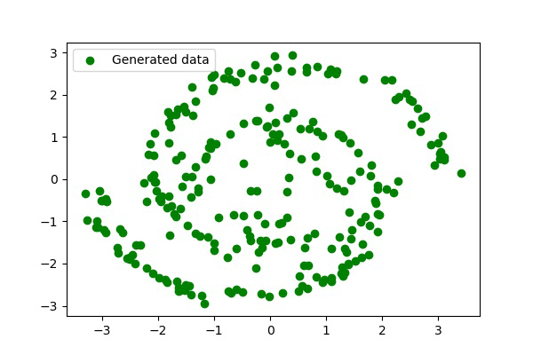
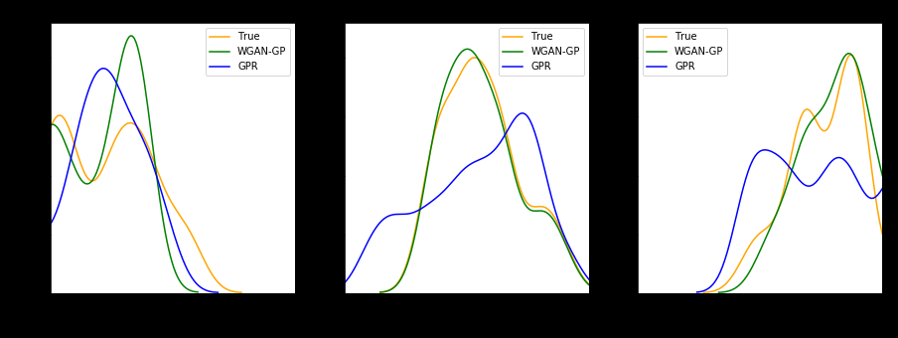
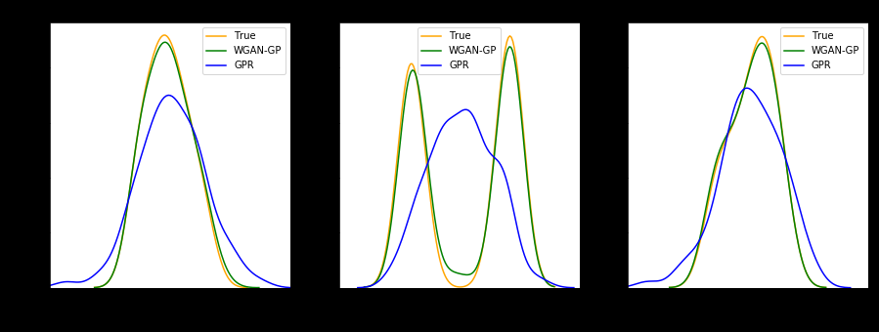
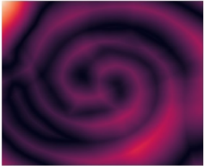
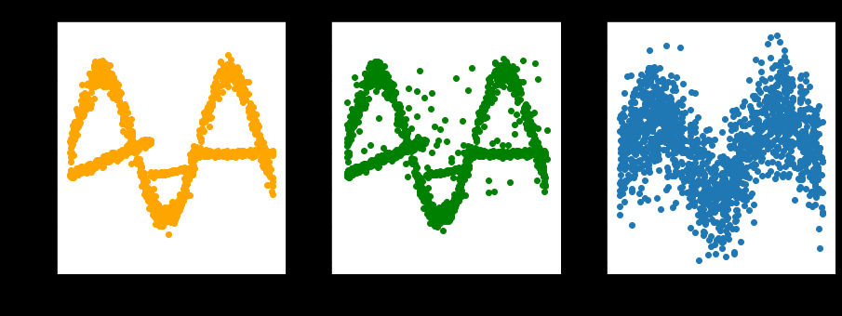
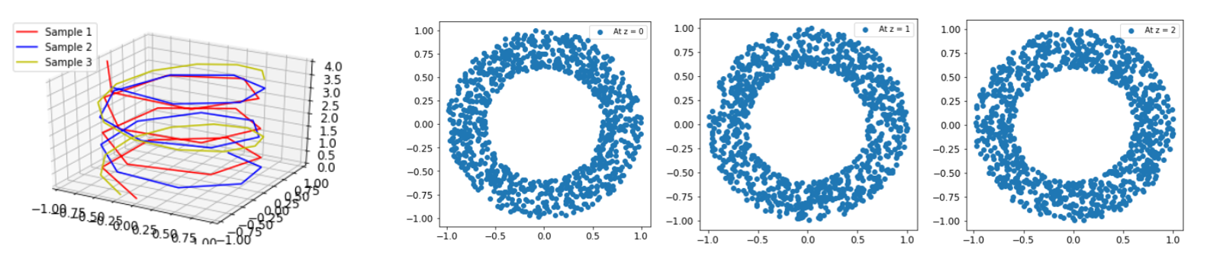
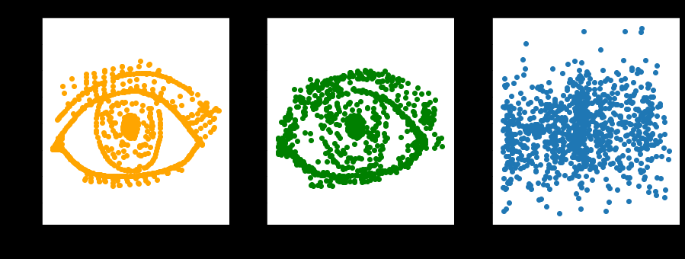
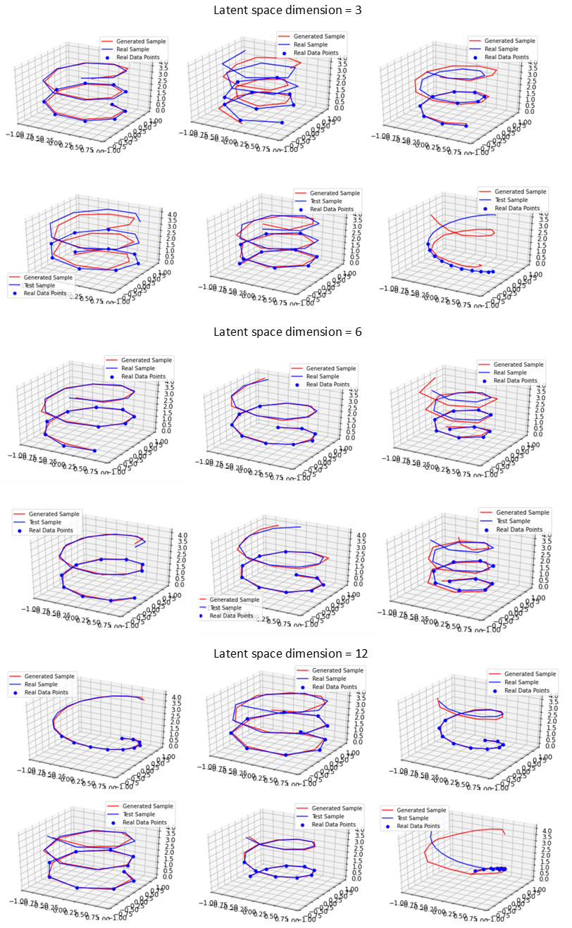
Bringing experiments/observations and models together: GANs applied to regression and uncertainty
Confidence/ error/ collect more data

Slide 12
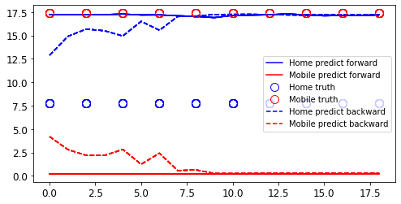
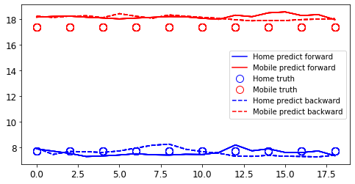
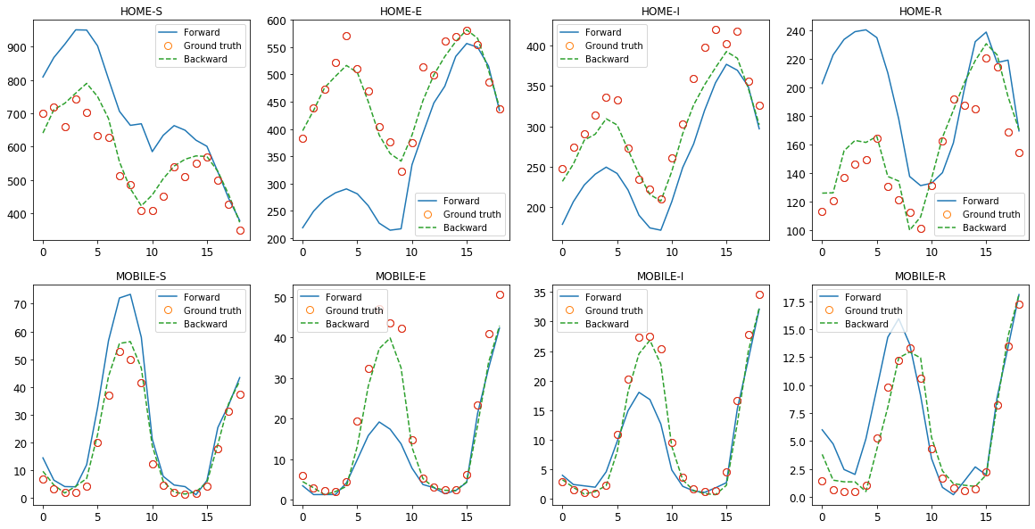
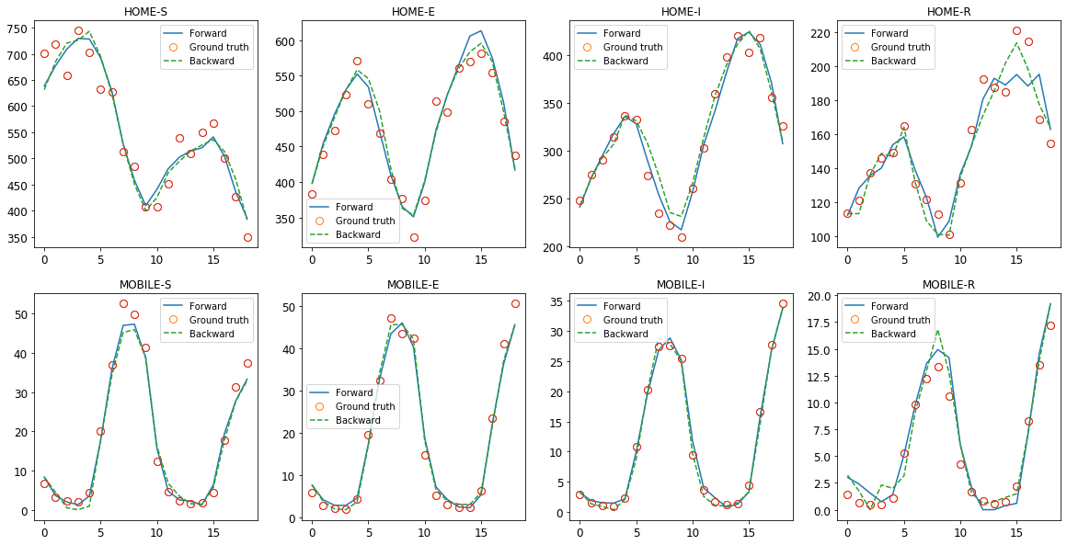
COVID-19: New AI: Data assimilation using GANs
Iteration 1
Iteration 29
R0s
R0s
Number of people
Time (s)
Time (s)
V. Santos Silva et al., (2021) Data Assimilation with Generative Adversarial Networks applied to a spatio-temporal compartmental model in epidemiology arXiv:2105.07729
.
Notes:
12

Slide 13
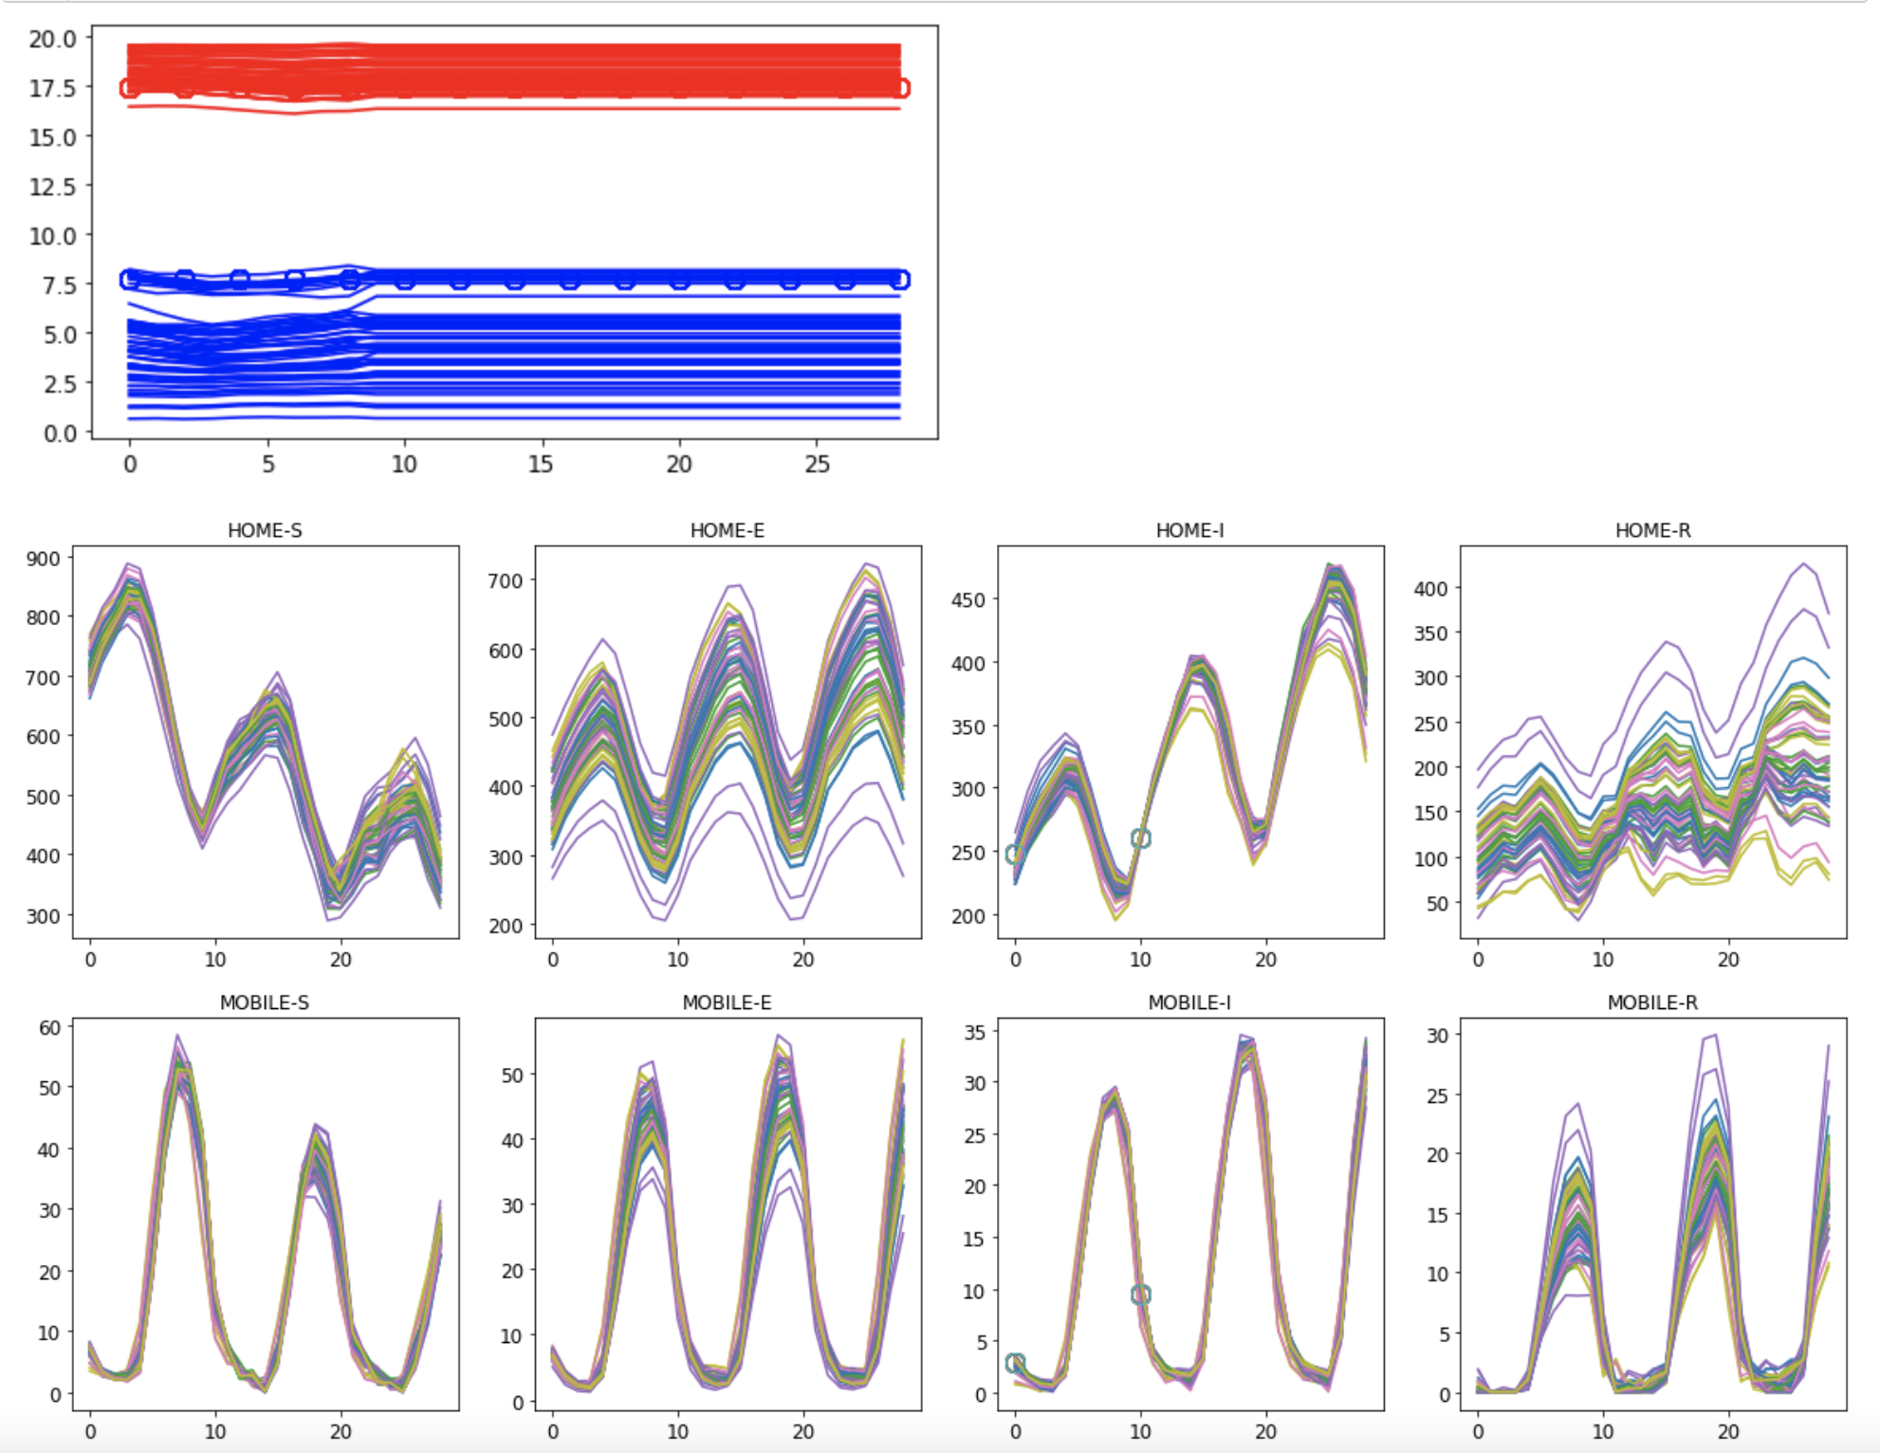
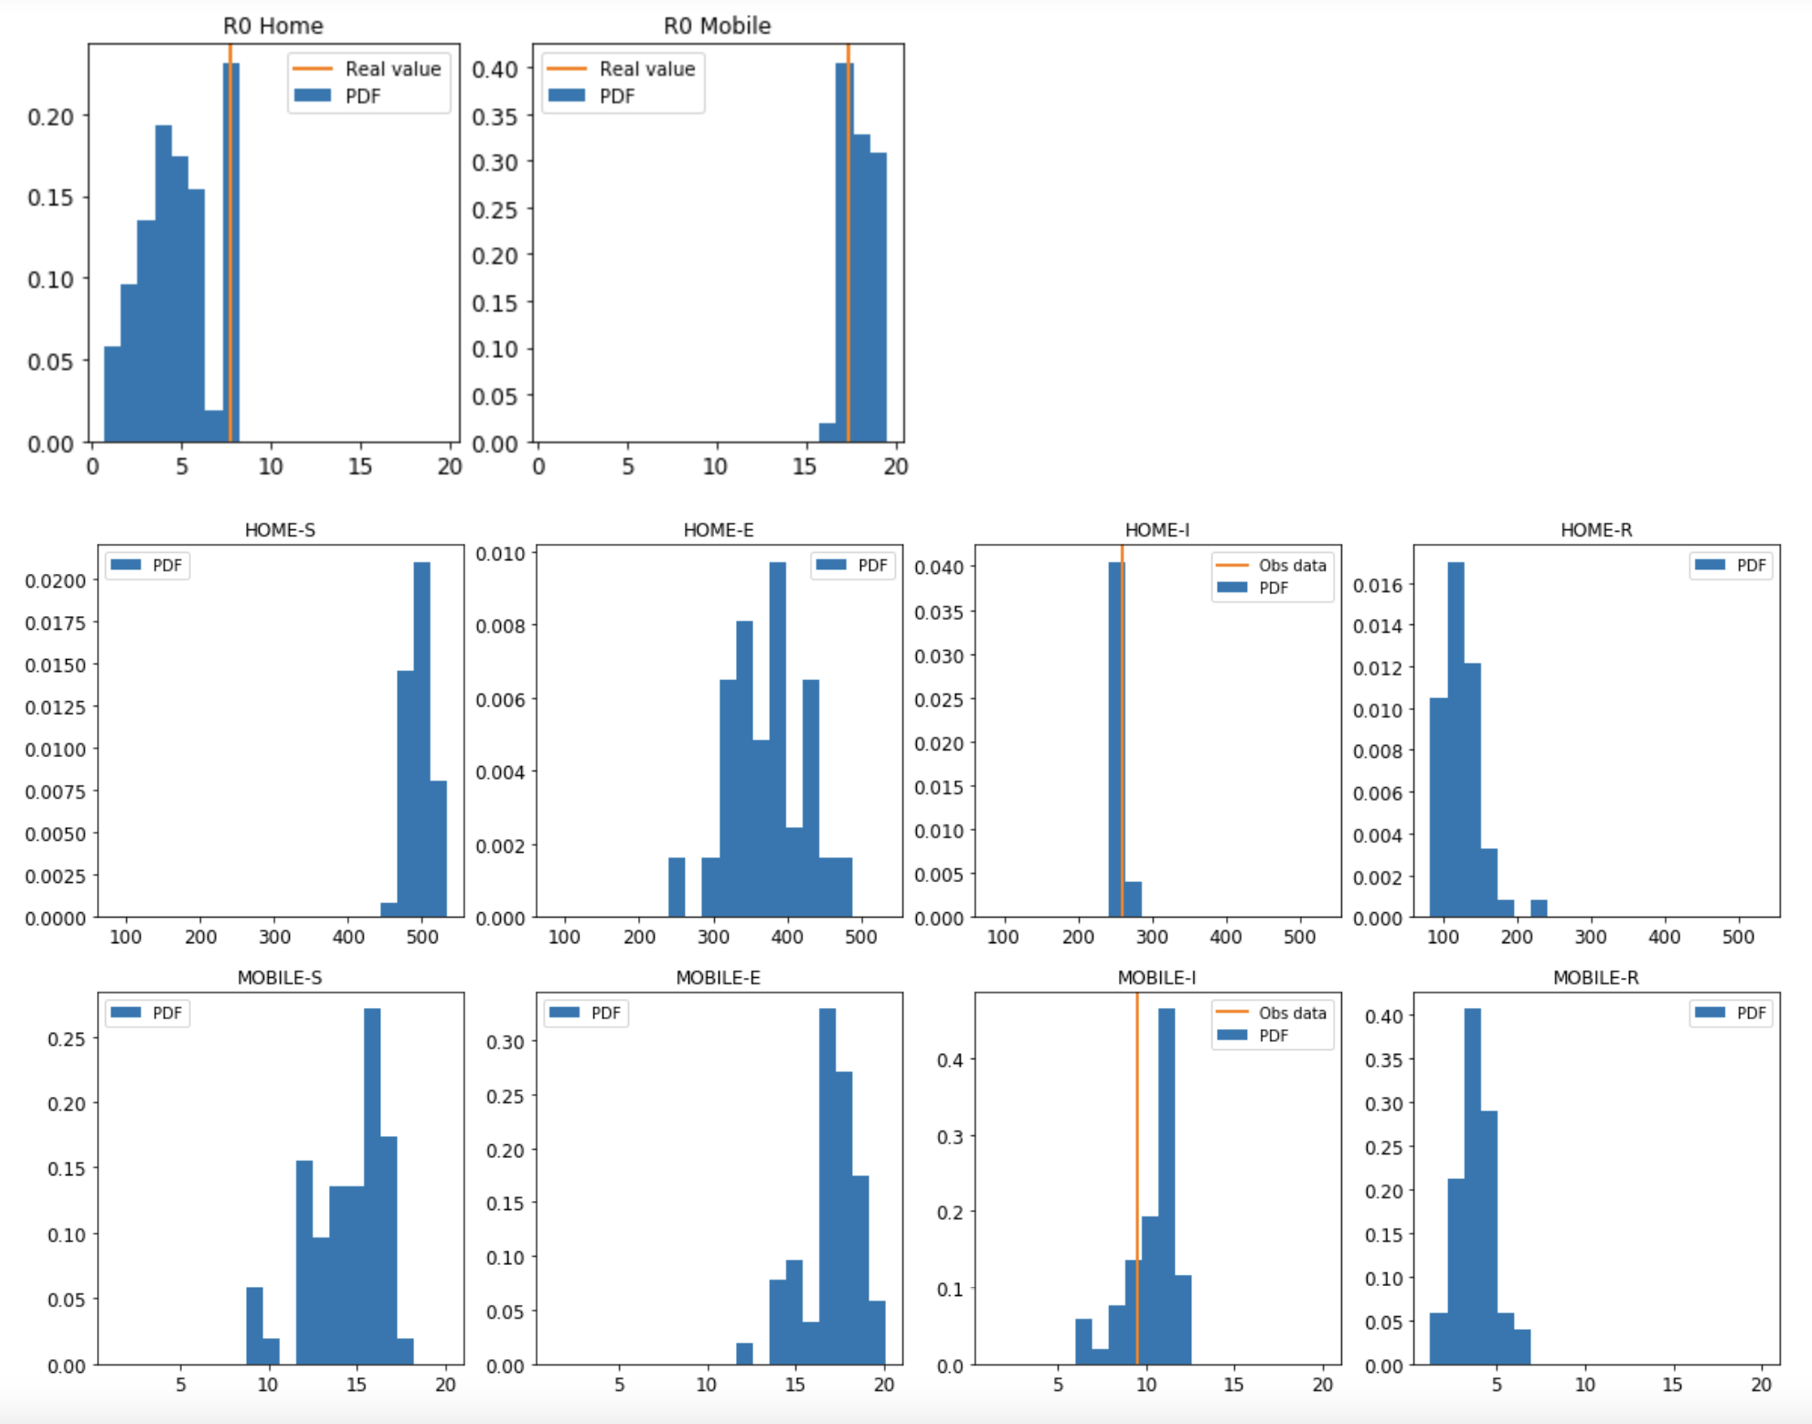
New AI: Uncertainty Quantification using Generative Adversarial Networks (GANs)
Spatial and temporal modelling of the spread of COVID-19 in a town
V. Santos Silva et al., (2021) Data Assimilation Predictive GAN (DA-PredGAN): applied to determine the spread of COVID-19 arXiv:2105.07729

Slide 14
Future Directions
UQ and DA
Using these methods to assimilate data to monitor and control usage (for example) within a digital twin framework
Including the eqns/physics, sub-grid-scale model formation
AI-implemented CFD, solids and their coupling
On the fly training from large CFD results

Slide 15
AI 4 High Fidelity Modelling (AI4HFM)

Slide 16
AI 4 High Fildelity Modelling from laptops to exascale:
Programming CFD/Nuclear Models using AI software which enables interoperability between GPUs, CPUs and AI computers (energy efficient exascale Cerebras CS2 ~1M node chip) & exploitation of community AI software;
AI-Physics modelling to reduce the number of unknowns and the CPU, GPU usage as well as the memory requirements;
Hybrisation of AI Physics modelling and discretization of the differential equations in order to construct; new sub-grid-scale (SGS) models, methods that force the equation residuals to zero (RDEIM) or physics informed methods - it’s now accepted that future SGS methods will increasing be based on AI and they may need implicit coupling to CFD using AI programming (1 above);
Digital twins that are able to assimilate data, perform uncertainty quantification and optimization using the optimization engine embedded in all AI software.

Slide 17
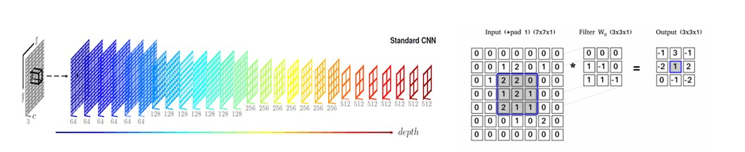
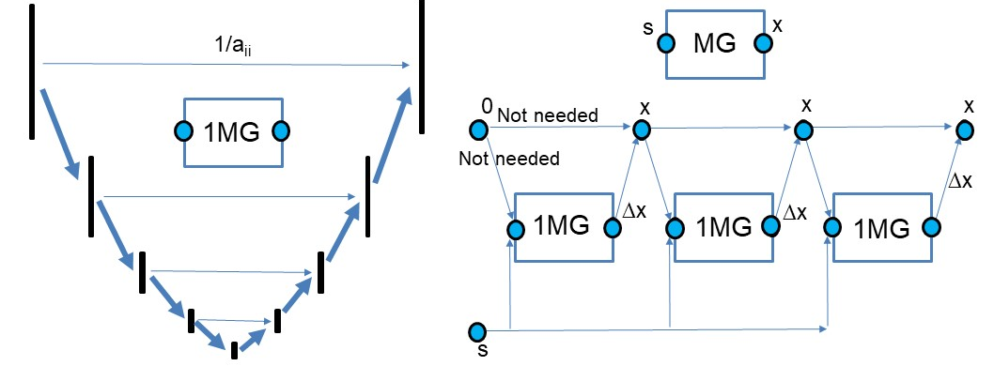
AI4CFD
Convolutional Neural Networks
AI technology provide novel solution of complex problem
Exascale CFD simulation – a wide range of turbulent scales
Develop GPU-based solver to relax the limitation of computational cost
Cerebras systems with 1M node chip
Summary speed - total 10⁶ - 10⁹ faster; AI models 10³ - 10⁶ faster; AI computer 10³ faster
Applications: indoor ventilation and urban flows
Multigrid-solution methods

Slide 18
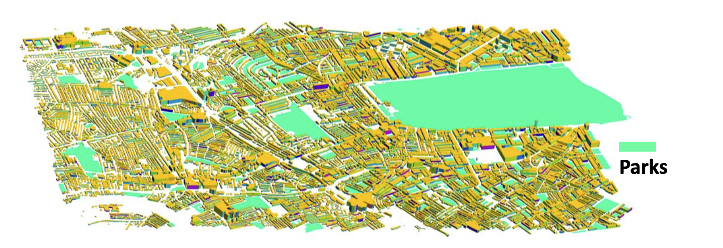
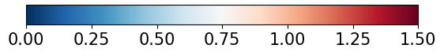
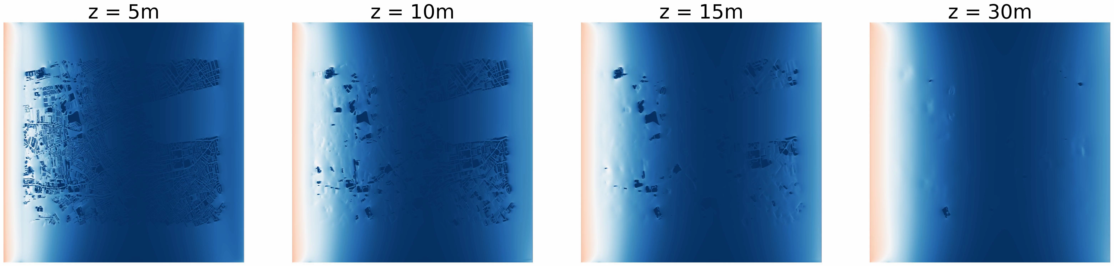
A neighbourhood in central London
NVIDIA RTX A5000
1024m x 1024m x 128m
134M nodes (dx=dy=dz=1m)
Quadratic filters (5x5x5)
8192 CUDA cores
1 hr ctime takes 10 hrs
Velocity magnitude (m/s)

Slide 19
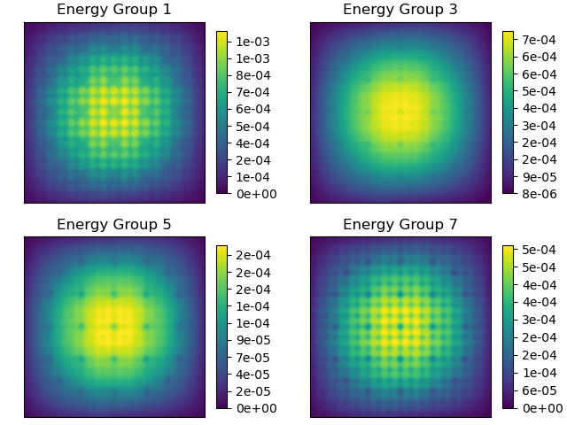
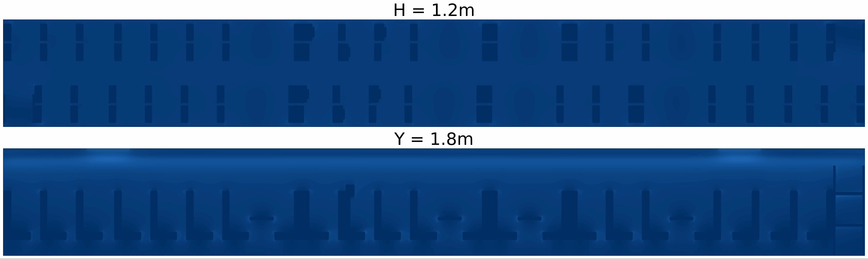
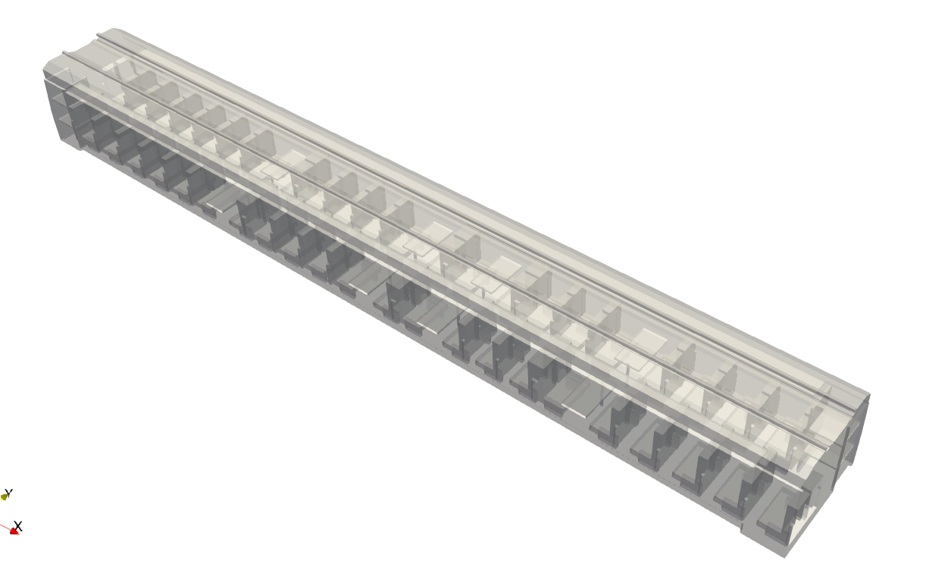
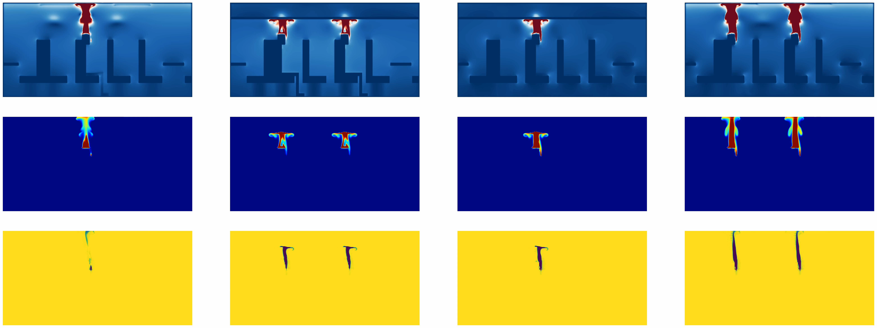
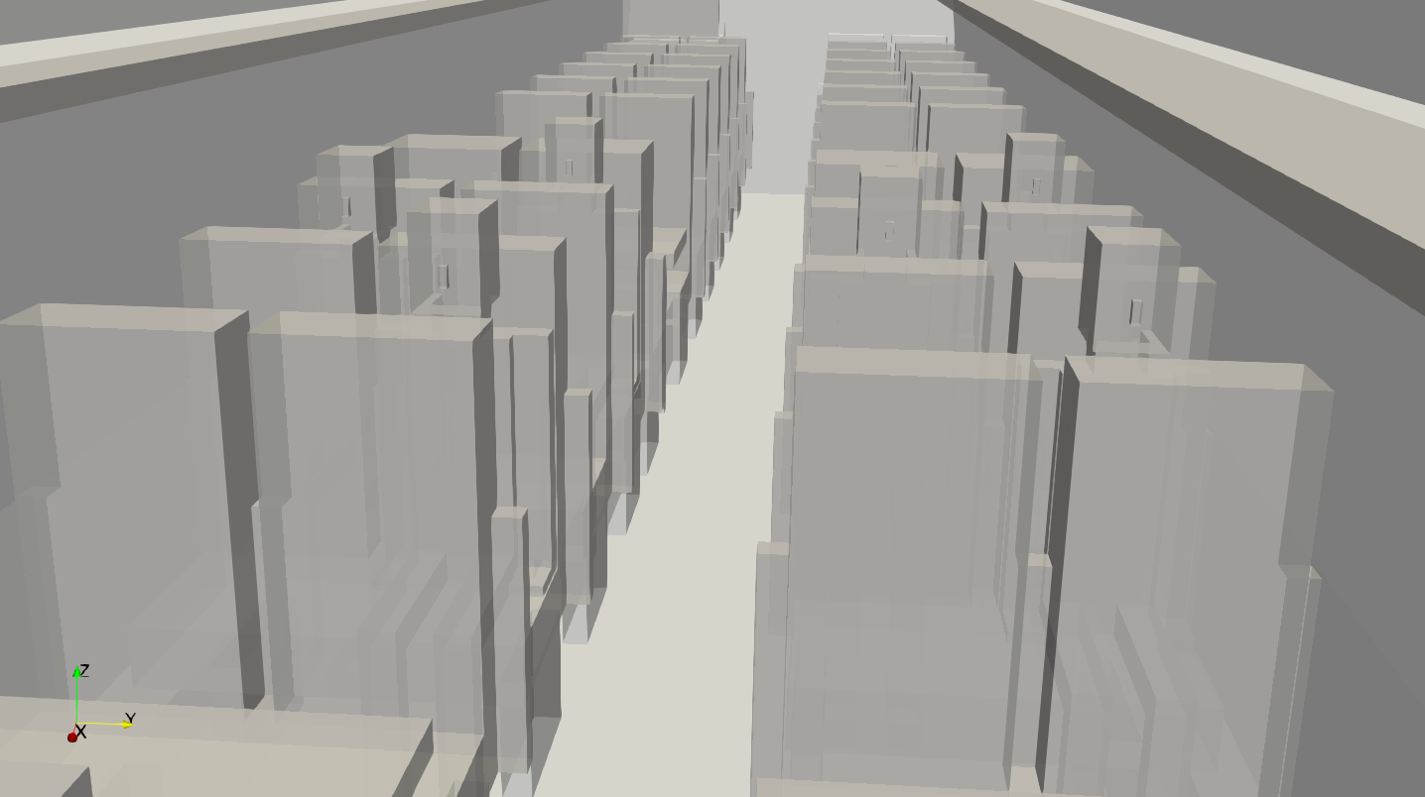
1) Left: AI4CFD Train model – Internal Flows similar to nuclear reactor 2) Right: Neutronics Model using AI4Boltzmann 3) bottom train geometry and model

Slide 20
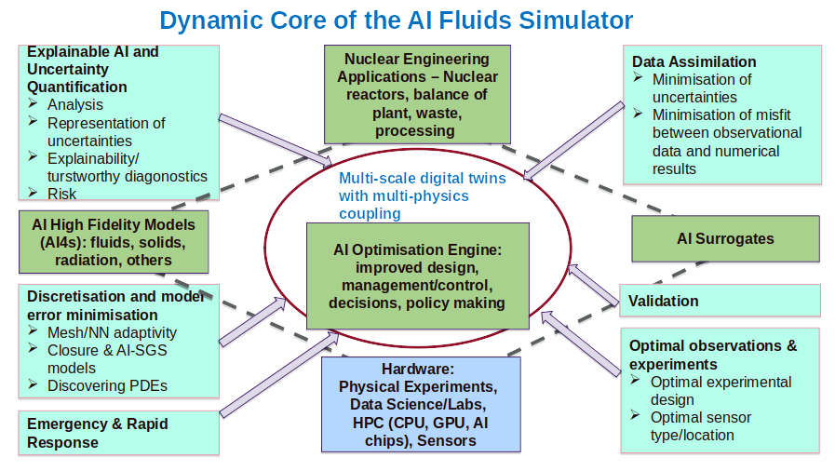
AI Nuclear Engineering Simulator

Slide 21
AI Nuclear
AI Nuclear Engineering Simulator:
Reactors, Processing,
Waste
Explainability & trustworthiness
Qualification of approach and methodology
Verification of approach and methodology
Validation activities and credibility
Uncertainty quantification
Risks and range
Reliability of output
Control Systems
Monitoring
Predictability
Design/Management changes needed:
Policy
Optimisation
Design
Control/Managment
Regulatory Approval
Plant performance in accident scenarios
Emergency & rapid response
Reporting/ Analysis

Slide 22

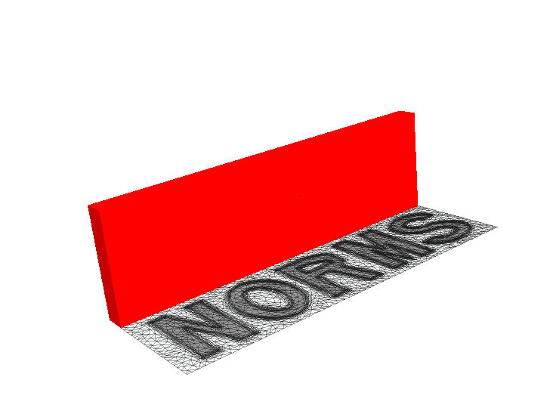


The authors would like to acknowledge:
PREMIERE

