Slide 1

MELCOR Workshop – SMR Containment I
Heat Structures and Condensation
SAND2025-04011PE
2025 European MELCOR Users’ Group Meeting
April 7th-11th, 2025

Slide 2
Overview
Heat structure package heat and mass transfer
  Heat structure boundary/surface nodalization and energy/temperature solution
  Heat transfer at boundary surface
    Convection
    Radiation
      Structure-to-structure
      Structure-to-gas
      Structure-to-pool
      Radiation enclosure model
  Mass transfer
    Condensation/evaporation
    Films and film tracking
Summary
Back-up (gas/aerosol radiation property calculations)

Slide 3
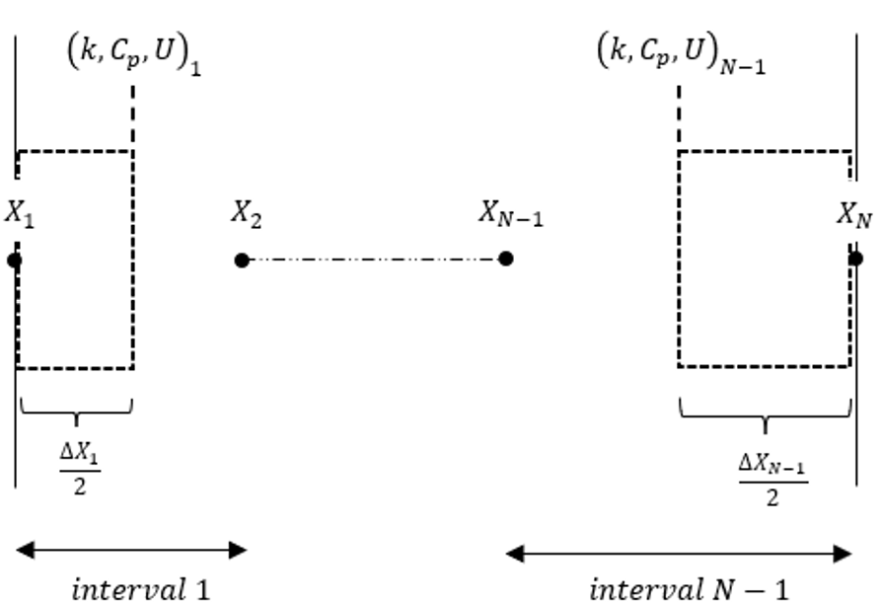
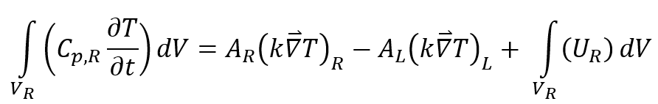
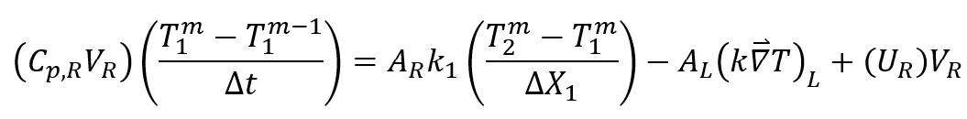
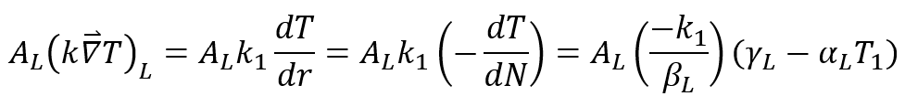

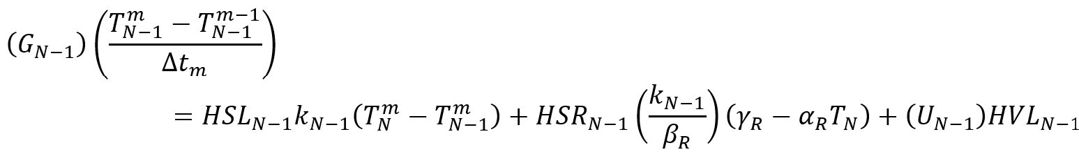



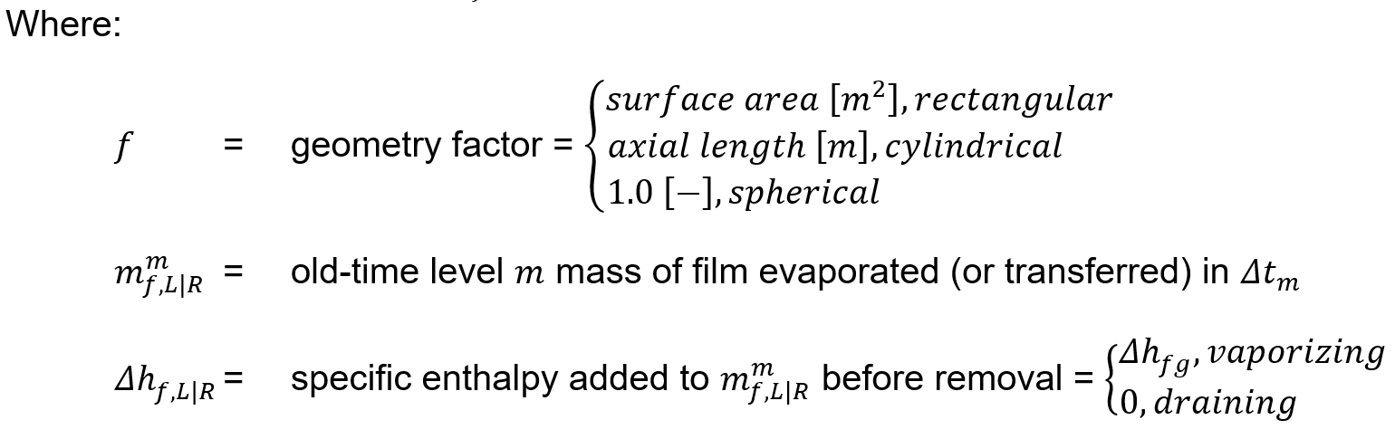
HS Boundary Surfaces
Mesh intervals, nodes, CV of integration, and finite difference equations on HS boundary
Treatment depends upon whether a liquid film exists…if no liquid film:
Generic boundary condition inform surface flux term:
Finite difference equations:
Special term for evaporating film (not draining film):

Slide 4
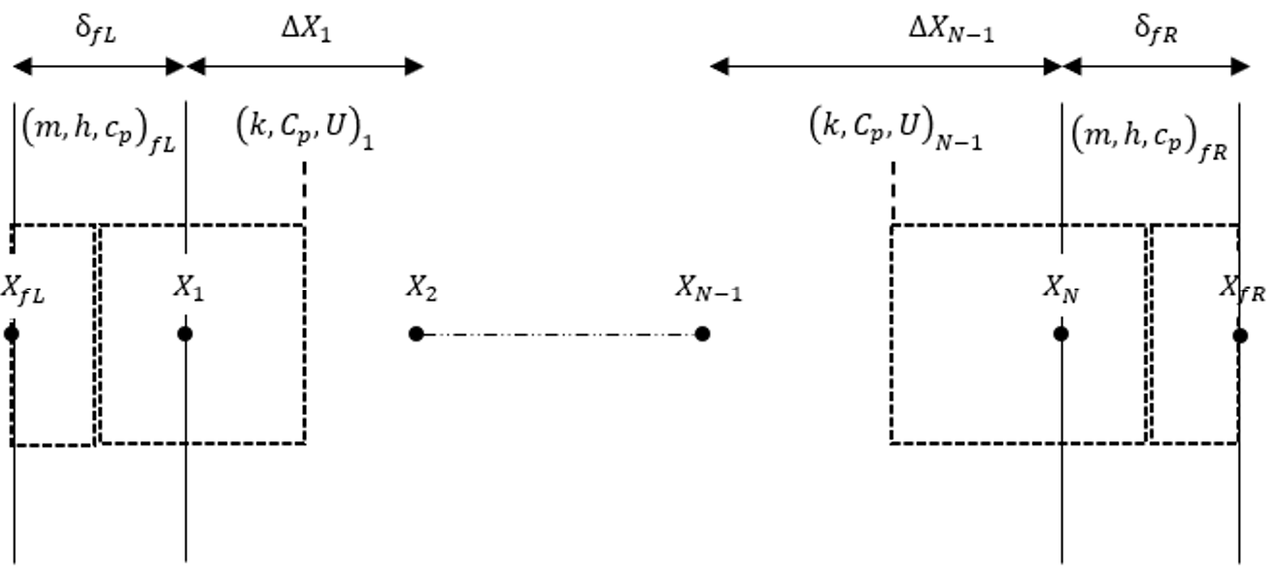
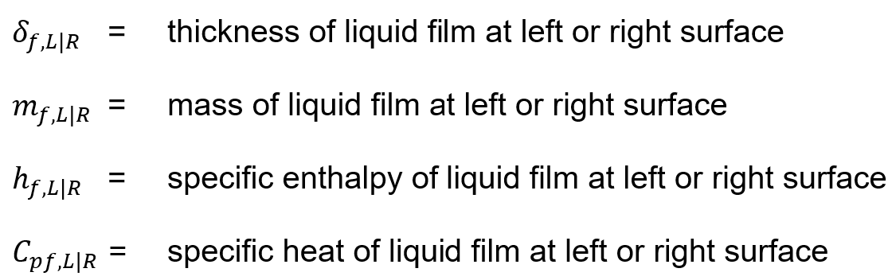
HS Boundary Surfaces
Mesh intervals, nodes, CV of integration, and finite difference equations on HS boundary
Treatment depends upon whether a liquid film exists…if liquid film:
  Keep structure surface temperature node at original location
  Extra film temperature node (film/atmosphere interface), extra film mesh interval, 2 CVs of integration:
    Liquid film mesh interval half-width
    Surface CV with other liquid film mesh interval half-width plus 1st structural mesh interval half-width
    Execute integration over each, and both entail some special treatment
  Assume no energy generation in the film mesh interval, but generally allow energy generation in structure
  Apply specially-crafted convection conditions on either interface of the film mesh interval half-width CV
  Apply specially-crafted convection condition on the outer interface of the film/structure CV
  Where the film/atmosphere interface is above pool, allow for condensation/evaporation

Slide 5
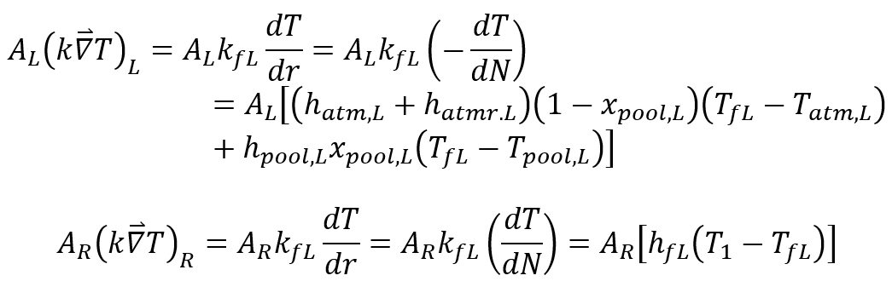
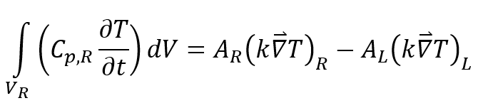
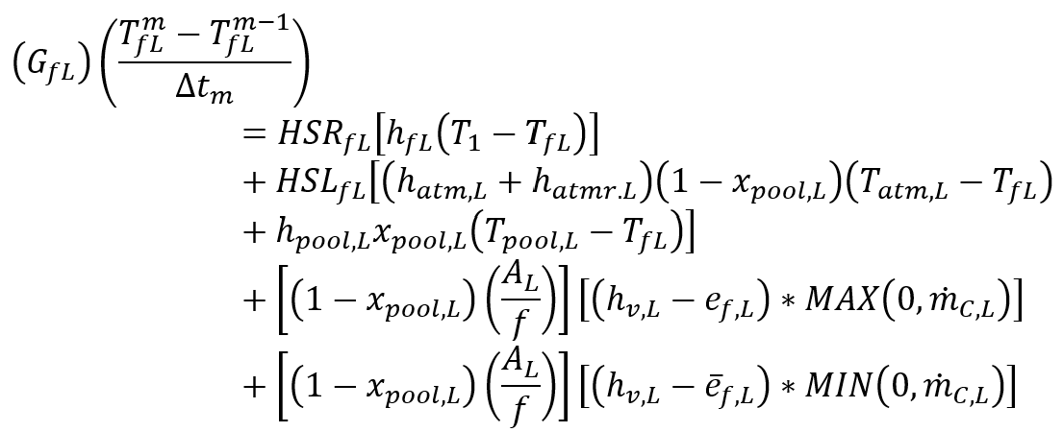
HS Boundary Surfaces
Boundary CV of film mesh interval half-width
Finite difference equation accounting for condensation/evaporation mass flux:
Condensation
Evaporation

Slide 6
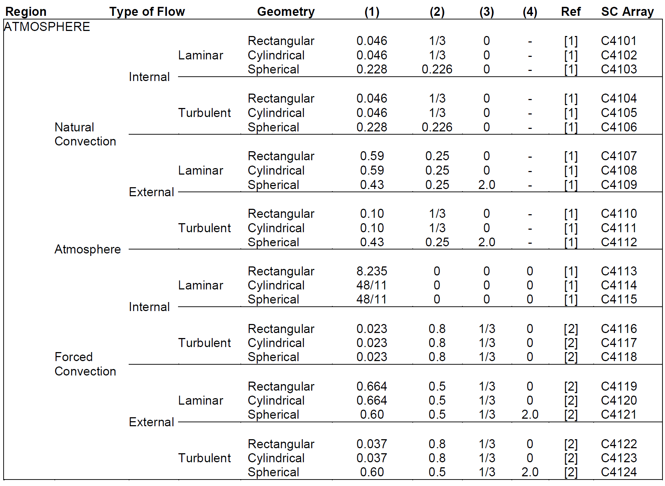



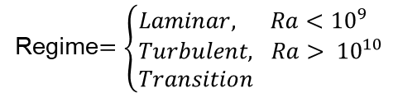
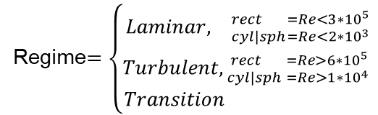



Convection on HS Boundary
Atmosphere convection heat transfer
  Forced (${Re}^{2}>10\left(Gr\right)$)
  Free (${Re}^{2}<Gr$)
  Mixed
$$Nu=C{Re}^{m}{Pr}^{n}+D$$
Regime$=\left\{\begin{aligned}Laminar, {rect =Re<3{∗10}^{5} \atop cyl|sph=Re<{2∗10}^{3}} \\ Turbulent, {rect =Re>{6∗10}^{5} \atop cyl|sph =Re>{1∗10}^{4} } \\ Transition \end{aligned}\right.$
$${Nu}_{trans}=\left[\frac{\left[Re−{Re}_{lim}\right]}{{Re}_{lim}}\right]\left[{ΔNu}_{t−l}\right]+{Nu}_{l}$$
$$Nu=C{Ra}^{m}+D$$
Regime$=\left\{\begin{aligned}Laminar, Ra<{10}^{9} \\ Turbulent, Ra> {10}^{10} \\ Transition \end{aligned}\right.$
$${Nu}_{trans}=\left[\frac{\left[Ra−{Ra}_{lim}\right]}{{Ra}_{lim}}\right]\left[{ΔNu}_{t−l}\right]+{Nu}_{l}$$
$$Nu=\left[\frac{\left[{{Re}^{2}}/{Gr}−1\right]}{9}\right]\left[{Nu}_{force}−{Nu}_{free}\right]+{Nu}_{free}$$

Slide 7

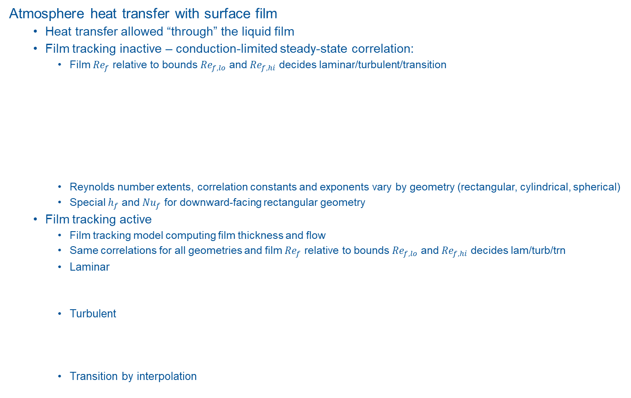

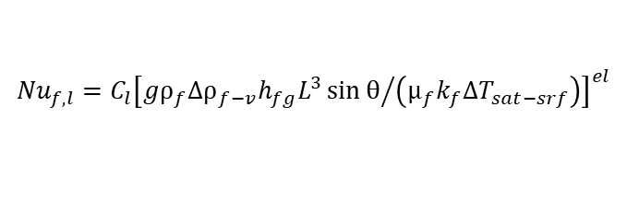
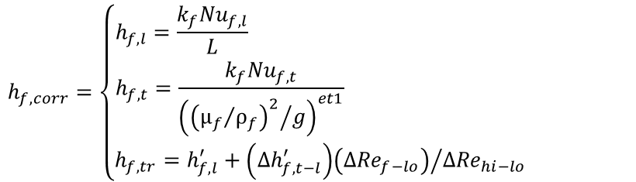

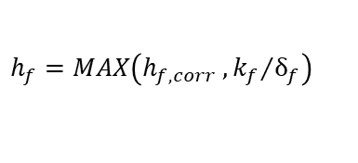
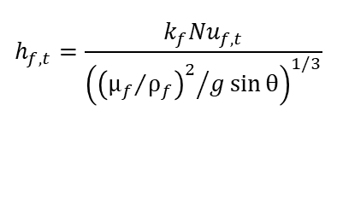
Convection on HS Boundary
Atmosphere heat transfer with surface film
  Heat transfer allowed “through” the liquid film
  Film tracking inactive – conduction-limited steady-state correlation:
    Film ${Re}_{f}$ relative to bounds ${Re}_{f,lo}$ and ${Re}_{f,hi}$ decides laminar/turbulent/transition
    Reynolds number extents, correlation constants and exponents vary by geometry (rectangular, cylindrical, spherical)
    Special $h_{f}$ and ${Nu}_{f}$ for downward-facing rectangular geometry
  Film tracking active
    Film tracking model computing film thickness and flow
    Same correlations for all geometries and film ${Re}_{f}$ relative to bounds ${Re}_{f,lo}$ and ${Re}_{f,hi}$ decides lam/turb/trn
    Laminar
    Turbulent
    Transition by interpolation
$$h_{f}=MAX\left(h_{f,corr} , {k_{f}}/{δ_{f}}\right)$$
$$h_{f,corr}=\left\{\begin{aligned}h_{f,l}=\frac{k_{f}{Nu}_{f,l}}{L} \\ h_{f,t}=\frac{k_{f}{Nu}_{f,t}}{{\left({{\left({μ_{f}}/{ρ_{f}}\right)}^{2}}/g\right)}^{et1}} \\ h_{f,tr}=h_{f,l}^{′}+{\left({Δh}_{f,t−l}^{′}\right)\left({ΔRe}_{f−lo}\right)}/{{ΔRe}_{hi−lo}} \end{aligned}\right.$$
$${Nu}_{f,l}=C_{l}{\left[{gρ_{f}{Δρ}_{f−v}h_{fg}L^{3}\sin{θ}}/{\left(μ_{f}k_{f}{ΔT}_{sat−srf}\right)}\right]}^{el}$$
$${Nu}_{f,t}={\left[{Re}_{f}^{et2}+C_{t}{Re}_{f}^{et3}{Pr}_{f}^{et4}\right]}^{et5}$$
$$h_{f,l}={k_{f}}/{MAX\left(δ_{f},δ_{min}\right)}$$
$$h_{f,t}=\frac{k_{f}{Nu}_{f,t}}{{\left({{\left({μ_{f}}/{ρ_{f}}\right)}^{2}}/{g\sin{θ}}\right)}^{1/3}}$$
$${Nu}_{f,t}={\left[{Re}_{f}^{et1}+C_{t}{Re}_{f}^{et2}{Pr}_{f}^{et3}\right]}^{et4}$$

Slide 8
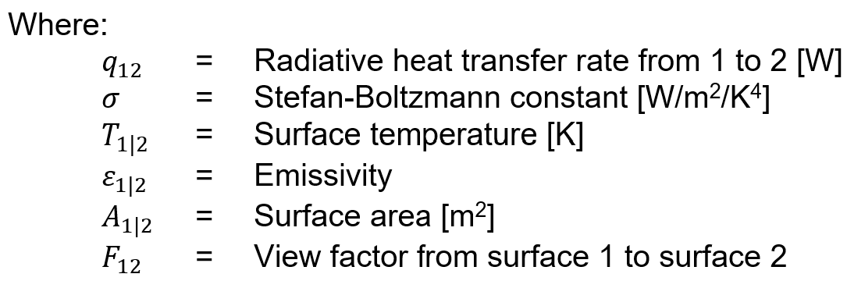
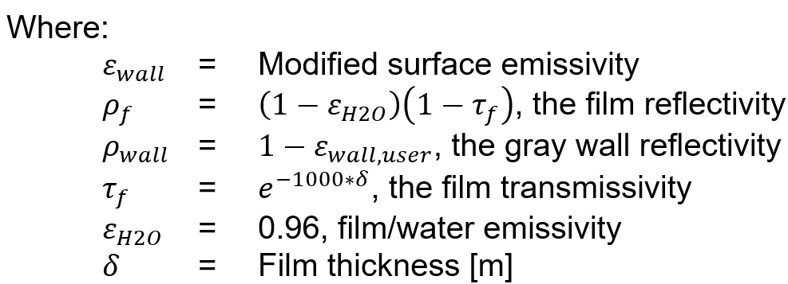
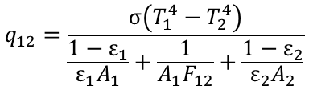
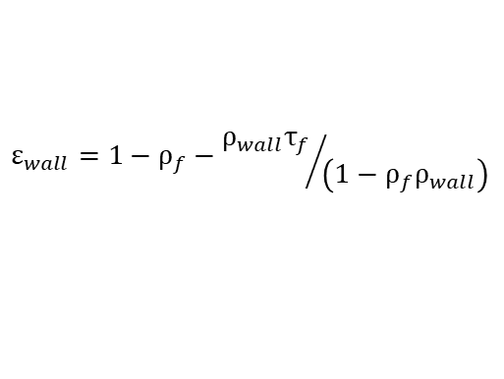
Radiation on HS Boundary
Structure-to-structure radiation model (HS_RD)
  Simple gray surface model
  Radiation heat transfer defined pairwise for arbitrarily many surfaces
    View factors by input
    Surface emissivity by input (real value or control function)
    Modified surface emissivity if film present
    Independent of radiation to other structures, gas, or pool surface
  Areas above swollen liquid level
  Zero radiation heat transfer if:
    Pool submerges either surface
    Either surface emissivity goes to zero
    View factor is zero
Structure-to-pool radiation model (HS_RD2)
  Pool area and temperature instead of surface 2
  Emissivity of pool surface by user input
HS1
HS2
q₁₂
$$q_{12}=\frac{σ\left(T_{1}^{4}−T_{2}^{4}\right)}{\frac{1−ε_{1}}{ε_{1}A_{1}}+\frac{1}{A_{1}F_{12}}+\frac{1−ε_{2}}{ε_{2}A_{2}}}$$
$$ε_{wall}=1−ρ_{f}−{ρ_{wall}τ_{f}}/{\left(1−ρ_{f}ρ_{wall}\right)}$$
HS1
q_{w,p}
POOL

Slide 9
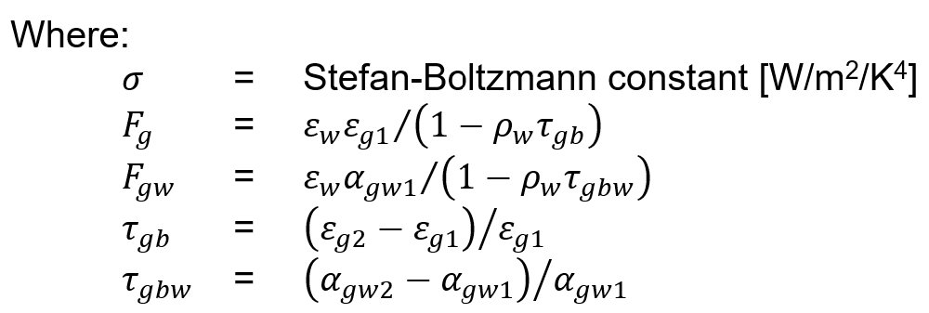


Radiation on HS Boundary
Structure-to-gas radiation model (HS_[L|R]BF)
  Computed independently for each structure
  No accounting for gas transmissivity
  No accounting for reflection among surfaces
  Choose model (equivalent band or gray gas)
  Only H₂O, CO, and CO₂
  No accounting for any aerosols in gas
  Modified surface emissivity if film present
Equivalent band model:
Gray gas model:
Gas emissivity
  Dependence on gas composition, pressure, temperature, and average optical depth (beam length)
  CONTAIN models for gas mixture emissivity
  Back-up slides
Wall emissivity can be modified for presence of film as previously illustrated
HS1
GAS
q_{w,g}
$$q_{w,g}=\left\{\begin{aligned}σ\left({F_{g}T}_{g}^{4}−F_{g,w}T_{w}^{4}\right), T_{g}≠T_{w} \\ 0 , T_{g}=T_{w}\end{aligned}\right.$$
$$q_{w,g}=\frac{σ\left(T_{g}^{4}−T_{w}^{4}\right)}{\frac{1}{ε_{g}}+\frac{1}{ε_{w}}−1}$$

Slide 10
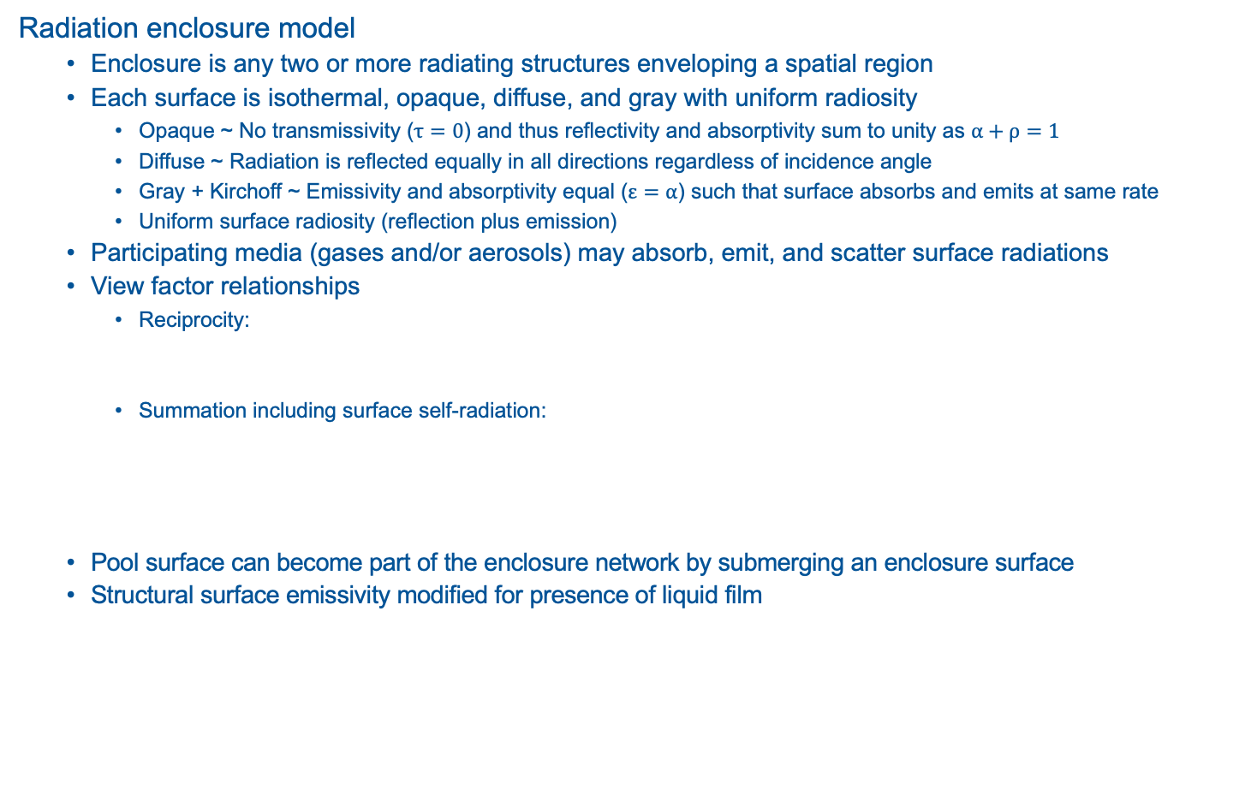


Radiation on HS Boundary
Radiation enclosure model
  Enclosure is any two or more radiating structures enveloping a spatial region
  Each surface is isothermal, opaque, diffuse, and gray with uniform radiosity
    Opaque ~ No transmissivity ($τ=0$) and thus reflectivity and absorptivity sum to unity as $α+ρ=1$
    Diffuse ~ Radiation is reflected equally in all directions regardless of incidence angle
    Gray + Kirchoff ~ Emissivity and absorptivity equal ($ε=α$) such that surface absorbs and emits at same rate
    Uniform surface radiosity (reflection plus emission)
  Participating media (gases and/or aerosols) may absorb, emit, and scatter surface radiations
  View factor relationships
    Reciprocity:
    Summation including surface self-radiation:
  Pool surface can become part of the enclosure network by submerging an enclosure surface
  Structural surface emissivity modified for presence of liquid film
HS3
$$A_{1}F_{12}=A_{2}F_{21}$$
AERO
HS1
HS2
HS2
GAS
$$\sum_{i=1}^{N}{F_{ij}}=1.0$$
POOL
HS4

Slide 11
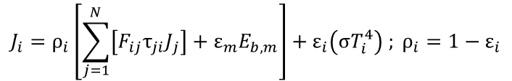


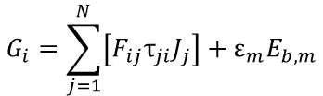

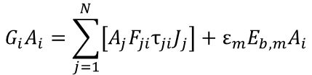





Radiation on HS Boundary
Radiation enclosure model
  Radiosity – total heat flux departing area (reflection and emission):
    Some portion of incident radiation flux $G_{i}$ reflects in $J_{i}$
    Some portion of blackbody emissive flux $E_{b,i}$ emitted in $J_{i}$
  Incident radiation on surface $i$:
    Sum contributions (radiosity) from all surfaces, accounting for:
      View factors, and
      Transmissivity through participating media $τ_{ji}$
    Add emission from participating media
    Use view factor reciprocity to eliminate areas
    Use definition of radiosity and blackbody emissive flux:
  Net radiation heat transfer rate from difference between radiosity and incidence:
$$J_{i}=ρ_{i}G_{i}+ε_{i}E_{b,i}$$
Participating Media
  Gas $ε$ and $τ$ with normal methods
  Aerosol cloud enhances radiant energy transmission to atmosphere
  Modak for gas emissivity
  Felske/Tien & Pilat-Ensor (aerosol)
$$G_{i}A_{i}=\sum_{j=1}^{N}{\left[A_{j}F_{ji}τ_{ji}J_{j}\right]}+ε_{m}E_{b,m}A_{i}$$
$$E_{b,m}=σT_{g}^{4}$$
$$ε_{m}=ε_{p}+ε_{g}−ε_{p}ε_{g}$$
$$G_{i}=\sum_{j=1}^{N}{\left[F_{ij}τ_{ji}J_{j}\right]}+ε_{m}E_{b,m}$$
$$ε_{g}=ε_{H2O}+ε_{CO}+ε_{CO2}−Δε_{cw}$$
$$ε_{p}=1−\left(\frac{15}{π^{4}}\right)φ\left(y\right)$$
$$J_{i}=ρ_{i}\left[\sum_{j=1}^{N}{\left[F_{ij}τ_{ji}J_{j}\right]}+ε_{m}E_{b,m}\right]+ε_{i}\left(σT_{i}^{4}\right) ; ρ_{i}=1−ε_{i}$$
$$q_{i}=A_{i}\left( J_{i}−G_{i} \right)$$

Slide 12
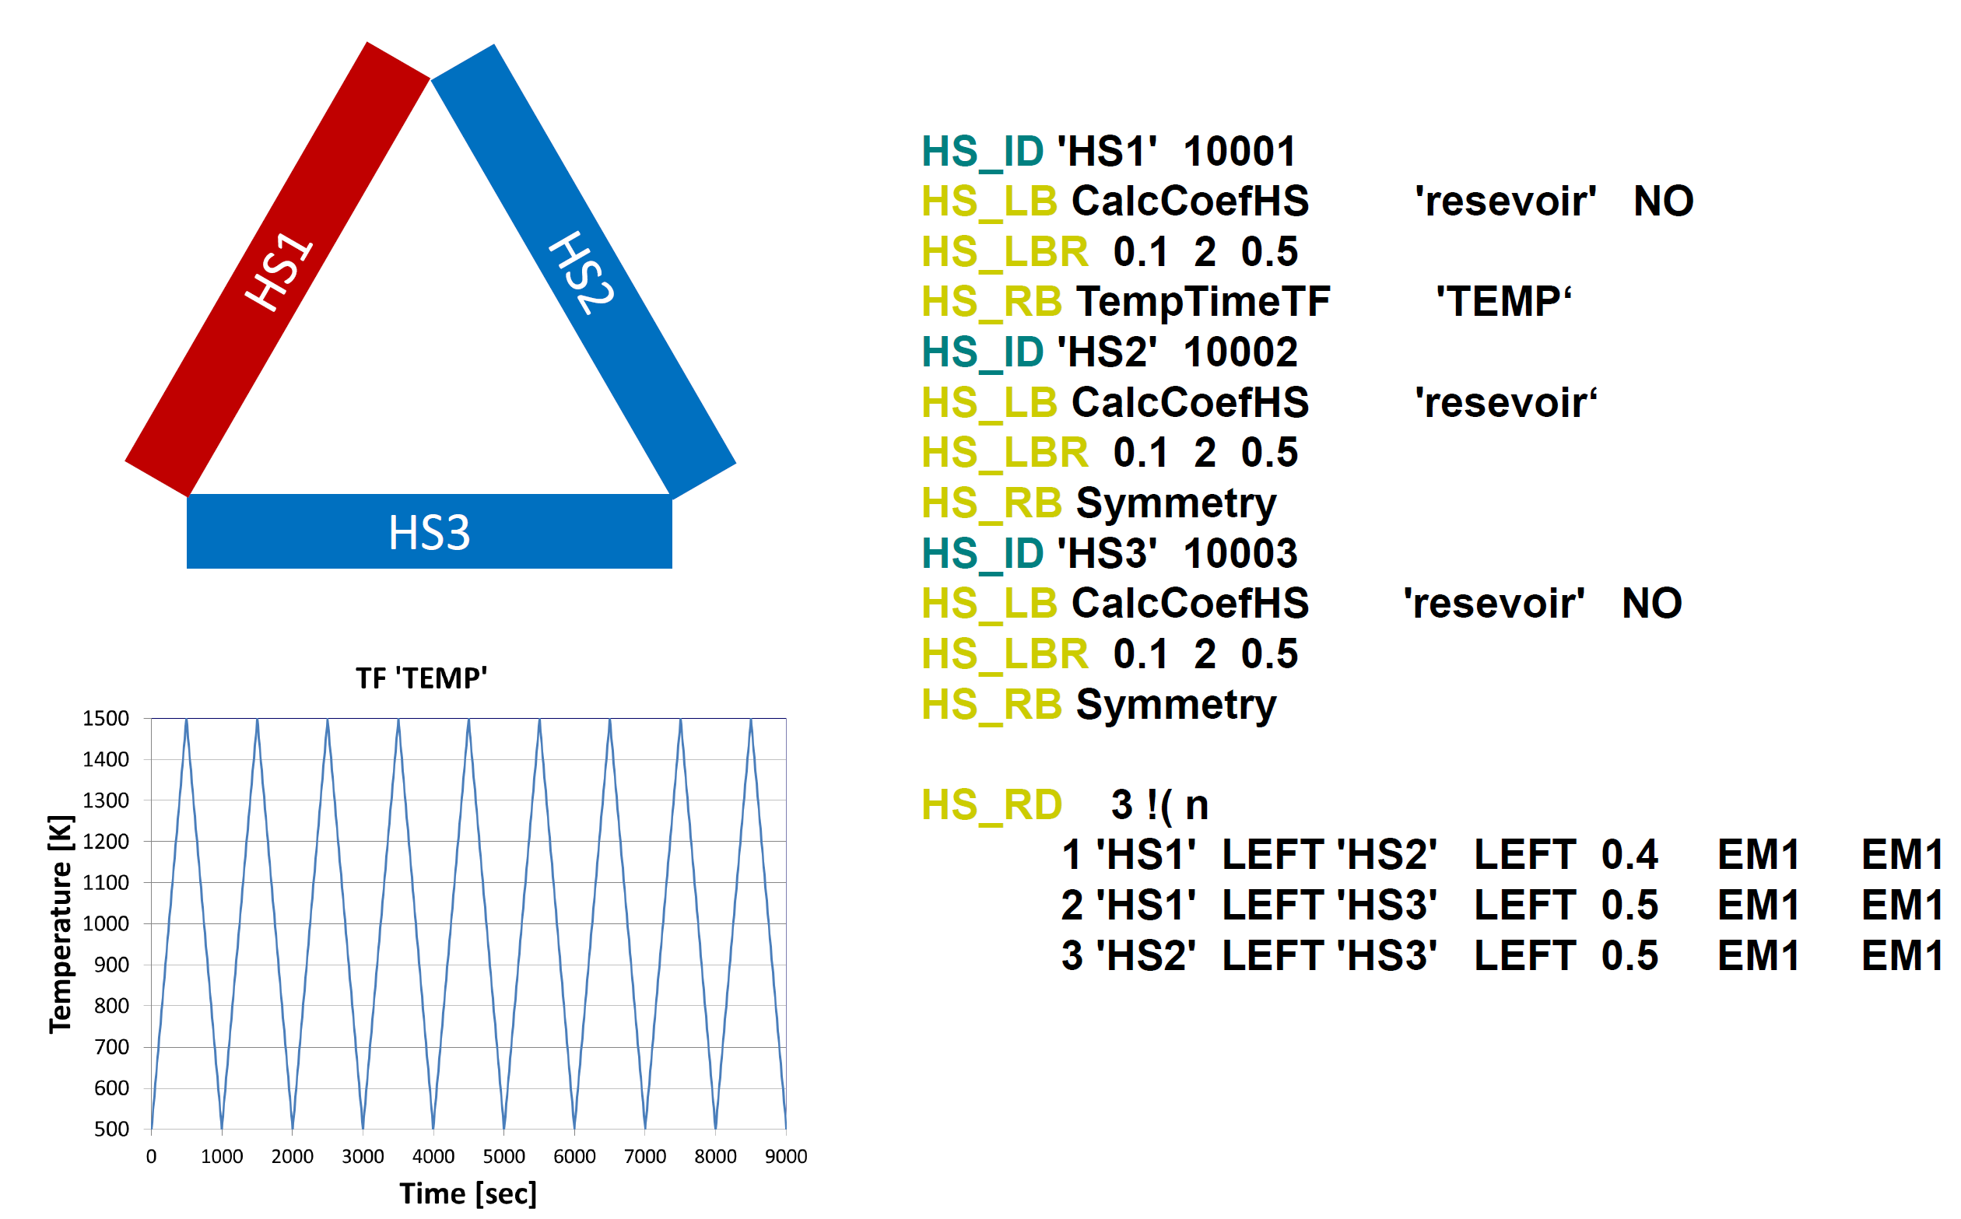
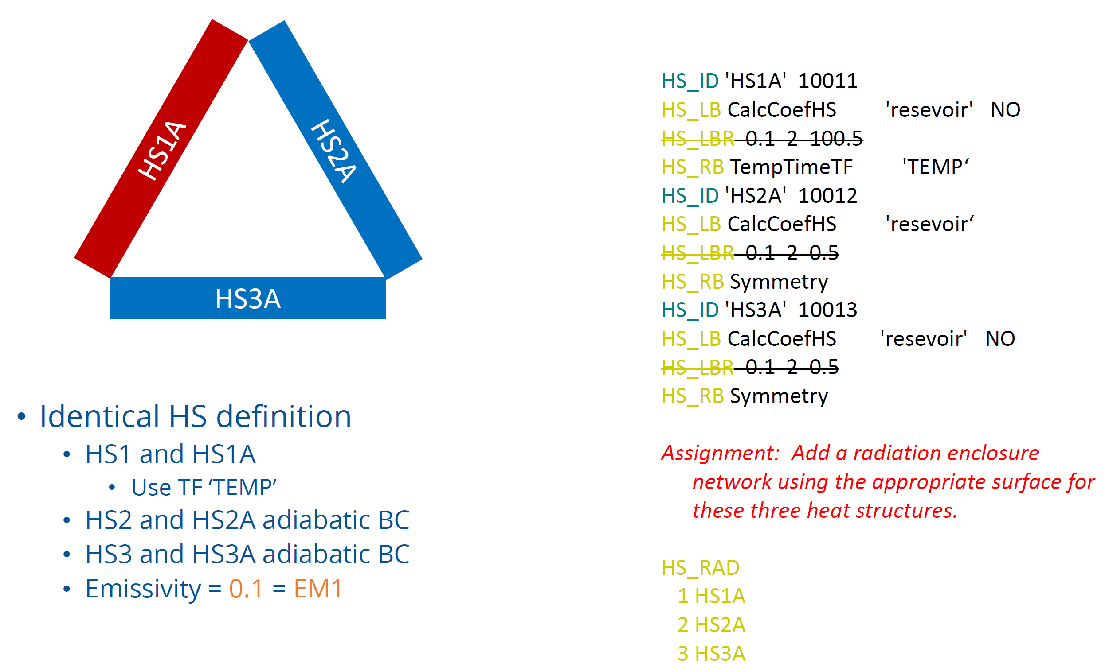
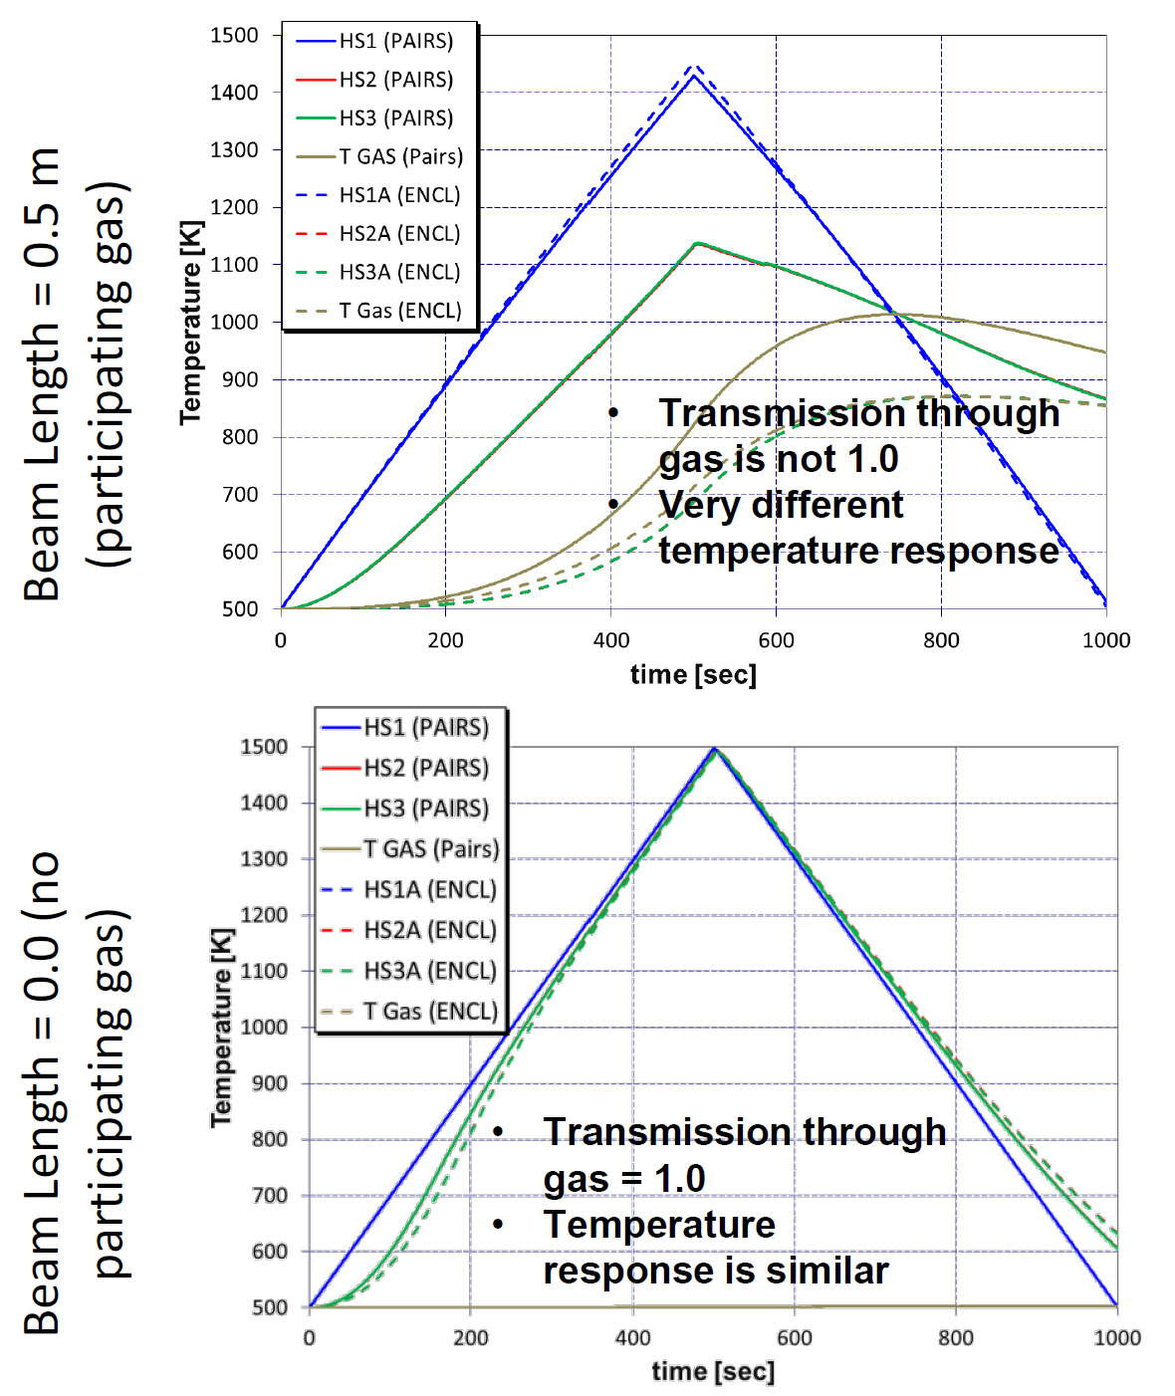
Radiation Example
Surface Pairs w/ Gray Gas
Enclosure w/ Participating Media
Comparing: Participating Gas Effect
Aerosol Effect (Enclosure Only)
NO gas component for RD
RAD approx. similar to gas-only response but purely due to aerosol emissivity
Differences with and without gas as participating medium
HS3 vs HS3A and TVAP
Water vapor the only contributor (20% RHUM CV)
Beam length of zero equates to full transmission
Initialize a nonradioactive aerosol in enclosure CV
Keep aerosol floating (no DS, cyclical settling)
Eliminate gas contribution (N₂ only CV atmosphere)
Choose kmx=1.0

Slide 13
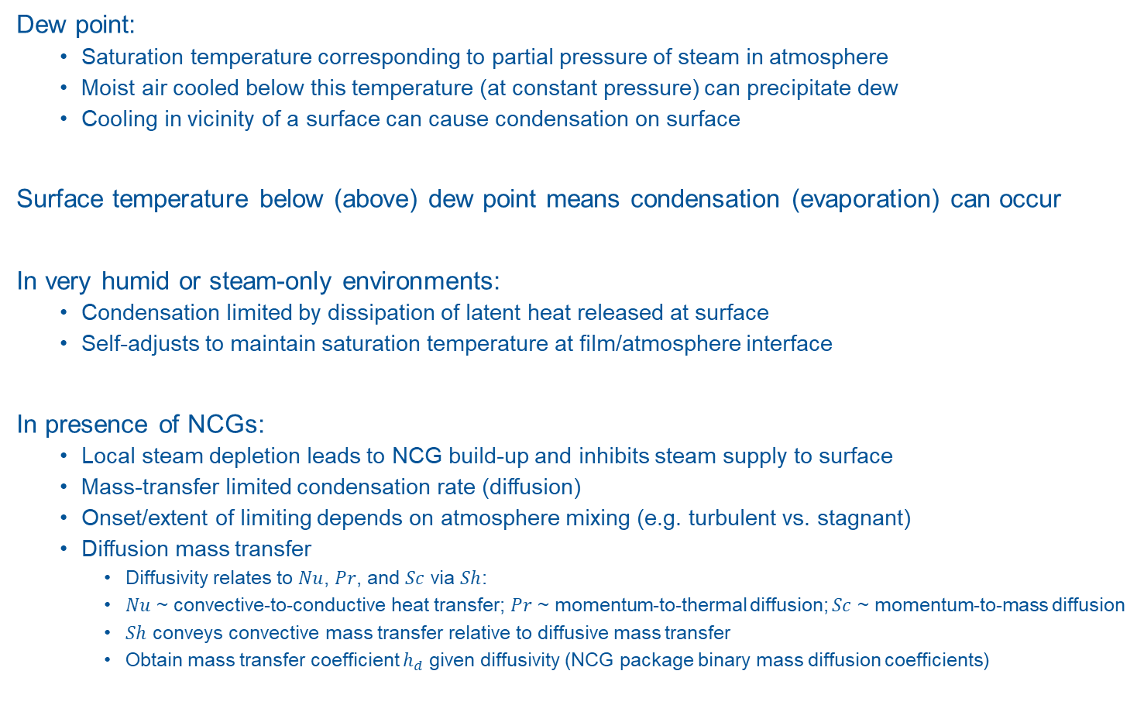
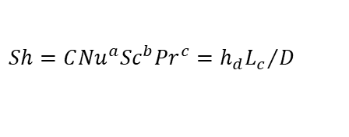
Mass Transfer on HS Boundary
Dew point:
  Saturation temperature corresponding to partial pressure of steam in atmosphere
  Moist air cooled below this temperature (at constant pressure) can precipitate dew
  Cooling in vicinity of a surface can cause condensation on surface
Surface temperature below (above) dew point means condensation (evaporation) can occur
In very humid or steam-only environments:
  Condensation limited by dissipation of latent heat released at surface
  Self-adjusts to maintain saturation temperature at film/atmosphere interface
In presence of NCGs:
  Local steam depletion leads to NCG build-up and inhibits steam supply to surface
  Mass-transfer limited condensation rate (diffusion)
  Onset/extent of limiting depends on atmosphere mixing (e.g. turbulent vs. stagnant)
  Diffusion mass transfer
    Diffusivity relates to $Nu$, $Pr$, and $Sc$ via $Sh$:
    $Nu$ ~ convective-to-conductive heat transfer; $Pr$ ~ momentum-to-thermal diffusion; $Sc$ ~ momentum-to-mass diffusion
    $Sh$ conveys convective mass transfer relative to diffusive mass transfer
    Obtain mass transfer coefficient $h_{d}$ given diffusivity (NCG package binary mass diffusion coefficients)
$$Sh=C{Nu}^{a}{Sc}^{b}{Pr}^{c}={h_{d}L_{c}}/D$$

Slide 14
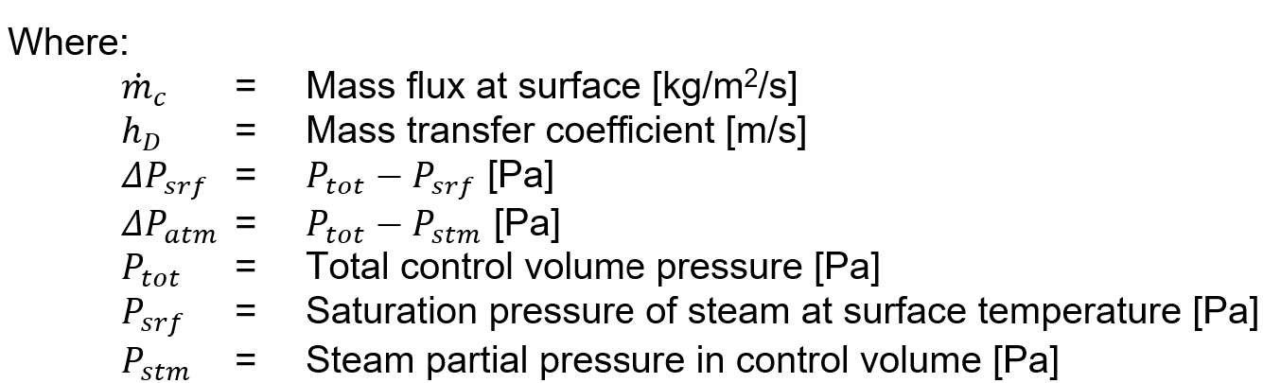
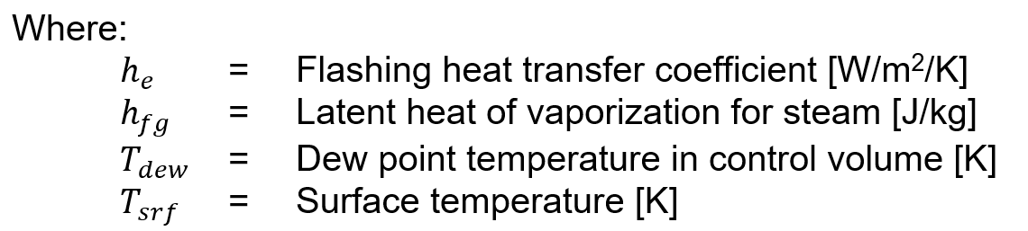


Mass Transfer on HS Boundary
Condensation in the presence of NCGs
  Mechanistic model: diffusion of condensable vapor through gas layer containing NCGs
  A diffusion layer type model
  Integrate product of mass flux and surface area exposed to atmosphere (critical pool fraction caveat)
  Physical limiters on condensation out of CV and evaporation off of HS surface
Surface
$${\dot{m}}_{c}=h_{D}ρ_{v}\ln\left(\frac{{ΔP}_{srf}}{{ΔP}_{atm}}\right)$$
Interface
P_{tot}
P_{stm}
Structure
P_{ncg}
P_{srf}
$${\dot{m}=MAX\left({\dot{m}}_{c},{\dot{m}}_{e}\right); \dot{m}}_{e}=h_{e}∗\frac{MIN\left(0, T_{dew}−T_{sfr}\right)}{h_{fg}}$$
Diffusion Layer
P
Film
Bulk Atmosphere
y

Slide 15
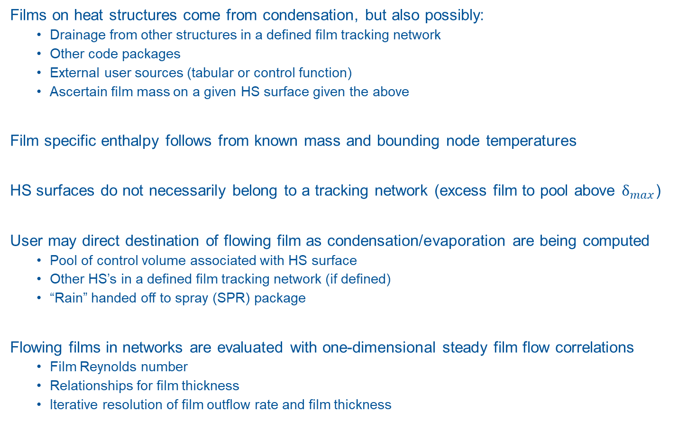
Film Tracking on HS Boundary
Films on heat structures come from condensation, but also possibly:
  Drainage from other structures in a defined film tracking network
  Other code packages
  External user sources (tabular or control function)
  Ascertain film mass on a given HS surface given the above
Film specific enthalpy follows from known mass and bounding node temperatures
HS surfaces do not necessarily belong to a tracking network (excess film to pool above $δ_{max}$)
User may direct destination of flowing film as condensation/evaporation are being computed
  Pool of control volume associated with HS surface
  Other HS’s in a defined film tracking network (if defined)
  “Rain” handed off to spray (SPR) package
Flowing films in networks are evaluated with one-dimensional steady film flow correlations
  Film Reynolds number
  Relationships for film thickness
  Iterative resolution of film outflow rate and film thickness

Slide 16
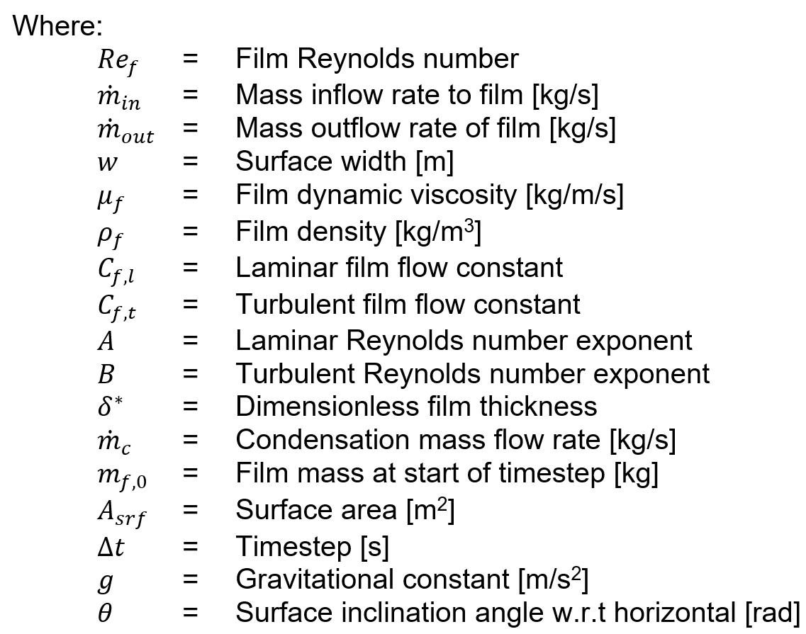

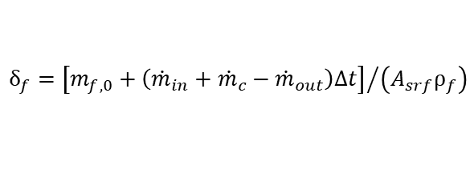
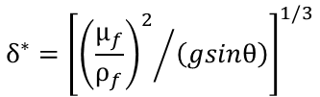
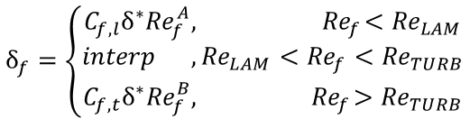
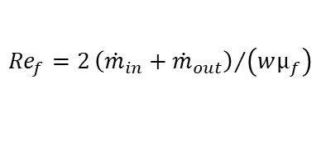
Film Tracking on HS Boundary
Film flow and thickness
Iterative solution:
  Given $m_{f,0},{\dot{m}}_{in},{\dot{m}}_{c}$
  Guessing ${\dot{m}}_{out}$ allows ${Re}_{f}$
  Simultaneously solve two $δ_{f}$ equations
  Seek self-consistent $δ_{f},{\dot{m}}_{out}$
  Guardrails on the solution
    Minimum film thickness for non-zero outflow
    Procedure if self-consistent solution not found from above
$${Re}_{f}=2{{\left({\dot{m}}_{in}+{\dot{m}}_{out}\right)}/{\left(wμ_{f}\right)}}$$
$$δ_{f}=\left\{\begin{aligned}C_{f,l}δ^{∗}{Re}_{f}^{A},{ Re}_{f}<{Re}_{LAM} \\ interp ,{Re}_{LAM}<{Re}_{f}<{Re}_{TURB} \\ C_{f,t}δ^{∗}{Re}_{f}^{B},{ Re}_{f}>{Re}_{TURB}\end{aligned}\right.$$
$$δ_{f}={\left[m_{f,0}+\left({\dot{m}}_{in}+{\dot{m}}_{c}−{\dot{m}}_{out}\right)Δt\right]}/{\left(A_{srf}ρ_{f}\right)}$$
$$δ^{∗}={\left[{{\left(\frac{μ_{f}}{ρ_{f}}\right)}^{2}}/{\left(gsinθ\right)}\right]}^{1/3}$$

Slide 17
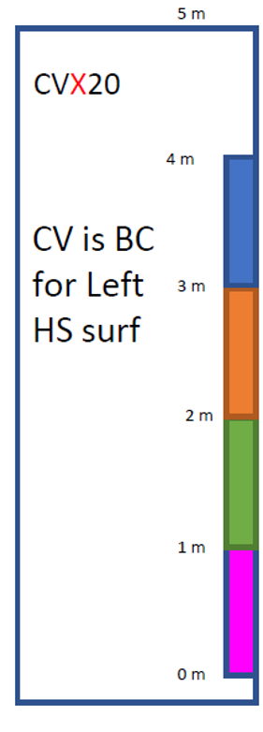
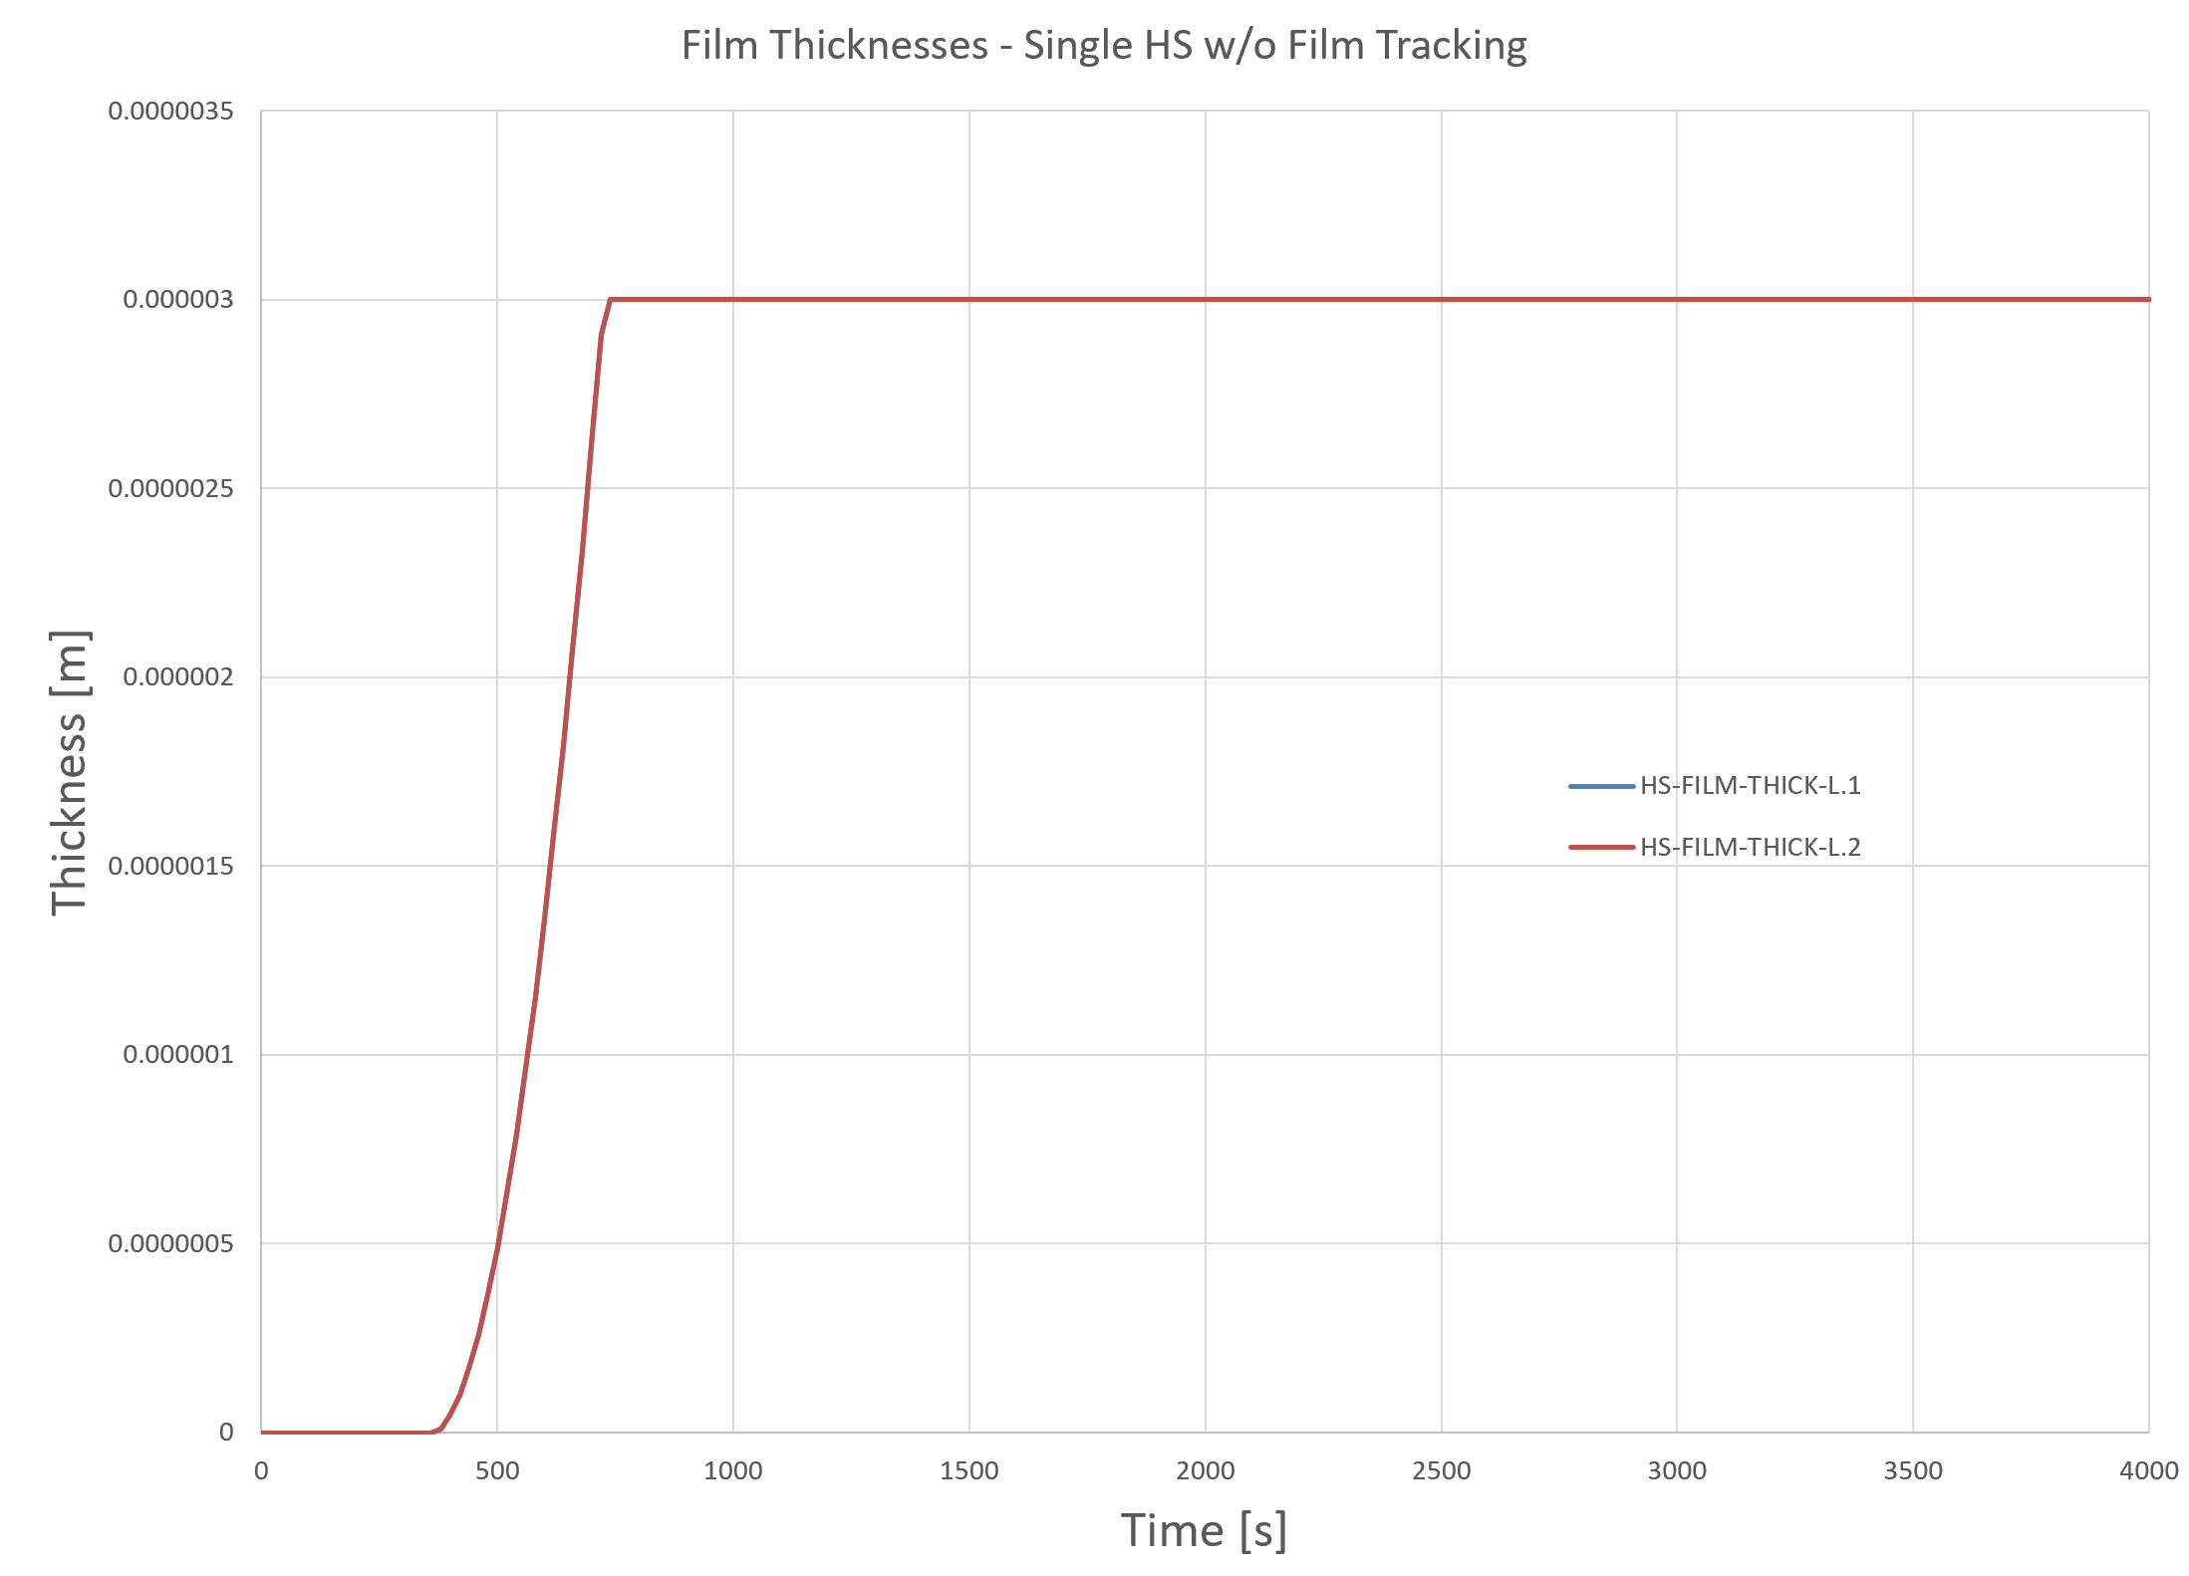
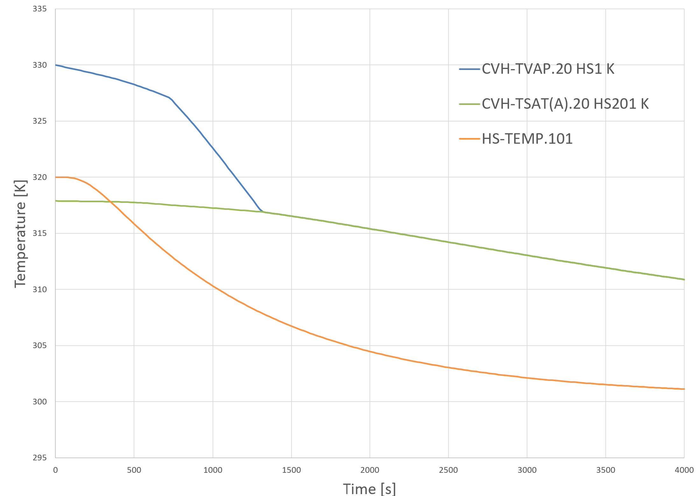
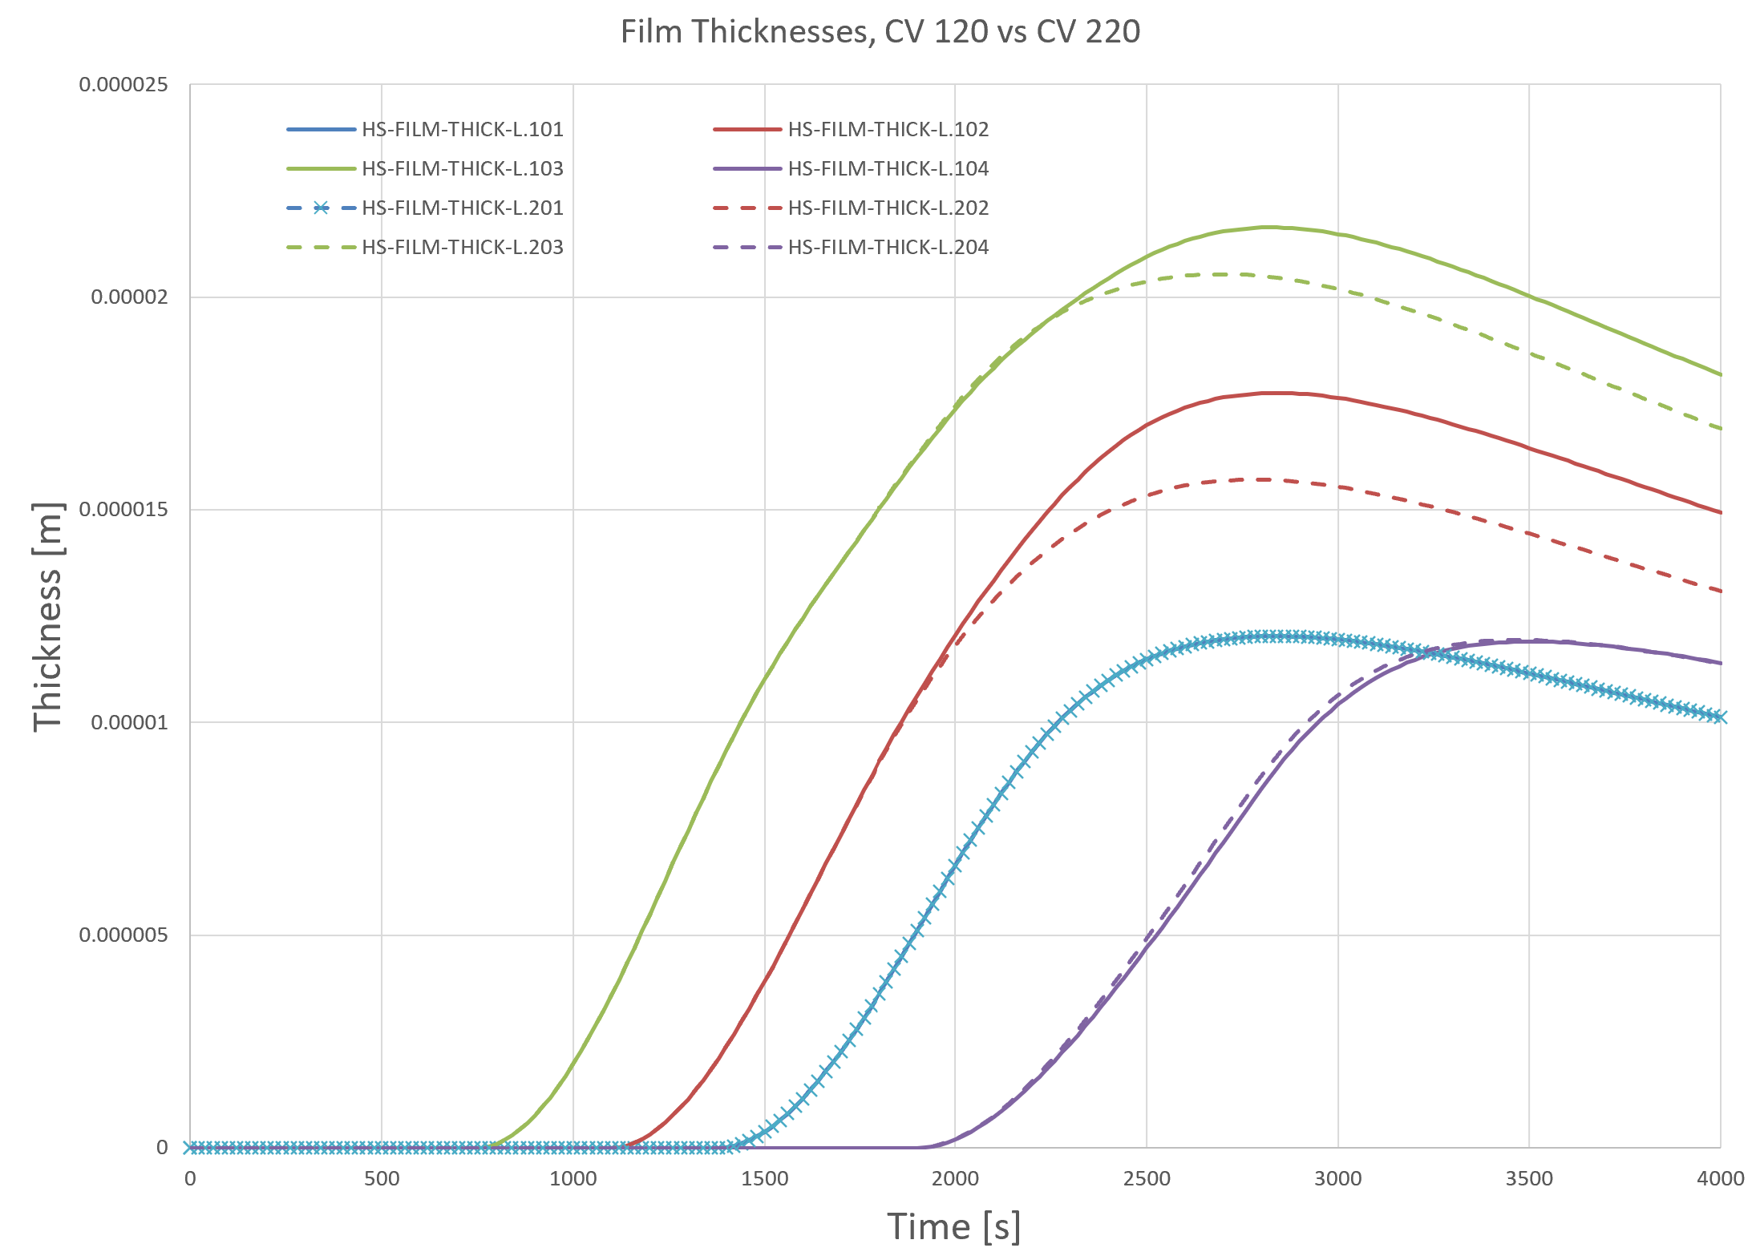





Condensation/Films Example
Single HS w/o Film Tracking
Multi HS w/ Film Tracking
Single CV’s (20/21) to single HS’s (1/2)
  5 m³ and 5 m tall CV
  330 K atm w/o pool and 55% humidity
  Vertical, rectangular HS w/ 1 m² area and $δ_{f,max}=$ 3 μm
CV 20 has no pool source, CV 21 has a pool source
No further film accumulation once ${δ_{f}=δ}_{f,max}$ (pool instead)
Film thickness trends similar (starts once T_HS <= T_SAT)
Pool level and effect on HS surface temperature
Single CV’s (120/220/221/222) w/ 4 HS’s
  120 has film tracking, RHUM = 0.55
  220 has film tracking, RHUM = 0.55
  221 has film tracking, RHUM = 0.99
  222 has film tracking, RHUM = 0.275
  For 120, 1 drains to 2 drains to 3 drains to 4
  For 22X
    1 drains equally to 2 and 4, and
    2 drains to 3 drains to 4
CV 120 vs CV 220
CV 222

Slide 18
Summary
Reviewed
  Finite difference equations on the HS boundary
  Convection heat transfer coefficients on the boundary with and without films
  Radiation heat transfer for HS surfaces
  Mass transfer (condensation/evaporation) on HS boundary
  Film tracking

Slide 19
Back-Up Slides

Slide 20






Gas ε and α Calculations
Structure-to-gas and radiation enclosure models require gas $ε$ and $α$
Radiation enclosure model allows accounting for aerosols present in gas
CONTAIN Modak radiative properties model
  Account for effects of H2O, CO, and CO2
  Account for aerosol in context of radiation enclosure model
  Kirchhoff’s law of radiation – Spectral emissivity for emission of radiation at T equals spectral absorptivity for radiation coming from a blackbody at T
  Rule for combining gas and/or aerosol emissivity/absorptivity into a mixture
  For each gas, sum over spectral absorption bands, curve fit approximation with a band correction
    Partial pressure ($P$), beam length ($L$), and temperature ($T$)
    Experimental parameters $c_{ijk}$ and Gauss-Chebyshev approx. parameters and n^{th} order polynomials $T_{n}$
  For gas mixture:
  Band correction factor:
$$\ln\left(ε\right)=\sum_{i=0}^{2}{T_{i}\left(x\right)}\sum_{j=0}^{3}{T_{j}\left(y\right)}\sum_{k=0}^{3}{c_{ijk}T_{k}\left(z\right) ;x= p_{1}+\frac{\ln\left(P\right)}{p_{2}} ;y=\frac{l_{1}+\ln\left(PL\right)}{l_{2}} ;z=\frac{T−t_{1}}{t_{2}}}$$
$$ε_{g}=ε_{H2O}+ε_{CO}+ε_{CO2}−Δε_{cw}$$
$$α_{g}=ε_{g}\left\{T_{w},L^{′}=L∗\left({T_{w}}/{T_{g}}\right)\right\}{\left({T_{g}}/{T_{w}}\right)}^{0.65−0.2∗\left({P_{H20}}/{\left(P_{CO2}+P_{H2O}+P_{CO}\right)}\right)}$$
$$Δε_{cw}=\left\{\begin{aligned}\left|\frac{ξ}{10.7+101ξ}−\frac{ξ^{10.4}}{111.7}\right|{\left\{\log\left(101.3\left(P_{CO2}+P_{H2O}\right)L\right)\right\}}^{2.76}F\left(T\right), {\left(P_{CO2}+P_{H2O}\right)L>1.013{∗10}^{4} \atop ξ>0.01 } \\ 0 ,otherwise\end{aligned}\right.$$
$$ξ={P_{H20}}/{\left(P_{CO2}+P_{H2O}\right)} ;F\left(T\right)=−1.0204{∗10}^{−6}T^{2}+2.2449{∗10}^{−3}T−0.23469$$

Slide 21




Aerosol & Mixture ε and α Calculations
Felsk-Tien method for emissivity
  Absorbing particles with negligible scattering
  $φ\left(y\right)$ the pentagamma function ; $λ_{m}$= 0.94 μm ; $C_{2}$=14.388*10⁻³ [m-K]
  $α_{λm}$ the absorption coefficient at the reference wavelength
    Pilat-Ensor model for “aerosol cloud emissivity”
    $C_{λm}$ called “kmx”, meant to account for effects of wavelength, index of refraction, particle size distribution, and aerosol material density
    $f_{m}$ the total aerosol mass concentration [kg/m³]
  Aerosol absorptivity $α_{p}$ can be calculated like $ε_{p}$ but use $T_{w}$
Gas and aerosol mixture emissivity and absorptivity:
$$ε_{p}=1−\frac{15}{π^{4}}φ\left(y\right) ;y=1+α_{λm}LT_{g}\left({λ_{m}}/{C_{2}}\right)$$
$$α_{λm}=4000∗C_{λm}f_{m}$$
$$ε_{m}=ε_{p}+ε_{g}−ε_{p}ε_{g}$$
$$α_{m}=α_{p}+α_{g}−α_{p}α_{g}$$

