Slide 1
MELCOR activities for STEP
Samad Khani, Matt Lukacs
Safety Case Engineering Group, UKAEA
samad.khnai@ukaea.uk, matthew.lukacs@ukaea.uk

Slide 2
Contents
UK Fusion Power Plant Programme – STEP
Tokamak faults
MELCOR model
Preliminary results
Future work
STEP OPEN

Slide 3
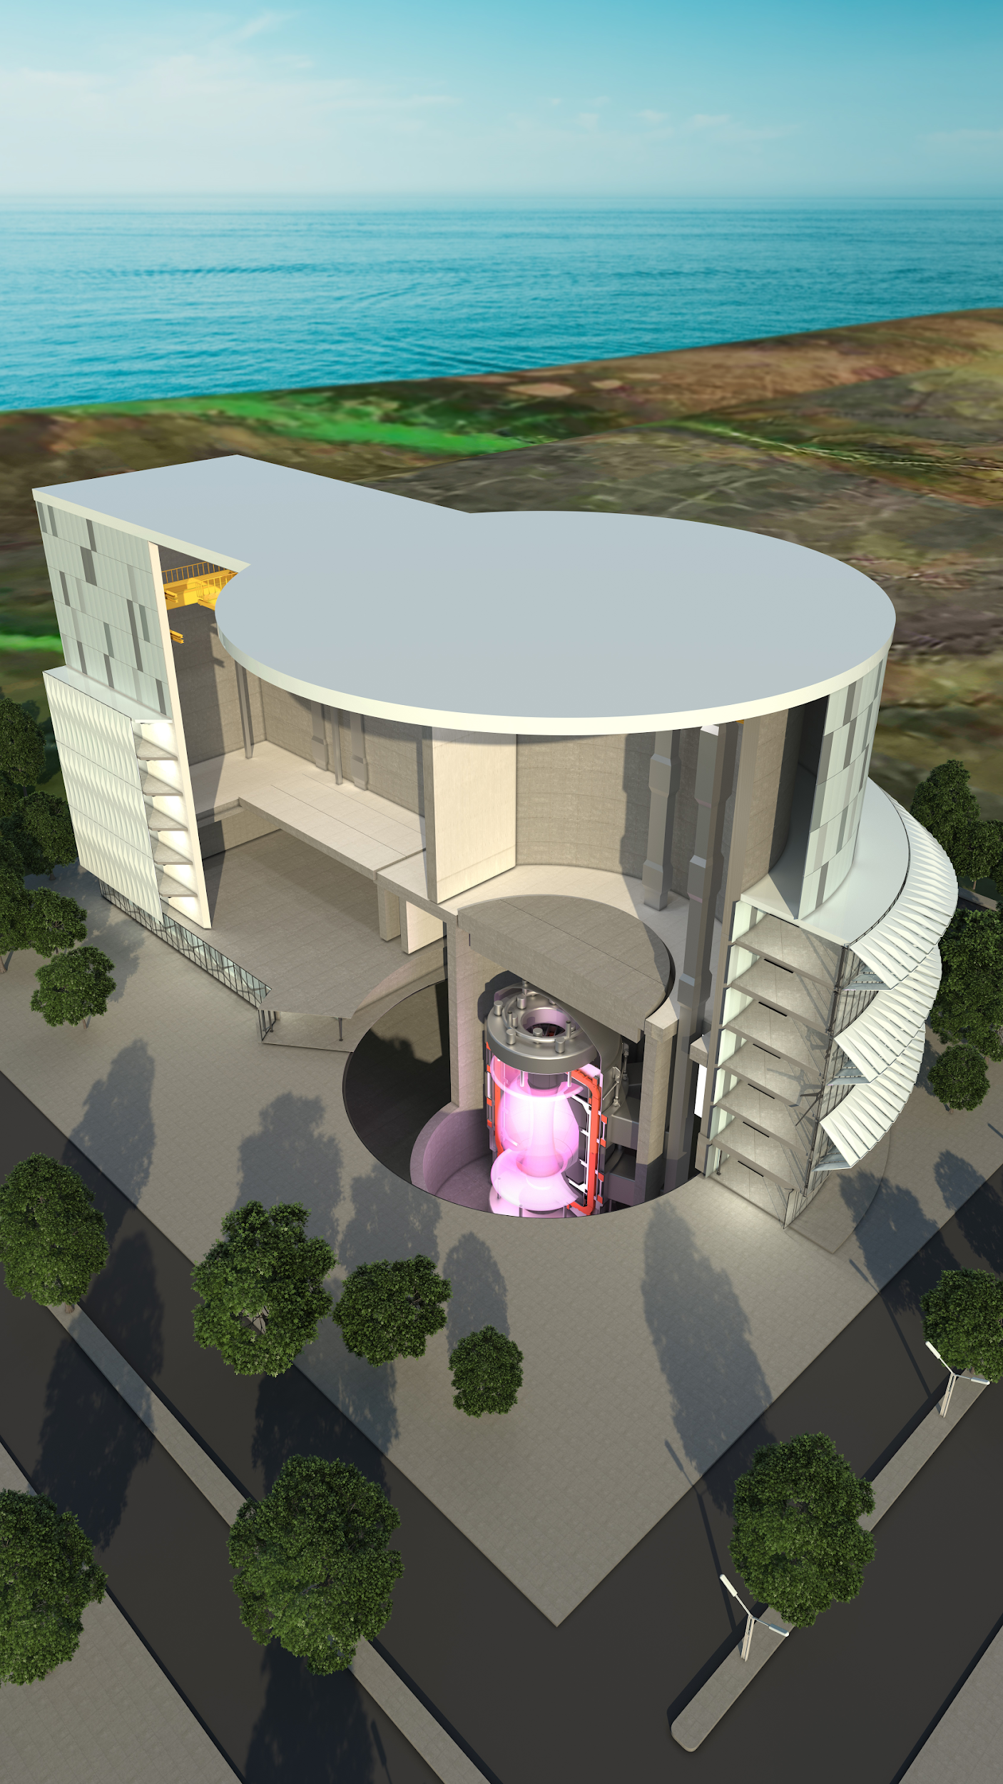

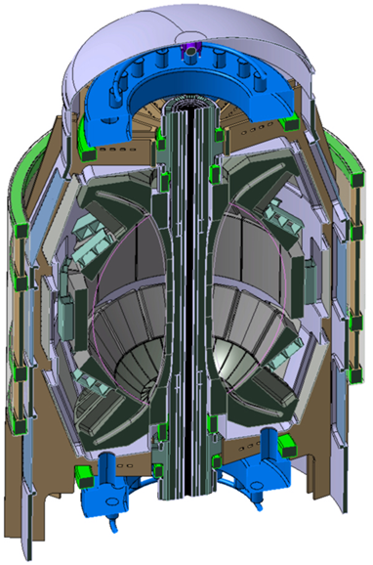
STEP (Spherical Tokamak for Energy Production)
Lithium as breeder (not fixed yet)
Tungsten first wall (most likely candidate)
High Temperature Superconducting coils (helium cooled), design in progress
Advanced Divertor Design (double divertor)
Plasma temperature >100 million degrees C
STEP OPEN

Slide 4

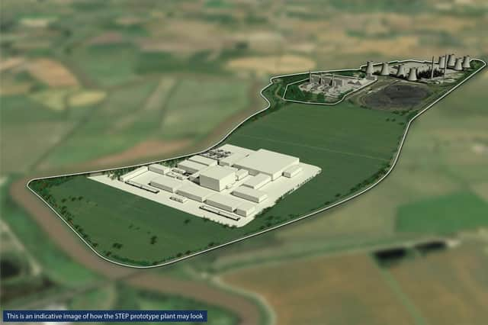
Where will STEP be built?
West Burton A –
Coal power station, 2000 MW
(to cease generation in 2023)
West Burton B –
Combined cycle gas power station with battery storage capacity of 49 MW
(expected to be generating into the 2040’s)
Early Render of STEP (500MW) Layout
West Burton,
Nottinghamshire
STEP OPEN
Notes:
Three power plants from three different resources, West Burton A since 1966 operated by EDF Energy. It’s retired this year, West Burton B construction started in 2008 and will be putting energy into the grid by 2040.

Slide 5
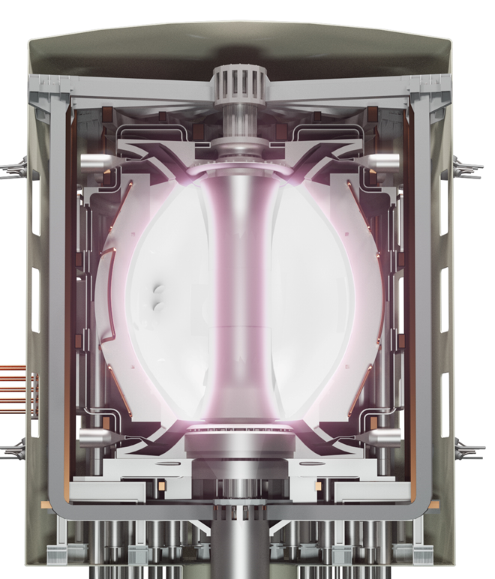
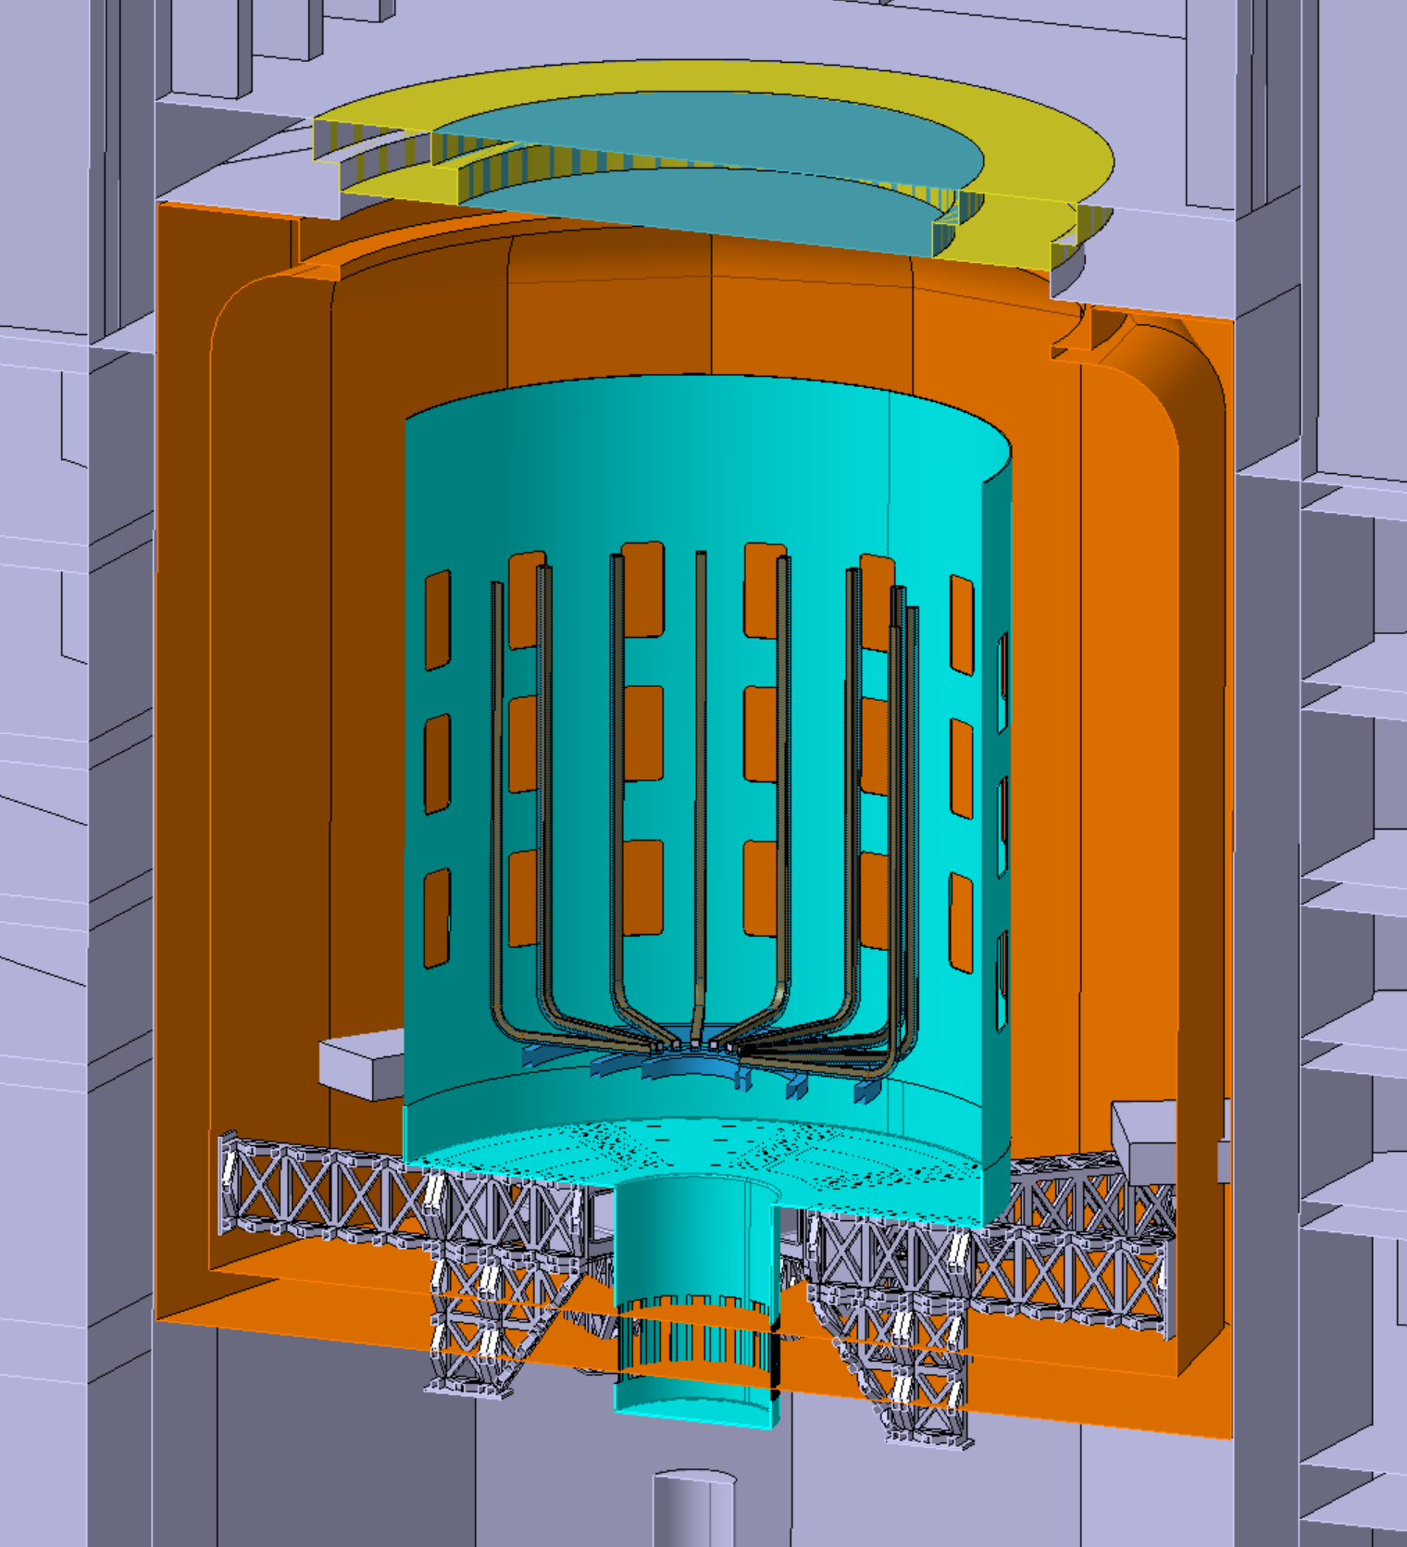
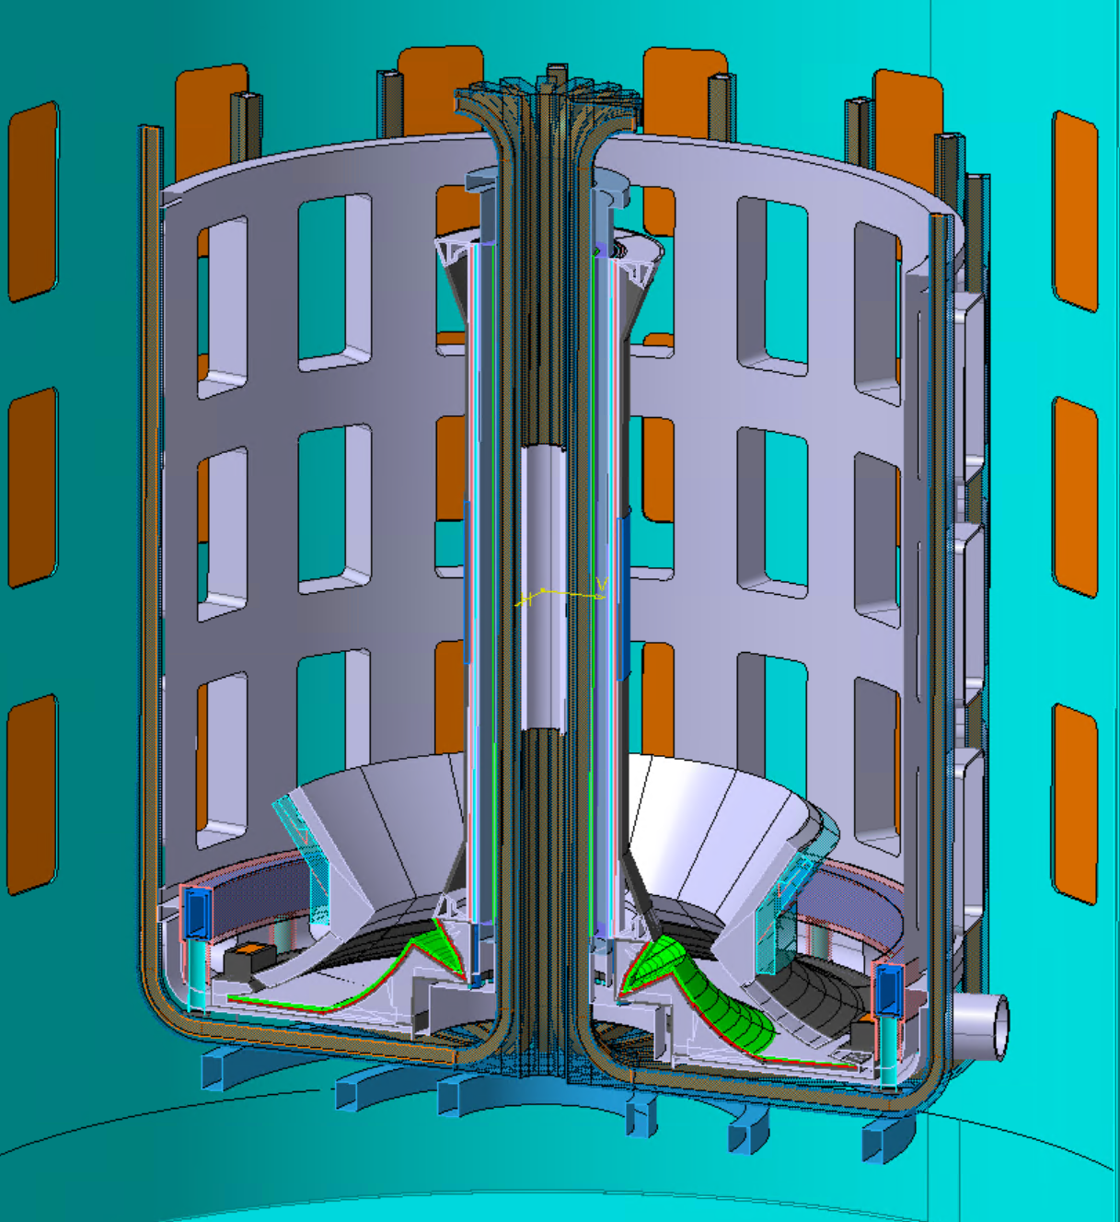
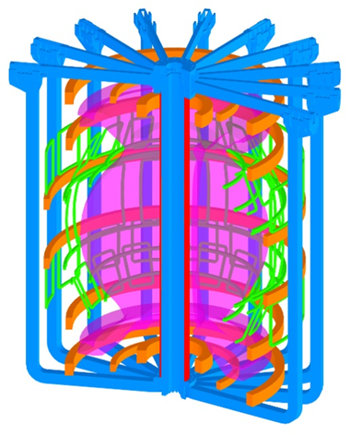
Tokamak Anatomy
vacuum vessel
cryostat
toroidal magnets
plasma
poloidal magnets
bio shield
STEP I OPEN
Notes:
Overall layout of the step tokamak, the main concept is to confine the D+T plasma by some super conducting magnets under vacuum condition, then extract heat from the high energy neutrons while making them to react with breeder material to generate the needed tritium.

Slide 6
Main Fusion inventories
Energy Inventory
  Plasma Energy
  Neutrons Energy
  Stored and decay heat in PFMs
Radioactive Material Inventory
  Tritium build-up
  Radioactive dust
Hazardous chemical inventories
  Lithium, Tin
  Pressurised H2O/D2O
  Hydrogen
  Cryogens (He and N2)
6
STEP OPEN
Notes:
Very high level categorisation of fusion specific sources for hazards, we’re dealing with energy, pressurised fluids for now and going to add stored energies, radioactive materials, lithium and hydrogen as well.

Slide 7
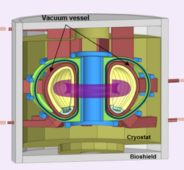
Tokamak Faults
Key tokamak faults:
Loss of Coolant
(LOCA)
  Leaks due to components failures, e.g. due to off-normal plasma events
Loss of Vacuum
  Can occur due to LOCA (e.g. due to over-pressure)
Damage to confinement boundaries (e.g. due to over-pressure following steam release)
Radiological / toxic release (tritium, activated dust etc)
Explosion / fire hazard (hydrogen)
Loss of Coolant Flow
  Initiator to LOCA if results in pipework / component failure
Magnet quench
  Release of stored energy, electrical arcing, electromagnetic loads, cryogens
Faults are not independent:
Interlinked faults with different permutations:
Plasma events
  Disruption resulting in electromagnetic and thermal loads on components
Plasma event
LOCA
LOVA
Quench
Quench
LOCA
LOVA
Plasma disruption
STEP OPEN

Slide 8
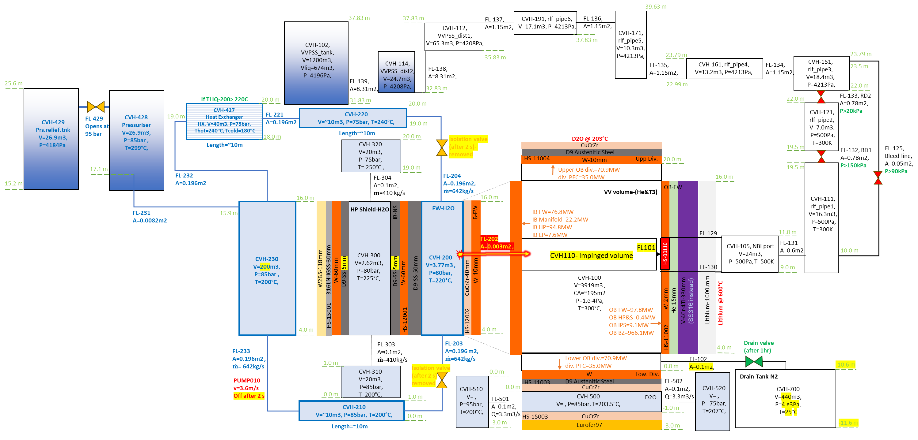
Nodalisation (still under revision)
STEP OPEN
Notes:
Step by step developed to include the most relevant components, OB side still remains outstanding and replicated by some HSs. Upper diverter also avoided for the sake of simplicity. PRS, HX and VVPSS added

Slide 9
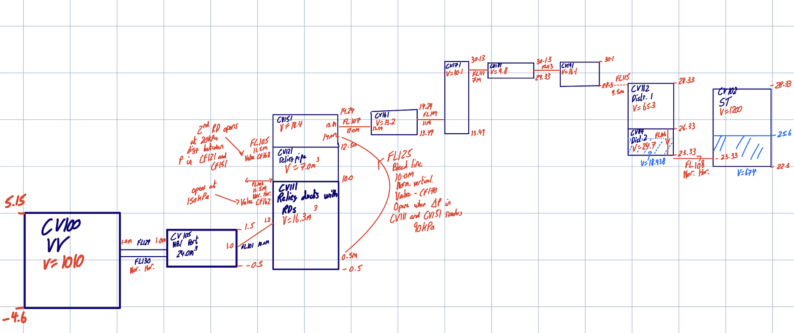
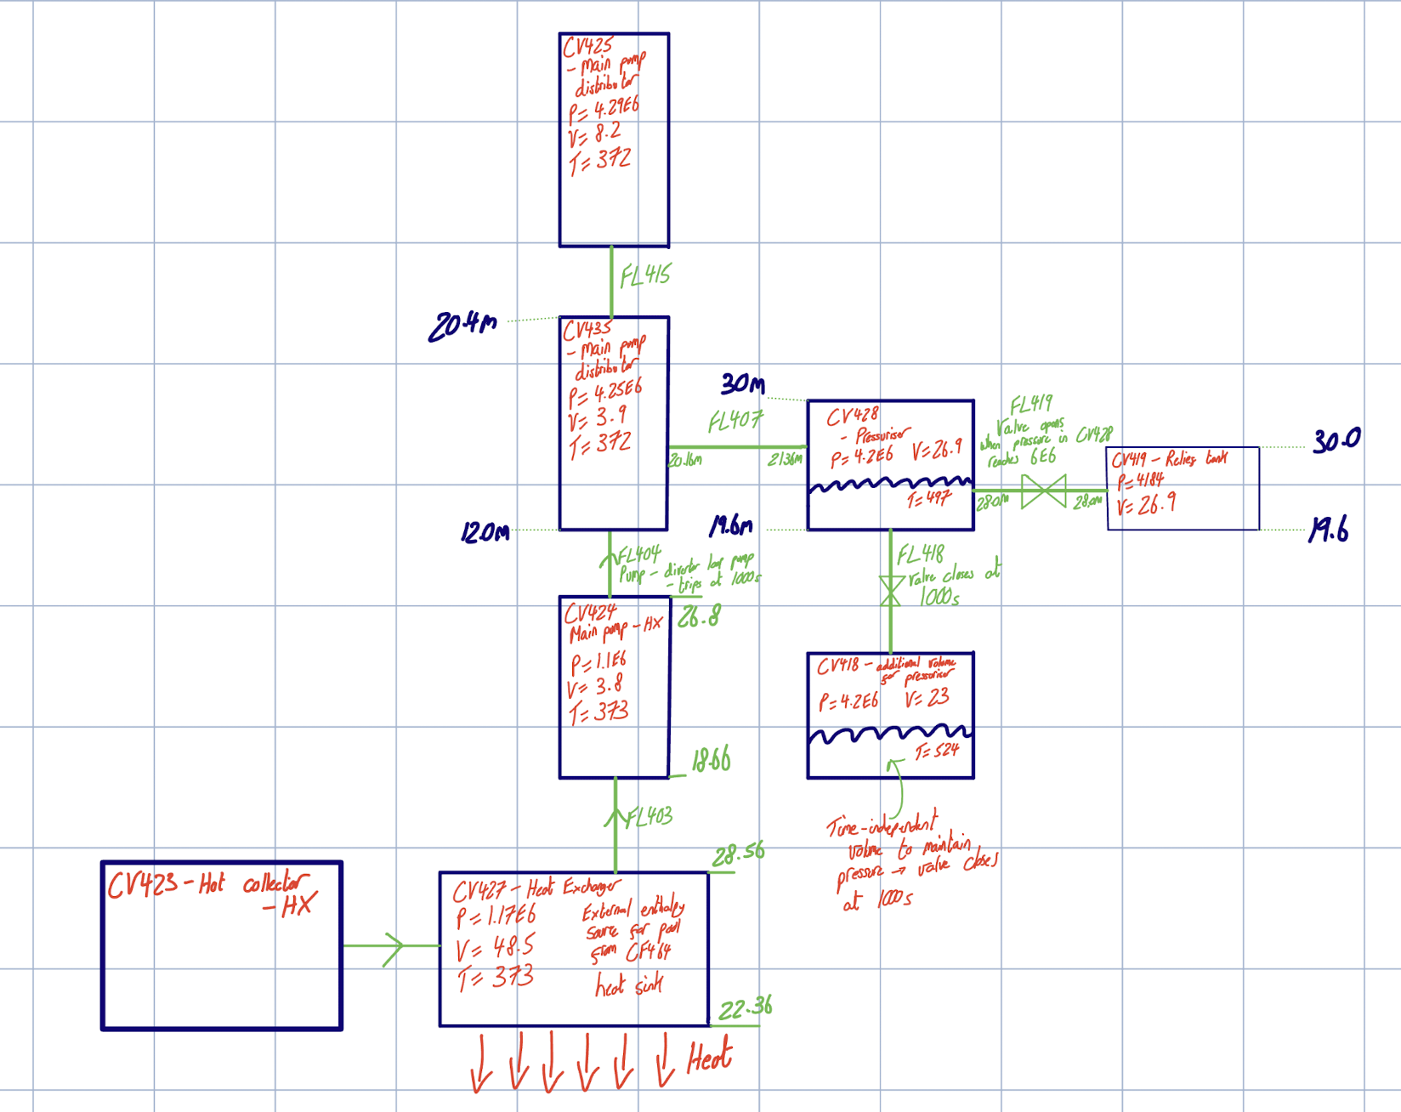
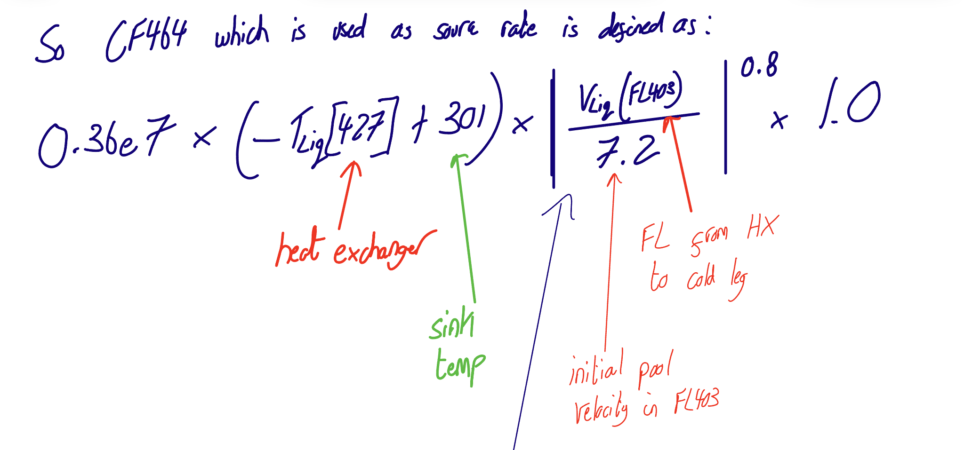
Pressuriser, HX and VVPSS
VVPSS:
PRS:
HX:
STEP OPEN

Slide 10
Modelling assumptions
No radio nuclide (RN) and decay heat data yet
Plasma heating (nuclear heating)
Draining tank is active 1 hr post transient
Pressuriser
Heat Exchanger
Water Impingement model included
LOCA starts at 1000 s
STEP OPEN

Slide 11
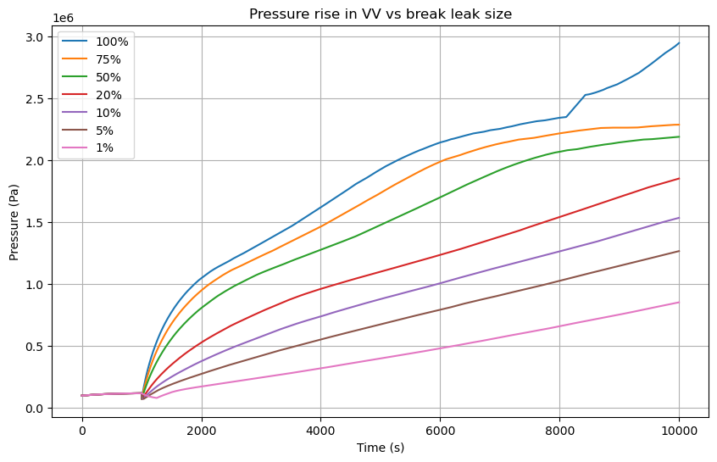
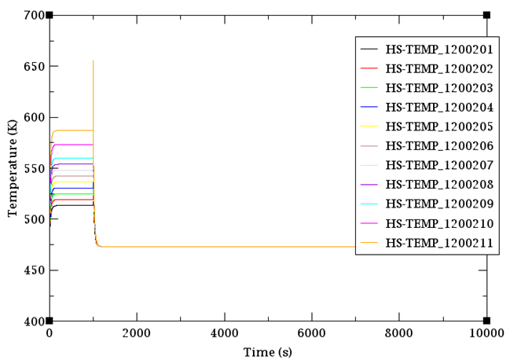
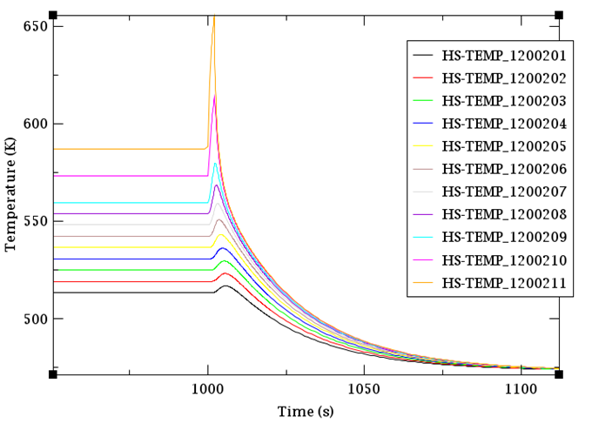
Preliminary results
Continuous injection of unlimited water without the VVPSS and Drain tank in place
STEP OPEN

Slide 12
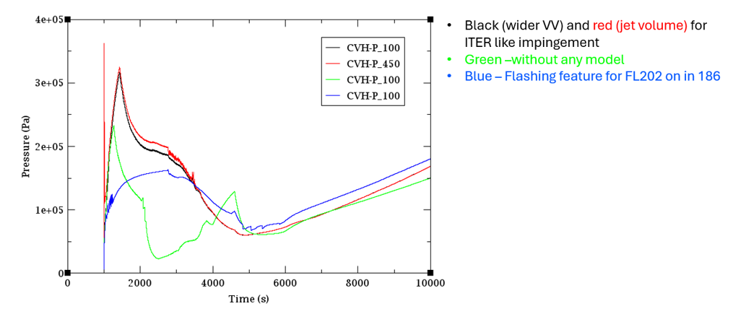
Preliminary results
Impingement model testing results, isolation valves disabled,
STEP OPEN

Slide 13
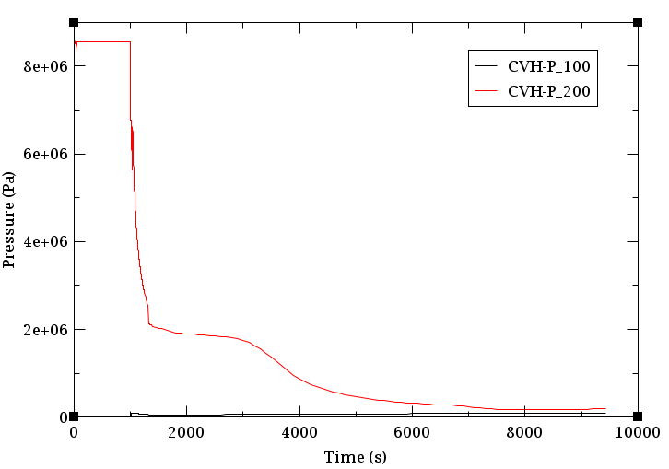
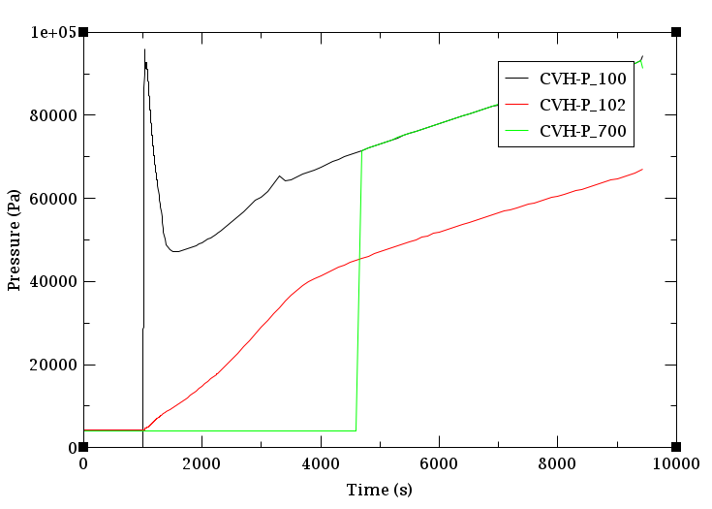
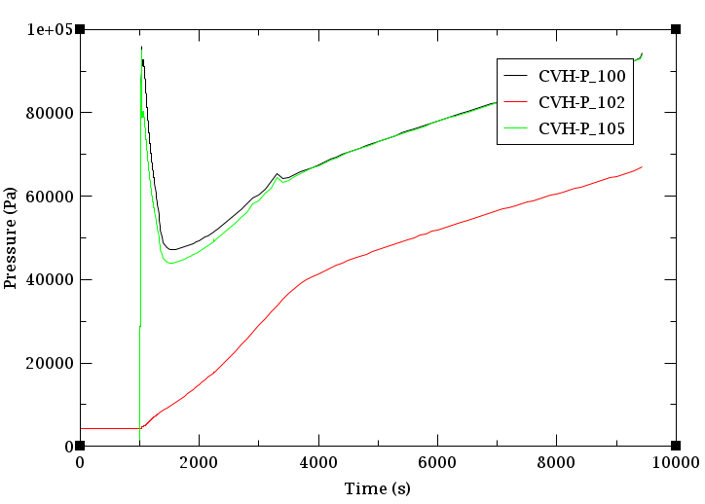
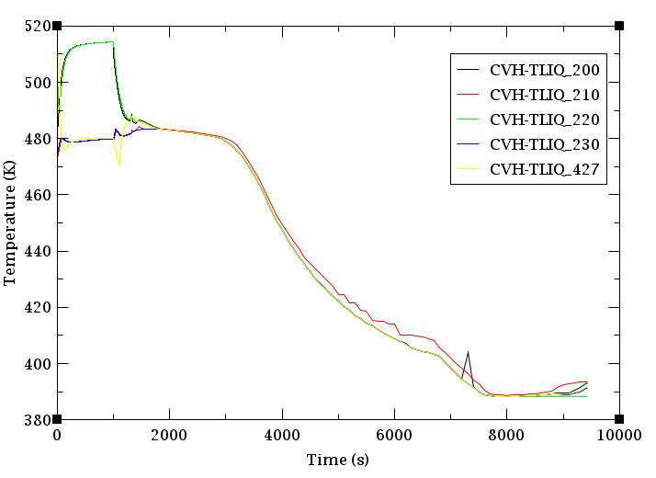
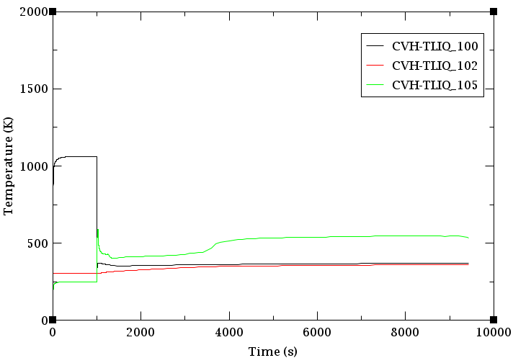
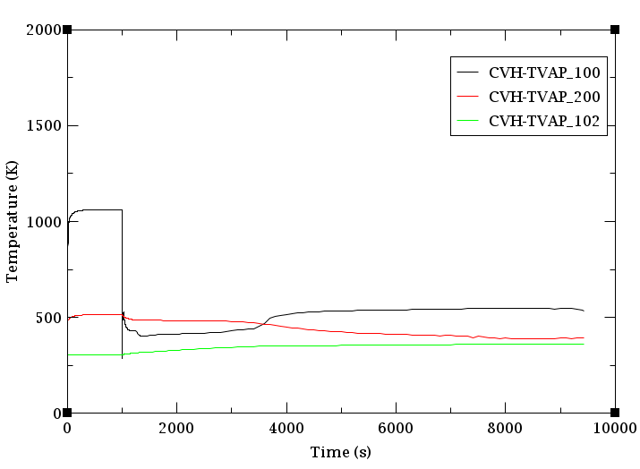
Preliminary results
VVPSS and Drain tank added, transient time sequence changed, plasma heat load updated, water inventory changed,
STEP OPEN

Slide 14
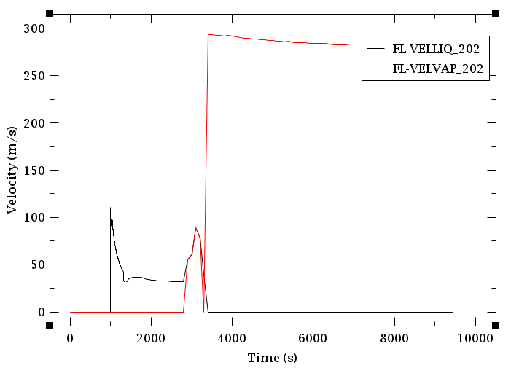
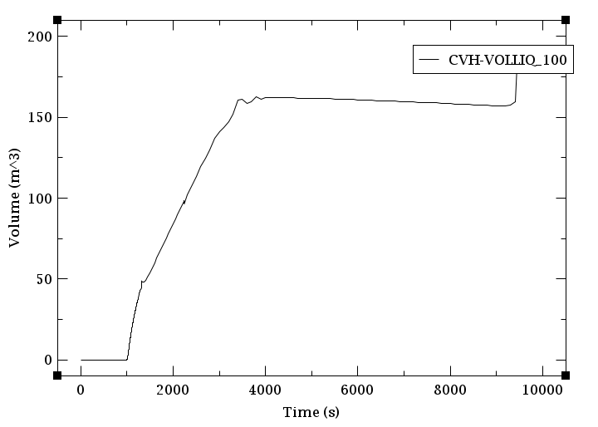
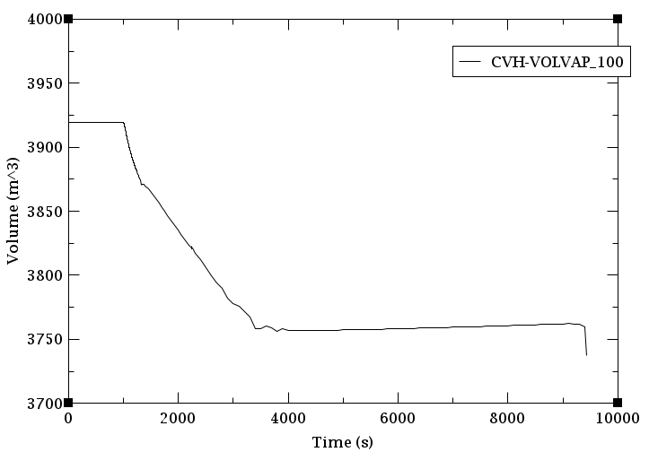
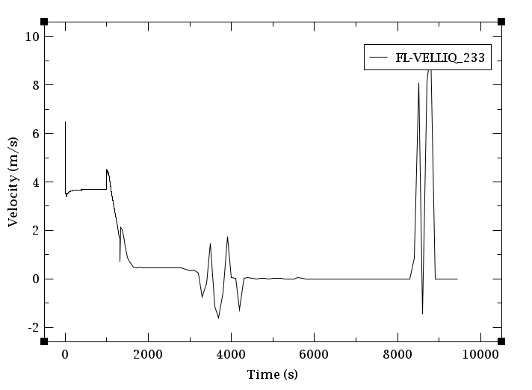
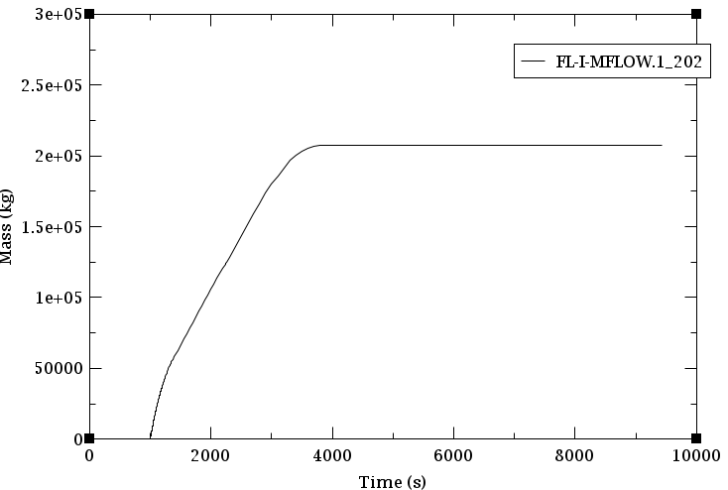
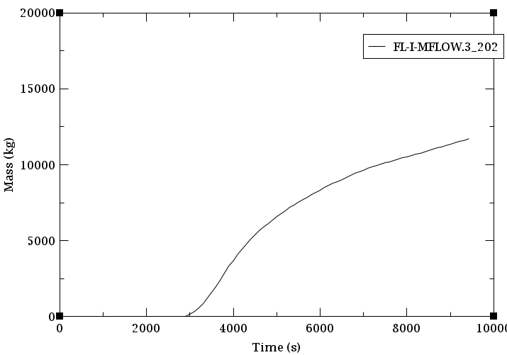
Preliminary results
STEP OPEN

Slide 15
Summary
Early stages of producing MELCOR model for STEP plant to simulate in-VV LOCA
Similar approach to ITER adopted for heat exchanger, pressuriser, and VVPSS
Promising early results at maintaining pressure in vacuum vessel below acceptable limits
Future work will focus on incorporating RN package and decay heat, modifying impingement model and adding the cryostat volume

Slide 16
Questions
STEP OPEN

