Slide 1





An approach for a Dynamic Probabilistic Risk Assessment with RAVEN and MELCOR
Tommaso Glingler
M. D’Onorio
G. Caruso
M. Pellegrini
D. Mandelli
A. Alfonsi
tommaso.glingler@uniroma1.it

Slide 2
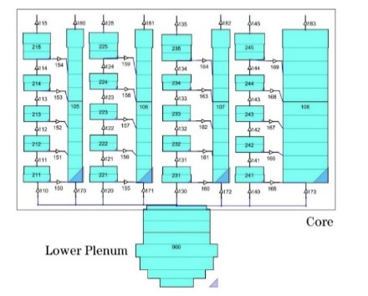
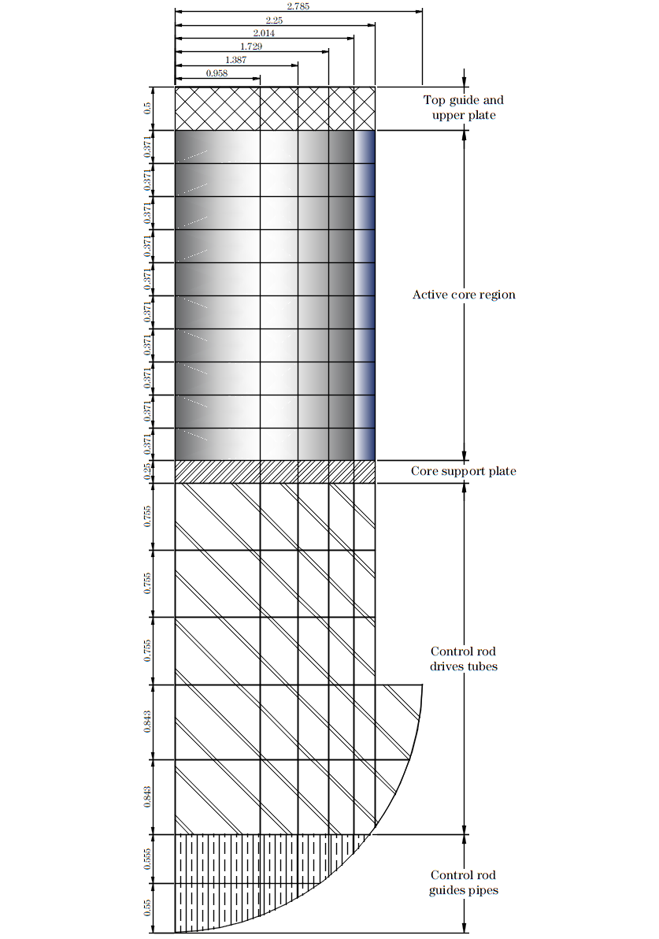
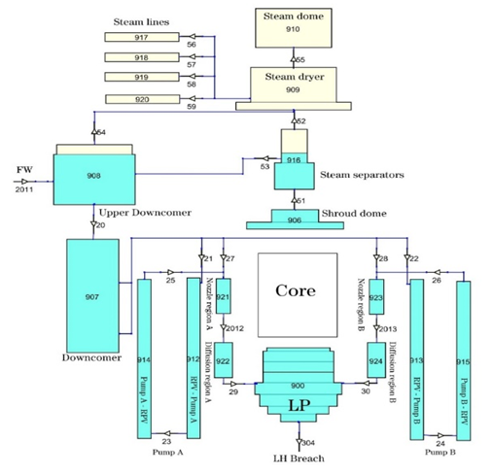
Outline
Introduction and Status of the Activity
Probabilistic Risk Assessment:
  Main concepts
  Fault Tree / Event Tree methodology
Dynamic Probabilistic Risk Assessment
  Dynamic Event Tree
Station Blackout Scenario of a BWR
  Discrete Dynamic Event Tree
    Event Sampling
    Simulation Results
  Binary Classification model

Slide 3
Introduction and background
R&D activities carried by Sapienza University of Rome with the collaboration of UTokyo
The main objective is to provide accident analyses of SBO scenario for a BWR4-MARK I.
Three defined option are proposed by TEPCO:
Gas Turbine Generator (GTG)
Alternative water injection pump (HPAC)
RCIC without DC power (black start)
For the 3rd option, the Dynamic Event Tree tool developed by Sapienza will be used to:
Explore possible pathways through which the system can evolve
Define a Limit Surface defined as the boundary between system success and system failure
Estimate Core Damage Frequency – Level 1 DPRA
Sapienza proposes a new approach for Dynamic Probabilistic Risk Assessment based on a Machine Learning Binary Classificator

Slide 4
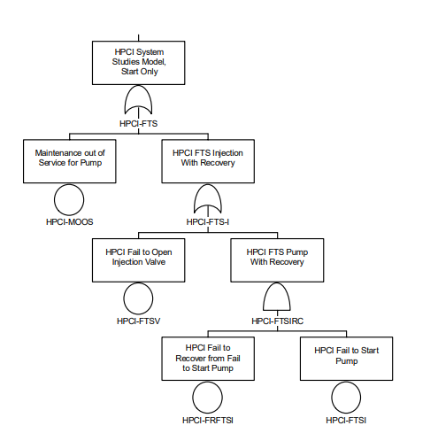
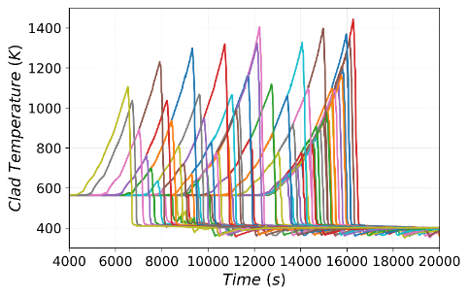
Probabilistic Risk Assessment
How likely is it?
- Event tree/fault tree methodology
What can go wrong?
Initiating Event
System 1
System 2
Accident Sequence
«Delineate and analyze a large number of accident sequences»
«Reliability Engineering models»
PRA
Success State
I*S1*S2
Success State
(S2)
(S1)
Failure State
(F2)
I*S1*F2
Initiating Event
(I)
Success State
I*S1*S2
«Encompass a wide variety of analysis endpoint»
Failure State
(S2)
What are the consequences?
Failure State
(F1)
I*F1*F2
(F2)
Core Damage – level 1
Large Release – level 2
Offsite Risk – level 3
Notes:
PRA is an engineering analysis process that answers the three fundamental risk questions (see FAQ R2). it provides both qualitative and quantitative information.
An NPP PRA model will, typically delineate and analyze a large number of accident scenarios, starting with an “initiating event,” and ending with some level of consequence.
Fault Trees are used to identify all combinations of component failures that can lead to system failures
Event Trees are used to determine the sequences of system failures that can lead to undesired consequences
The probabilities of the different combinations of component/system failures are developed using Boolean logic. As parameters characterizing the probability of failure of single components are failure rates

Slide 5
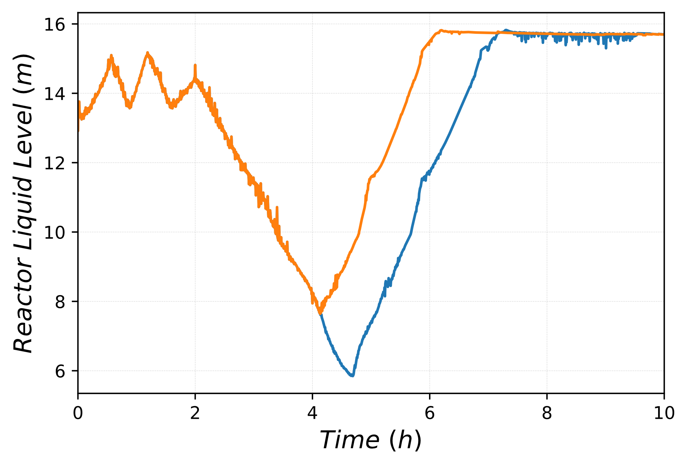
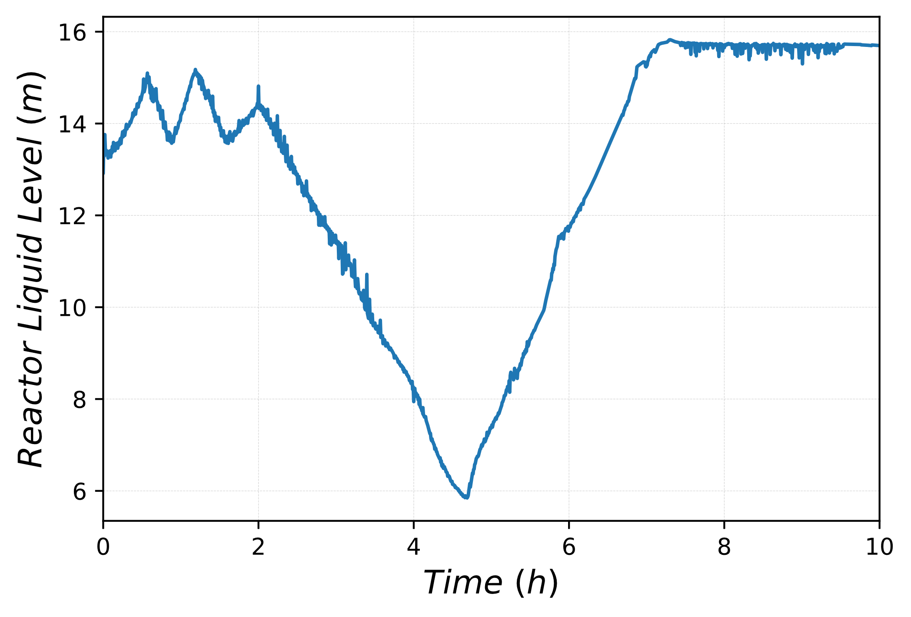

Dynamic Probabilistic Risk Assessment
DPRA problem can be interpreted as exploration of the space of event sequences to discover the system vulnerabilities (exploration process), and provide an estimate of the likelihood
«
«
Operation of Control systems
Multiple Failure Modes
System Response
Component Degraded Operation
Human Operarator
Notes:
Dynamic PRA refers to the integration of time-dependent modeling coupled with a probabilistic model to explore potential scenario pathways as a function of time.
The dynamic phenomena have a strong influence on the system’s response (e.g., the operation of control/protection devices upon reaching assigned thresholds of the process variables values).
The hardware component failure behavior and human operator actions depend on the process dynamics.
The complex interactions between human operator actions and hardware components influence the system’s response and failure behavior.
There are a variety of degraded modes related to multiple failure modes and the process dynamics.

Slide 6
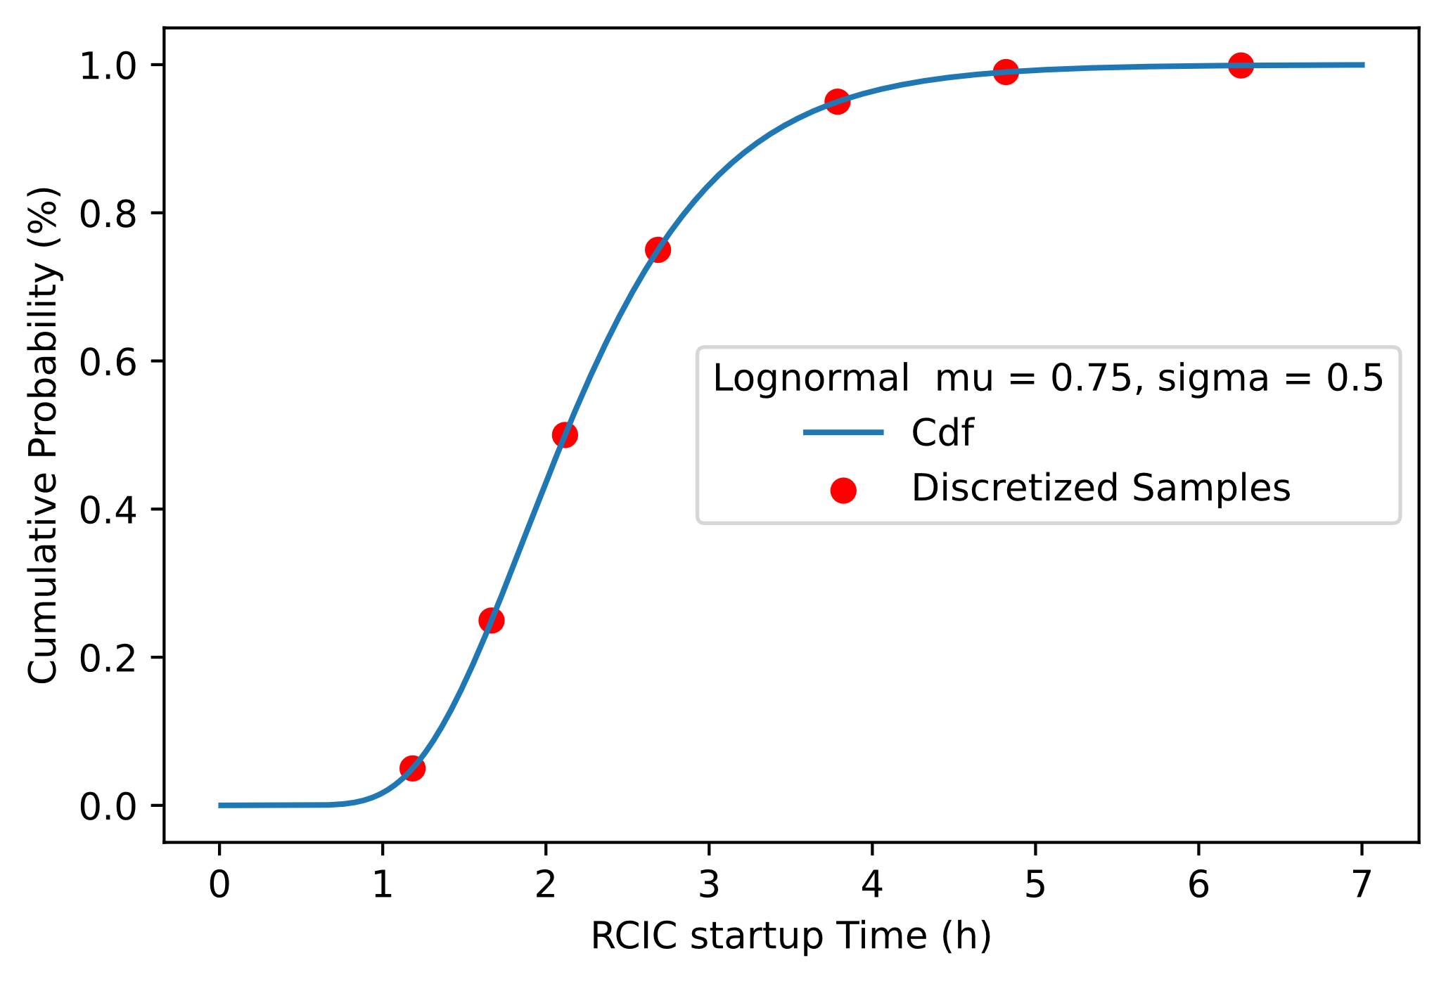

Discrete Dynamic Event Tree
n: possible states
m: components modeled
k: time steps
Challenges:
State explosion problem
Propagation of aleatory and epistemic uncertainties
Represent all possible states which a system could reach
Physical Model solved by a system code and characterized by discrete events modeled within a reliability framework
Transitions are predetermined
$$number of sequences= n^{m^{k}}$$
Supervised DPRA
Guided Exploration:
High consequences and low probability event sampling
State-space Pruning:
Avoid re-evaluating similar scenarios
Reduced-Order Models:
Simplified system code modeling
Notes:
Discrete-time: System state is computed with system codes from an initial condition. Discrete time steps are considered for failures and external disturbances, such as operator responses”
These deviations are predefined to happen at discrete time-steps, and the responses come from the rules and procedures the operators must carry out when the deviations are detected. The deviations and responses have associated probabilities
The state explosion problem prohibits the application of classical DPRA methods to large-scale complex systems. Supervised DPRA methods address this problem reducing the number of simulations
Guided Exploration:
Most relevant risk scenarios are explored first. Branching rules are selected to simulated low probability and high consequence states
Probability truncation threshold and simulation time limits
State-space Pruning:
Reducing the size of the state-space to be searched
Use predefined knowledge of the state-space to avoid re-evaluating similar scenarios
Reduced-Order Models:
Adjust the level of detail of the physical models being simulated

Slide 7

Discrete Dynamic Event Tree modeling
System Code: MELCOR
Risk Assessment Code: RAVEN
Dynamic Event Tree sampler lets a system code find the accident sequence path
When an event occurs, the sampler generates new possible scenarios
Guided exploration: preliminary event timings are set to find Recovery Time Limit
Truncation method:
  PCT > 1477.0 K
  HPCI successfull recovery
Main Ingredients:
EXEC_STOPCF
TRIP Function
MEL_RESTARTFILE
Notes:
Fukushima Daiichi Unit 3 was a BWR/4 of 2381 MWt. The operating pressure in the reactor pressure vessel was 7.03 MPa considering an average core temperature of 286 °C.
The MELCOR in-vessel model includes downcomer, recirculation loops, jet pumps, steam separators, steam dryers, steam dome and four steam lines, as well as lower plenum and core region.
COR nodalization is shown. Lower plenum and core structures have been modelled using 19 Axial Levels (AL) and 6 rings. The active core region has been represented by 4 concentric core rings with associated radial peak factors. The fuel assemblies have been divided into ten axial levels (9-18th AL).
The 40 active core cells are thermally coupled two by two for each CV, modelling the power response of the included fuel assemblies, giving an accurate and continuous representation of the local fuel degradation. 20 CVs have been used to simulate four core channels and associated bypass volumes, connected through flow paths that open when the canister fails, allowing natural circulation in the open core after channel box failure.
The Primary Containment Vessel (PCV) model includes Drywell (DW), pedestal, vent lines, and Wetwell (WW).
Reactor Core Isolation Cooling (RCIC) system, High Pressure Coolant Injection (HPCI) system
The overall goal was to conceive a tool to enable Risk Informed Safety Margin Characterization (RISMC):
Evaluating risk (uncertainty propagation)
Understanding risk (limit surface, ranking, sensitivity, data mining)
Mitigating risk (optimization)

Slide 8
Accident Analysis Specification
Loss of Off-site Power followed by loss of the Diesel Generator (Station Blackout)
Postulated Initiating Event: Total loss of AC power as a result of complete failure of both offsite and onsite AC and DC power sources
Operators successfully scram the reactor and put it in sub-critical conditions by fully inserting the control rods in the core
Aggravating failure of all Diesel Generator causing loss of Emergency Core Cooling System
Operators begin actions to recover Diesel Generators
Emergency Battery are functional and provide DC for the operation of RCIC
RCIC parameters
Pump fixed flow rate | [kg/s] | 26.0
Steam Line extraction | [kg/s] | 2.51
Water Temperature | [K] | 283.15
Water Inventory | [m³] | 1500.0
Accident Sequence Events
Remaining Battery Life: Depending on the use of DC power, battery power can deplete. When this happens, all remaining control systems are offline. Failure to start is also considered
RCIC blackstart: following battery depletion, a team of plant operators perform action for RCIC black start. Batteries from nearby vehicles are recovered and connected to the RCIC
Diesel Generator recovery: Plant operators start recovery operations to bring back on-line the DGs

Slide 9
Control logic scheme for the BWR system
Initiating Event:
Loss of Off-site Power followed by loss of the Diesel Generator (Station Blackout)
LOOP
Reactor trips
MSIV valves close
DGs fail to run
DC power is available through emergency batteries
Boundary Conditions
Actions: Level control using RCIC and/or HPCI via CST
RCIC control logic:
    ON: level < 12.0 m
    OFF: level > 14.5 m
Trip condtions:
CST empty
Loss of DC
Low pressure
Event: Battery Fail to start
Actions: DG recovery
Event: Diesel Generator recovered and DC available
Event: Battery depletion
Actions: Battery Recovery for RCIC black start
No manual control of the system:
Valves always open
Fixed flow rate at 26.0 kg/s
Trip condtions:
CST empty
Degraded state if RCIC turbine flooded
flow rate = 10% nominal
Event: RCIC black start operation

Slide 10
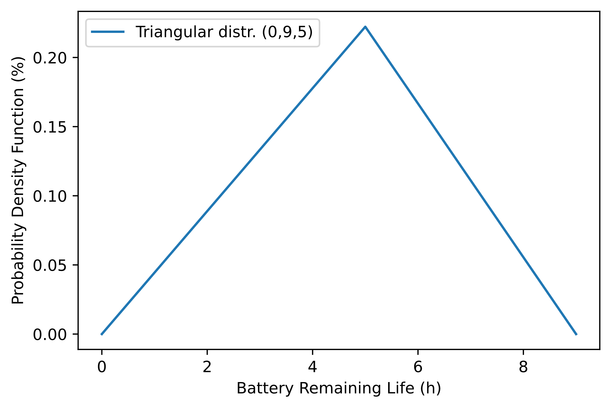
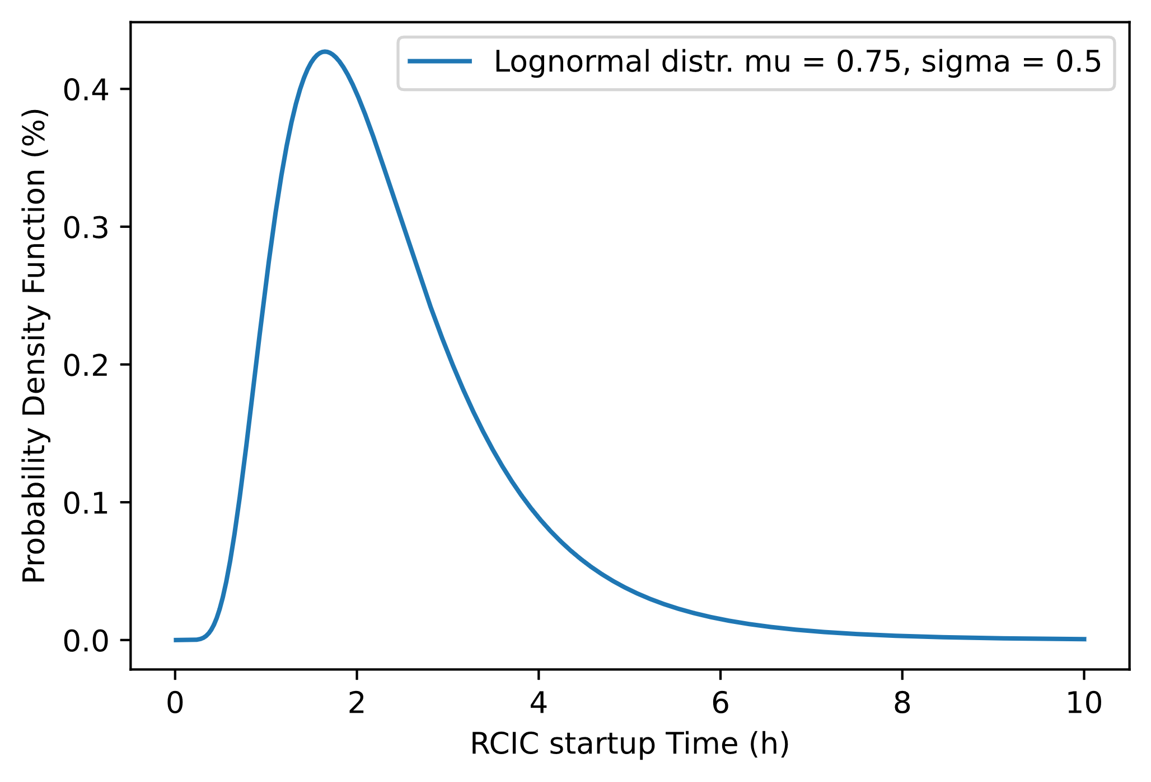
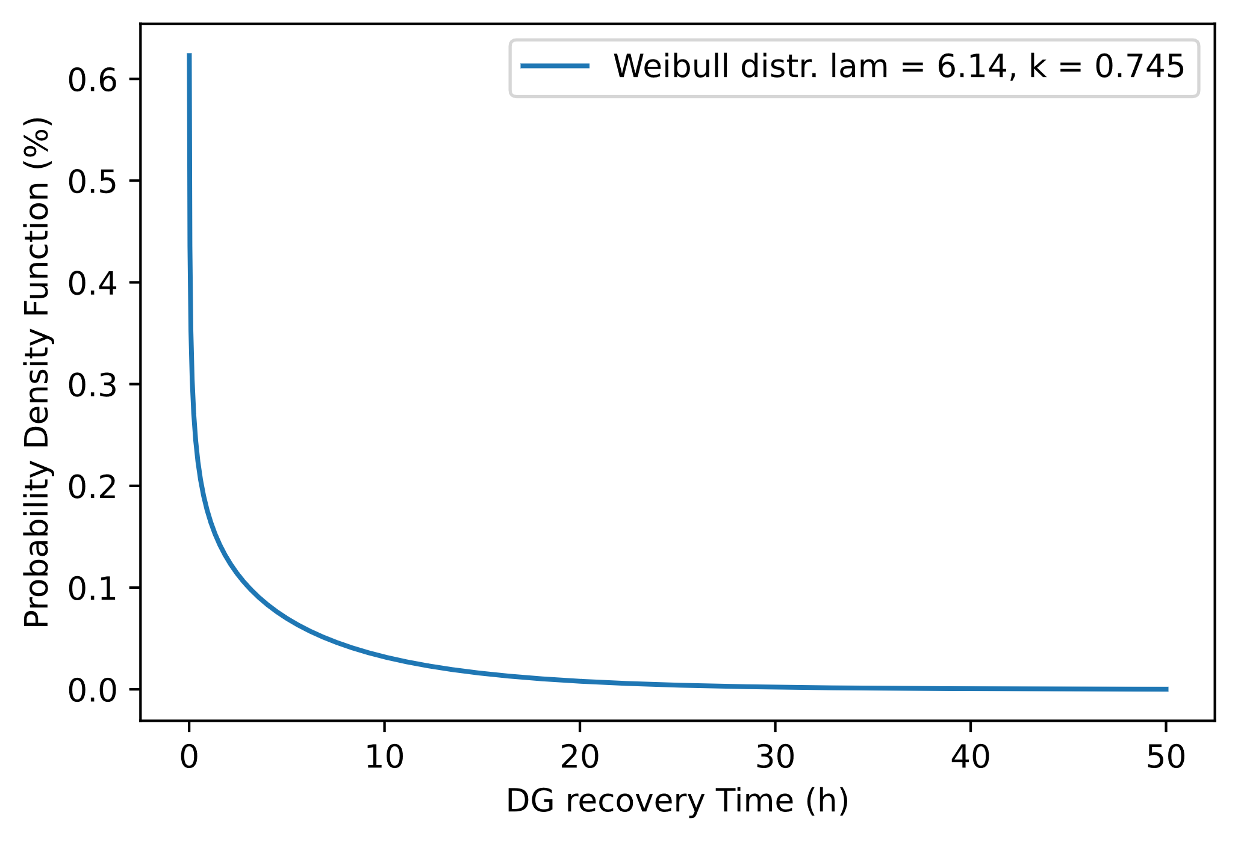
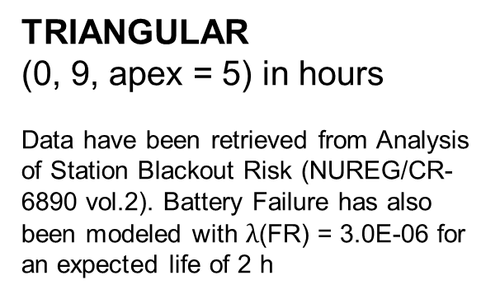
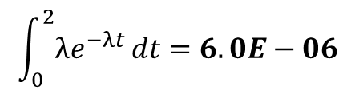
Event Probability Density Function
Battery Remaining Life
RCIC black start
DG recovery time
TRIANGULAR
(0, 9, apex = 5) in hours
Data have been retrieved from Analysis of Station Blackout Risk (NUREG/CR-6890 vol.2). Battery Failure has also been modeled with $λ$(FR) = 3.0E-06 for an expected life of 2 h
LOGNORMAL
(m = 45, s = 30) in minutes
Modeling of human actions is often performed using lognormal distributions, we chose such a distribution where its parameters are dependent from Stress level and Task complexity, following a SPARH model of human actions.
WEIBULL
(l = 6.14, k = 0,745) in hours
Data have been retrieved from Analysis of Loss of Offsite Power Events: 1986-2004 (NUREG/CR-6890 vol.1). Such distribution represents the pdf of repair of one DGs.
$$\int_{0}^{2}{λe^{−λt }dt=6.0E−06}$$

Slide 11












Event Discrete Sampling
LOGNORMAL (mu = 0.75, sigma = 0.5) in hours
%tile | 5 | 25 | 50 | 75 | 95 | 99 | omitted
cpi | 0.05 | 0.20 | 0.25 | 0.25 | 0.20 | 0.049 | 0.001
Percentile
RCIC Black start
Percentiles
Conditional Probabilities - CPi
Omitted action
Omitted action -$P\left(T>t_{99\%}\right)=0.001$
Cumulative Distribution Funciton
$$99\% tile$$
$P\left(t_{95\%}<T≤t_{99\%}\right)=0.049$
$$95\% tile$$
$P\left(t_{75\%}<T≤t_{95\%}\right)=0.20$
$$75\%tile$$
$P\left(t_{50\%}<T≤t_{75\%}\right)=0.25$
$$50\%tile$$
$P\left(t_{25\%}<T≤t_{50\%}\right)=0.25$
$$25\% tile$$
$P\left(t_{5\%}<T≤t_{25\%}\right)=0.20$
Percentile 5% of action time
$P\left(T≤t_{5\%}\right)=0.05$

Slide 12
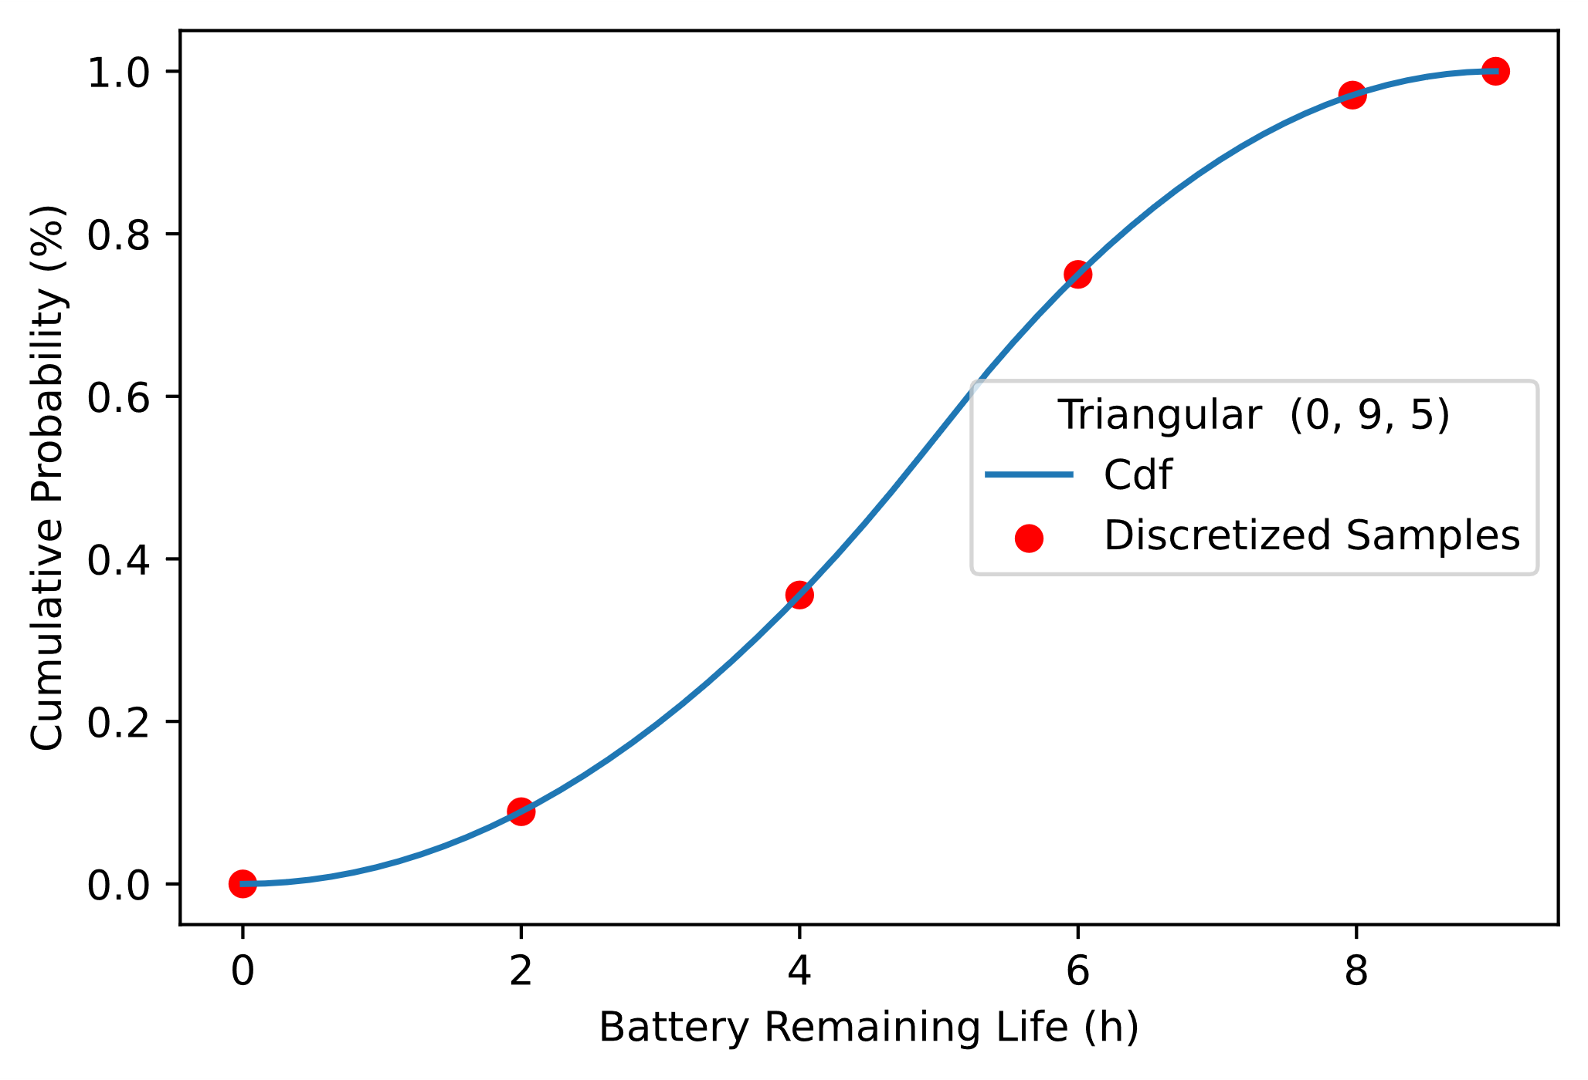
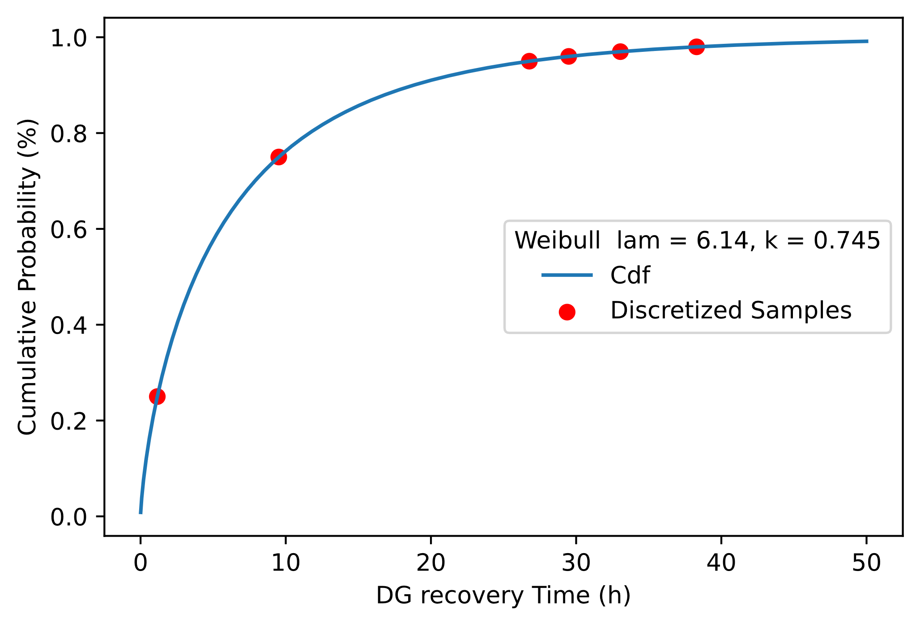
Event Discrete Sampling
Battery Remaining Life
Diesel Generator recovery time
TRIANGULAR (0 , 9 , apex = 5) in hours
%tile | 0 | 1 | 40 | 78 | 97 | 99
cpi | 3.0E-06 | 0.098 | 0.29 | 0.38 | 0.19 | 2.61E-02
WEIBULL (l = 6.14, k = 0.745) in hours
%tile | 25 | 75 | 94 | 96 | 97 | 98
cpi | 0.25 | 0.5 | 0.19 | 0.01 | 9.92E-03 | 1.01E-02

Slide 13
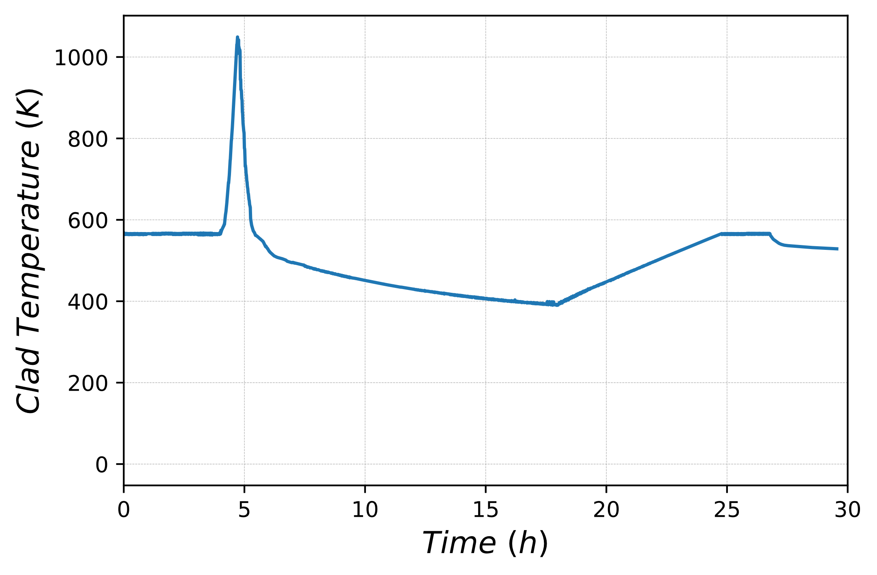
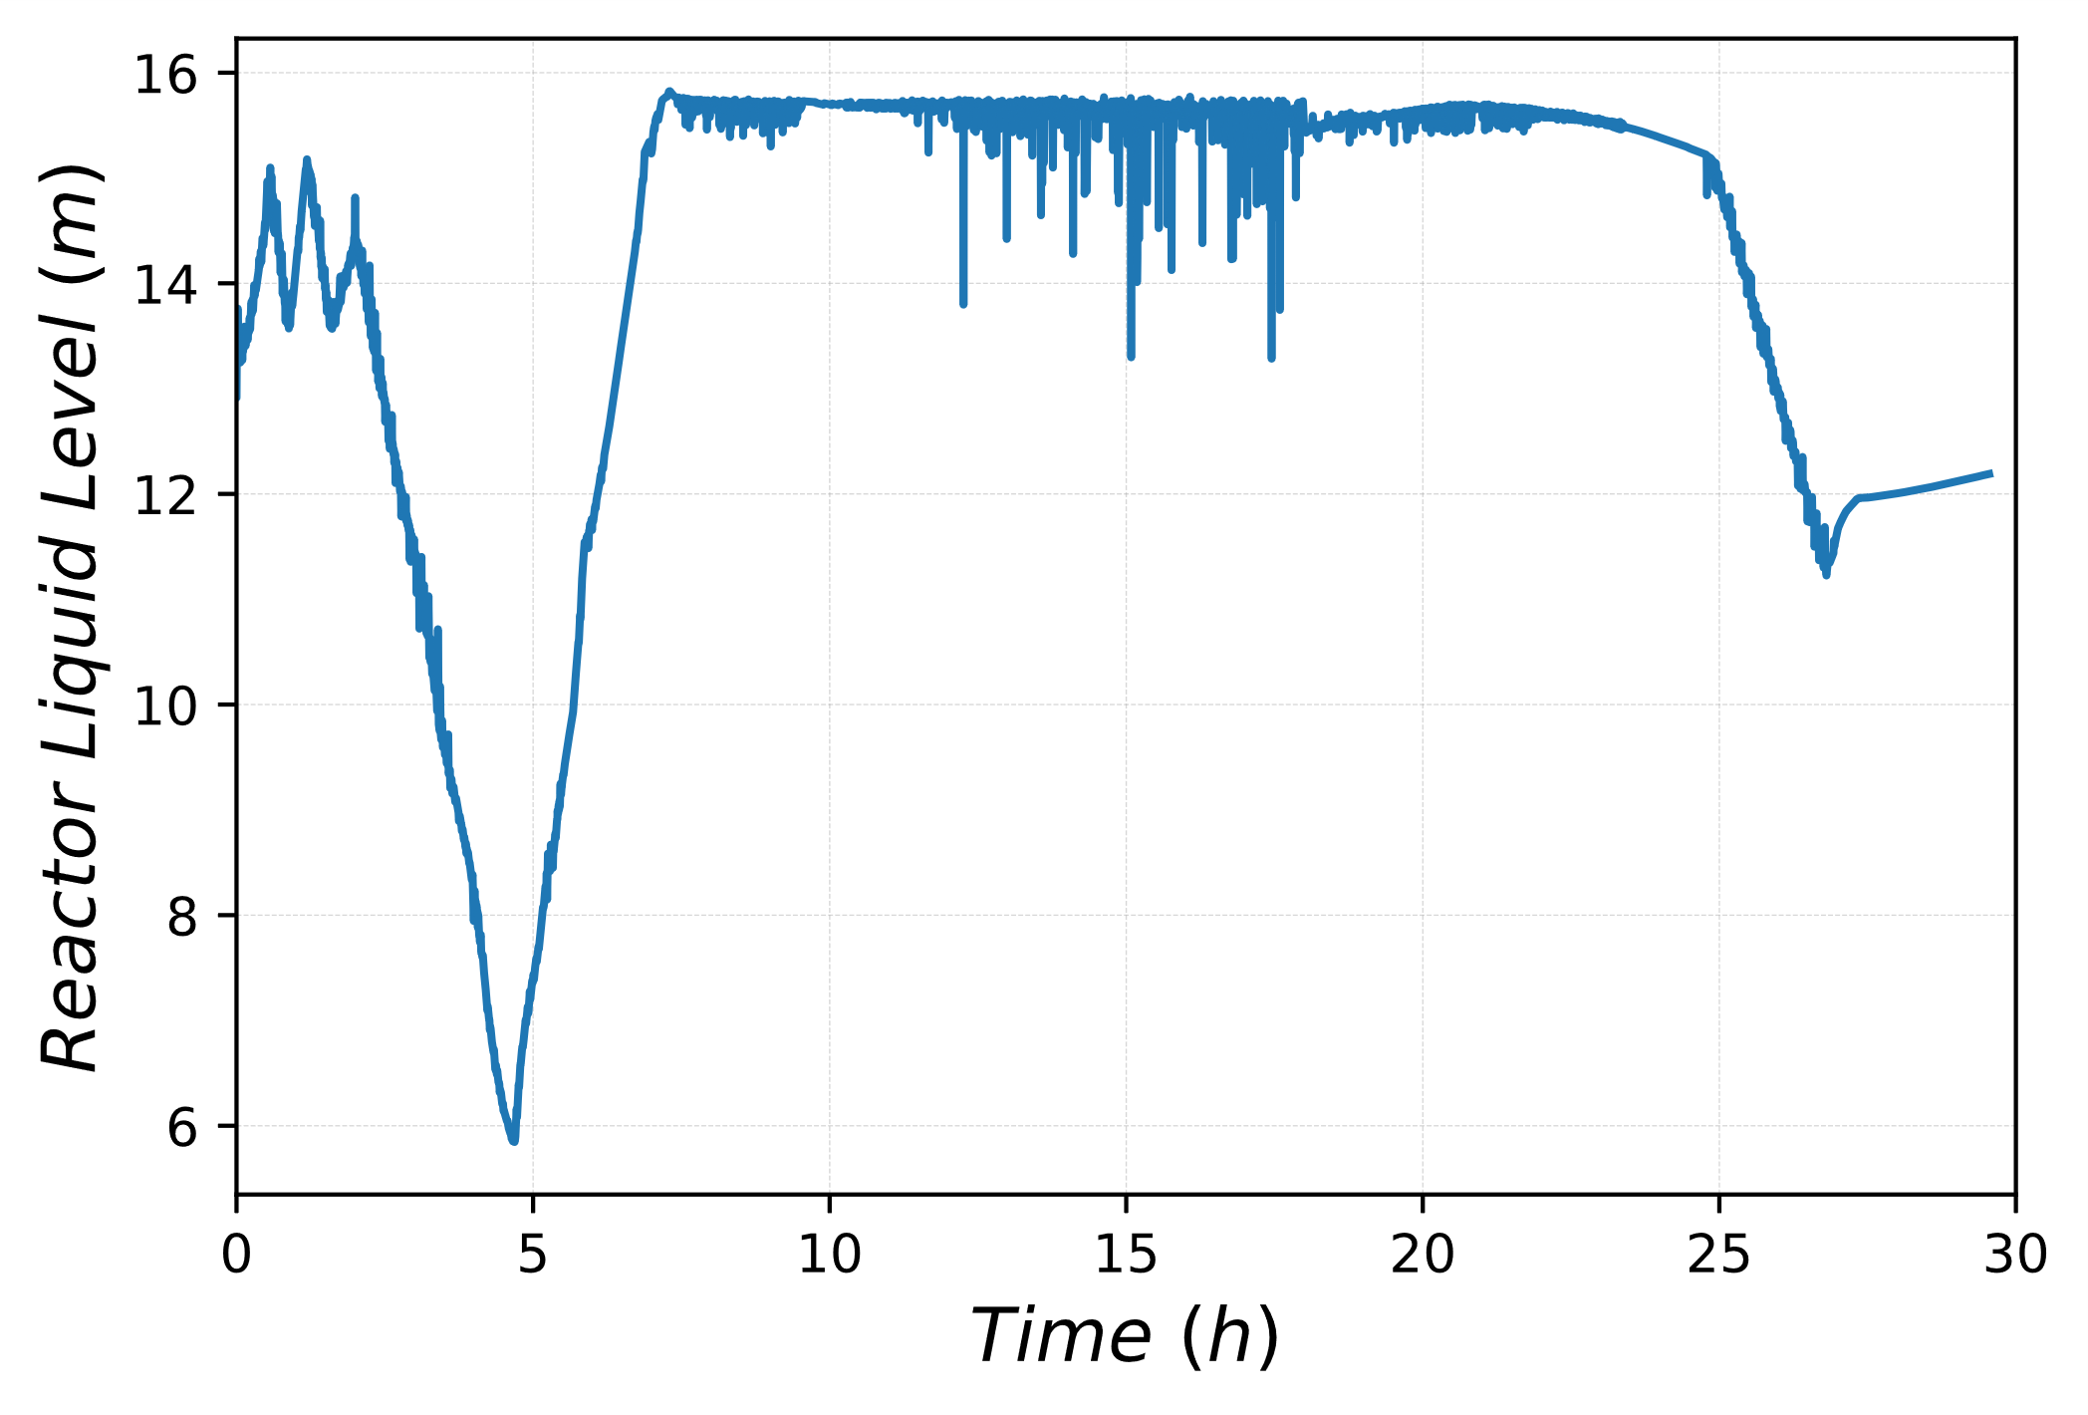
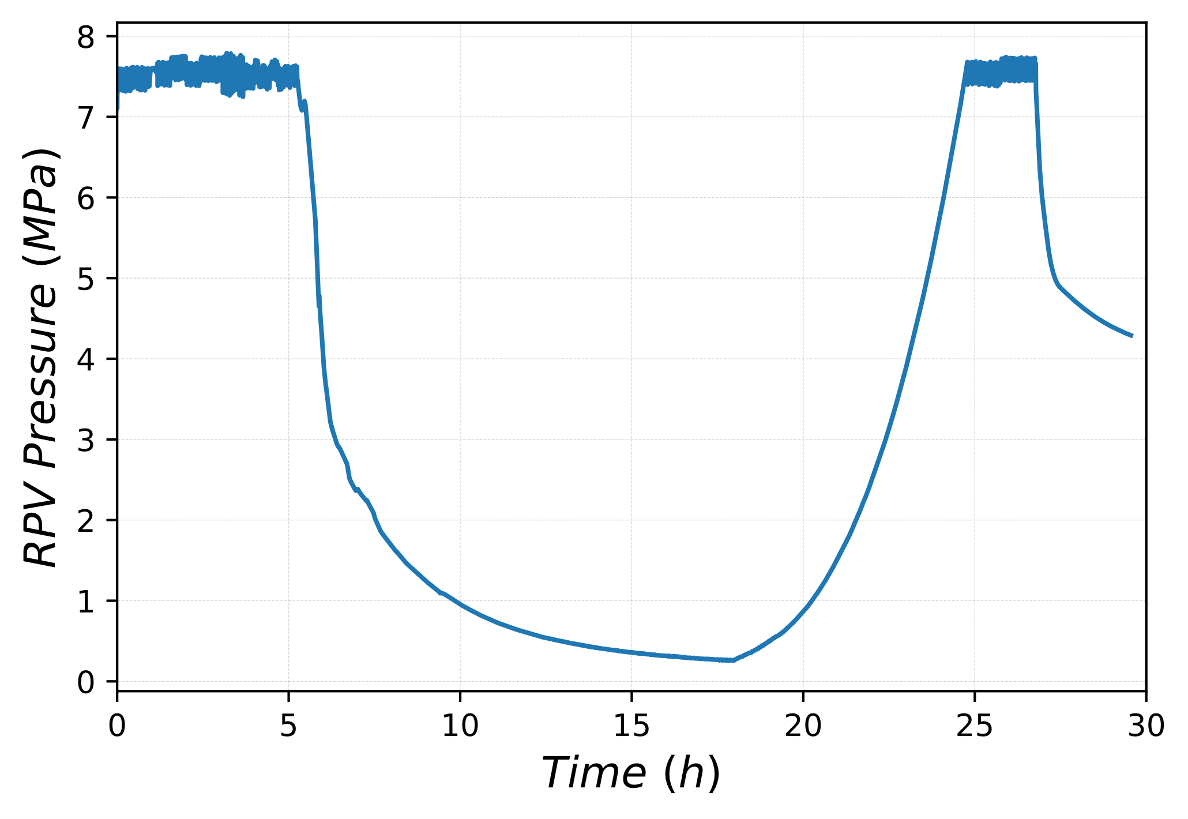

Simulation Result - reference case
RCIC black start
RCIC on
Branch ID | Battery Life (h) | RCIC black start action time (h) | DG Recovery Time (h)
DET_1-1-1-2-1-1-1-2-1-2 | 2 | 2.687 | 26.77
HPCI on
CST empty
DC current available
Battery charge depleted
CST empty
DG recovery
RCIC black start
c
RCIC on
RCIC on
HPCI on
HPCI on
RCIC black start
CST empty

Slide 14
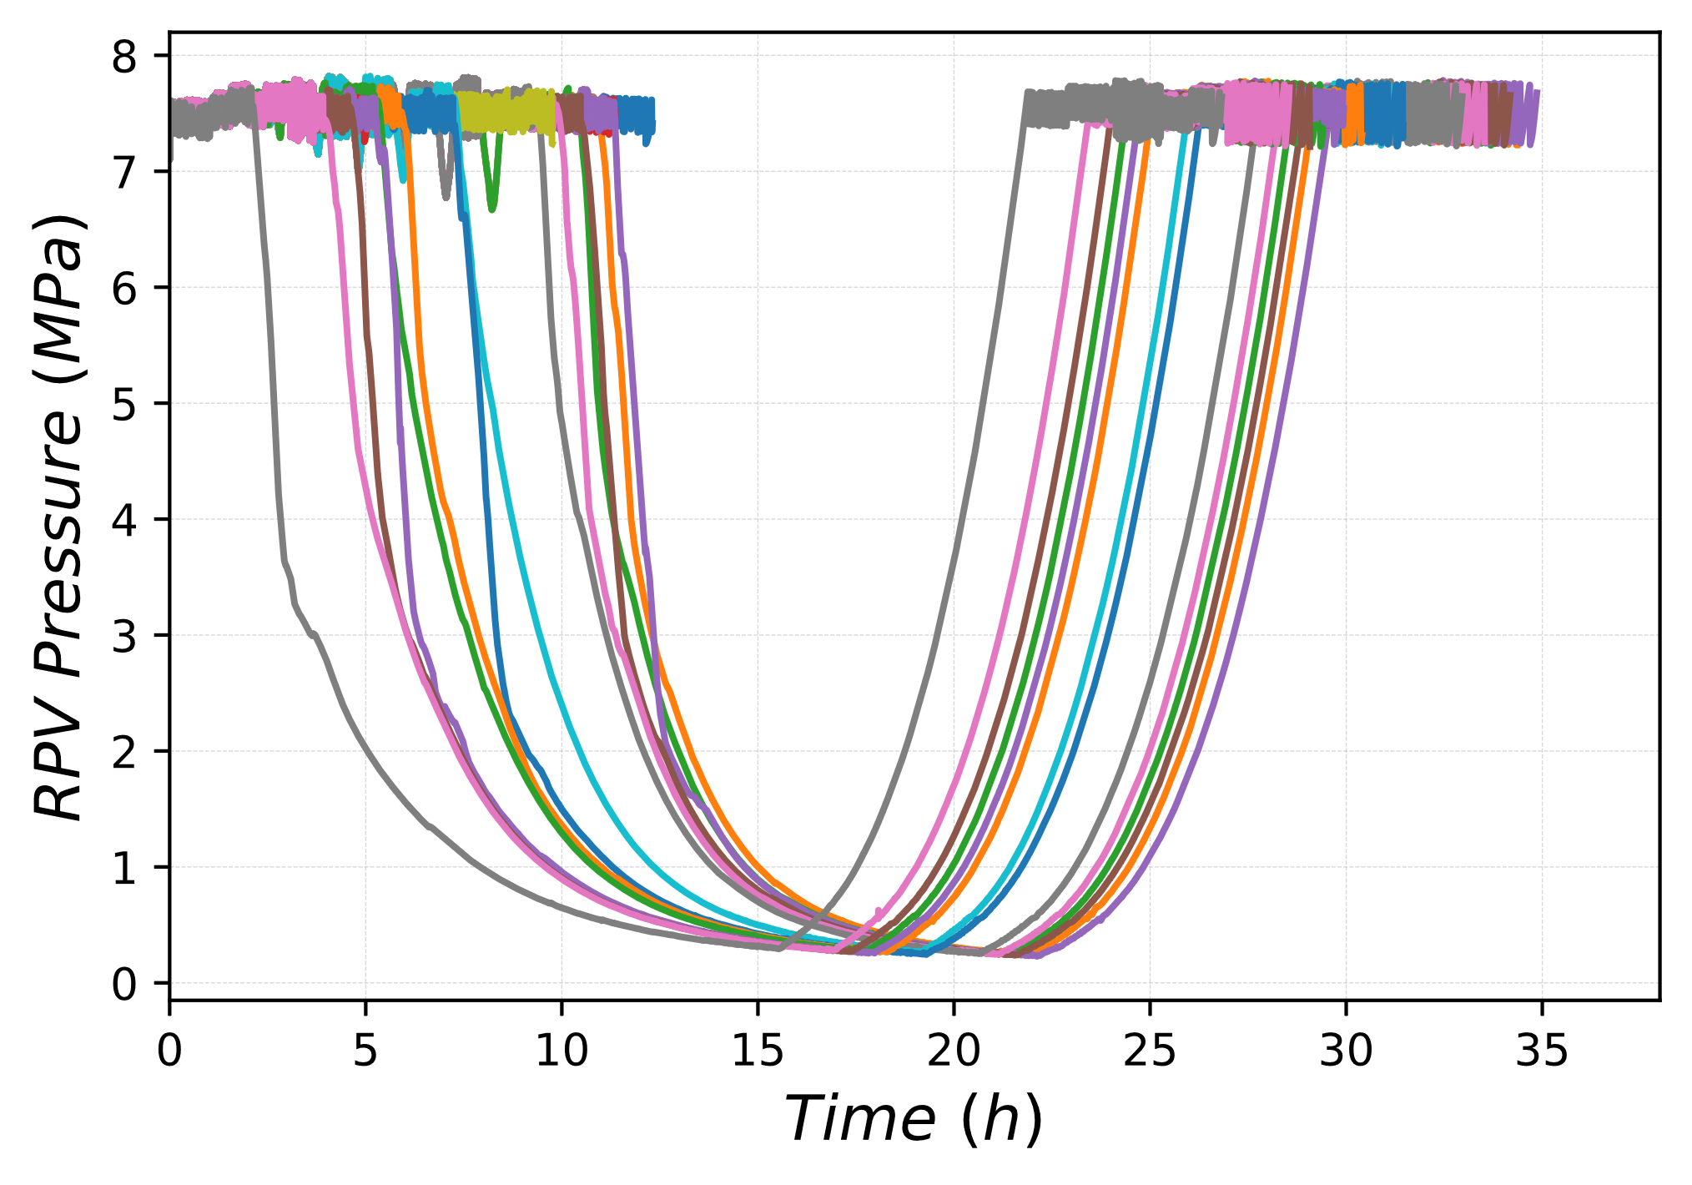
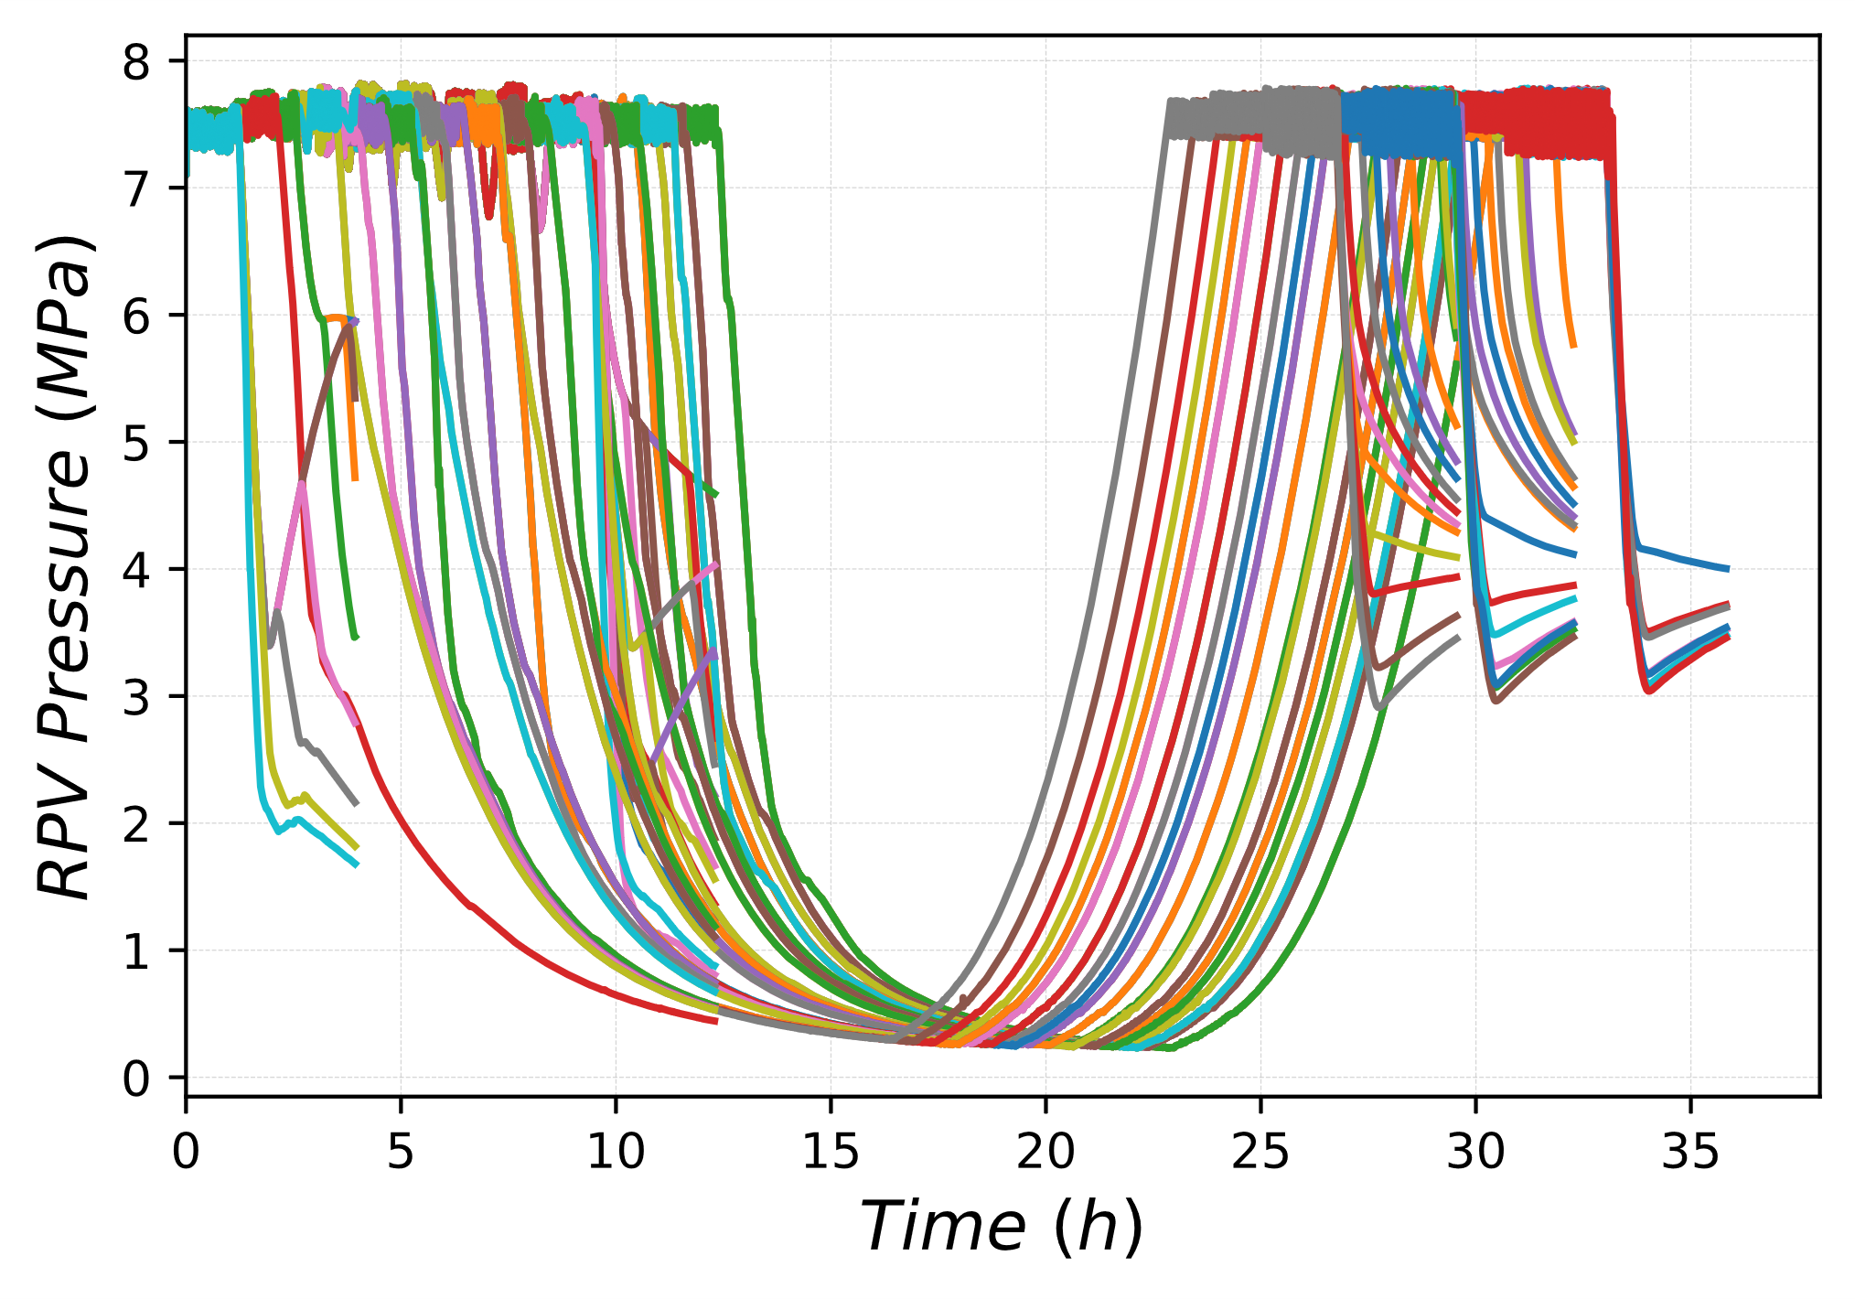
Dynamic Event Tree simulation results
Binary Classification between CD sequence and successfull recovery of the system
Main Results
Core Damage Scenarios
Successful Recovery
RPV pressure transient
RPV pressure transient

Slide 15
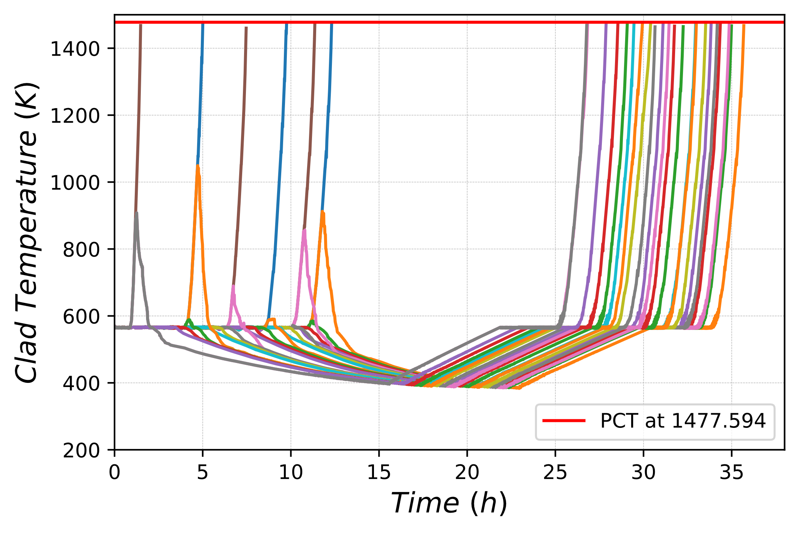
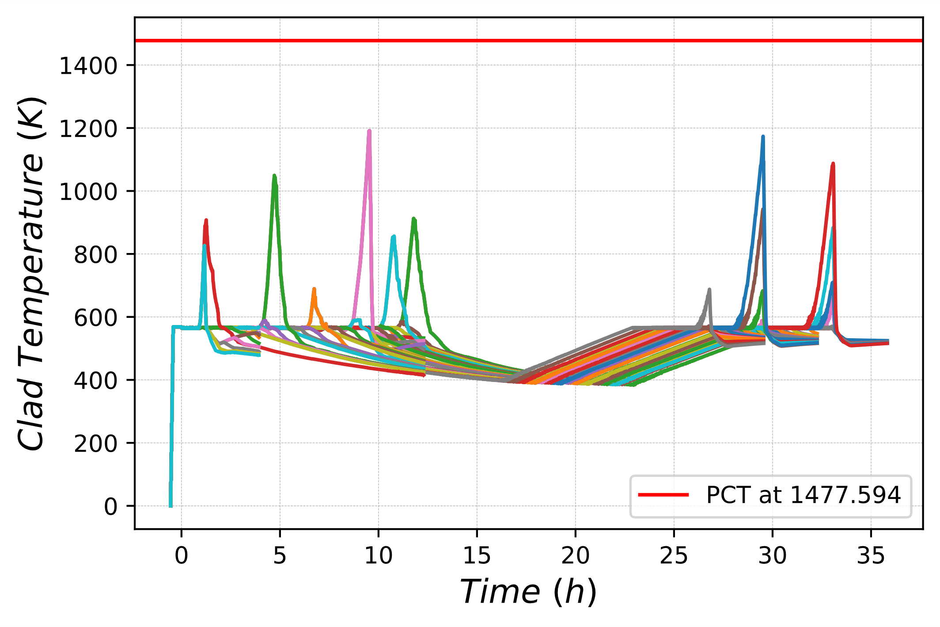
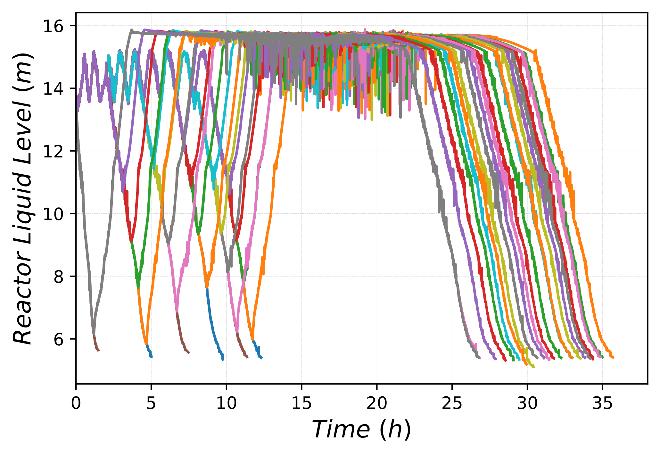
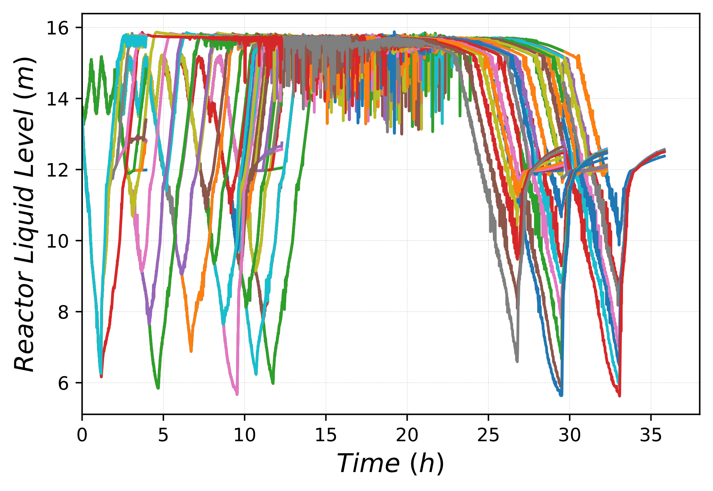

Dynamic Event Tree simulation results
Core Damage Scenarios
Successfull Recovery
Clad Temperature Transient
Reactor Liquid Level

Slide 16
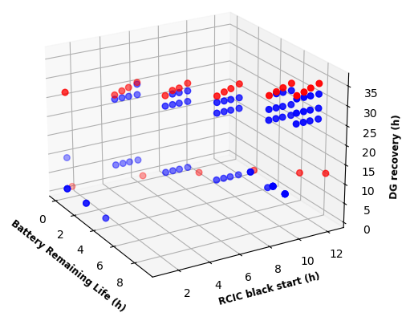
Dynamic Event Tree simulation results
Core Damage Branch ID | Core Damage Frequency i | cpi
 |  | Battery | RCIC | DG
DET_1-1-1-1-1-1-1-2-1-1-1-1-1 | 1.17E-03 | 0.0293 | 0.20 | 0.20
DET_1-1-1-1-1-1-1-2-1-1-1-1-2-1-1-1 | 2.21E-04 | 0.0293 | 0.25 | 0.0301
DET_1-1-1-1-1-1-1-2-1-1-1-2-1-1-1 | 2.21E-04 | 0.0293 | 0.2505 | 0.0301
DET_1-1-1-1-1-1-1-2-1-1-2-1-1-1 | 1.76E-04 | 0.0293 | 0.1997 | 0.0301
DET_1-1-1-1-1-1-1-2-1-2-1-1-1 | 4.40E-05 | 0.0293 | 0.0499 | 0.0301
DET_1-1-1-1-1-1-2-1-1-1-1-1 | 8.83E-03 | 0.2207 | 0.20 | 0.2000
DET_1-1-1-1-1-1-2-1-1-1-1-2-1-1-1 | 1.66E-03 | 0.2207 | 0.25 | 0.0301
DET_1-1-1-1-1-1-2-1-1-1-2-1-1-1 | 1.66E-03 | 0.2207 | 0.2505 | 0.0301
DET_1-1-1-1-1-1-2-1-1-2-1-1-1 | 1.33E-03 | 0.2207 | 0.1997 | 0.0301
DET_1-1-1-1-1-1-2-2-1-1-1 | 1.09E-04 | 0.2207 | 0.0499 | 0.0099
DET_1-1-1-1-1-2-1-1-1-1-1 | 1.58E-02 | 0.3944 | 0.20 | 0.20
DET_1-1-1-1-1-2-1-1-1-2-1-1-1 | 9.78E-04 | 0.3944 | 0.25 | 0.0099
DET_1-1-1-1-1-2-1-1-2-1-1-1 | 9.80E-04 | 0.3944 | 0.2505 | 0.0099
DET_1-1-1-1-1-2-1-2-1-1-1 | 7.81E-04 | 0.3944 | 0.1997 | 0.0099
DET_1-1-1-1-1-2-2-1-1-1 | 1.95E-04 | 0.3944 | 0.0499 | 0.0099
DET_1-1-1-1-2-1-1-1-1 | 2.67E-02 | 0.2667 | 0.20 | 0.50
DET_1-1-1-1-2-1-1-1-2-1-1-1 | 6.61E-04 | 0.2667 | 0.25 | 0.0099
DET_1-1-1-1-2-1-1-2-1-1-1 | 6.63E-04 | 0.2667 | 0.2505 | 0.0099
DET_1-1-1-1-2-1-2-1-1-1 | 5.28E-04 | 0.2667 | 0.1997 | 0.0099
DET_1-1-1-1-2-2-1-1 | 1.33E-04 | 0.2667 | 0.0499 | 0.01
DET_1-1-1-2-1-1-1-1 | 8.89E-03 | 0.0889 | 0.20 | 0.50
DET_1-1-1-2-1-1-1-2-1-1-1 | 2.20E-04 | 0.0889 | 0.25 | 0.0099
DET_1-1-1-2-1-1-2-1-1 | 2.23E-04 | 0.0889 | 0.2505 | 0.01
DET_1-1-1-2-1-2-1-1 | 1.78E-04 | 0.0889 | 0.1997 | 0.01
DET_1-1-1-2-2-1-1 | 4.44E-05 | 0.0889 | 0.0499 | 0.01
DET_1-2-1-1 | 2.99E-07 | 3.0E-06 | 0.1997 | 0.50
DET_1-2-1-2-1-1 | 1.50E-09 | 3.0E-06 | 0.0499 | 0.01
DET_1-2-1-2-1-2 | 2.99E-08 | 3.0E-06 | 0.0499 | 0.20
Core Damage Scenario
Successful Recovery
Core Damage Frequency =0.0723

Slide 17
Discrete Dynamic Event Tree - Drawbacks
DET simulation require high computational cost and MELCOR simulations are prone to numerical crashes (unpredictable)
Core Damage Frequency estimation is conservative. Real Conditional Probability lies in the interval between two successive percentiles chosen.
Omission – CP_{i} = 0.001
5
Cp_{i,real} < 0.05
99%tile - CP_{i} = 0.049
4
New approach to solve conservative assumption and avoid high number of MELCOR simulations
Failure
95%tile – CP_{i} = 0.45
3
Cp_{i, computed} = 0.05
50%tile – CP_{i} = 0.45
2
5%tile – CP_{i} = 0.05
1
Notes:
This discretization approachis based on the conservative assumption that the sequence out-come associated with upperbound of the interval is applicable for the whole interval it represents. This assumption in particular influences the quantitative estimate through the first failure branch in DET simulations or in other words the precise success interval.

Slide 18
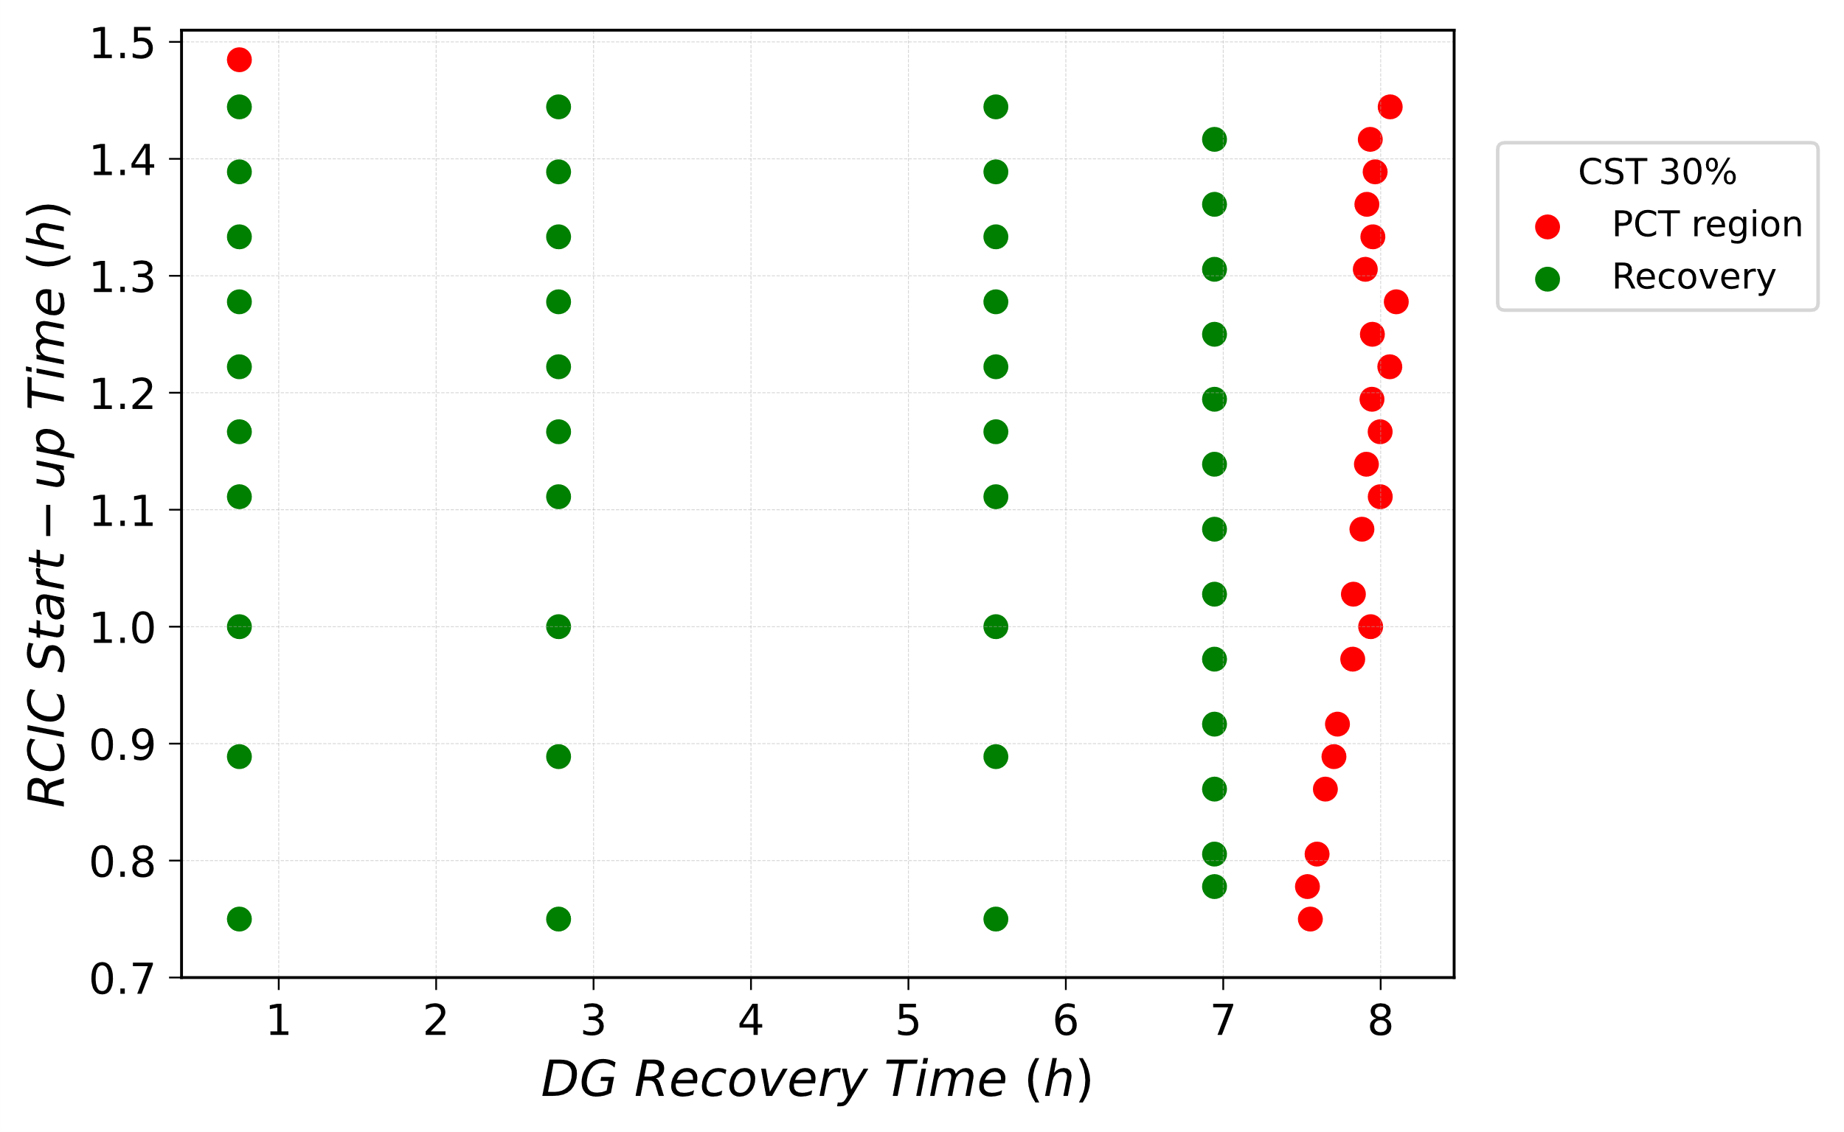
Binary Classification Model - workflow
Sampling of discrete event timings
Possible approaches:
Low probability, high consequence
Adaptive methods
Limit surface search
Step 1
Simulations based on Dynamic Event Tree
Step 2
RAVEN acts as the driver code for DET applications whereas MELCOR is a severe accident code that can simulate the thermal–hydraulic response of a NPP
Post-processing and data classification
Preparation of a dataset based on simulation result.
For each branch are the following parameters are defined
Features: Event timing
classess: CD and Successfull recovery
Step 3

Slide 19
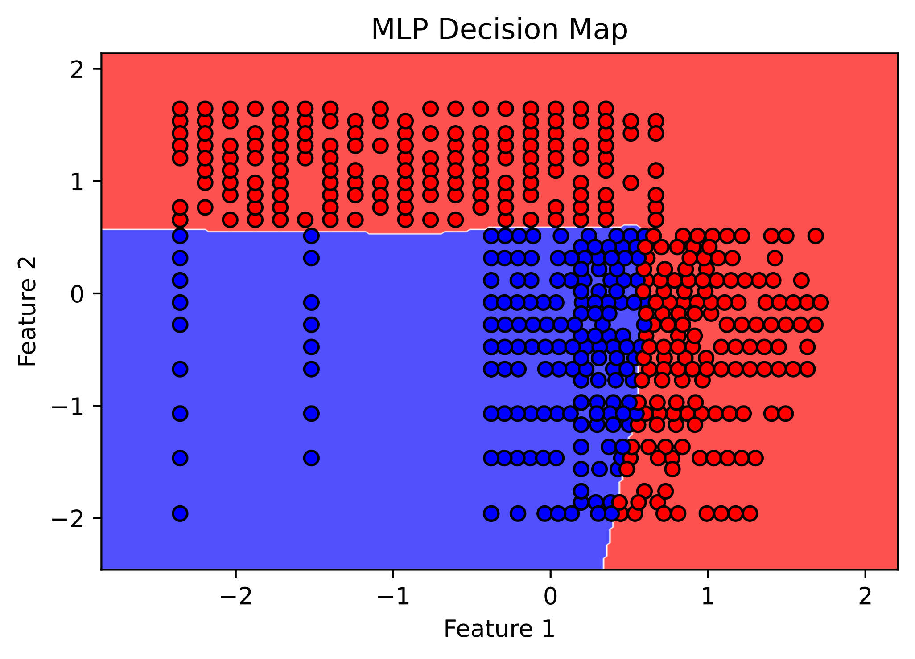
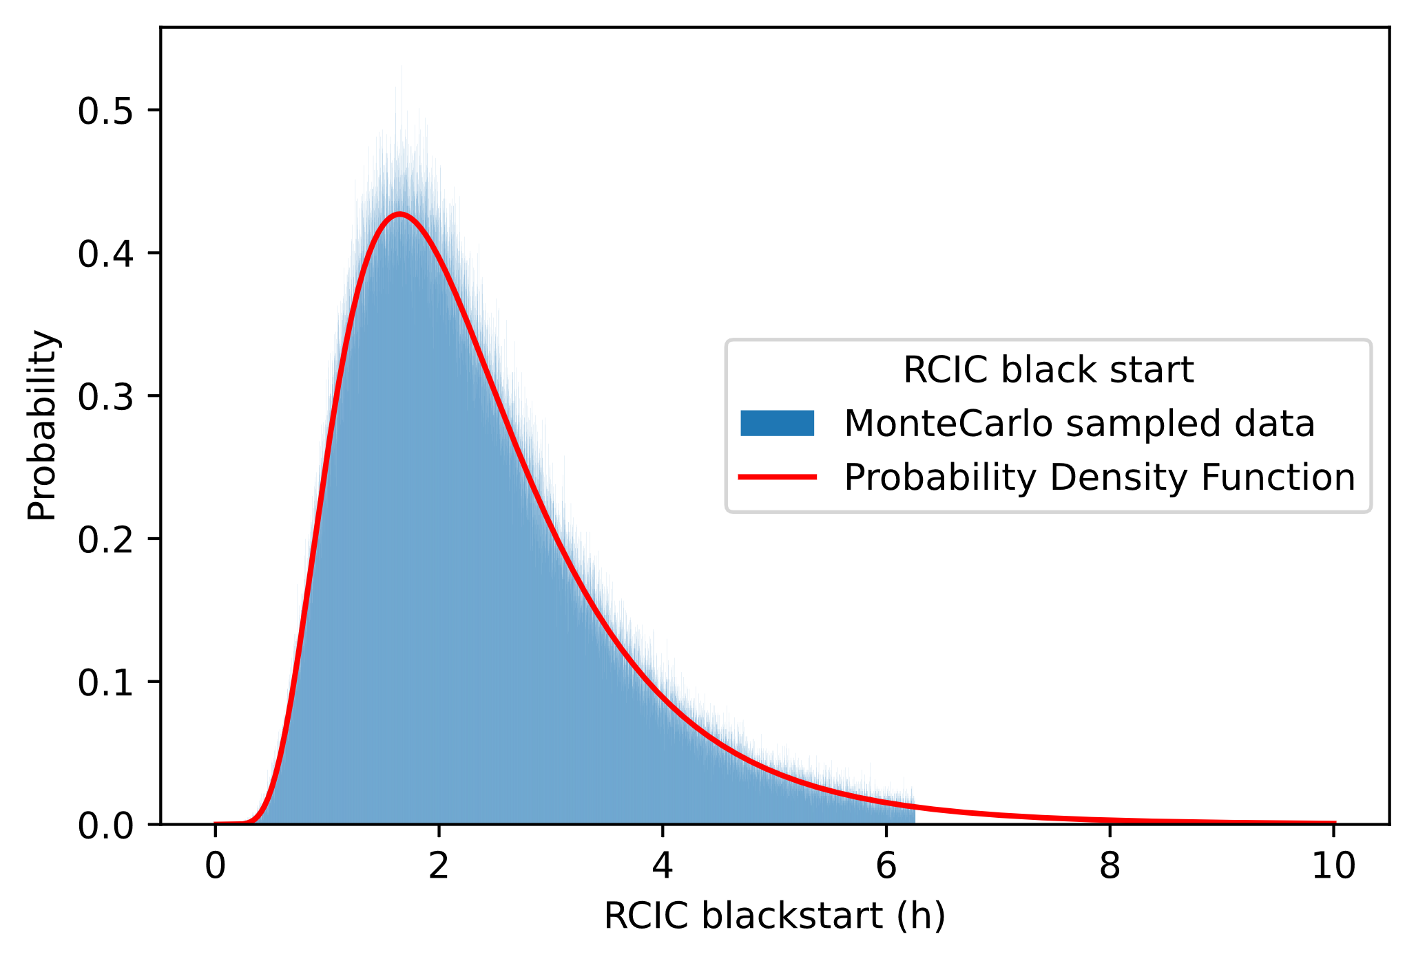

Binary Classification Model - workflow
Step 4
Train Binary classification model
Python provides ML libraries «easy» to implement
Sample event timings from pdf
Step 5
Sample input data from probability density function, for each event of the accident sequence
Classify event with Binary classification model
Step 6
Core Damage sequence or successful recovery is predicted using the binary classification model
$$CDF=\frac{N_{CD}}{N_{samples}}$$

Slide 20
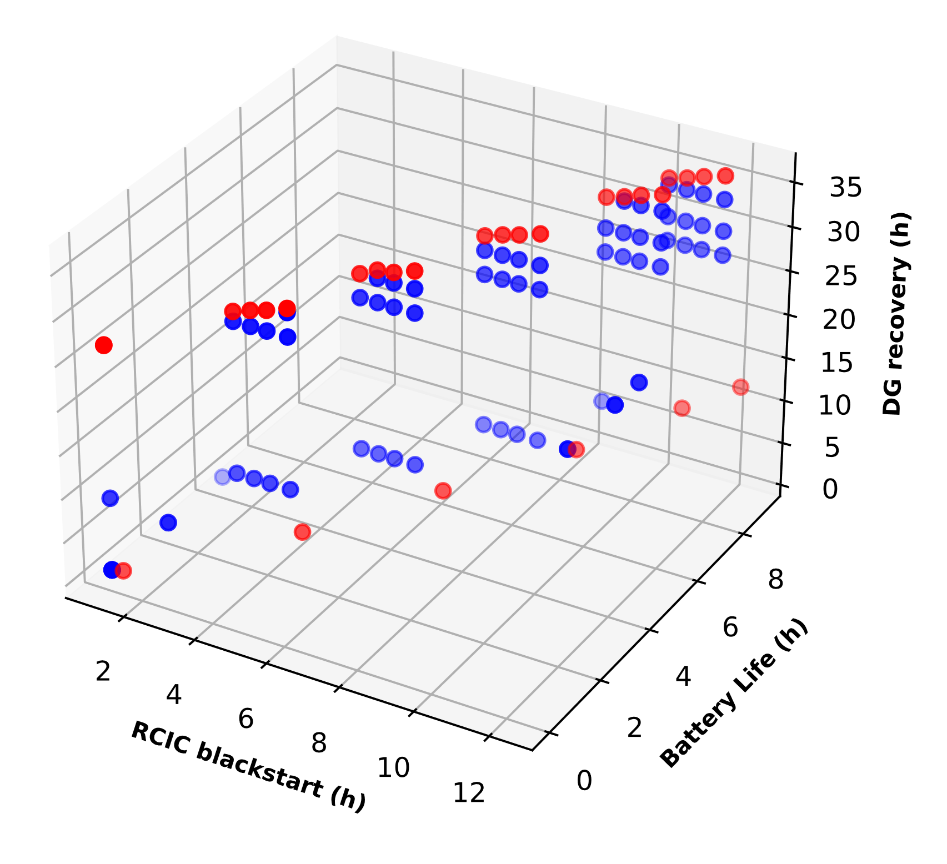
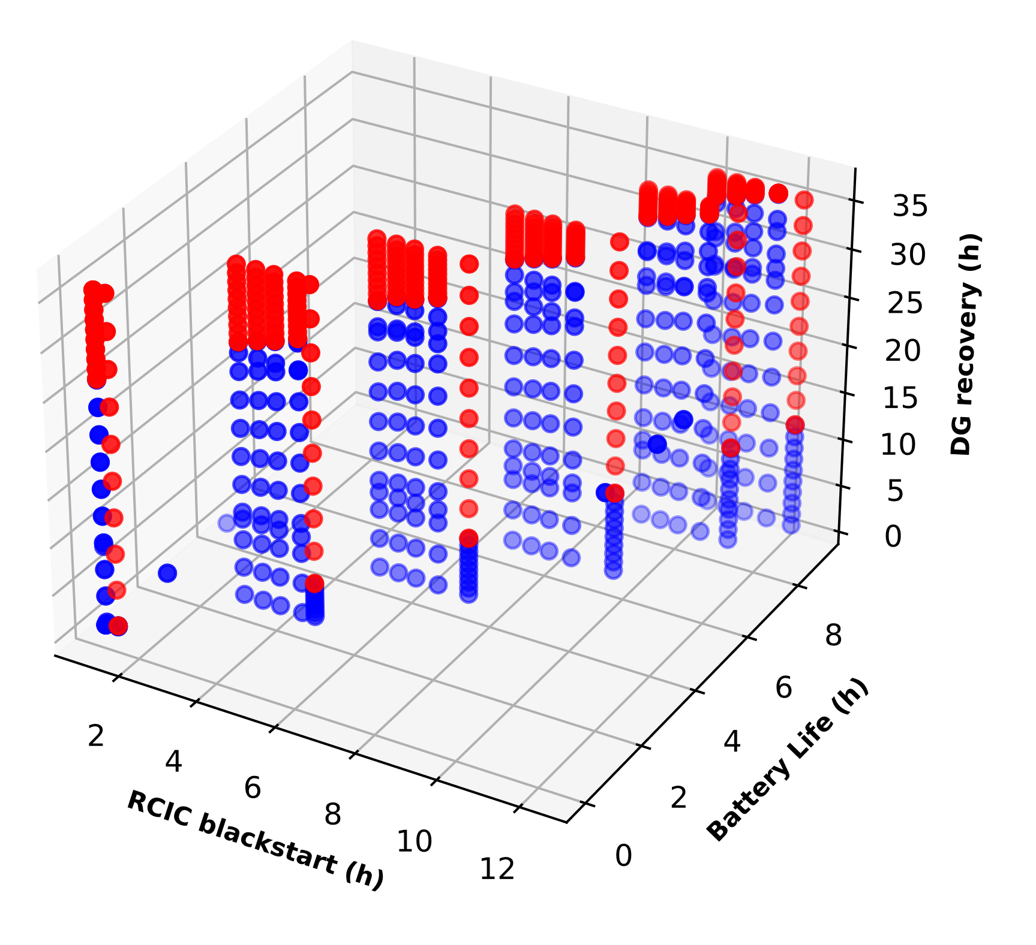
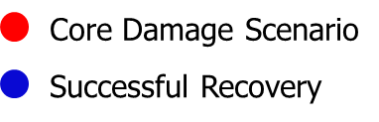
Preliminary Results for a Binary Classification Model
Step 1-2: (Sampling and DET exploration)
Same data and procedure has been used from the Discrete Dynamic Event Tree
Step 3: (Post Processing and data classification)
Increase Data Set based on simulation history
Limit Surface data from DDET
Increased Data Set based on Limit Surface

Slide 21
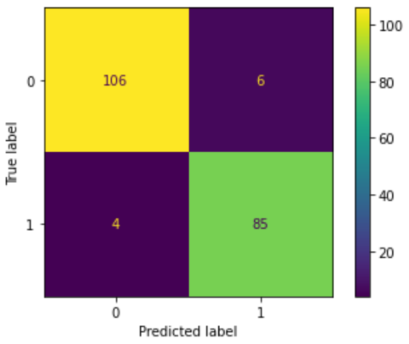
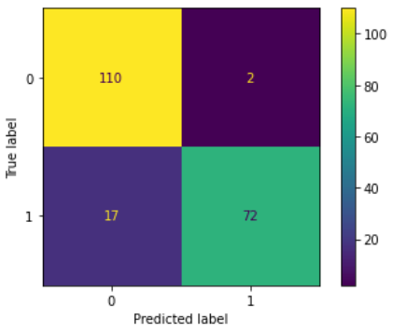
Preliminary Results for a Binary Classification Model
Step 4: (Neural Network predictor)
Same data and procedure has been used from the Discrete Dynamic Event Tree
Option 1
Option 2
Scikit Multi-layer Perceptron
Keras Sequential model
Features: 3 (Battery, RCIC, DG)
Output: Class 1 for Core Damage
  Class 0 for successful Recovery
Layers: 3
Nodes: (8, 16, 8) Activation: Relu
Adam Optimizer
Features: 3 (Battery, RCIC, DG)
Output: Class 1 for Core Damage
  Class 0 for successful Recovery
Layers: 3
Nodes: (5, 10, 5) Activation: Relu
Adam Optimizer
Iteration 14370,
Loss: 0.033,
Accuracy: 0.950
Iteration 9325
Loss: 0.157
Accuracy: 0.930

Slide 22
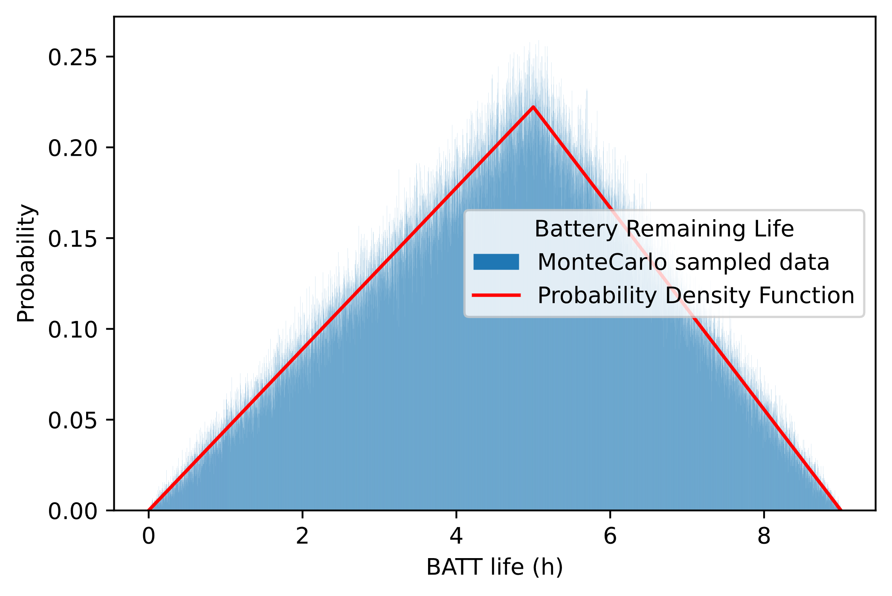
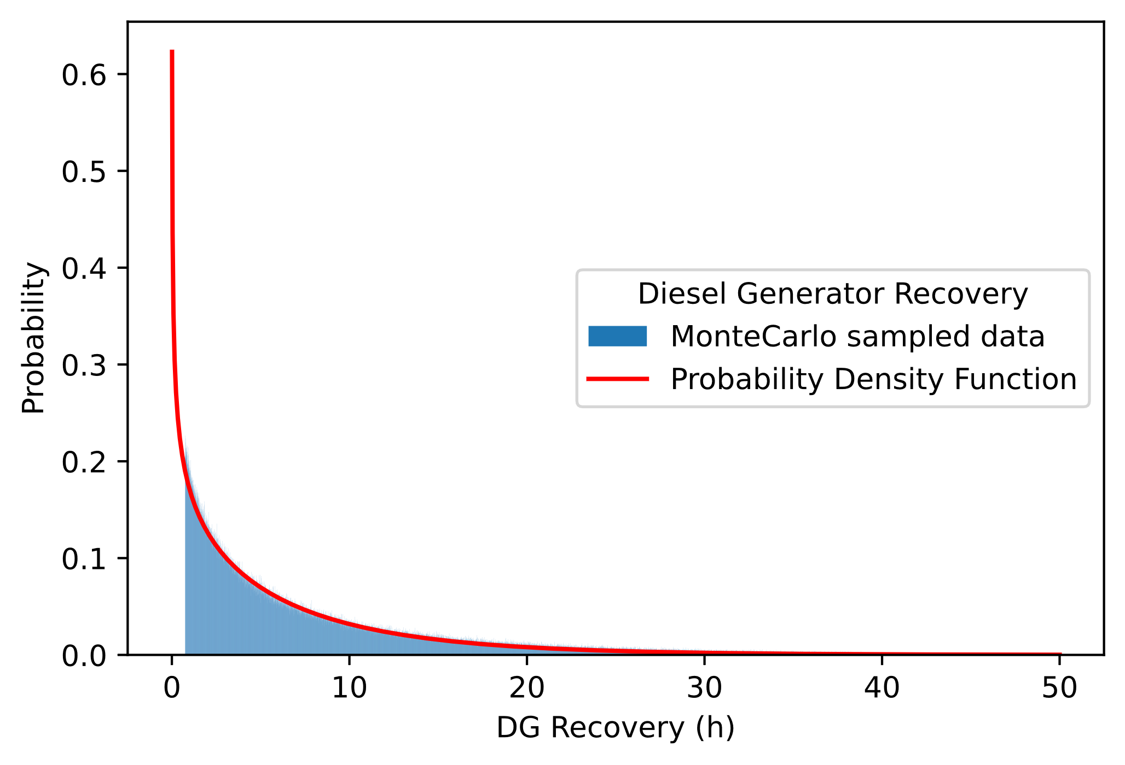
Preliminary Results for a Binary Classification Model
Step 5: (sample data)
Sample Input data from probability density function.
For each of the event in the accident sequence a timing is sampled. Data sampled reproduce the probability density function
In total 1,000,000 data are sampled.
Input for classifier is structured as an array of (1000000 , 3)

Slide 23
Preliminary Results for a Binary Classification Model
Step 6: (Classification & Frequency estimation)
Estimate class of data sampled through Classifier and estimate Core Damage Frequency
Array obtained from step 5, containing the event timing is predicted by the classifier.
Output of the classifier is:
  1 for Core Damage Sequence
  0 for Successful Recovery
Elements of the output vector are summed to obtain the number of core damage sequence
Machine Learning estimation
Classical estimation
MLPClassifier
Sequential Classifier
Discrete Dynamic Event Tree)
Core Damage Frequency = 0.036
Core Damage Frequency = 0.035±0.01
Core Damage Frequency =0.0723

Slide 24
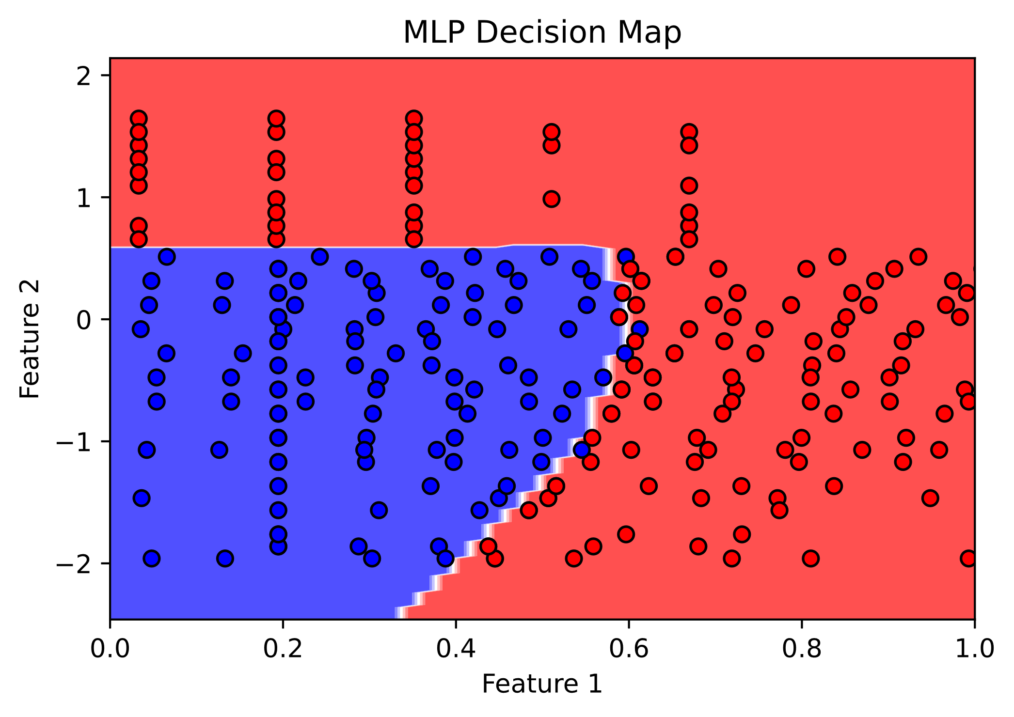
Next Steps...
Boundary Region predicted by Classifier needs to be assessed
Optimize and find the best classifier for the Limit Surface search
Error propagation of estimator accuracy needs to be assessed
Increase the number of features to evaluate all possible events during a Station Blackout scenario:
  SRV stuck-open
  Firewater Injection
  AC recovery
  ...

Slide 25

Thank you for your attention
Tommaso Glingler
tommaso.glingler@uniroma1.it

Slide 26
References
[1] Glingler, T., Alfonsi, A., Mandelli, D., Giannetti, F., Caruso, G., D'Onorio, M. Dynamic Event Tree Analysis of a Severe Accident Sequence in a Boiling Water Reactor Experiencing a Cyberattack Scenario, Annals of Nuclear Energy Vol. 192, November 2023, https://doi.org/10.1016/j.anucene.2023.109994
[2] D'Onorio, M., Glingler, T., Giannetti, F., Caruso, G. Dynamic Event Tree Analysis as a Tool for Risk Assessment in Nuclear Fusion Plants Using RAVEN and MELCOR, IEEE Transactions on Plasma Science, 2022, 50(11), https://doi.org/10.1109/TPS.2022.3165170.
[3] M. D’Onorio, et al., Preliminary uncertainty quantification of the core degradation models in predicting the Fukushima Daiichi unit 3 severe accident, Nuclear Engineering and Design, Vol. 382, October 2021, https://doi.org/10.1016/j.nucengdes.2021.111383
[4] M. D’Onorio, et al., Severe accident sensitivity and uncertainty estimation using MELCOR and RAVEN, Journal of Physics: Conference Series, Volume 2177, 38th UIT Heat Transfer International Conference (UIT 2021) 21-23 June 2021, Cassino, Italy, DOI: 10.1088/1742-6596/2177/1/012021
[5] D. Mandelli, et al., Risk-Informed Safety Margin Characterization Methods Development Work, INL public library, 2014
[6] S. Eide et al, Reevaluation of station blackout risk at nuclear power plants, U. S. Nuclear Regulatory Commission, NUREG/CR-6890 Vol. 1,
[7] Glingler, T., et al., Nuclear Safety Enhanced: A Deep Dive into Current and Future RAVEN Applications, Nuclear Engineering Desing, 2024 (in review)

Slide 27
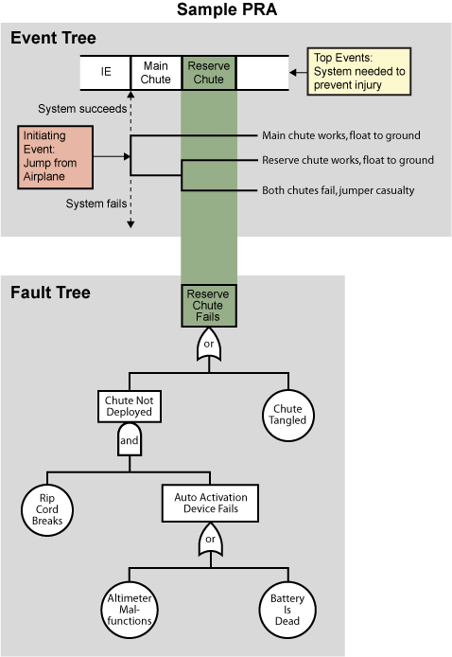
Event Tree / Fault Tree methodology
Characteristics:
Ordering of events:
Outcome isn’t affected by variations in the ordering of events
Event Timing:
Scenario outcomes are not affected by event timing
Process variables:
State of the system is incorporated in the top event modeling
Boundary Conditions:
Basic event are represented by constant failure rates
Modeling Dependencies:
Common Cause Initiators:
  Earthquake as IE has an impact of downstream top event modelling
Functional Coupling:
  success or failure is deterministically guaranteed or irrelevant
Shared Equipment:
  defined through a correct representation of Minimal Cut Sets
Notes:
A number of structural characteristics of this static, logic-based approach for modeling accident scenarios are of interest.
First, if variations in the ordering of the success and failure events are possible, these variations do not affect the final outcome of a scenario or its likelihood.
Second, variations in event timing do not affect scenario outcomes or frequencies, as long as these variations are not large enough to change 'failures’ to 'successes', or vice versa.
Third, the effect of process variables and operator behavior on scenario development are incorporated through the success criteria defined for the event tree/fault tree top events.
Fourth, the boundary conditions for the analysis are provided in terms of top event successes and failures; variations in parameters not explicitly modeled are not treated.
The event tree/fault tree methodology provides information needed to analyze three important types of dependent events.
Common Cause Initiators: Initiating event has to provide information also for common cause failure. Earthquake scenario as IE has an impact on failure assessment of top events
Functional Coupling: given a particular set of top event successes and failures, the likelihood of success or other top events need not be analyzed (success or failure is deterministically guaranteed or irrelevant).
Shared Equipment: when multiple top events share a set of components (or basic events).

Slide 28
Event Tree / Fault Tree - Drawbacks
Degraded State of system and its components
Control system action
Time-dependent model of system evolution
(e.g., MELCOR, RELAP, etc.)
Dynamic State of the System
Operator action and behaviour
Reliability engineering models
(e.g., RAVEN, DYLAM, ADAPT)
Notes:
Plant State variable Defined by progression of the accident

Slide 29
RAVEN TOOL
RAVEN (Risk Analysis Virtual Environment) development has begun in early 2012.
RAVEN is open-source and can be downloaded from GITHUB:
  https://github.com/idaholab/raven
The overall goal was to conceive a tool to enable Risk Informed Safety Margin Characterization (RISMC)
  Evaluating risk (uncertainty propagation)
  Understanding risk (limit surface, ranking, sensitivity, data mining)
  Mitigating risk (optimization)
Multiple operative systems are supported (Windows, Linux and Mac)
RAVEN development is performed under a strict Software Quality Assurance process:
  NQ1 – Lvl. 2
  User manuals and guides, theory manuals, tests documentation
  Multiple level of peer-review process
  Automatic verification (testing) (~650 regression tests)

Slide 30
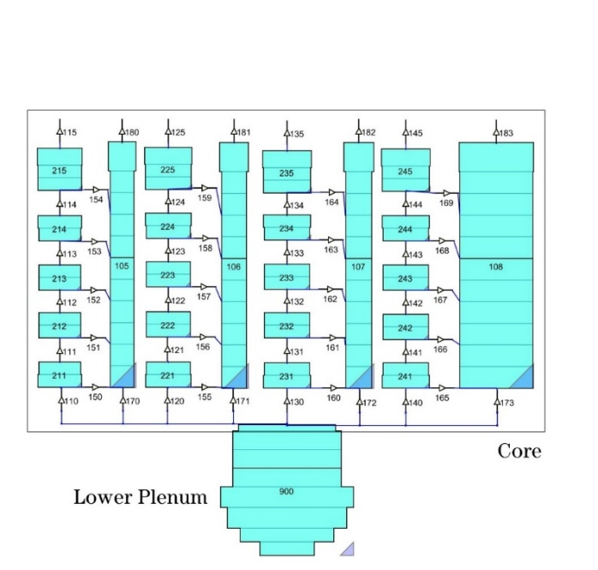
Fukushima Daiichi unit 3 MELCOR model
  BWR4-MARK I of 2381 MWt
  Lower plenum and core structures have been modelled using 19 AL and 6 RR
  The active core region has been represented by 4 concentric core rings and 10 AL (9-18th AL)
  20 CVs modelling four core channels and associated bypass volumes
  Model includes DW, WW, Reactor building, RCIC and HPCI systems
Notes:
Fukushima Daiichi Unit 3 was a BWR/4 of 2381 MWt. The operating pressure in the reactor pressure vessel was 7.03 MPa considering an average core temperature of 286 °C.
The MELCOR in-vessel model includes downcomer, recirculation loops, jet pumps, steam separators, steam dryers, steam dome and four steam lines, as well as lower plenum and core region.
COR nodalization is shown. Lower plenum and core structures have been modelled using 19 Axial Levels (AL) and 6 rings. The active core region has been represented by 4 concentric core rings with associated radial peak factors. The fuel assemblies have been divided into ten axial levels (9-18th AL).
The 40 active core cells are thermally coupled two by two for each CV, modelling the power response of the included fuel assemblies, giving an accurate and continuous representation of the local fuel degradation. 20 CVs have been used to simulate four core channels and associated bypass volumes, connected through flow paths that open when the canister fails, allowing natural circulation in the open core after channel box failure.
The Primary Containment Vessel (PCV) model includes Drywell (DW), pedestal, vent lines, and Wetwell (WW).
Reactor Core Isolation Cooling (RCIC) system, High Pressure Coolant Injection (HPCI) system

Slide 31
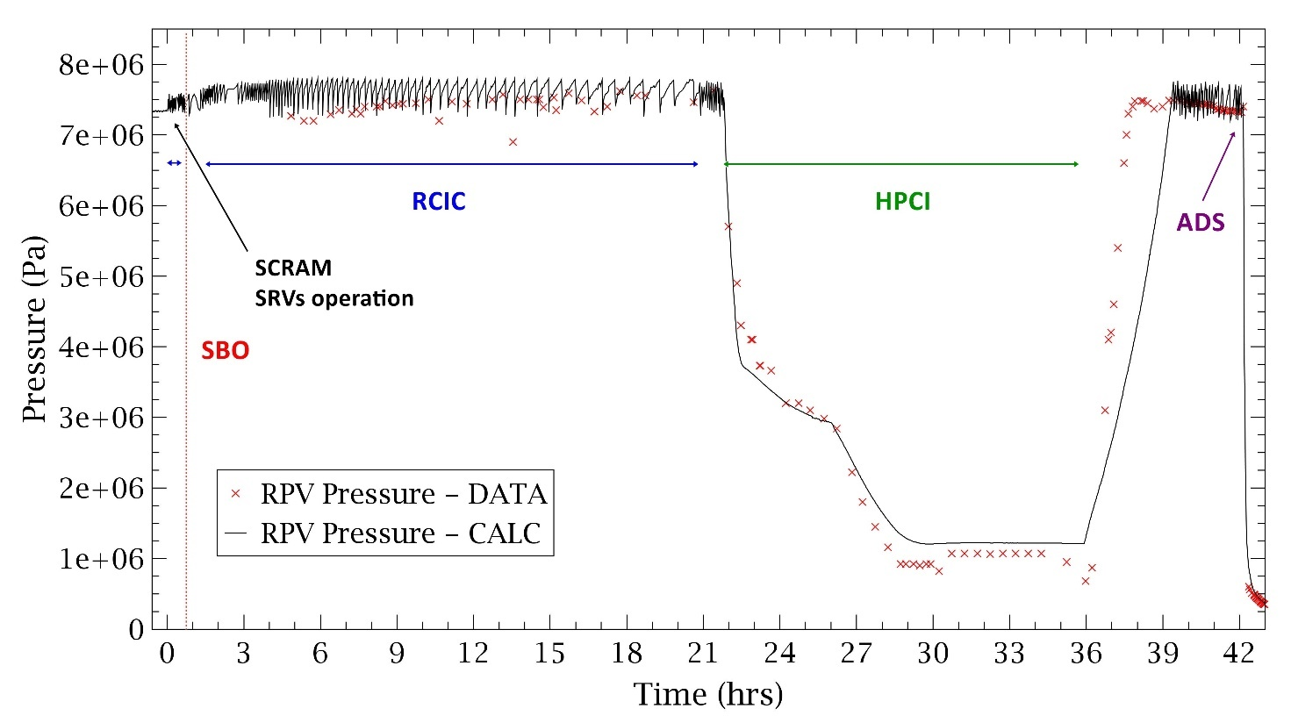
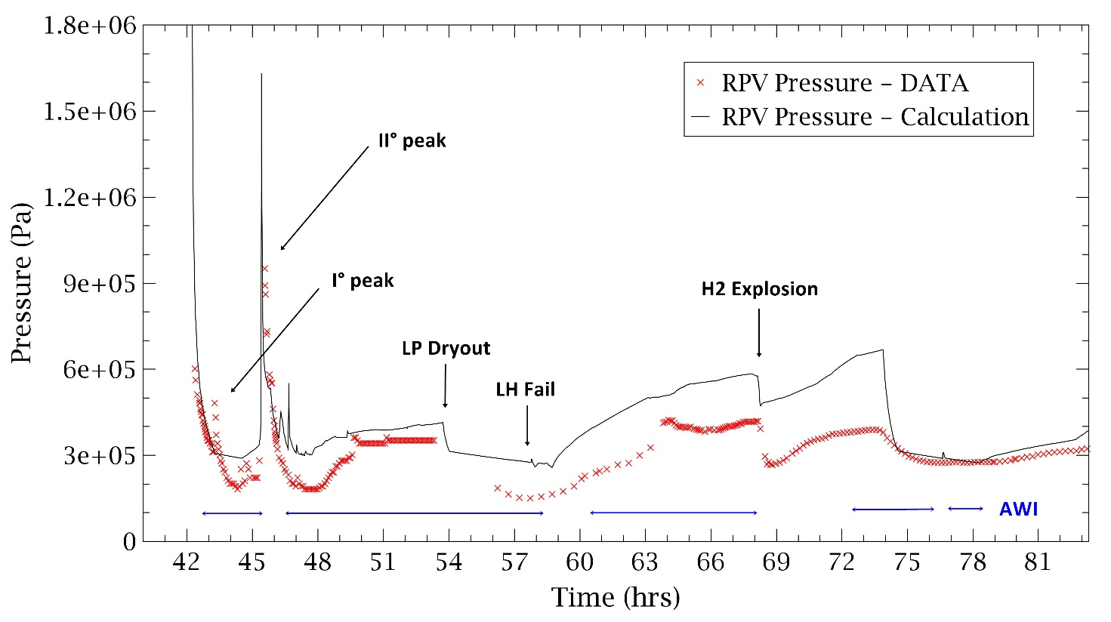
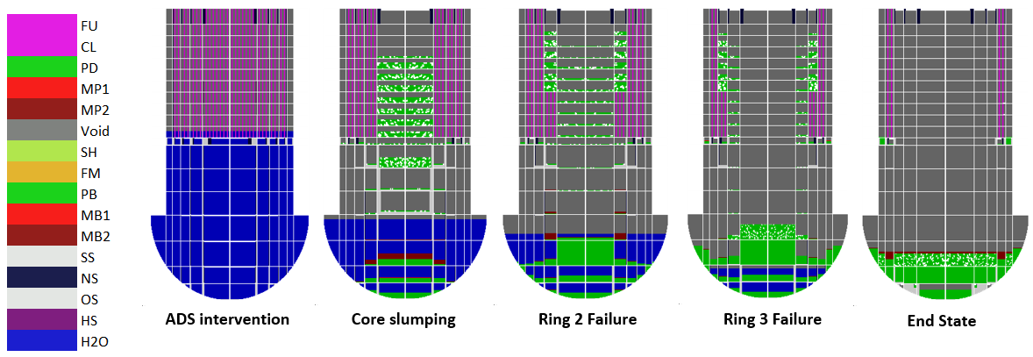
Fukushima Unit 3 accident analysis - Validation of MELCOR model
RPV Pressure during RCIC, HPCI operation
See following references:
M. D’Onorio, et al., Preliminary uncertainty quantification of the core degradation models in predicting the Fukushima Daiichi unit 3 severe accident, Nuclear Engineering and Design, Vol. 382, October 2021, https://doi.org/10.1016/j.nucengdes.2021.111383
M. D’Onorio, et al., Severe accident sensitivity and uncertainty estimation using MELCOR and RAVEN, Journal of Physics: Conference Series, Volume 2177, 38th UIT Heat Transfer International Conference (UIT 2021) 21-23 June 2021, Cassino, Italy, DOI: 10.1088/1742-6596/2177/1/012021
Notes:
Values are in good agreements with reference operational status. MELCOR calculation results have been compared with public measured data taken from (TEPCO, 2012b) and (TEPCO, 2012c).

Slide 32
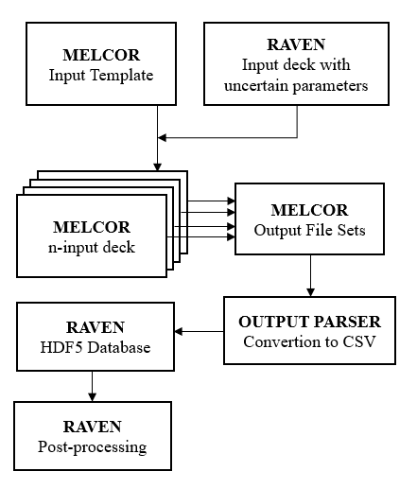


MELCOR-RAVEN COUPLING
The coupling has been realized through a Python Interface integrated into the source code
The Interface is capable to:
  Generate a run command for MELGEN and MELCOR executable
  Convert binary plot file of MELCOR 2.1 in CSV file
  Python module used: struct.
  This module performs conversions between Python values and C structs represented as Python strings. This can be used in handling binary data stored in files.
Initial Sampling of:
  Physical parameters
  Initial Conditions
  Transition Conditions, i.e., time of a transition event
Runs the system simulator using the values previously sampled and eventually applying a random noise to some parameters
Converts each .PTF file in csv. To overcome the handling of large datafiles the interface allows to create a CSV file with only variables required by the users. So is possible to obtain an HDF5 database which comprises variables from all MELCOR packages (CVH, FL, COR, RN etc.)
Notes:
The Python interface allows to perturb all the parameters accessible through the MELCOR input deck. The interface interpret the information coming from RAVEN input deck, translate such information in the input of the driven code and manipulate output data file to create a database.
A MELCOR input deck is used as a template, the chosen parameters are specified as strings with special characters. In such a way, RAVEN can identify such parameters and replace the string with values sampled from a specified distribution.
Consequently, number N of MELCOR input decks, specified in the sampling phase, is generated. Once the HDF5 database has been generated, statistical analysis of the output sets can be performed.

Slide 33

RAVEN – MELCOR for DET analysis
MELCOR simulation begins
RAVEN SAMPLER
Branching condition is met
Initiating Event
MELCOR simulation for each generated branch restarts (with new sampled values)
MELCOR run of the current branch stops
Has the stop condition (mission time of event) been reached?
0
t₁
t₂
t₃
Time
NO
Two (or more) branches are generated by RAVEN
Operational Tools:
Parser Reader of .MES and EDF file
MELCOR input deck modification
File generation for external functions
YES
Completed history

Slide 34
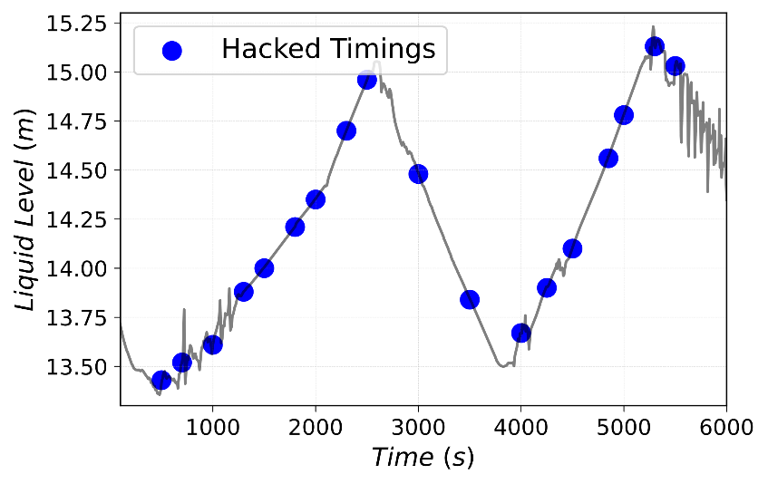
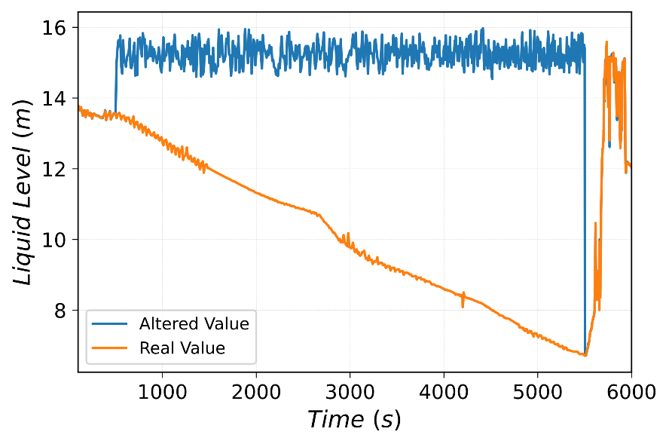
Test Case: Cyberattack on a BWR/3 during a hot-shutdown
Sampling Strategy
Event | Distribution | Lower Boundary [s] | Upper Boundary [s] | # of values sampled
Cyberattack | Uniform | 500.0 | 6000.0 | 20
Recovery | Uniform | 5500.0 | 150000.0 | 15
Core Liquid Level transient
Altered and actual liquid levels
Discretization Strategy
Guided exploration
Restricted Sampling
Truncation method based on PCT > 1477 K
GOAL
Investigate a recovery time limit for each of the sampled cyberattack times
LIMITING SURFACE

Slide 35
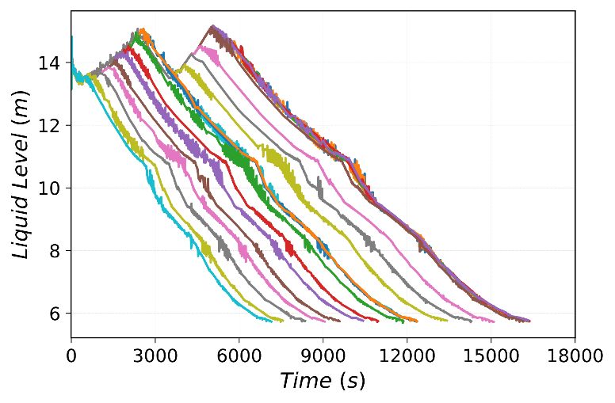
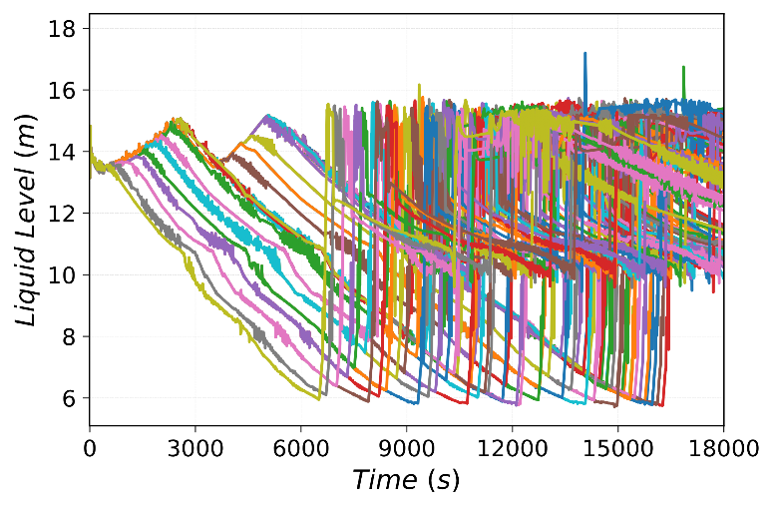
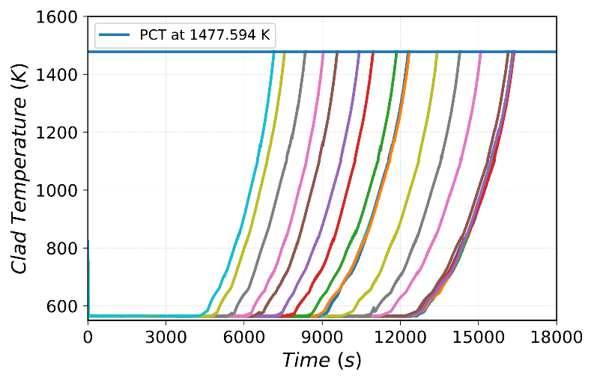
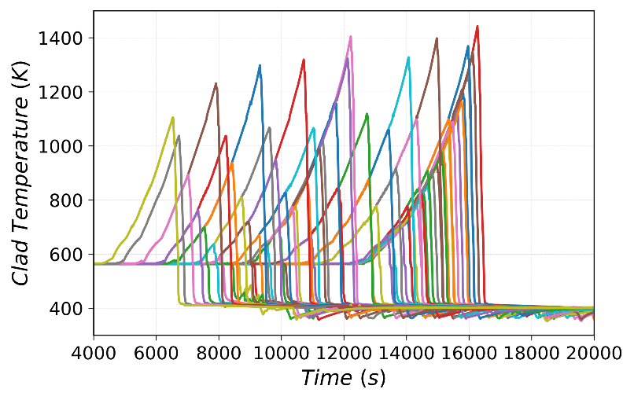
Test Case: Cyberattack on a BWR/3 during a hot-shutdown
Binary Classification between PCT scenarios and successfull recovery of the system
Main Results
PCT
Successfull Recovery
Liquid Level transient
Liquid Level transient
Temperature transient
Temperature transient

Slide 36
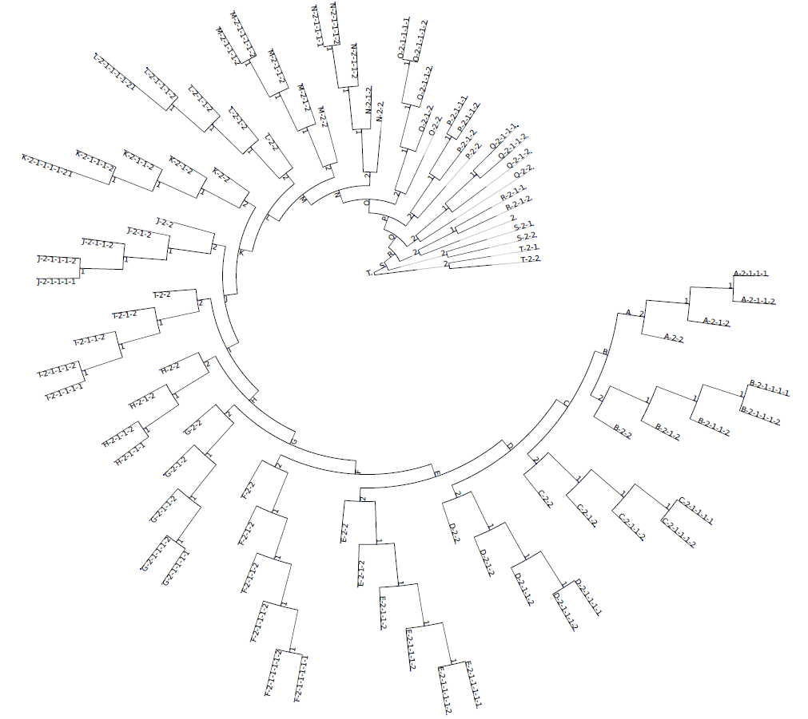
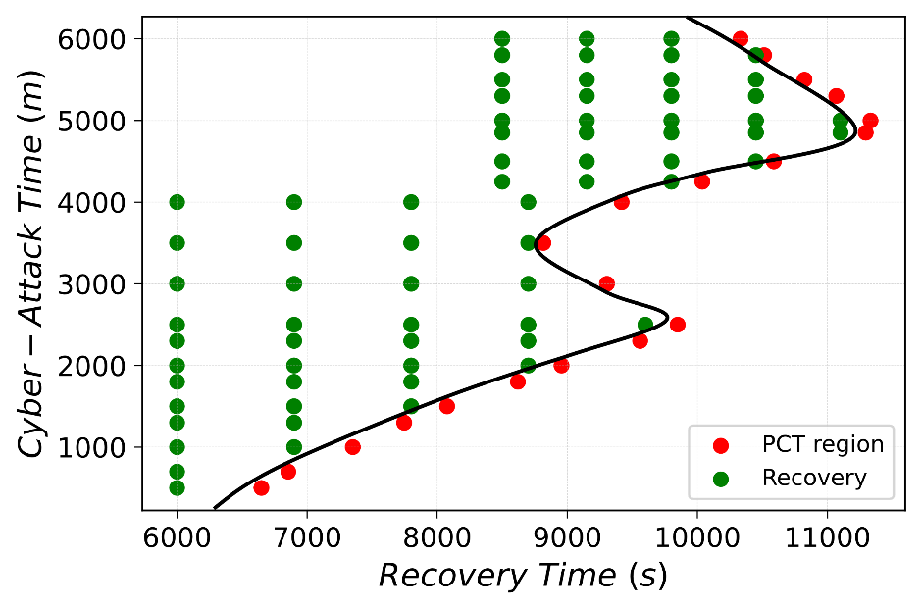
Test Case: Cyberattack on a BWR/3 during a hot-shutdown
Main Results
Two regions of the input space are identified, thus delineating the PCT region.
The Limiting Surface is defined as the boundary between system success and system failure
Dynamic Event Tree visual representation
PCT scenarios
Branch ID | Cyberattack Time [s] | Liquid level [m] | PCT timing [s]
T-2-1 | 500.0 | 13.57 | 6648.16
S-2-1 | 700.0 | 13.52 | 6854.56
R-2-1-1 | 1000.0 | 13.64 | 7351.08
Q-2-1-1 | 1300.0 | 13.82 | 7745.96
P1-2-1-1-1 | 1500.0 | 13.95 | 8075.95
O-2-1-1-1 | 1800.0 | 14.21 | 8619.97
N-2-1-1-1-1 | 2000.0 | 14.44 | 8955.32
M-2-1-1-1-1 | 2300.0 | 14.96 | 9559.87
L-2-1-1-1-1-1 | 2500.0 | 15.0 | 9848.16
K-2-1-1-1-1 | 3000.0 | 14.39 | 9304.55
J-2-1-1-1-1 | 3500.0 | 13.83 | 8815.34
I-2-1-1-1-1 | 4000.0 | 13.85 | 9417.21
H-2-1-1-1 | 4250.0 | 14.22 | 10037.8
G-2-1-1-1-1 | 4500.0 | 14.41 | 10587.6
F-2-1-1-1-1-1 | 4850.0 | 14.92 | 11293.9
E-2-1-1-1-1-1 | 5000.0 | 15.08 | 11330.96
D-2-1-1-1-1 | 5300.0 | 14.86 | 11067.89
C-2-1-1-1-1 | 5500.0 | 14.75 | 10823.52
B-2-1-1-1-1 | 5800.0 | 14.66 | 10512.87
A-2-1-1-1 | 6000.0 | 14.21 | 10332.60
Limiting Surface

