Slide 1
Experience with the recent release of MELCOR at UJV Rez for VVER-1000 analyses with focus on iodine forms in the containment
Miroslav Kotouč

Slide 2
Outline
More realistic iodine representation in MELCOR simulations
  CsI vs. I₂
Disappearance of UO₂/decay heat from the simulation
  For the VVER-440
Testing the r2023.0.9 vs. r2024.0.0 on identical VVER-1000 input deck
  CTMT long-term pressurization

Slide 3
iodine representation in melcor

Slide 4
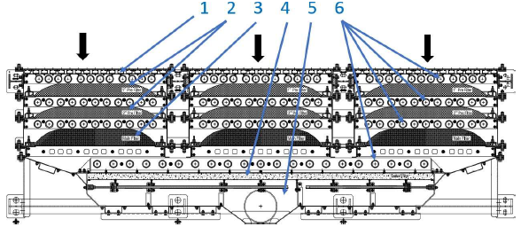
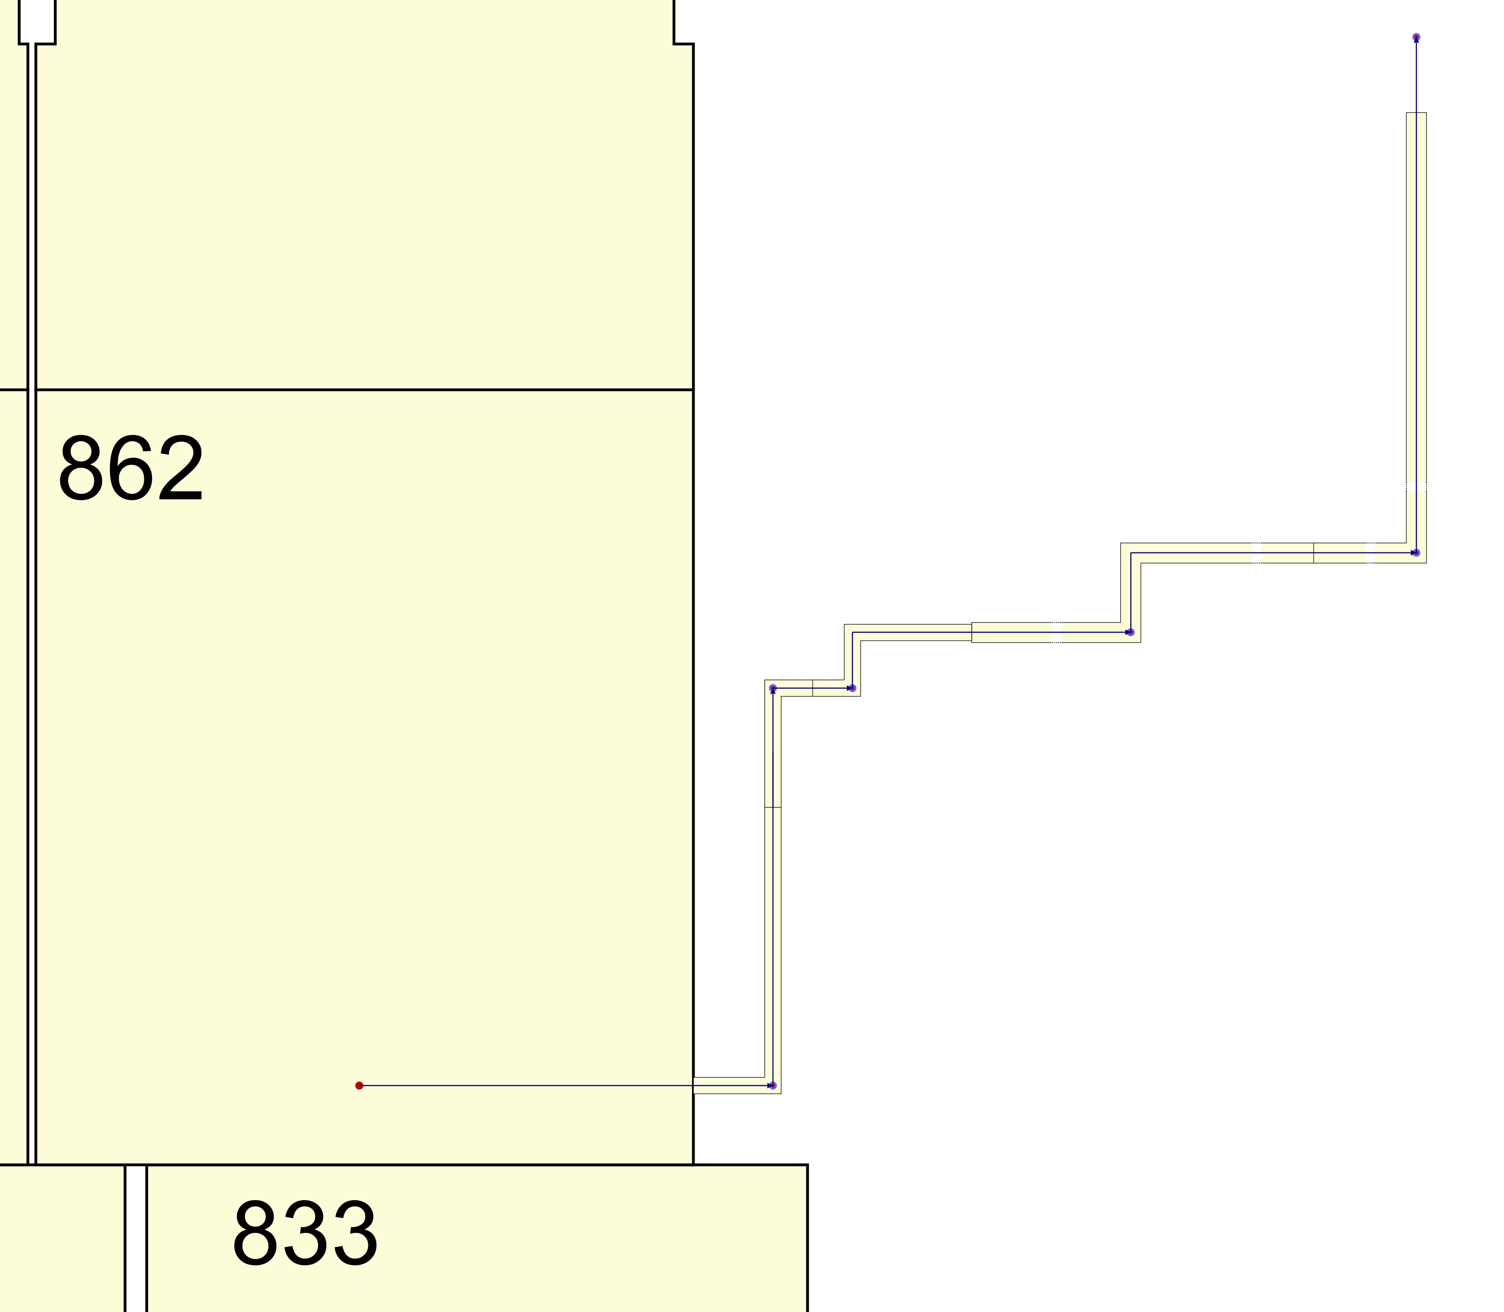
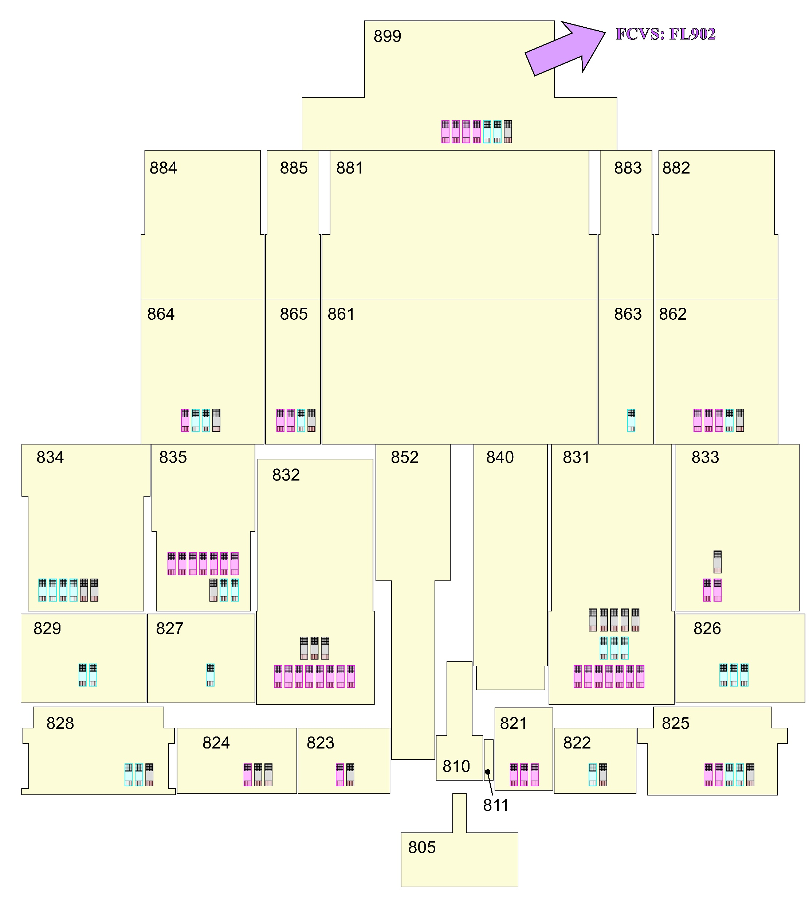
forms of iodine in melcor
MELCOR UG (2024)
Goal: estimate properly/realistically ST onto the FCVS filters
MELCOR default: class combination ‘CS’ + ½*’I2’ => ‘CSI’
=> practically all ‘I2’ class transfers into the ‘CSI’ class, which might bias the results taking into account that:
    CsI (~aerosols) gravitationally settle
      MELCOR does not allow for mechanistic resuspension of RNs from water sumps
    Filters are more efficient for aerosol (DF~10⁴) than for gaseous iodine (DF~10²)
    Correct speciation is important also for radiological consequences assessment
NUREG-1465 estimated the approximate amount of CsI => CTMT:
I.e., up to ~5 % of iodine shall be treated as gaseous iodine in the CTMT
Moreover, iodine in the CTMT undergoes chemical-physical reactions
DFM-type of filter unit proposed for the Temelin NPP (VVER-1000)
Detailed FCVS duct model
Integral CTMT model

Slide 5
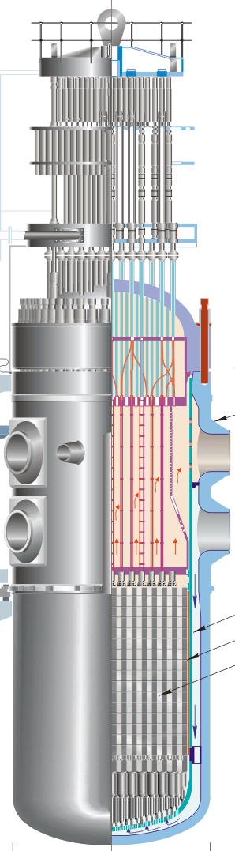

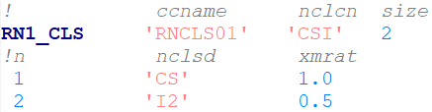



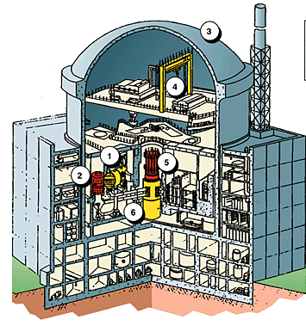

finding realistic iodine speciation
Integral MELCOR simulation
Cs M [kg/kmol] | 132.91
I M [kg/kmol] | 126.9
I i. i. [kg] | ~20
Study performed in 3 steps:
  MELCOR integral analysis => sources of m/H/RN
    Assuming 5 % of iodine in the ‘I2‘ class and 95 % of I in the ‘CSI’ class
  COCOSYS CTMT analysis <= sources of m/H/RN
    advanced chemical reactions, pH in the sumps, dose rate and wet/dry painted/steel/concrete surfaces
  MELCOR integral analysis with the COCOSYS-calculated long-term ‘I2‘ class mass
Must be new element
Initial mass: ’I2’+2*’CS’
Specific decay power history
…
…
Absolute values
Detailed COCOSYS CTMT response
…

Slide 6
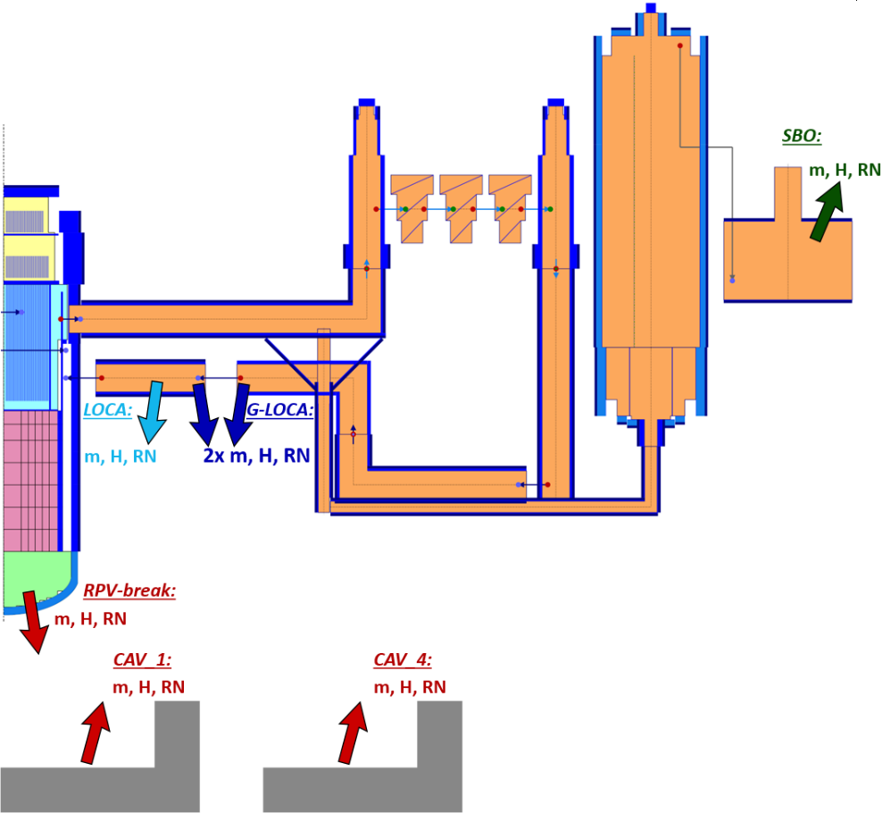
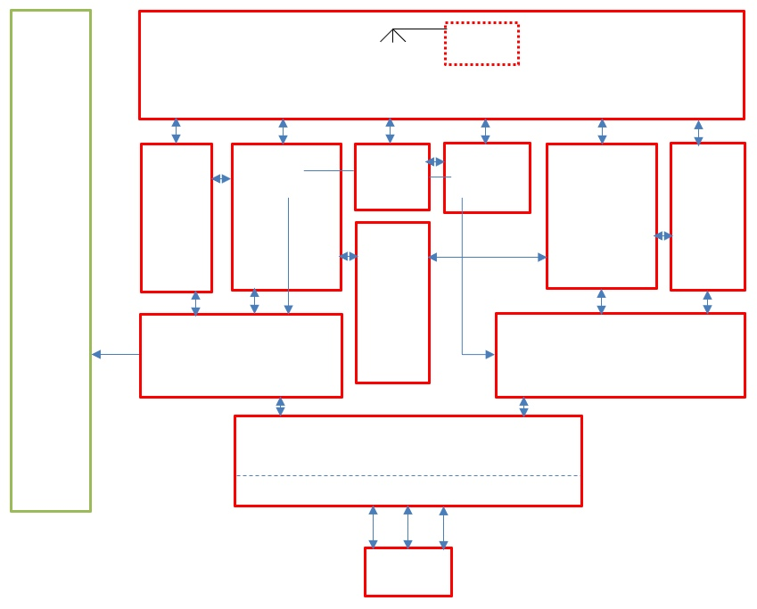
SPECIATION of iodine: cocosys analysis
MELCOR integral analysis (fixed 5 % of I₂)
sources into EDF
COCOSYS CTMT analysis
stand-alone calc. based on MELCOR sources
pH=5; P=2 kGy/hr

Slide 7
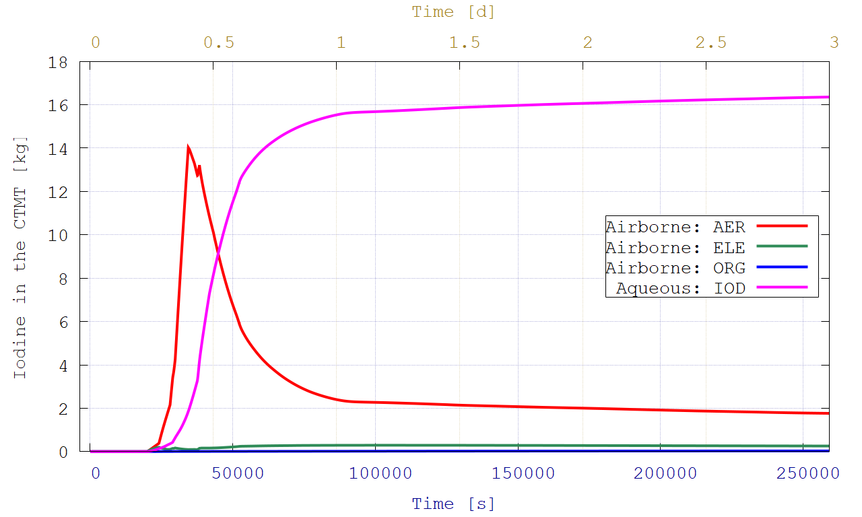
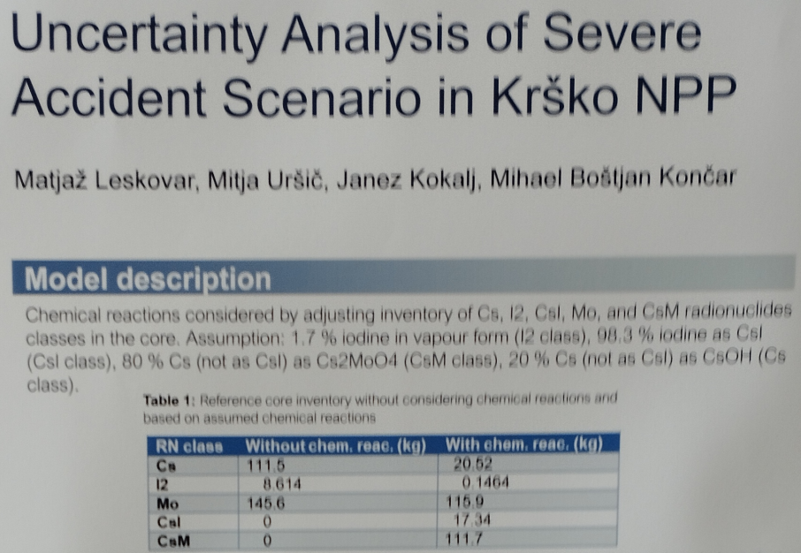
cocosys ctmt results
M. Leskovar, “Uncertainty Analysis of Severe Accident Scenario in Krško NPP,” Proceedings of the International Conference Nuclear Energy for New Europe, Portorož, Slovenia, September 11-14 (2023).
Iodine dissolved in sumps
Airborne aerosols
Molecular (I₂) ~0.31 kg
Organic
Initial inventory of iodine ~20 kg => 0.31 kg of I₂ makes ~1.56 % of iodine in the ‘I2‘ class!

Slide 8
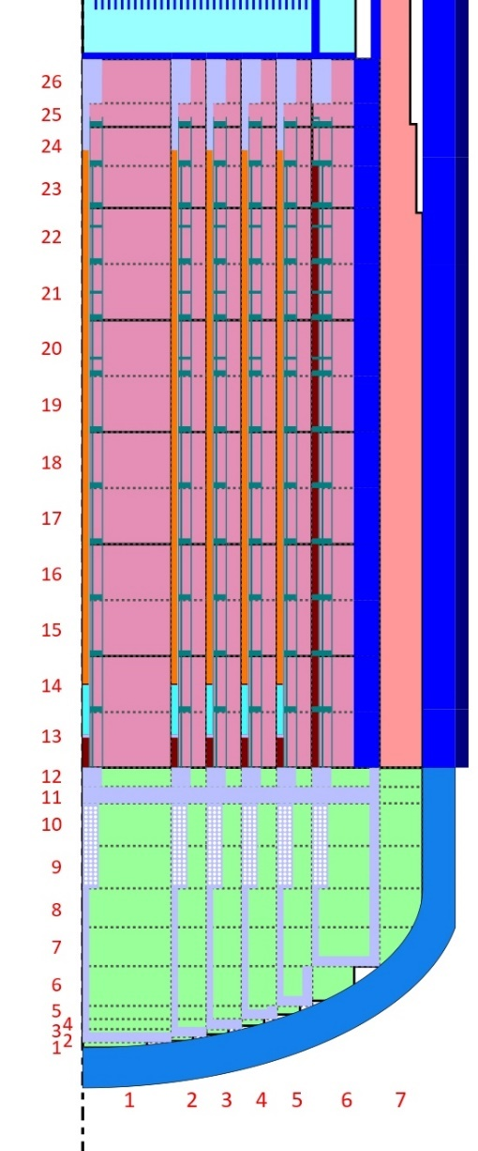
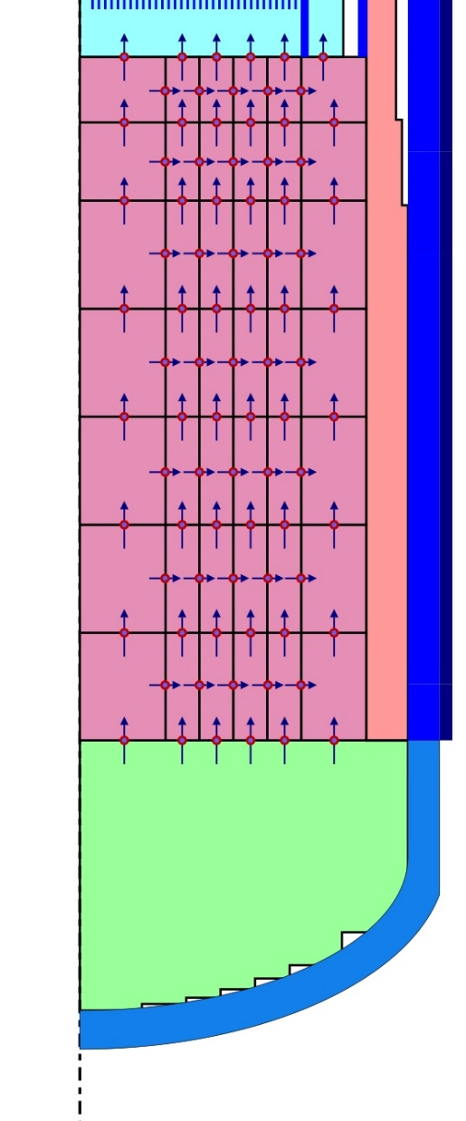
sensitivity study: iodine representation
MELCOR integral calculation: Guillotine-Break LOCA
FCVS in operation after reaching 0.58 MPa(abs)
3 cases for iodine representation:
  „CsI“ (red curves in the graphs)
    automatic CsI formation is allowed
    automatic Cs₂MoO₄ formation is allowed
  „1.56I2“ (green curves in the graphs)
    1.56 % of iodine => ‘I2’ class
    98.44 % of iodine => ‘CSI’ class
    automatic Cs₂MoO₄ formation is allowed
  „3.00I2“ (blue curves in the graphs)
    3.00 % of iodine => ‘I2’ class
    97.00 % of iodine => ‘CSI’ class
    automatic Cs₂MoO₄ formation is allowed

Slide 9
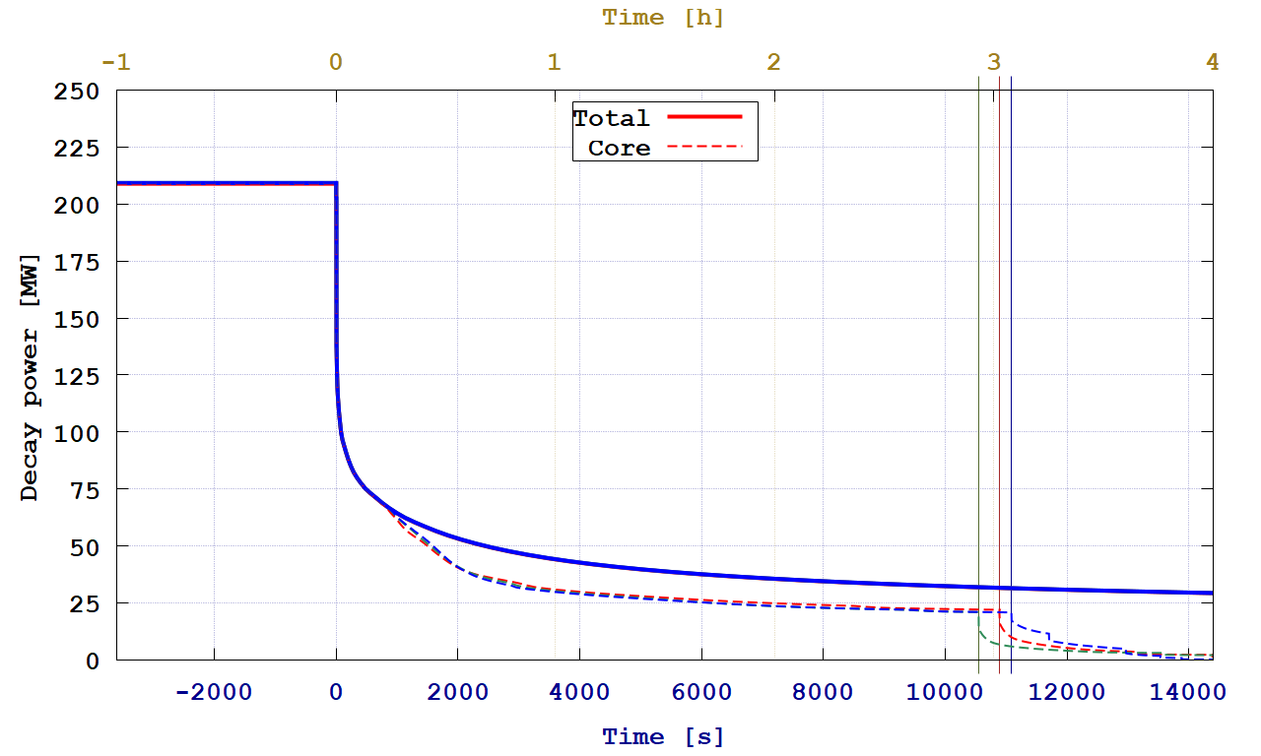
g-loca scenario: decay heat
CsI
1.56I2
3.00I2
Instants of RPV failure
Not monotonic behavior observed
FPs release

Slide 10
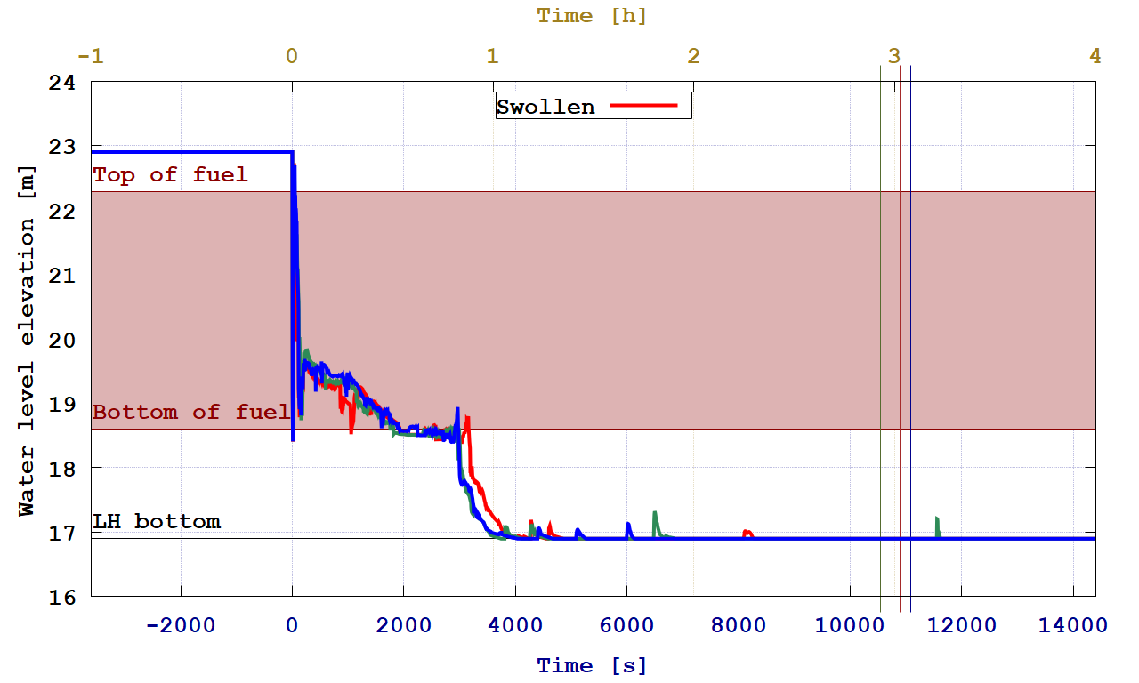
g-loca scenario: rpv water level
CsI
1.56I2
3.00I2
Instants of RPV failure
Again, no pattern found for the in-vesel phase & amount of CsI; some similarity for the fixed ‘I2’ amount

Slide 11
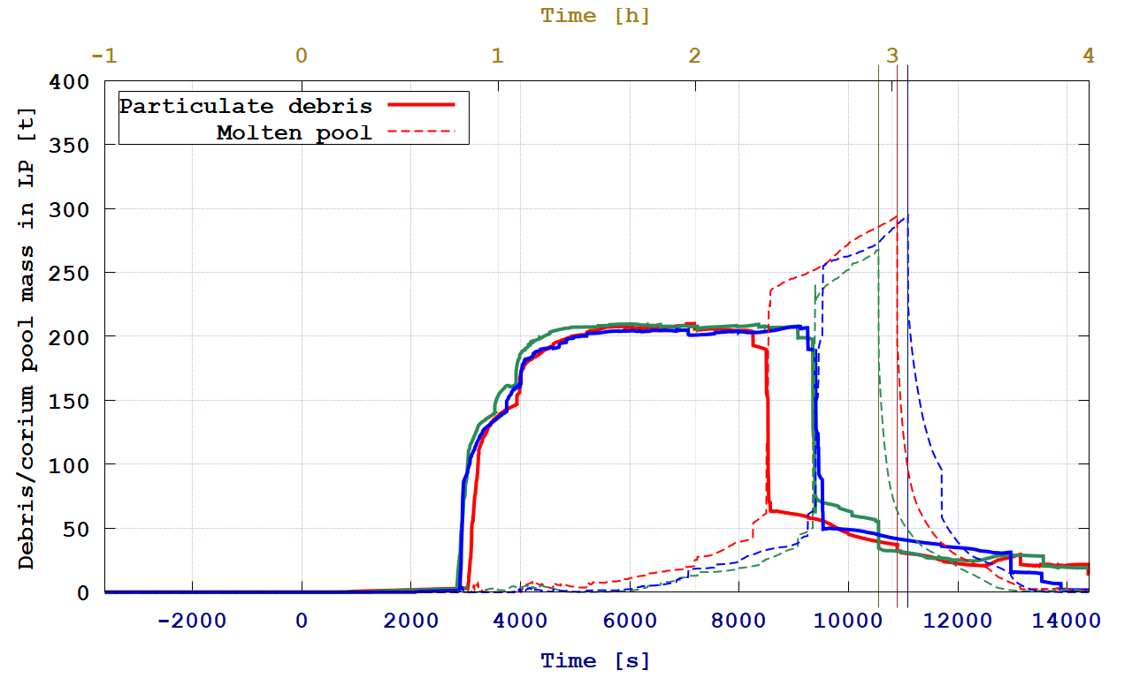
g-loca scenario: pd/mp in lower p.
CsI
1.56I2
3.00I2
Instants of RPV failure
Again, cases with the fixed ‘I2’ amount are similar

Slide 12
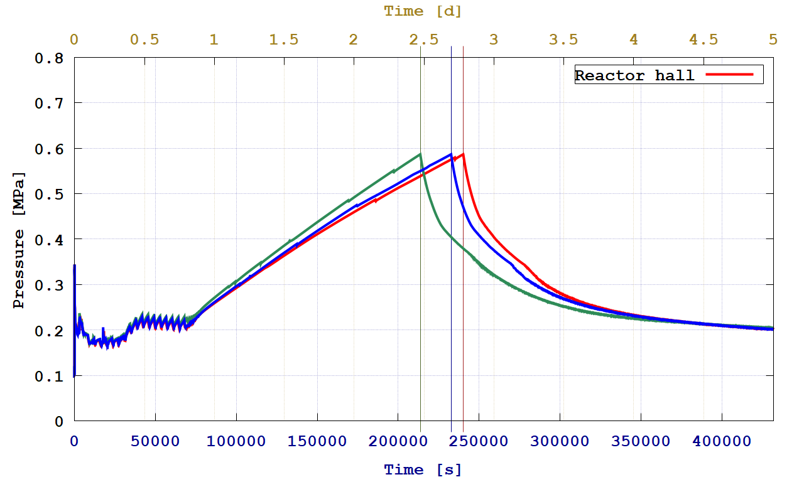
g-loca scenario: ctmt pressure
CsI
1.56I2
3.00I2
Instants of FCVS opening
Rather big discrepancies in CTMT failure times; related to I₂ (volatile) content in the atmosphere?

Slide 13
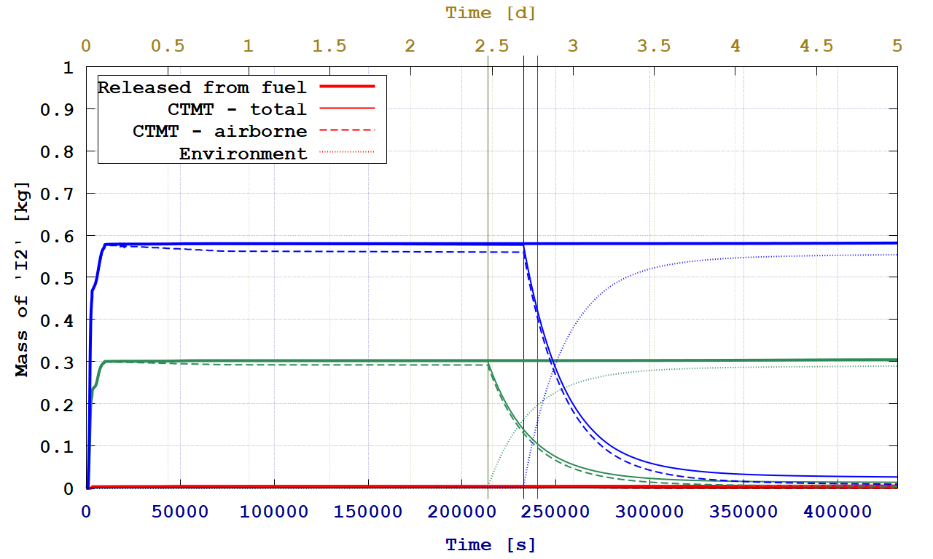
g-loca scenario: ‘i2‘ release
CsI
1.56I2
3.00I2
Instants of FCVS opening
Whole ‘I2’ class is located in the CTMT, almost solely as airborne
Releases of ‘I2’ onto the FCVS filters is proportional to the fixed amount of ‘I2’
Some adsorption…

Slide 14
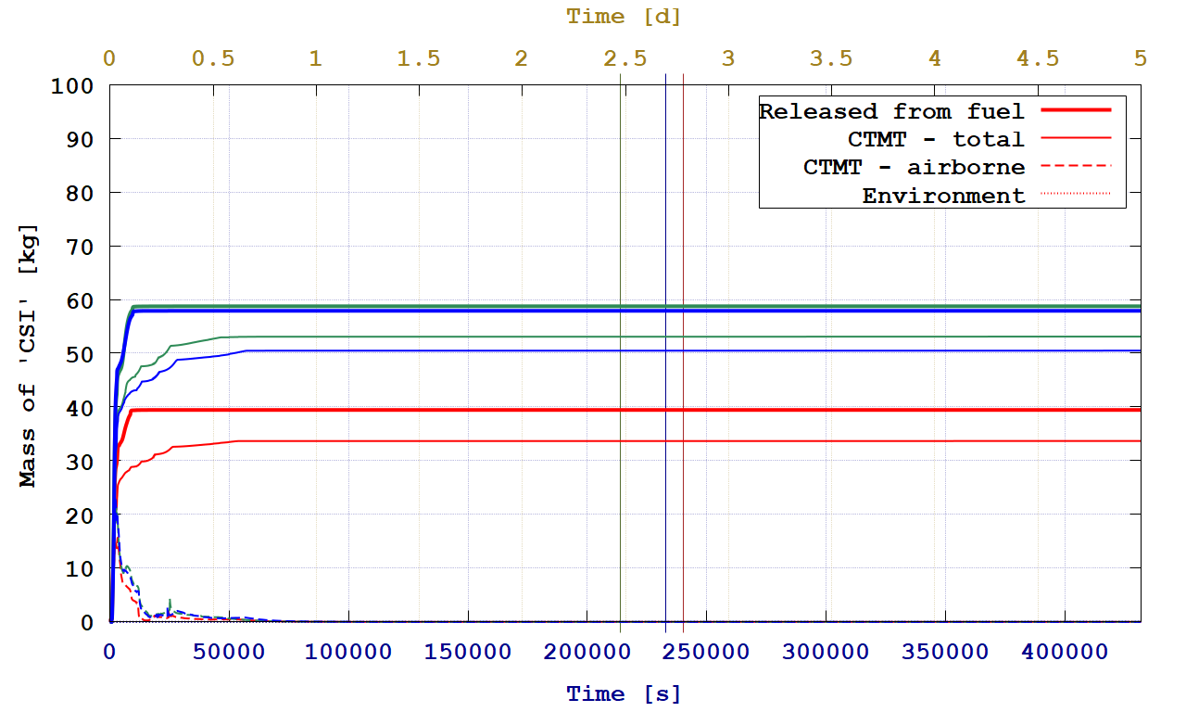
g-loca scenario: ‘csi‘ release
CsI
1.56I2
3.00I2
Instants of FCVS opening
Expected: a little less ‘CSI’ for the 3 % of ‘I2’ than for the 1.56 % of ‘I2’
Much less ‘CSI’ mass released: this means MELCOR correctly combines ‘CS’ and ‘I2’ with the factor of 0.5 for ‘I2’
‘CSI’ (aerosols) willingly settle

Slide 15
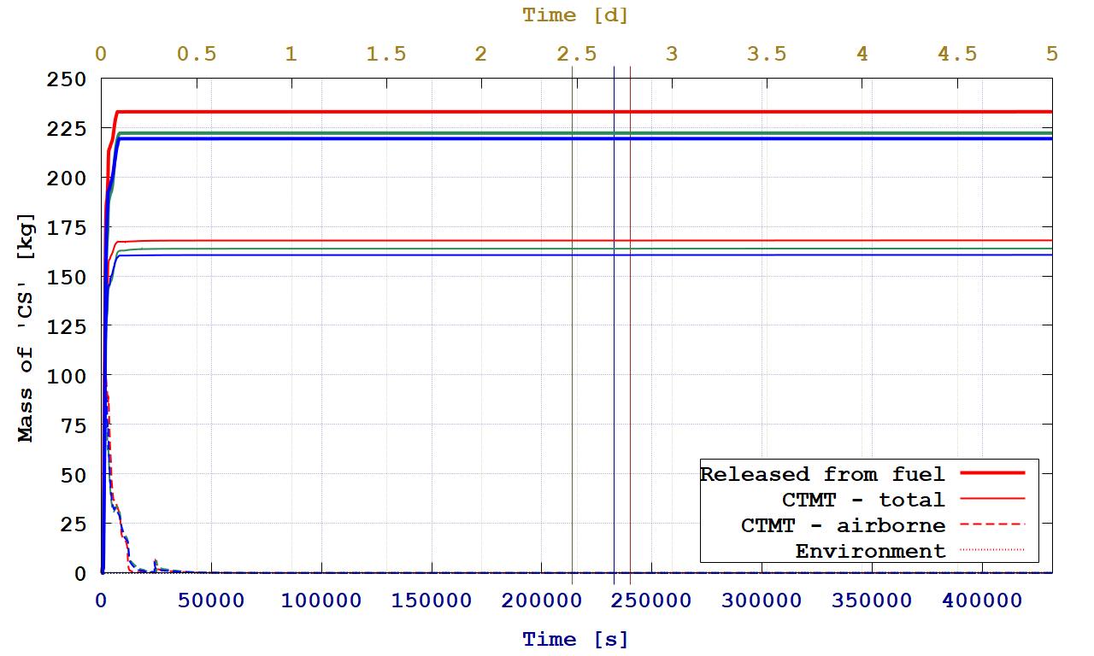
g-loca scenario: ‘cs‘ release
CsI
1.56I2
3.00I2
Instants of FCVS opening
Less ‘CSI’ is created => more ‘CS’ remains and is released
Expected: more ‘CS’ release for the 3 % of ‘I2’ and thus less amount of ‘CSI’, thus more available ‘CS’
‘CS’ (aerosols/vapors) willingly settle/condense

Slide 16
disappearance of uo2/decay heat

Slide 17
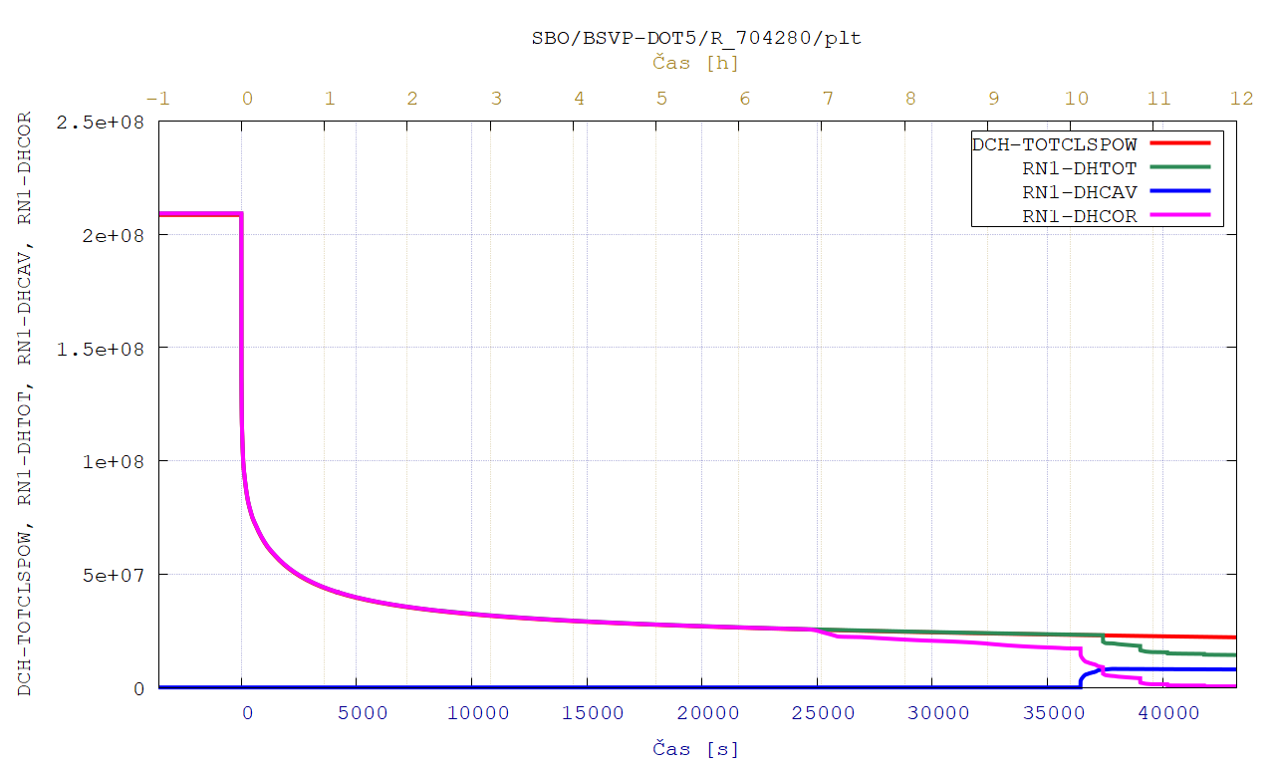
vver-1000 input deck: decay heat
RN total decay heat starts to deviate
Instant of RPV failure
DCH total decay heat according to the table

Slide 18
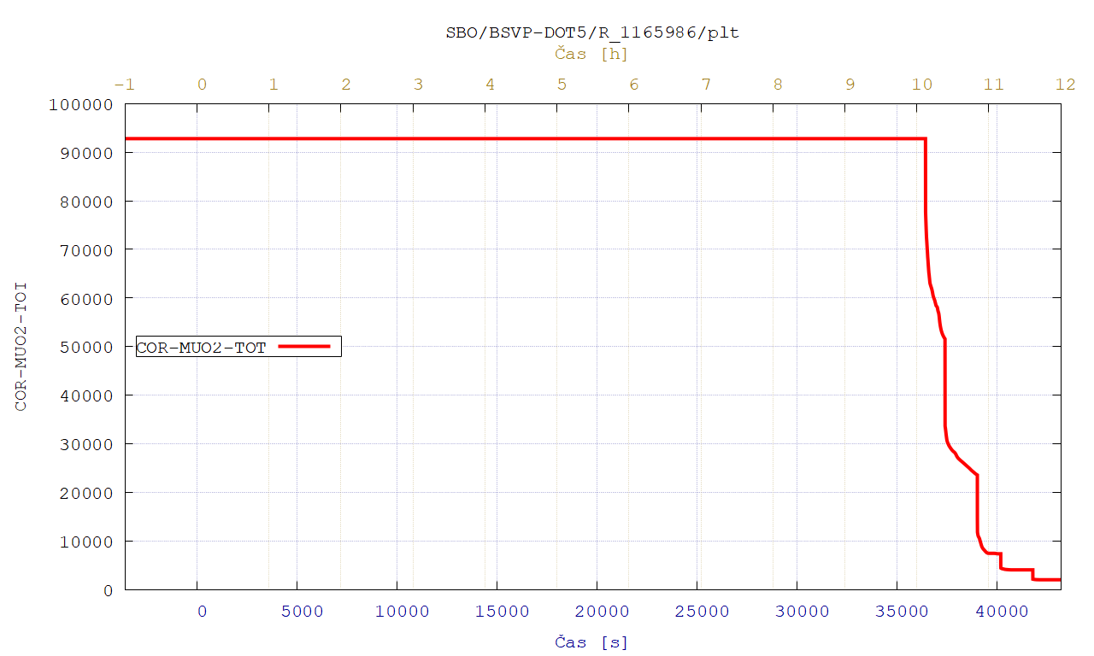
vver-1000 input deck: uo2 mass
Instant of RPV failure

Slide 19
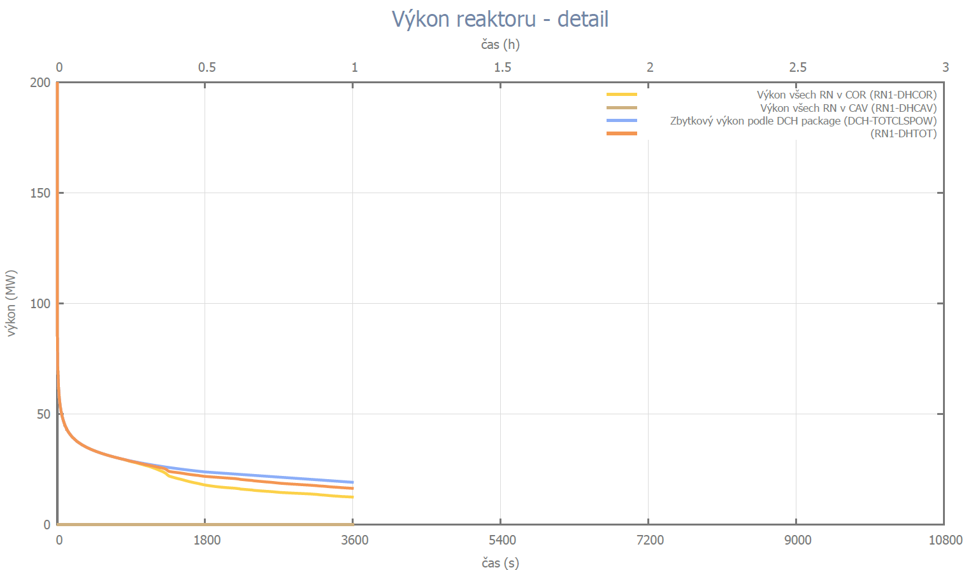
vver-440 input deck: decay heat
RN1-DHTOT starts to diminish before RPV failure!!!
DCH-TOTCLSPOW as expected
RN1-DHCOR according to the FPs release

Slide 20
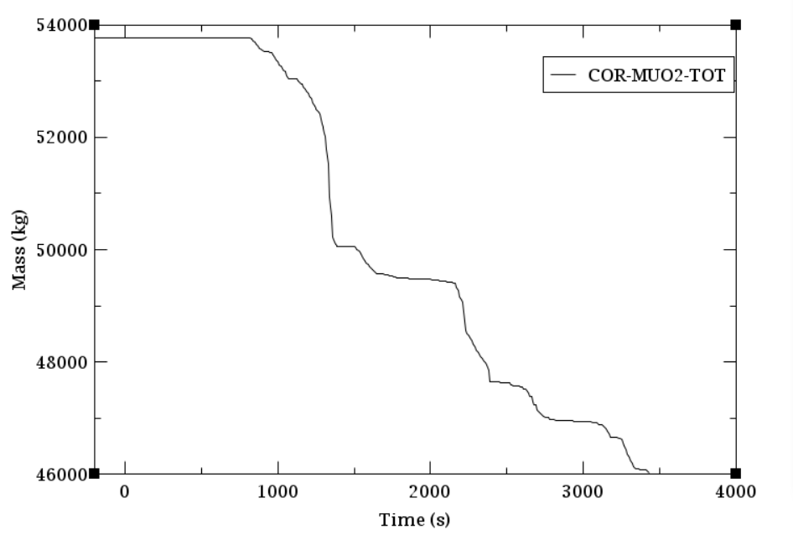
vver-440 input deck: uo2 mass
Why is the total amount of UO2 decreasing?!?!

Slide 21
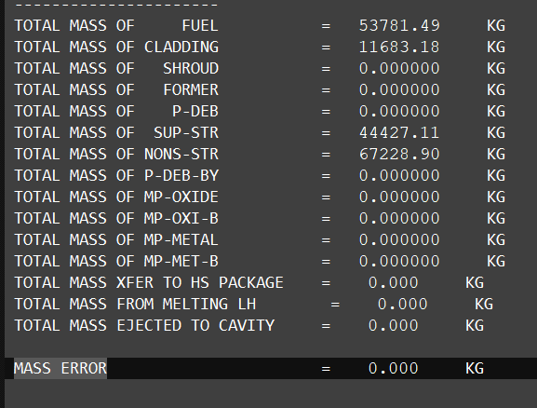
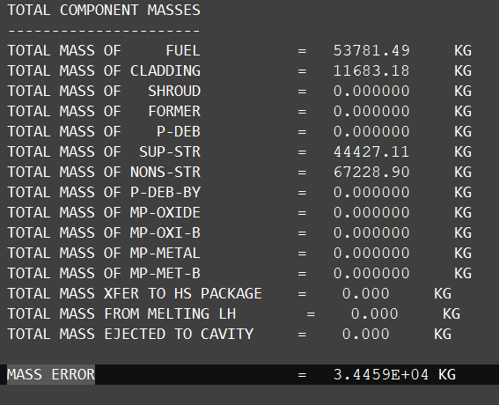
vver-440 input deck: MEGouT(melOUT) errors
MEGOUT: no error…
MELOUT: same masses, but error 34 tons!?!?...

Slide 22
r2023.0.9 vs. r2024.0.0

Slide 23
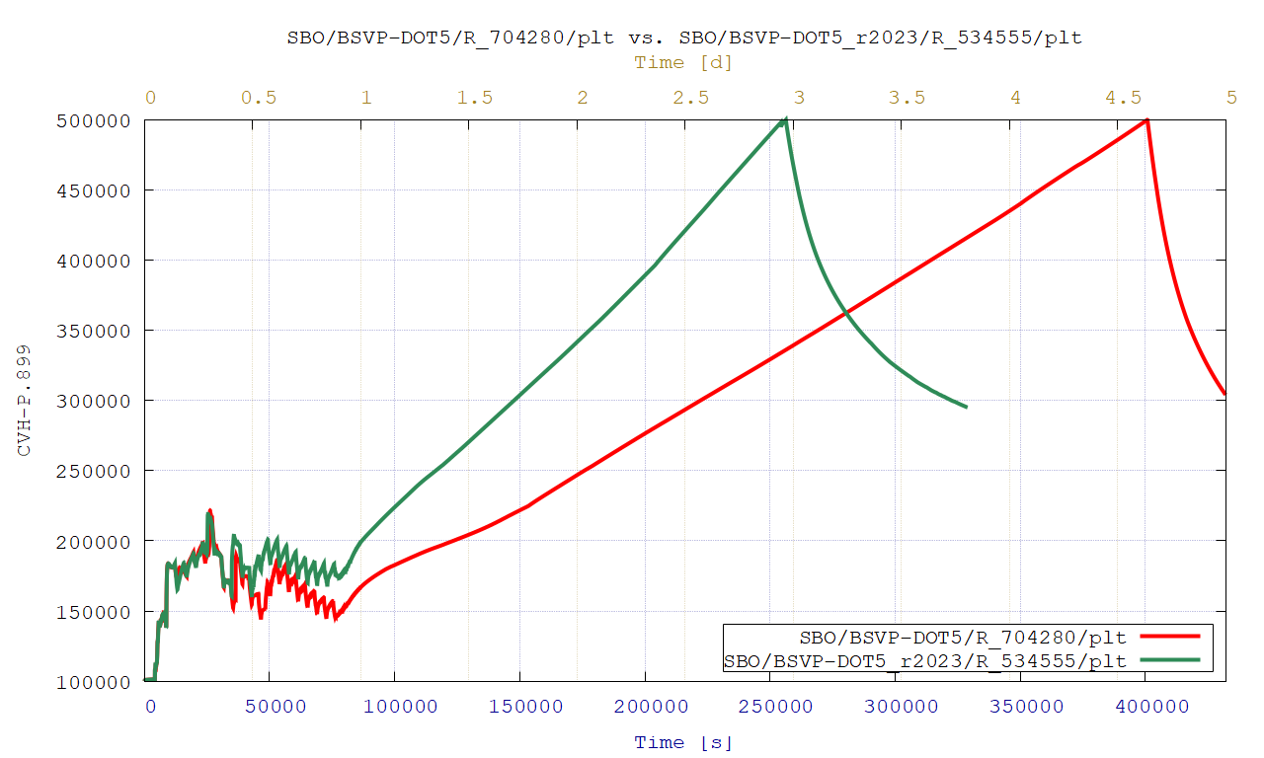
identical vver-1000 input: ctmt pressure
HS package: 2D HSs not active yet…?
r2023.0.9
r2024.0.0

Slide 24
A few conclusions/observations
It is important to estimate before-hand the form of iodine expected to exist in long-term in the CTMT:
  Gaseous I₂ naturally increases the ST into the environment/FCVS filters
  The proposed fixed amount of ‘I2’ class is ~1.56 acording to COCOSYS
  The right way of combining ‘CS’ with ‘I2’ is to use the molar ratio
    2 … for automatic ‘CSI’ creation
    1 … for manual setting the‘CSI’ mass
For the VVER-440 input deck, we do lose UO2 mass and decay heat from the simulation right after the onset of fuel degradation
Unexpected large differences in CTMT pressure when testing the r2024 MELCOR release

Slide 25
Thank you for your attention!
ÚJV Řež, a. s.
Hlavní 130, Řež
250 68 Husinec, Czech Republic
e-mail: sales@ujv.cz
www.ujv.cz

Slide 26
g-loca scenario: decay heat in RN classes
Total (whole-core) decay heat
0.00, 1.56 or 3.00 % of iodine as ‘I2’, i.e. in the atmosphere, is rather marginal…
Halogens RN class decay heat

