Slide 1
COMPARISON OF A DBA SEQUENCE IN A GENERIC iPWR BETWEEN MELCOR AND ASTEC CODES
15th Meeting of the European MELCOR and MACCS User Group
Speaker: Gianmarco Grippo
Contributors: Giuseppe Agnello, Pietro Maccari, Stefano Ederli, Andrea Bersano, Fulvio Mascari

Slide 2


Introduction
The following activity is being developed in the framework of Horizon Europe SASPAM-SA project
Funded by the European Union. Views and opinions expressed are however those of the author(s) only and do not necessarily reflect those of the European Union or European Commission-Euratom.
Neither the European Union nor the granting authority can be held responsible for them.
AIM OF THE ACTIVITY
A code-to-code benchmark has been conducted to investigate the integral SA codes capabilities in simulating the main thermal-hydraulic phenomena occurring in a generic iPWR design during a DBA sequence. The aim of the activity is to gain first insights about the possible differences in predicting iPWR typical phenomena between the codes ASTEC and MELCOR

Slide 3
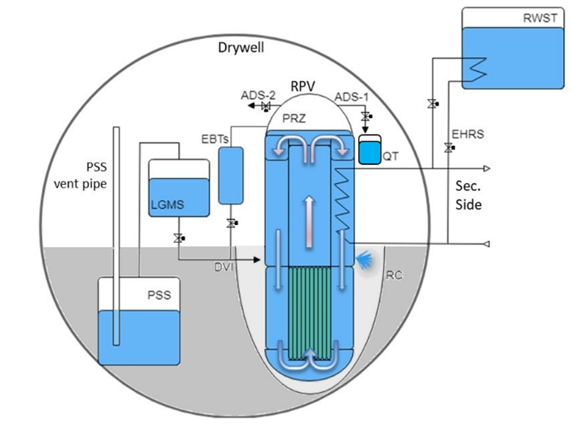
Design 2 – General view
The iPWR Design-2 is characterized by the use of several passive systems and by a dry containment.
The reactor operates in forced circulation during normal operation and employs a passive mitigation strategy in accidental transients.
It consists of an integral RPV, which contains the core, a compact SG, the Control Rod Drive Mechanism (CRDM), the primary pumps and the pressurizer included in the upper head.
The hot water at the core outlet flows upward in a circular riser up to the primary pumps suction.
Above the riser, a perforated plate separates the riser from the PRZ, which is enclosed in the RPV upper head.

Slide 4
Design 2 – Nodalization information
In order to develop the ASTEC and MELCOR input-deck, a reference database was needed.
Considering the characteristics of Design 2 reactor type and the selected passive systems, a generic IRIS SMR type has been considered as reference for this analysis.
During the development of the MELCOR and ASTEC nodalization of the generic IRIS design, no proprietary data have been used.
The main geometric information has been determined by scaling the data available from the SPES-3 facility, by engineering evaluation or public general data available for the IRIS reactor.

Slide 5
Selected scenario
DBA
After the qualification of the steady state, the DBA scenario selected is the guillotine break of one Direct Vessel Injection (DVI) line, considering the availability of all safety systems.

Slide 6
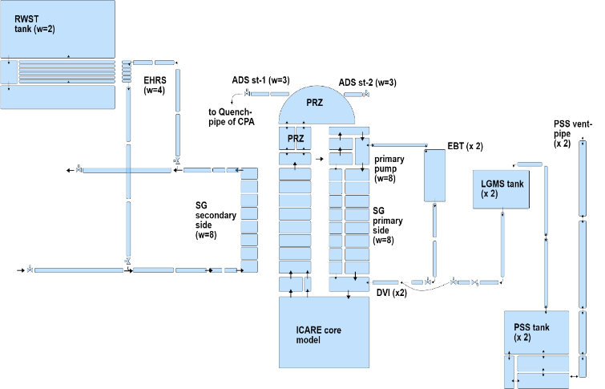
ASTEC input deck
CESAR has been used for detailed nodalizing the upper part of the RPV, the secondary system (steam line, feedline and SGs), and most of the passive safety systems.

Slide 7
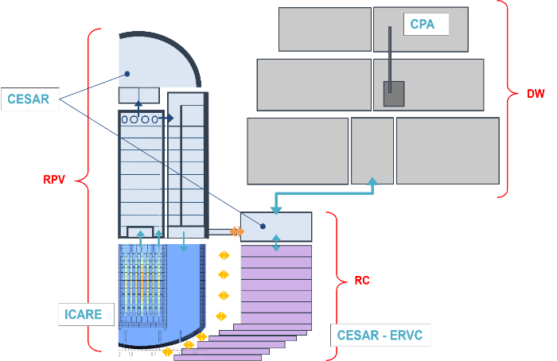
ASTEC input deck
ICARE module model
  core, bypass and downcomer channels;
  The core internals;
CPA module used to model
  The DW;
  The dedicated insertion model of CPA is used to model the QT suppression system.
RC has been modelled with CESAR to be thermally coupled with the external vessel structure of ICARE

Slide 8
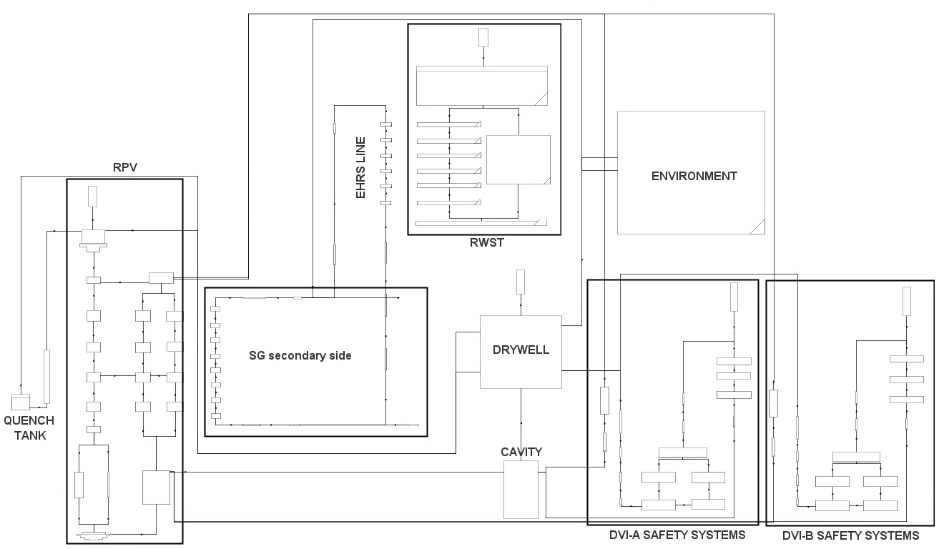
MELCOR input deck
The core and LP nodalization in the COR package is characterized by 16 axial levels and 6 radial rings
The containment region:
  One CVH volume for RC (coupled with the correspondent CAV package);
  One CVH volume for the DW region;

Slide 9
Description of the transient
BREAK OF DVI LINE
High Containment Pressure signal
SCRAM
Secondary system isolation
EHRS actuation
Low PRZ level signal
RCP coastdown
RI-DC valves opening
Low PRZ pressure signal
EBTs actuation
ADS stage-1 actuation
Low DP RPV-Containment signal
LGMSs actuation
Low LGMS mass signal
ADS stage-2 actuation

Slide 10
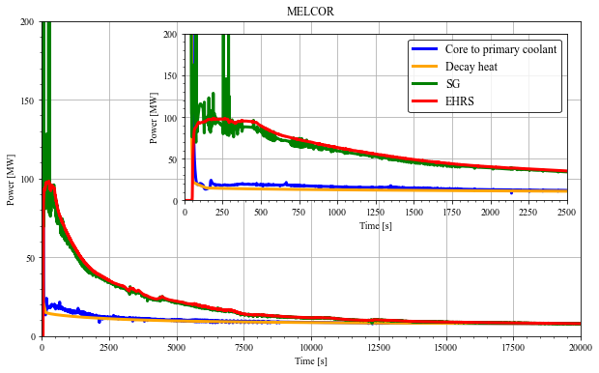
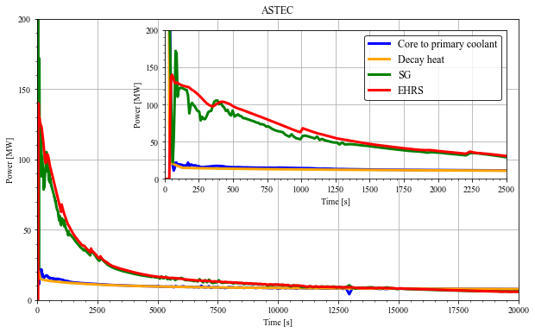
Balance of the plant
EHRS POWER PEAK
MELCOR
100 MW
ASTEC
140 MW
EHRS system’s removed power in ASTEC is greater than in MELCOR;
The primary system’s depressurization in ASTEC is faster than MELCOR;
  Faster pressure increase in the DW
  Faster pressure equalization between the RPV and the DW;
Early phase
0s - 1000s

Slide 11
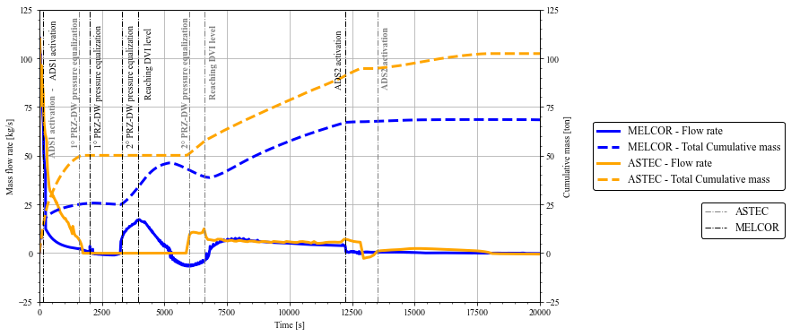
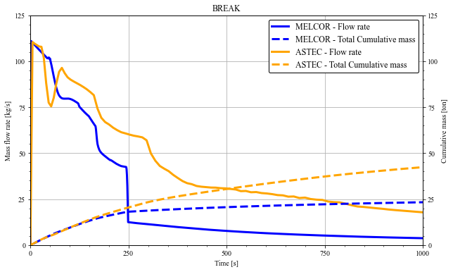
Break massflow rate - SoT
MELCOR at 223s
Saturated blowdown is reached before in MELCOR than in ASTEC
ASTEC at 913s

Slide 12
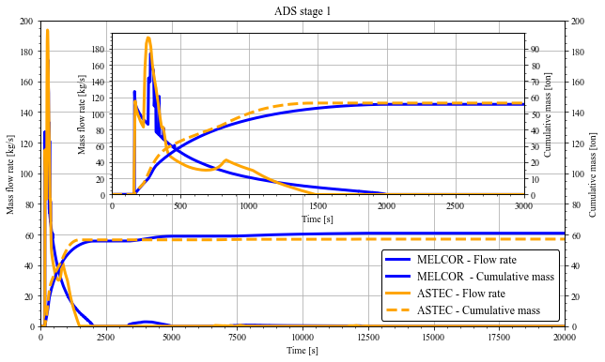
ADS stage 1
Same predicted behavior and initial peak during subcooled blowdown.
The opening of the ADS 1 is practically at the same time
  166s ASTEC
  167s MELCOR
The mass flow rate predicted by the two code is qualitative and quantitative well represented and comparable in this first phase

Slide 13
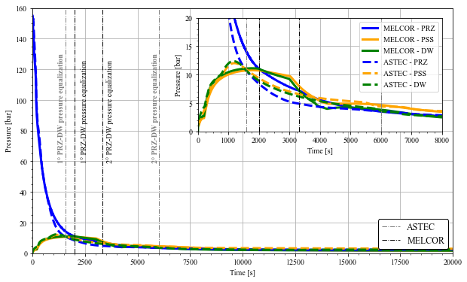
1° Pressure Equalization
1° Pressure Equalization
MELCOR
2000 s
ASTEC
1584 s
This phenomenology determines the stop of the break flow rate in both the codes.
DVI BREAK
RPV pressure decrease
ADSs1 actuation
RPV depressurization increase
1° P. equalizaition
MELCOR: 0 s
ASTEC: 0 s
MELCOR: 167 s
ASTEC: 166 s
MELCOR: 2000 s
ASTEC: 1584 s
t [s]

Slide 14
2° Pressure Equalization
2° Pressure Equalization
MELCOR
3315 s
ASTEC
6006 s
The pressure in the RPV becomes higher again and, consequently, the break flow rate start again.

Slide 15
Break massflow rate – Between 1° and 2° Eq.
ASTEC predict a delayed restart of water injection through the break from the primary side to the cavity.
The codes predict the same phenomenology with different timing
Why 2° equalization and restart of the break massflow rate again?

Slide 16
PSS VENT reverse flow

Slide 17
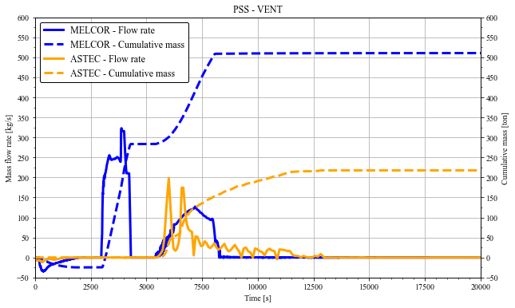
PSS VENT reverse flow
Due to:
PSS gravity head;
Major condensation phenomena in DW than suppression in PSS
!
This phenomenon influenced the DW pressure, the restart of the BREAK massflow rate and the cavity level

Slide 18
PSS VENT reverse flow
Reverse flow
MELCOR
3010 s
ASTEC
5534 s
MELCOR major condensation in the DW structure.
This phenomenon brings to a faster 2° pressure equalization in MELCOR than ASTEC predictions.

Slide 19
BREAK reverse flow
Level in the cavity reaches the DVI level
DVI LEVEL
2° Pressure eq.
Restart of BREAK MFR
Cavity level reach DVI elevation
Inversion of BREAK MFR
MELCOR: 3315 s
ASTEC: 6006 s
MELCOR: 3950 s
ASTEC: 6600 s
t [s]

Slide 20
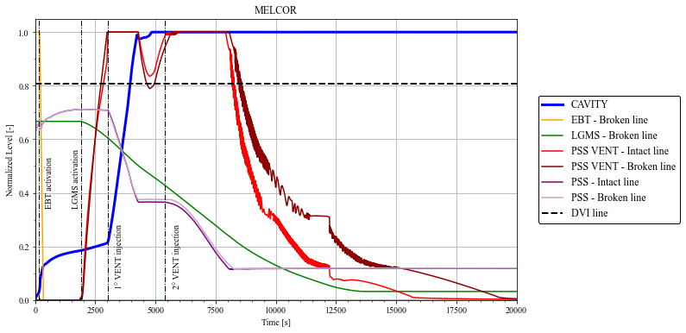
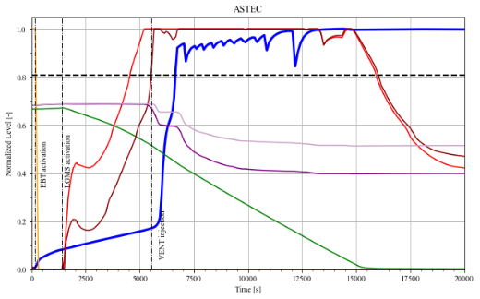
Level in the cavity
Broken DVI passive systems
DW condensation
PSS reverse flow
Break flow rate

Slide 21
Level in the cavity
EBT activation
Rise of CAV. level
EBT draining completes
Reduced level increase
LGMS actuation
1° PSS reverse flow
Cavity reaches DVI
MELCOR: 152 s
ASTEC: 160 s
MELCOR: 652 s
ASTEC: 660 s
MELCOR: 1884 s
ASTEC: 1398 s
MELCOR: 3010 s
ASTEC: 5534 s
t [s]

Slide 22
Level in the cavity
MELCOR predicts a faster level increase in the cavity in the first 500s.
The BREAK mass flow rate is higher in ASTEC
MELCOR behavior is due to a major condensation in the containment structure.

Slide 23
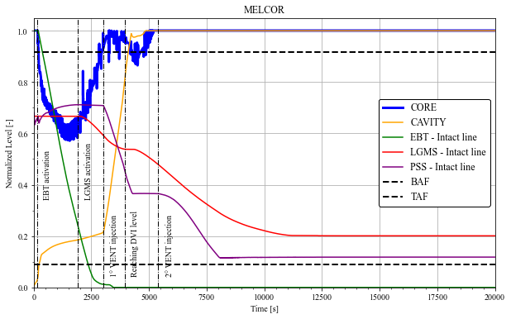
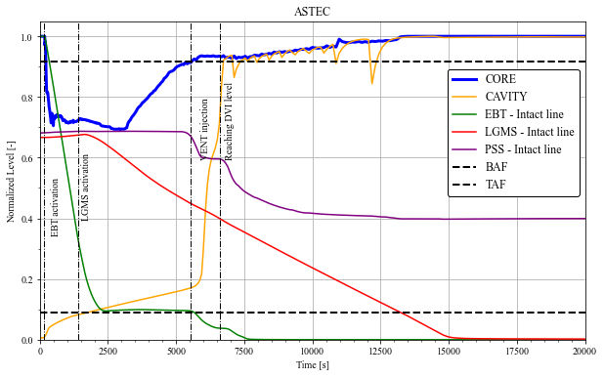
Level in the core
Break flow
Passive systems activation (Intact line)

Slide 24
Level in the core
Minimum CORE level is reached
Starts again the break flow small and small level reduction is predicted
EBT activation
CORE level decreasing stop
LGMS actuation
Core level above the TAF
Cavity reaches DVI
Reverse BREAK flow
MELCOR: 152 s
ASTEC: 160 s
MELCOR: 1884 s
ASTEC: 1398 s
MELCOR: 3010 s
ASTEC: 5534 s
t [s]

Slide 25
EBT and LGMS behaviour – Intact line
Regarding ASTEC…..
CORE level reaches the minimum at 3000s
Due to the longer time interval between 1° and 2° equalization, the EBT stops to inject. Subsequently, LGMS starts to inject affecting sensibly the level decrease

Slide 26
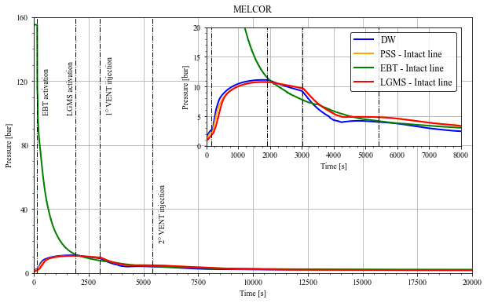
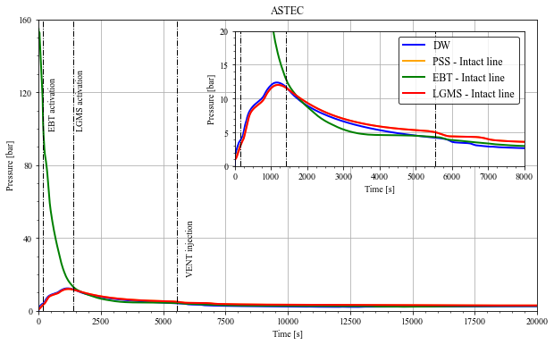
EBT and LGMS behaviour – Intact line
EBT system follows the pressure behavior of the primary side
the LGMS follows the pressure behavior of the DW
After the first equalization, the RPV pressure becomes lower than the DW one

Slide 27
Results remarks
Event | MELCOR | ASTEC
Break | 0 | 0
High Containment pressure signal (SCRAM, isolation SG, EHRS activation) | 41 | 20
Low PRZ water level signal (Pump coast down and RI-DC opening) | 122 | 65
Low PRZ pressure signal (ADS Stage-1 opening, EBTs opening) | 148 | 158
Low DP RV-Containment (LGMSs opening) | 1884 | 1398
1° RPV- DW pressure equalization | 2000 | 1584
2° RPV- DW pressure equalization | 3315 | 6006
1° vent injection | 3010 | 5534
2° vent injection | 5405 | -
Core level reach the TAF | 3000 | 5500
Cavity level reach the DVI | 3950 | 6600
Low LGMS mass (ADS Stage -2 opening) | 12265 | 12902
MELCOR minimum level at about 0.6 while ASTEC at about 0.7
The upper part of the core is uncovered in the MELCOR simulation for 2900s while ASTEC for 5400s
The maximum cladding temperature predicted by MELCOR and ASTEC is about 622K and 619K
No degradation core phenomena are predicted
No hydrogen is produced

Slide 28
Conclusion
The codes are able to predict the expected dominant phenomena driving the transient but some quantitative discrepancies affecting the sequence of event can be underlined.
MELCOR calculation are characterized by a major condensation in the containment and by a major direct condensation in the PSS in comparison with ASTEC.
ASTEC code is characterized by a major heat removal from the passive heat removal systems and a major two-phase break flow rate.
More investigations are currently in progress to characterize these quantitative differences.

Slide 29
Thank you for your attention!
gianmarco.grippo2@unibo.it

