Slide 1




15th Meeting of the European MELCOR and MACCS User Group
Sapienza University of Rome, C.so Vittorio Emanuele II 244, Rome
April 15-18, 2024
IVMR Preliminary results in a passively mitigated iPWR
M. Principato, F. Giannetti, M. D’Onorio Sapienza University of Rome
G. Grippo, G. Agnello, F. Mascari
ENEA

Slide 2
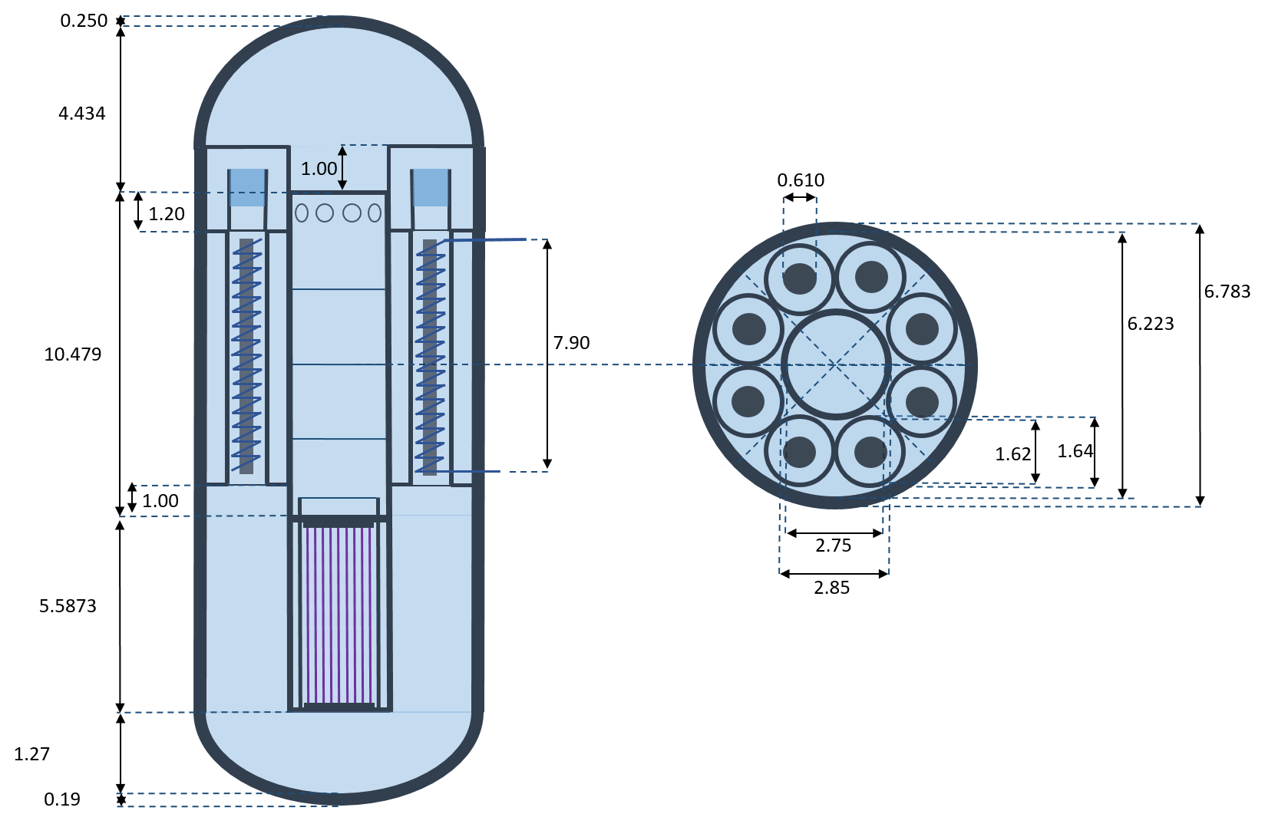
iPWR SASPAM-SA Design 2 MELCOR model
Design 2 is an iPWR reactor type characterized by the use of several passive systems, a dry containment and an electric power of about 300 MWe.
Generic IRIS design, no proprietary data have been used: the main geometric information determined by scaling the data available from the SPES-3 facility, and by engineering evaluation or public general data available for the IRIS reactor.
Design 2 MELCOR input deck developed by Sapienza in collaboration with ENEA and CIEMAT using MELCOR 2.2 r2023.0.6.
15th EMUG, Rome 17/04/2024

Slide 3
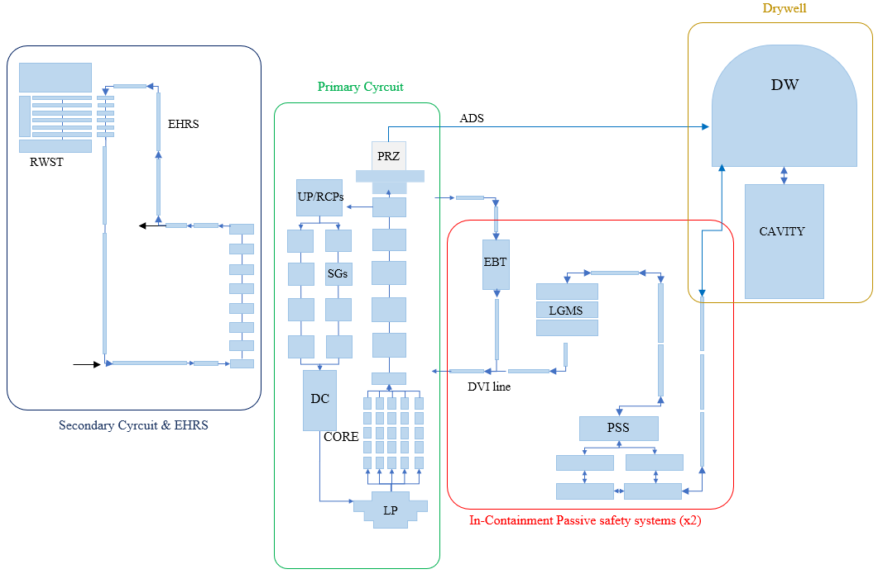
Design 2 Input Summary
The MELCOR input deck is composed by:
  121 CVH;
  122 HS;
  153 FL.
Modelled systems:
  Integral Primary circuit;
  Secondary circuit;
  Containment;
  Safety systems;
Input developed during activities in the EURATOM Project SASPAM-SA
15th EMUG, Rome 17/04/2024

Slide 4
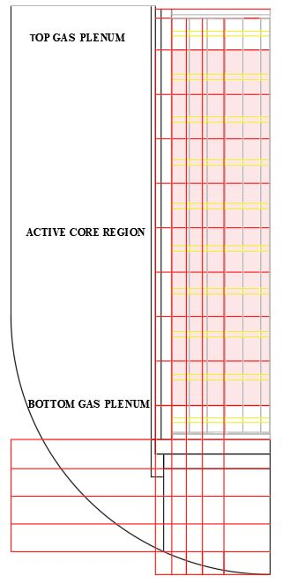
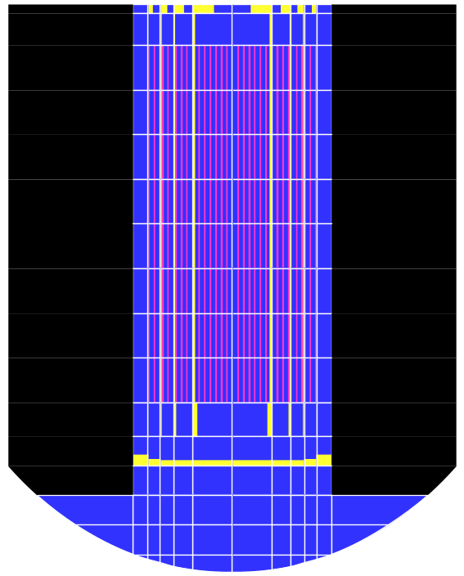
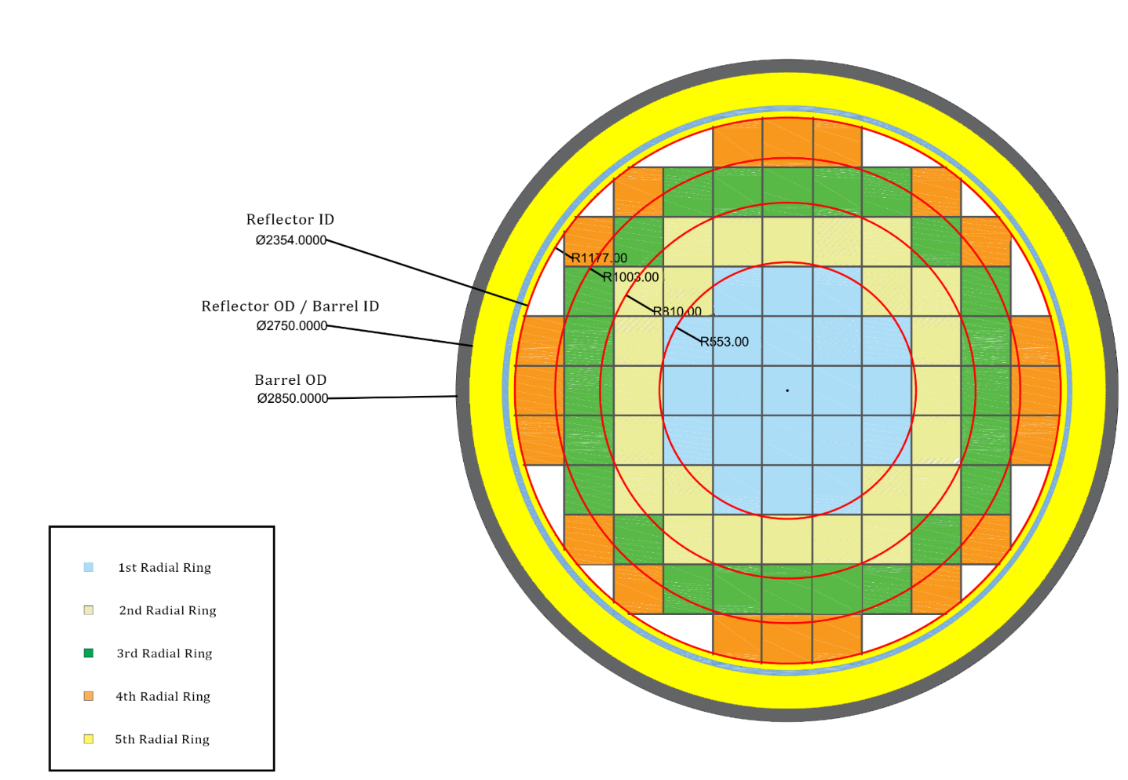
CORE and LP Nodalization
The CVH package is coupled with a more detailed nodalization of the COR package, (nodes doubled in height) which divide:
The “active” region into:
  5 concentric rings
  11 axial levels
  The Lower plenum into:
  6 concentric rings
  5 axial Levels
  The core inventory at shutdown comes from SASPAM-SA nuclide inventories, and decay heat is computed by ASTEC in SASPAM-SA framework, to keep consistency in the project.
15th EMUG, Rome 17/04/2024

Slide 5

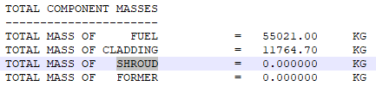
CORE and LP Nodalization
All relevant COR parameters (Radiation exchange Factors, Candling HTCs, Debris to LH HTC, Debris to Water HTC, Debris Velocity etc.) are adopted from MELCOR Best Practices (SOARCA, NUREG/CR-7008).
Input Open Issues:
Shroud/Reflector: initially, the reactor’s heavy reflector has been modelled along with the corresponding reactor type (PWR-HR). This led to the whole mass of reflector to be relocated along with the core support plate (COR_SHS does not work for PWR-HR). As an alternative the PWR reactor type was used, modelling the reflector as a Shroud component, but although the mass and geometry were inserted in the input, MELCOR output a 0 kg mass of shroud (might be a wrongful CVH/COR bypass input by user?).
Eutectics model NOT activated in v2023.0.6, due to consecutive code crashes at the start of degradation (Subroutine CORDBD). Trials with v2024 are ongoing.
PSS/Quench tank modelling.
15th EMUG, Rome 17/04/2024

Slide 6
SA transient analysis
The selected SA scenario is initiated by the guillotine rupture of the DVI line, along with the failure of every passive system: EBTs, LGMSs, EHRS, and ADS-1.
Simulation carried out with MELCOR v2023.0.6.
Failure is meant for the related line valves.
Low probability scenario.
15th EMUG, Rome 17/04/2024

Slide 7
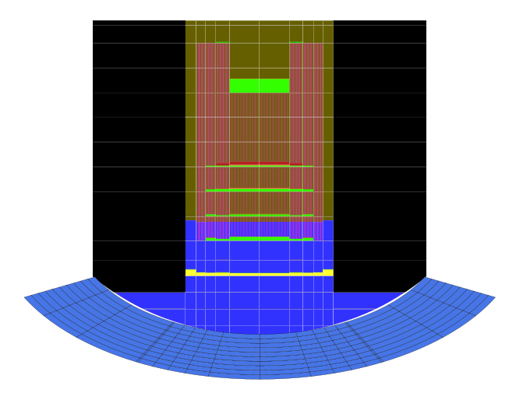
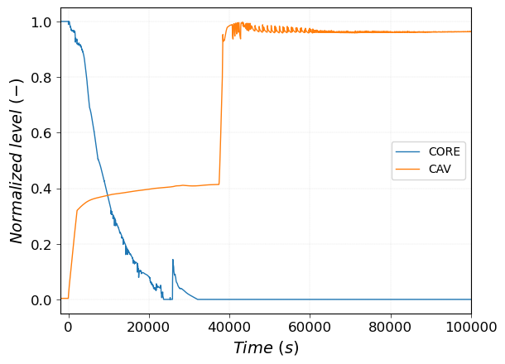
SA transient analysis
The simulation starts with 2000s of steady state, which is followed by the initiating event (SBLOCA): a progressive discharge of the vessel is observed.
After roughly 16000s from the rupture, core degradation starts. The containment pressure peaks at about 1.4 MPa, which is above the containment design pressure. A leak has been roughly implemented, but a more rigorous containment/leak modelling will be object of SASPAM-SA future activities.
PSS Reverse flow
Core and Cavity normalized water levels
Core and LH SNAP visualization at 16660 s
15th EMUG, Rome 17/04/2024

Slide 8
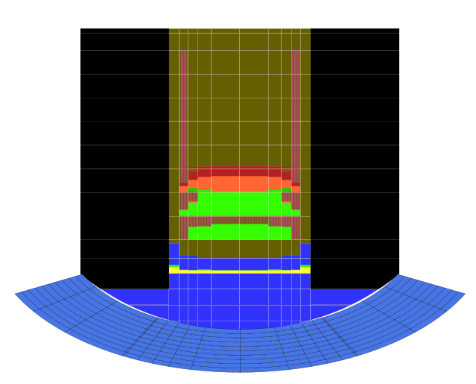
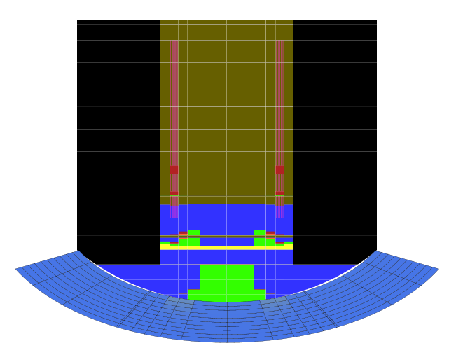
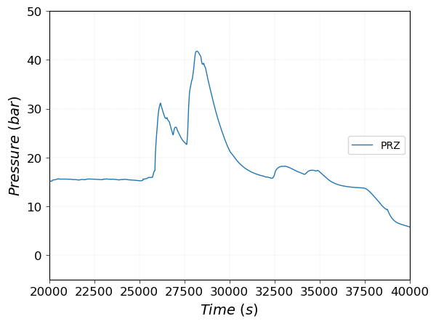
SA transient analysis
19800 s
26600 s
As degradation continues, we observe a progressive melting of the core, which eventually relocates in the LH, causing a double peak pressure, the maximum being of roughly 40 bar. The residual water boils off.
Primary pressure
15th EMUG, Rome 17/04/2024

Slide 9
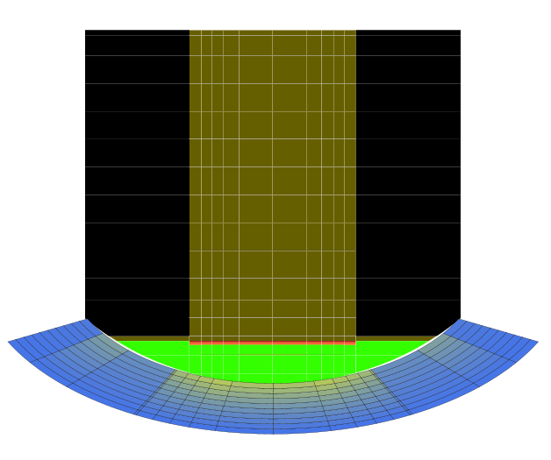
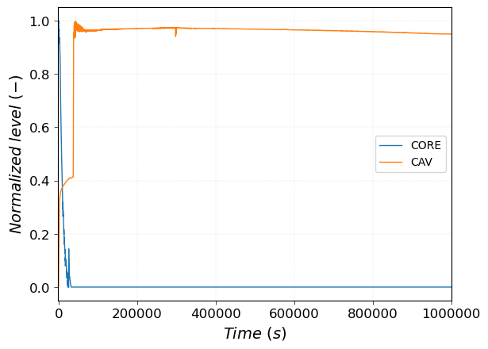
SA transient analysis
After relocation the particulate debris sits at the bottom of the LH, melting the lower support plate completely by radiative HT. The particulate pool sits in a stable state in the LH until the end of the simulation, set at 1’000’000 s.
The cavity water is at saturation temperature, and its level has a very low decrease rate.
LH transition elevation
1’000’000 s = 278 h
Core and Cavity normalized water levels
15th EMUG, Rome 17/04/2024

Slide 10
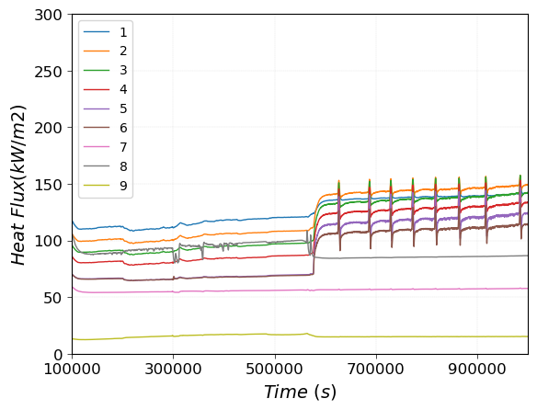
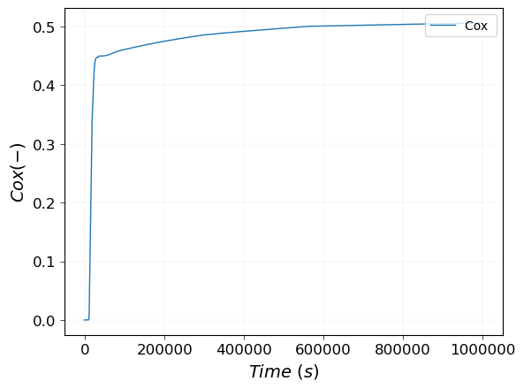
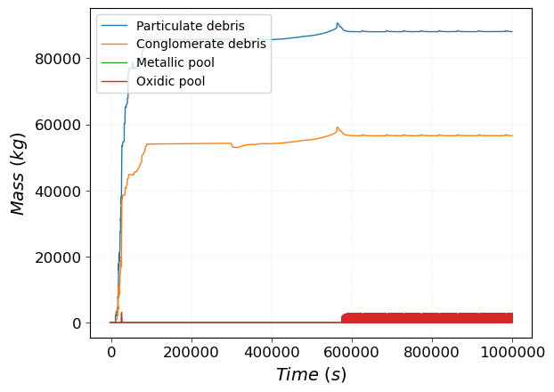
Some IVMR Results
Heat fluxes from PD to LH, per axial mesh
Zirconium Degree of Oxidation
Heat Fluxes are slowly increasing in the long term, with an average value of 68 kW/m2 at 10^6 s. No vessel ablation is registered.
Most of the problem’s oxidation occurs between 10000 and 30000 seconds, with a slow increase after relocation. Approximately 400 kg of H2 are produced. Its safety impact will be investigated in SASPAM-SA WP5 (containment)
A very consistent portion of the relocated material is resolidified as conglomerate debris, due to the quenching in the residual water pool at 20000 s. Every input structure ends up relocating in the Lower Plenum.
Masses in the Lower Plenum
15th EMUG, Rome 17/04/2024

Slide 11
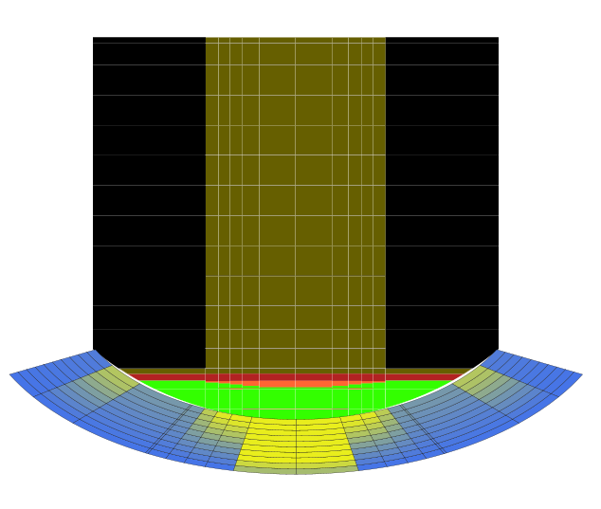
V2024 Simulation
Results are yet to be fully investigated
Vessel failure occurs at LH bottom by melting after 100’000 s from the initiating event
Decay Heat is slightly higher (Cause of failure?)
A portion of PD adiacent to vessel boundary melts, causing a “focusing effect” at the bottom?
100’000 s = 27 h
15th EMUG, Rome 17/04/2024

Slide 12
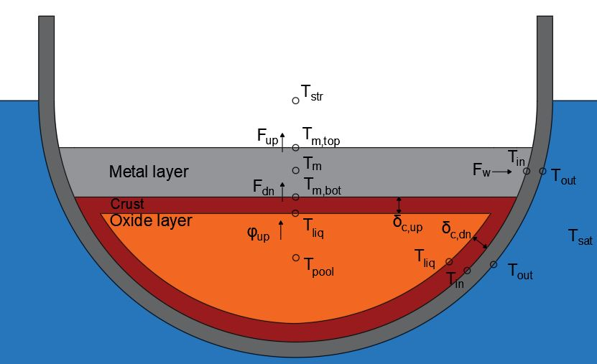
IVMR 0D model future comparison
Purposes: identify specificities of iPWRs with respect to HPRs in terms of IVMR configurations and provide SASPAM-SA partners a fast-running tool giving the magnitude of expected results
Will be adaptable to any Water-Cooled Design
From the MELCOR transient results it is clear that a fair comparison can’t be done for now (no particulate debris implemented in the 0D model)
A comparison would be possible by building a stand-alone lower plenum MELCOR calculation (with molten pool layouts)
15th EMUG, Rome 17/04/2024

Slide 13


Acknowledgement/Disclaimer
The research activity is carried out by Sapienza University of Rome with the MELCOR code, in the framework of the DIAEE-ISIN agreement signed on 13/05/2020 as part of the General Arrangement between the United States Nuclear Regulatory Commission (US-NRC) and the Italian National Inspectorate for Nuclear Safety and Radiation Protection (ISIN).
Funded by the European Union. Views and opinions expressed are however those of the author(s) only and do not necessarily reflect those of the European Union or European Commission-Euratom.
Neither the European Union nor the granting authority can be held responsible for them.

Slide 14
Thank you for your attention
15th EMUG, Rome 17/04/2024

