Slide 1
Development of a model for analysing LOCA scenarios involving lithium spills in fusion applications
M. Pérez, G. D´Ovidio, F. Martín-Fuertes
CIEMAT, Laboratorio Nacional de Fusión
The 15th Meeting of the European MELCOR and MACCS User Group
April 15th-18th, 2024

Slide 2
INDEX
Introduction.
  The IFMIF-DONES facility.
  MELCOR for fusion version.
Problem description.
Lithium spill estimate.
Spill function analysis.
Lithium spreading model.
Lithium Loop Cell MELCOR model.
Results & limitations.
Conclusions and ongoing activities.

Slide 3
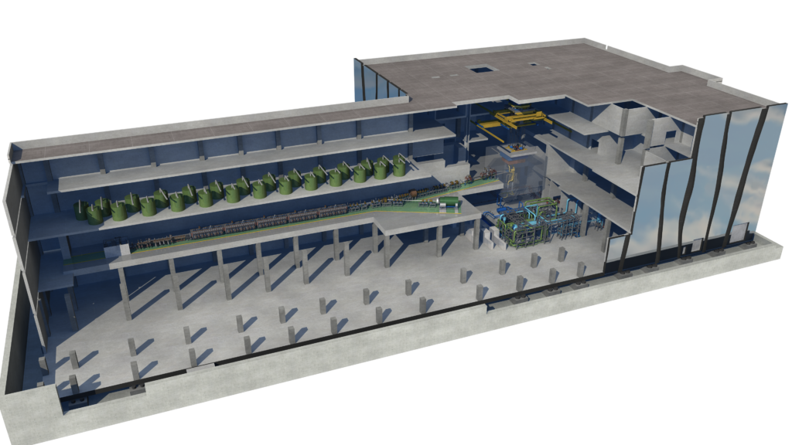
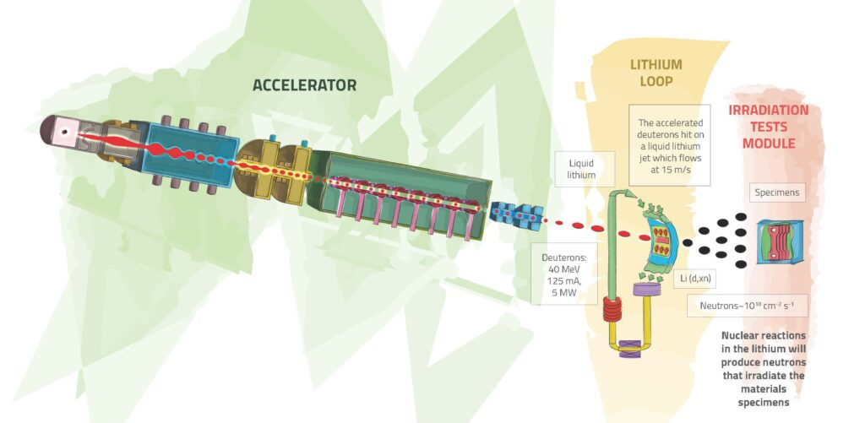
1. Introduction
Accelerator line
Test Cell
The IFMIF-DONES facility:
The IFMIF-DONES facility will be a research facility for testing, validating, and qualifying materials to be used in the future fusion power plants.
Objective of the DONES program: to develop a database of fusion-like neutron irradiation effects in the materials required for the construction of DEMO (Demonstration Fusion Power Reactor), and to provide a neutron source producing high-energy neutrons.
The accelerator will produce a D-beam, accelerating up to 40 MeV of energy (I = 125 mA, P_{th} = 5 MW), which will impact in lithium curtain flowing at 15 m/s → The stripping reactions will generate a large number of neutrons that will irradiate the material samples.
Lithium loop
Figure 1: Main building of IFMIF-DONES (Source: https://ifmif-dones.es/dones-program/dones-facility/)
Figure 2: Functioning scheme (Source: https://ifmif-dones.es/dones-program/dones-facility/)

Slide 4
MELCOR for fusion version:
In the safety activities for the IFMIF-DONES facility, MELCOR for fusion (v1.8.6) is being used for the deterministic analyses of the RAS (Reference Accident Scenarios) → MELCOR for fusion has been used for the ITER licensing and now for DEMO.
Version 1.8.6, developed by Idaho National Laboratory (INL).
Modifications:
  Oxidation of beryllium, carbon, or tungsten clad structures in steam environments;
  Condensation and freezing of water, or helium in cryogenic environments;
  Flow boiling heat transfer correlations;
  N₂, Li, PbLi or helium as the working fluid;
  Turbulent and centrifugal aerosol deposition;
  Enclosure radiant heat transfer;
  Lithium-air reaction model, &
  Transport model for tritiated water (HTO).
References:
  Merrill, B. J., Moore, R. L., Polkinghorne, S. T., & Petti, D. A. (2000). Modifications to the MELCOR code for application in fusion accident analyses. Fusion Engineering and Design, 51–52, 555–563. https://doi.org/10.1016/S0920-3796(00)00220-9
  Merril, B. J. (2000). Modifications made to the MELCOR code for analyzing lithium fires in fusion reactors.

Slide 5
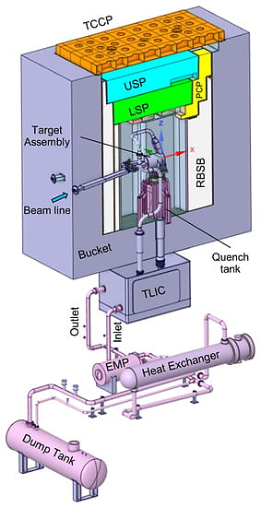
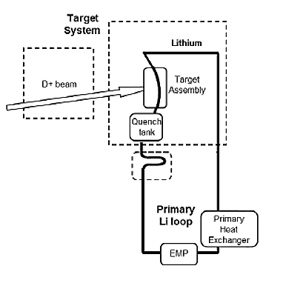
2. Problem description
Scenario analysed: break at the lowest height of the Primary Lithium Loop (PLO) with a lithium spill into the Lithium Loop Cell (LLC).
Main objective: to obtain the key metric of the time to reach lithium solidification.
To analyse the problem, 4 phases:
  Lithium spill estimate.
  Spill function (study of the spreading area as a function of time).
  Lithium spreading model, with the aim of capturing the heat transfer area evolution.
  Lithium Loop Cell MELCOR model.
TC
LLC
Break
Figure 3: Primary Li loop scheme (PLO) [16]
Figure 4: Test Cell and lithium loop of IFMIF-DONES [18]

Slide 6
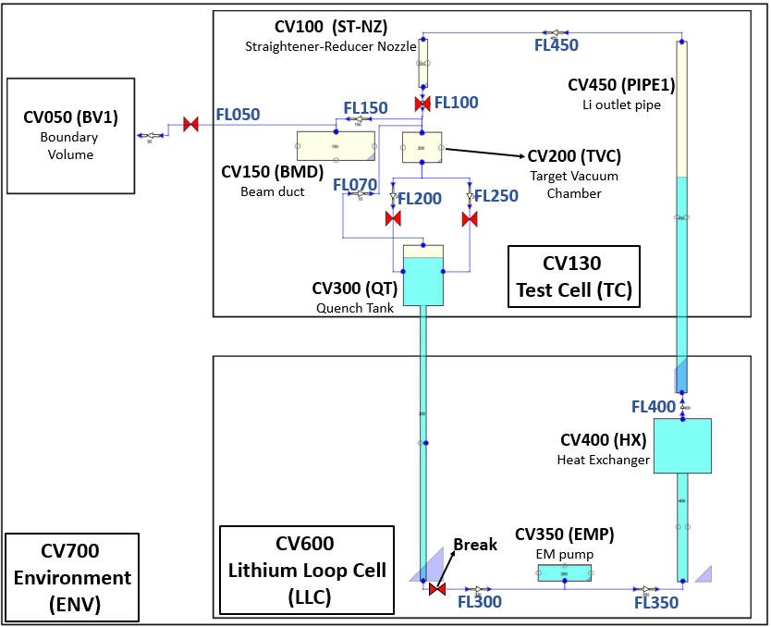
3. Lithium spill estimate
Main sections of the MELCOR model:
  Vacuum pumping system serving the Li loop through the beam duct (CV050);
  The Target Assembly, composed of the straightener-reducer nozzle (CV100), the Target Vacuum Chamber (CV200), and the last section of the beam duct (CV150);
  Quench Tank and Li outlet pipe (CV300);
  EM pump (CV350);
  Heat exchanger (CV400) and Li inlet pipe (CV450).
Steady-state (0 to 1000 s):
  Start-up sequence;
  Normal operation.
Transient starts at t = 1000 s:
  Beam shut-down.
Figure 5: SNAP view of the MELCOR model of DONES PLO

Slide 7
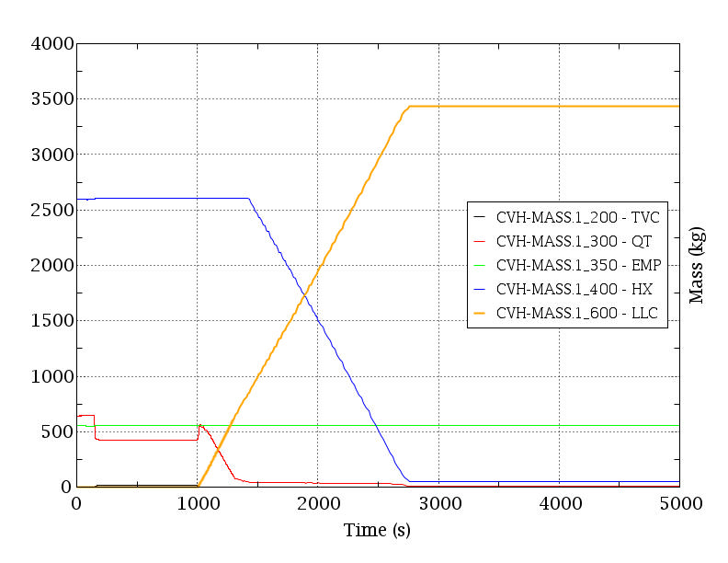
t ≈ 2860s
LLC
Evolution of Li mass in the PLO due to the break:
The mass of Li in the HX, the TVC and the QT decreases once the transient starts → PLO is partially drained.
Li mass spilled inside the LLC room reaches 3400 kg:
  80% of total inventory of the PLO.
  Linear behaviour (1.909 kg/s).
Ar filling the LLC atmosphere enters in the PLO in counter-current flow through the break.
≈ 3437.6 kg of Li
(80% of total inventory)
HX
EMP
TVC
QT
t = 1000 s
spill starts
Figure 6: Evolution of the Li mass in the PLO due to the break

Slide 8
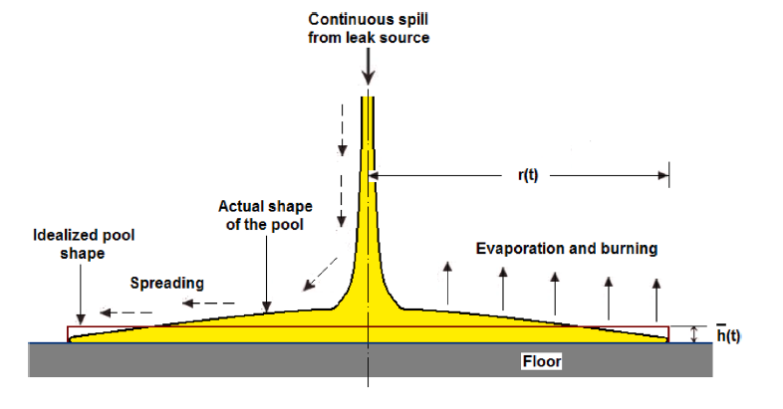
4. Spill function analysis
Based on reference [15] → Numerical studies to analyse the propagation characteristics of accidental spill of liquid Na in Fast Reactors (SFR).
The expansion of the liquid is a function of time: as time passes, the total area of the pool formed will be larger, increasing the surface area and, therefore, increasing the heat transfer area, and the heat transfer itself.
Figure 7: Schematic of continuous leak scenario [15]
Figure 8: Time varying pool radius for large leak rate for Na spills [15] and Li spill
From the analysis of the Na spills → extrapolation and evaluation of the evolution of the pool radius formed in a Li spill as a function of time.
Continuous leakage (estimated with our MELCOR model).
Two phases of spreading & pool – floor heat transfer:
  1st phase → Fast spreading (central area) → turbulent regime.
  2nd phase → Slower spreading → laminar regime.

Slide 9
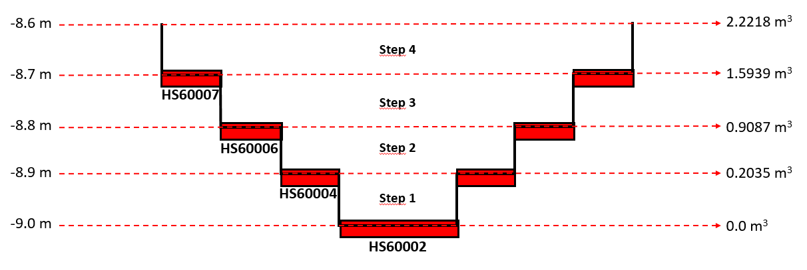
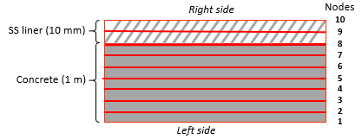
5. Lithium spreading model
Table 1: Characteristic parameters of continuous lithium spill spreading
Time (s) | Pool radius (m) | Total spreading area (m²) | Total Li mass spilled (kg) | Total Li volume spilled (m³)
0 | 0 | 0 | 0 | 0
60 | 4.75 | 70.88 | 107.86 | 0.2035
240 | 8.32 | 217.47 | 481.64 | 0.907
420 | 9.38 | 276.41 | 844.77 | 1.5939
600 | 10.1 | 320.47 | 1177.599 | 2.2218
Adaptation to MELCOR modelling is challenging:
Objective: to capture in detail the progressive heat transfer phases (liquid Li to LLC floor) → “Steps” MELCOR model.
Two phases of spreading:
    First phase → Fast, turbulent phase → Central HS
    Second phase → Laminar phase
Heights
Figure 9: MELCOR model for the Li spreading pool
Total volume
Step 4
Step 3
Step 2
Step 1
Laminar Heat Transfer Coefficient ≈ 50 W/m²K (fixed by user)
Turbulent Heat Transfer Coefficient ≈ 712 W/m²K (calculated by MELCOR-fusion)
Lc = A/p
Figure 10: HSs layout

Slide 10
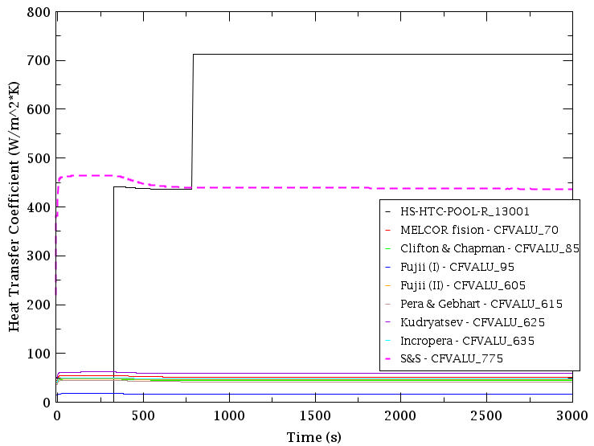
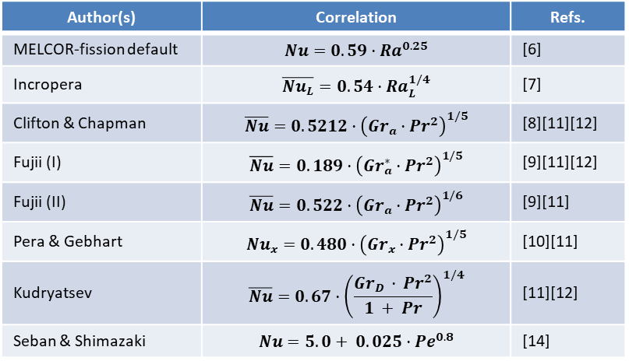

Table 2: List of correlations analysed with MELCOR
Author(s) | Correlation | Refs.
MELCOR-fission default | $$Nu=0.59·{Ra}^{0.25}$$ | [6]
Incropera | $$\overline{{Nu}_{L}}=0.54·{Ra}_{L}^{1/4}$$ | [7]
Clifton & Chapman | $$\overline{Nu}=0.5212·{\left({Gr}_{a}·{Pr}^{2}\right)}^{1/5}$$ | [8][11][12]
Fujii (I) | $$\overline{Nu}=0.189·{\left({Gr}_{a}^{∗}·{Pr}^{2}\right)}^{1/5}$$ | [9][11][12]
Fujii (II) | $$\overline{Nu}=0.522·{\left({Gr}_{a}·{Pr}^{2}\right)}^{1/6}$$ | [9][11]
Pera & Gebhart | $${Nu}_{x}=0.480·{\left({Gr}_{x}·{Pr}^{2}\right)}^{1/5}$$ | [10][11]
Kudryatsev | $$\overline{Nu}=0.67·{\left(\frac{{Gr}_{D }· {Pr}^{2}}{1 + Pr}\right)}^{1/4}$$ | [11][12]
Seban & Shimazaki | $$Nu=5.0+ 0.025·{Pe}^{0.8}$$ | [14]
HTC correlation for liquid metals in natural convection:
Purpose of the study → Identify the correlation used by MELCOR for fusion to calculate the HTC for liquid metals.
Preliminary study of the flow regime calculated by MELCOR & the criteria used → Laminar natural convection (as a result of spilled liquid velocity/break size).
Identification of several correlations for liquid metals available in the literature, including the one used by MELCOR-fission (v.1.8.6) in the MELCOR manuals, and those used in previous work analysing the same problem → Comparison of all correlations identified with MELCOR.
MELCOR-fusion version uses Seban & Shimazaki correlation for HTC calculation (not reported in manuals!) → S&S gives a HTC factor of 4 higher than other correlations (C&Ch, Fujii…), for natural convection, laminar regime.
Seban & Shimazaki correlation
$$\left[Nu=5.0+0.025·{Pe}^{0.8}\right]$$
Figure 11: Comparison of correlations for HTC

Slide 11
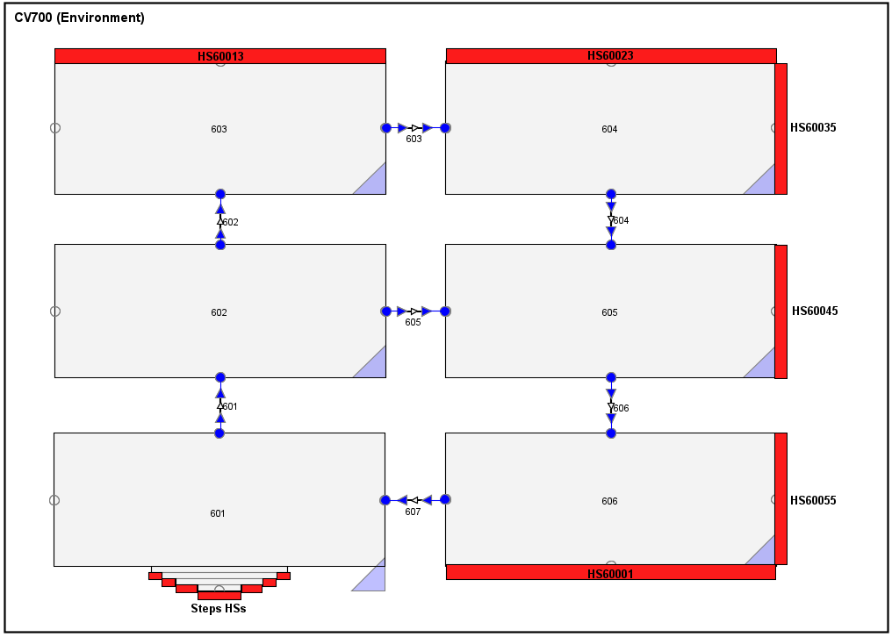
6. Lithium Loop Cell MELCOR model
Objective: to capture the heat transfer between the liquid Li and the room atmosphere.
LLC divided in 2 rings (inner and outer), which in turn are subdivided into 6 CVs.
Steps model located in the inner ring, where the Li spills occurs. Walls, floor and ceiling have been modelled as HS.
Modelling also needs to take care of POOL-ATM heat transfer in LLC, also under free or forced convective regime in the spill cell (as predicted by MELCOR criteria), while the energy is afterwards distributed in the whole room.
The spill function has been extrapolated in the case of a leakage of 4500 kg of Li (PLO is completely empty – worst case).
LLC ceiling HS
CV603
FL603
CV604
FL602
FL604
CV602
CV605
LLC wall HS
Inner ring
FL605
Outer ring
FL601
FL606
CV601
CV606
FL607
Spill
Floor HS
Figure 12: Lithium Loop Cell MELCOR model

Slide 12
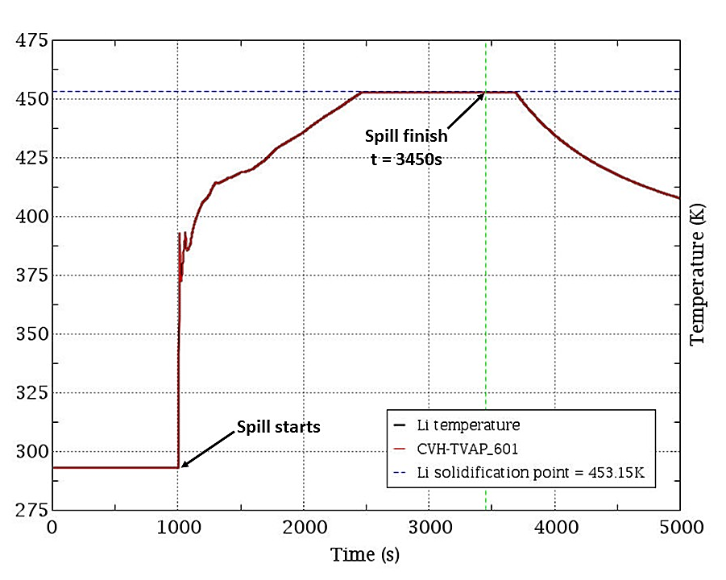
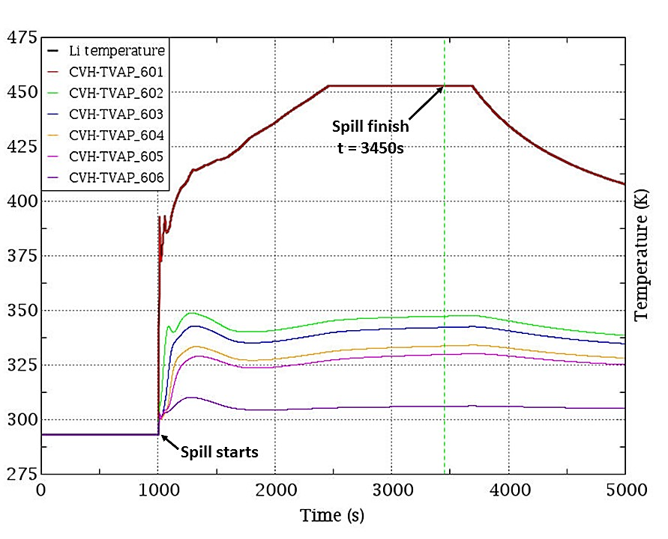
7. Results & limitations
t = 2400 s
t = 3700 s
SOLID PHASE
Figure 13: Temperature transient in CV601
Figure 14: Evolution of the atmosphere temperatures during the transient
Solid phase is predicted during ≈ 2900 kg of the Li spill (the first 1400 s of transient); then, solid & liquid phases cohexist until the end of the spill.
A convection pattern is formed: heat rises through the Inner Ring (CV601, CV602, and CV603) and descends through the Outer Ring (CV604, CV605, and CV606) → Energy is distributed in the whole room.

Slide 13
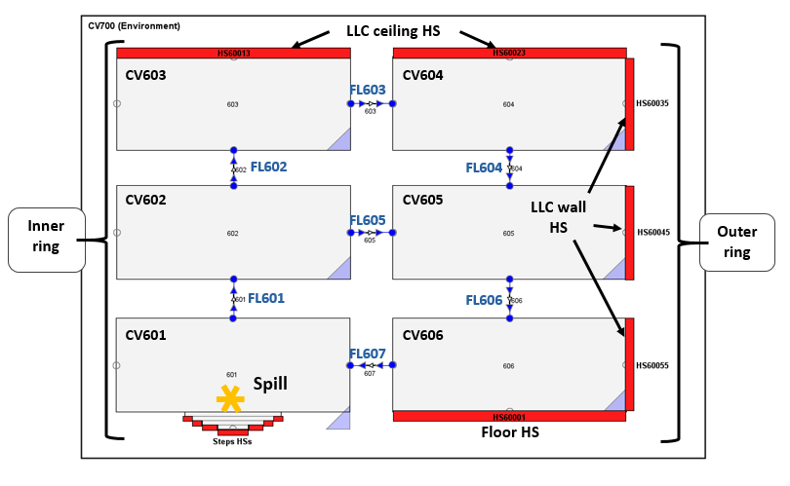
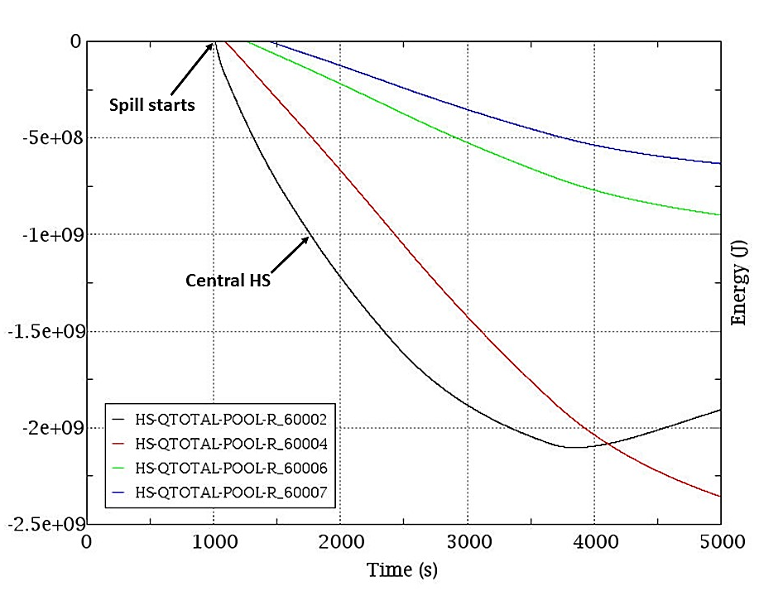
Heights
Total volume
Step 4 HS
Step 3 HS
The heat transfer rate of the spilled Li at the beginning of the spill is high, decreasing as the temperature of the LLC liner increases.
Spill front progress with the time.
Step 2 HS
(Step 1 HS)
Figure 15: Total energy transferred across the 4 floor Li wetted HSs: central, second, third, and fourth (HSs from the “steps” MELCOR model located in CV601)

Slide 14
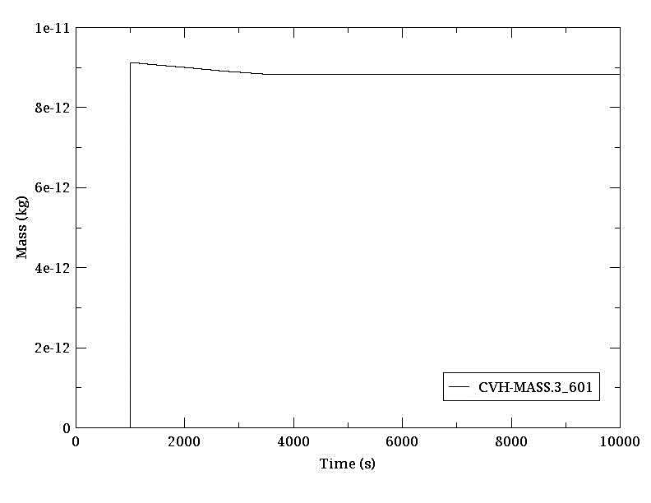
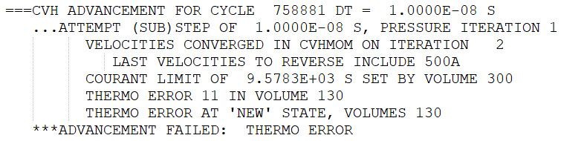
Limitations of the MELCOR-fusion version:
No solid lithium is allowed as hydrodynamic material in the CVH package.
Computational errors appear due to the Li Equation of State (EoS) extrapolation when approaching the solid phase:
  THERMO ERROR 11, related to the low amounts of Li vapour (≈ 10⁻¹¹ - 10⁻¹² kg).
MELCOR-fusion uses the Seban & Shimazaki correlation for laminar and/or turbulent regime.
MELCOR-fusion is programmed to automatically switch from non-equilibrium to equilibrium thermodynamic conditions between vapour and liquid in a CV whenever the fluid´s temperature reaches the melting point.
Figure 16: Mass of lithium vapour in CV601

Slide 15
8. Conclusions and ongoing activities
The analysis of the proposed scenario has been divided into 4 phases:
  Different MELCOR models have been developed for the analysis of each phase.
  The correlation for the HTC calculation using by MELCOR-fusion has been verified → Seban & Shimazaki correlation.
The results obtained are positive:
  The temperature reached by Li is not high;
  The time during which there is a liquid phase is 1400 s (≈ 20 minutes).
Depending on the problem, it is important to subdivide the volume into several smaller volumes in order to correctly capture the different convection movements formed;
  The heat transfer depends on these convection movements formed, in addition to the heat transfer through walls, ceiling, floor, etc. of the room.
Several limitations in modelling with MELCOR-fusion have been experienced:
  MELCOR-fusion upgrade needed (see reference [19]).
The results have been obtained from simplified MELCOR models → a more refined model is under development (main focus of thesis):
  Matlab program to analyse in more detail the heat transfer between the liquid Li with floor, atmosphere, walls, etc.

Slide 16
Thank you for your attention!
E-mails:
manuel.perez@ciemat.es
gianluca.dovidio@ciemat.es
francisco.martin-fuertes@ciemat.es

Slide 17
References
# | Author | Title of work | Source | Doc. Type | DOI or document locator
1 | F. Martin-Fuertes et al. | SC04.D012 - Safety analysis report-2021 | Eurofusion IDM | Report | EFDA_D_2PHGE4, v1.0
2 | G. D’Ovidio, F. Martín-Fuertes & F. Ogando | Review and Update of DONES Deterministic Accident Analyses in 2020 | Eurofusion IDM | Report | EFDA_D_2NCSBK, v1.0
3 | Danilo Nicola Dongiovanni | ENEA contribution to Accident Analyses | Eurofusion IDM | Report | EFDA_D_2NQXM6, v1.1
4 | S. Bermejo, P. Fernández & A. García | Accidents by Lithium fire | Eurofusion IDM | Report | EFDA_D_2NFDW9, v1.0
5 | R. O. Gauntt, J. E. Cash, et al. | MELCOR Computer Code Manuals Vol. 1: Primer and Users´ Guide | - | Manual | -
6 | R. O. Gauntt, J. E. Cash, et al. | MELCOR Computer Code Manuals Vol. 2: Reference Manuals | - | Manual | -
7 | Incropera, DeWitt, Bergman & Lavine | Fundamentals of Heat and Mass Transfer, 6th edition | - | Book | -
8 | J. V. Clifton & A. J. Chapman | Natural convection on a finite-size horizontal plate | Int. J. Heat and Mass Transfer | Paper | DOI: 10.1016/0017-9310(69)90092-1
9 | T. Fujii, H. Honda & T. Morioka | A theoretical study of natural convection heat transfer from downward-facing horizontal surfaces with uniform heat flux | Int. J. Heat and Mass Transfer | Paper | DOI: 10.1016/0017-9310(73)90227-5
10 | L. Pera & B. Gebhart | Natural convection boundary layer flow over horizontal and slightly inclined surfaces | Int. J. Heat and Mass Transfer | Paper | DOI: 10.1016/0017-9310(73)90126-9

Slide 18
# | Author | Title of work | Source | Doc. Type | DOI or document locator
11 | N. Sheriff & W. Davies | Liquid metal natural convection from plane surfaces: a review including recent sodium measurements | Int. J. Heat and Mass Transfer | Paper | DOI: 10.1016/0142-727X(79)90002-X
12 | IAEA | Challenges related to te used of liquid metal and molten salt coolants in advanced reactors | - | Report | -
13 | N. Zuckerman & N. Lior | Jet impingement heat transfer: physics, correlations, and numerical modeling | Advances in Heat Transfer | Book | DOI: 10.1016/S0065-2717(06)39006-5
14 | R. A. Seban & T. Shimazaki | Heat transfer to a fluid flowing turbulently in a smooth pipe with walls at constant temperature | University of California | Report | -
15 | S. Muthu Saravanan, P. Mangarjuna Rao & S. Raghupathy | Analysis of liquid sodium spills spreading on floor Surface pertaining to sodium pool fires events in SFR cells | Nuclear Engineering and Design | Paper | DOI: 10.1016/j.nucengdes.2020.110614
16 | IFMIF-DONES Team | IFMIF-DONES Plant Description Document | Eurofusion IDM | Report | EFDA_D_2MP8HQ, v3.0
17 | R. P. Cleaver, P.S. Cronin & J. A. Evans | An experimental study of spreading liquid pools | IChemE (Institution of Chemical Engineers) | Paper | https://www.icheme.org/media/10158/xvi-paper-13.pdf
18 | A. Zsákai et al. | Integrate design of the vacuum and safety barrier between the Lithium and Test Systems of IFMF-DONES | Journal of Nuclear Engineering | Paper | DOI: 10.3390/jne4010004
19 | F. Mascari et al. | Current status of MELCOR 2.2 for fusion safety analyses | Fusion Engineering and Design | Paper | DOI: 10.1016/j.fusengdes.2023.113869

Slide 19
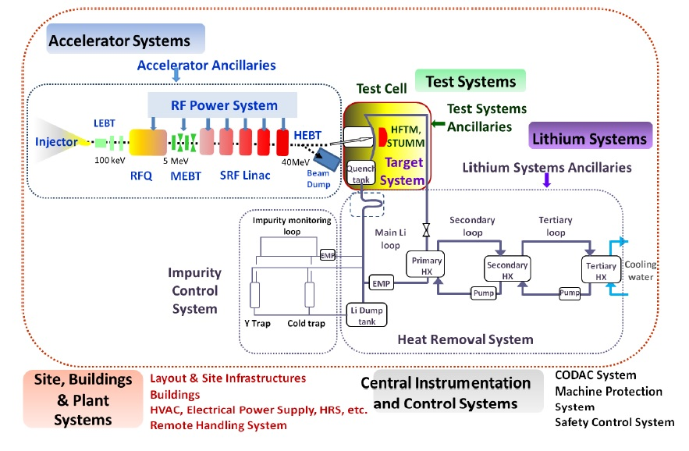
IFMIF-DONES scheme
Schematic plant configuration (Source: Ibarra, A. et al. (2018). ‘The IFMIF-DONES Project: Preliminary engineering design’. Nuclear Fusion, 58(10))

Slide 20
Control logic of the MELCOR model for the lithium spill estimate
Steady-State
Break in the inlet nozzle of the TVC (t = 1000 s)
  Generated when SU1, SU3 & SU45 are reached
  t = 202 s
  From 0 to 5 MW in 100 ms
  t = 202 s
Beam shut-down
Start-up phase
  Pressure >= 1000 Pa
  t = 113 s
  T >= 250 ºC
  t = 124 s
  Q >= 50 kg/s
  t = 203 s
  t = 114 s
  t = 214 s
SU
SU1
SU2
SU3
SU4
SU5
SU7
SU9
NO
Partial vacuum pressure in TVC OK
Li temperature in the target OK
Normal Operation
EMP start-up
Li mass flow rate OK
Generation of the “ready for beam” signal
Beam power injection in the target
Nominal pressure head and flow rate achieved
1. TVC gas pressure > 1 kPa
2. Li jet velocity <= 5 m/s
3. Li temperature inside TVC > 583 K (310 ℃)
4. QT lithium level < 0.5 m
Start-up sequence
Transient

Slide 21
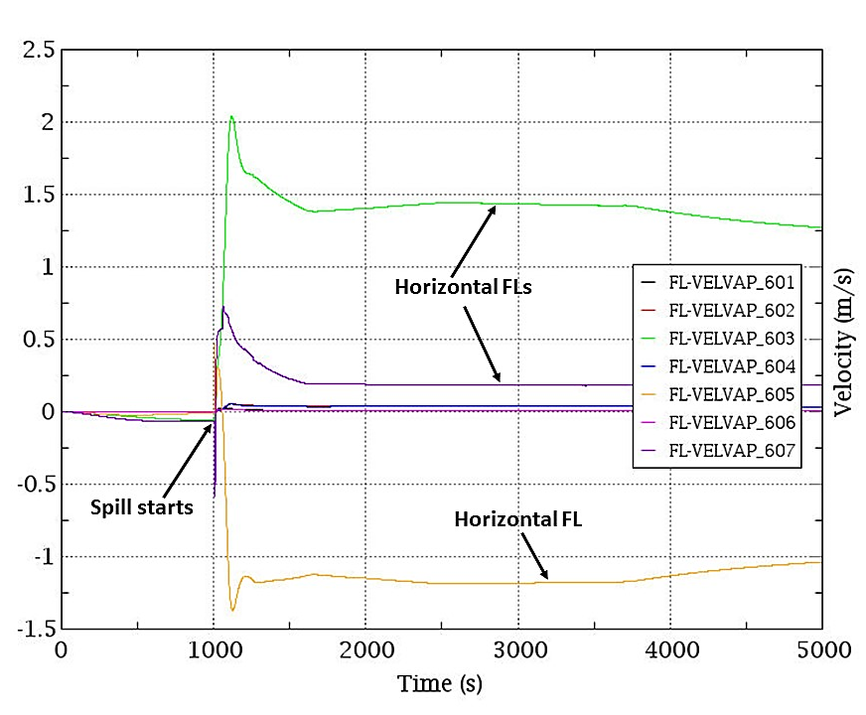
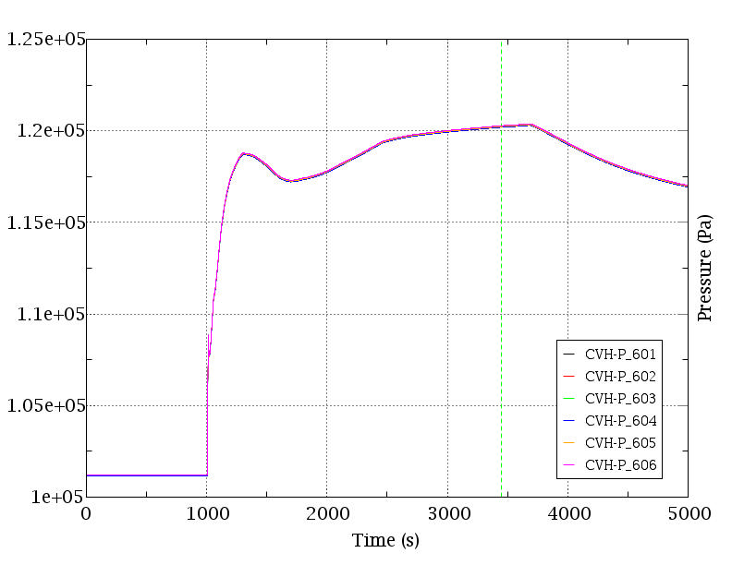
More results of LLC MELCOR model…
Spill finish
t = 3450 s
Spill starts
Figure: Air flow velocity though the FLs
Figure: Pressure transient
The highest velocities is reached in the horizontal FLs that connect the Inner Ring with the Outer Ring → convection pattern.
Pressure reached by the CVs is very similar due to the fast propagation of the pressure wave → maximum peak of ≈ 1.2E5 Pa (≈ 300 s after the end of the spill).

Slide 22
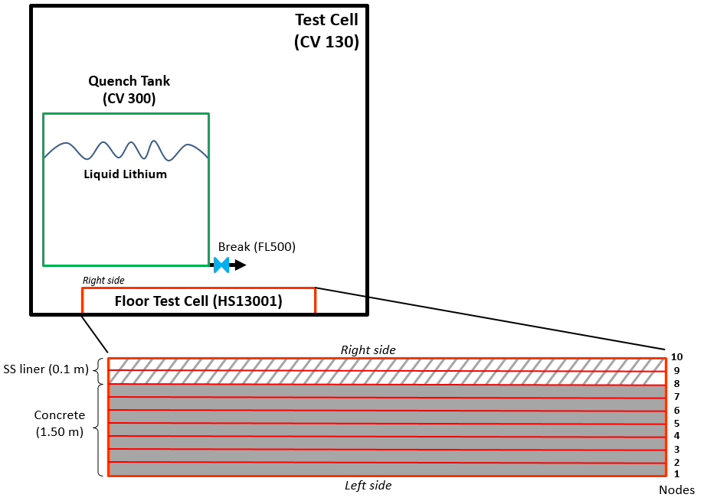
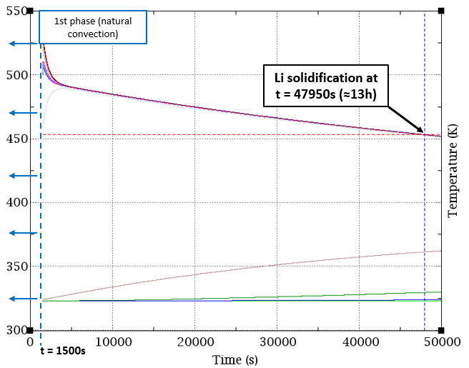
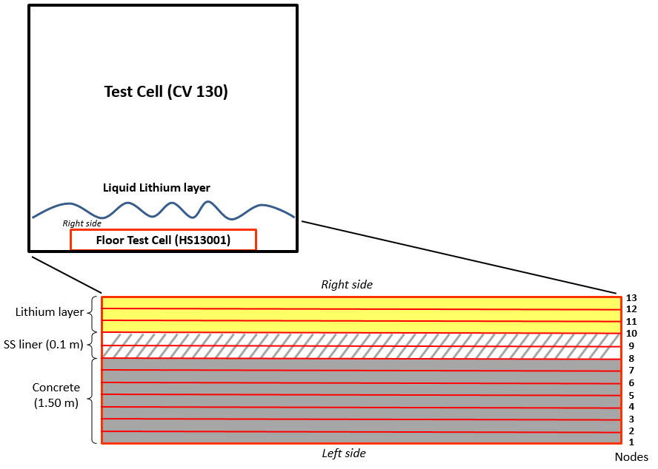
Another scenario: break in the Quench Tank (QT) with a Li spill into the Test Cell (TC)
MELCOR model for lithium spill (natural convection phase).
Attempted solution: divide the problem into 2 phases:
  First phase (short): break in the QT and lithium spill.
  Second phase (long): start after finishing the lithium spill and the mass remains static → Lithium modelled as a HS layer
Results obtained: Li solidification time of ≈ 13 hours.
MELCOR model for lithium spill (conduction phase).
HS nodes temperature transient for 2nd phase (heat transfer by conduction)

