Slide 1



Overview of Sapienza MELCOR activities in the frame of the EUROfusion consortium
Matteo D’Onorio
Tommaso Glingler
Gianfranco Caruso
matteo.donorio@uniroma1.it

Slide 2
Outline
Introduction
Overview on EU-DEMO reactor Nuclear Safety
TH nodalization of the EU-DEMO reactor main systems
Accident analysis made for EU-DEMO
  Accident analysis made for ITER TBS
MELCOR-RAVEN coupling
Uncertainty analyses, optimization problems, DET
Conclusions
Notes:
I briefly introduce the EU-DEMO reactor and the TH nodalization developed to perform safety analysis. Thus, I will give an overview of these safety analysis made for the DEMO. As well as, I will shortly discuss also about some activities made for the ITER TBS. After that I move to the desription the MELCOR-RAVEN coupling activity, focusing on some applications related to UQ, Opt and DET.

Slide 3
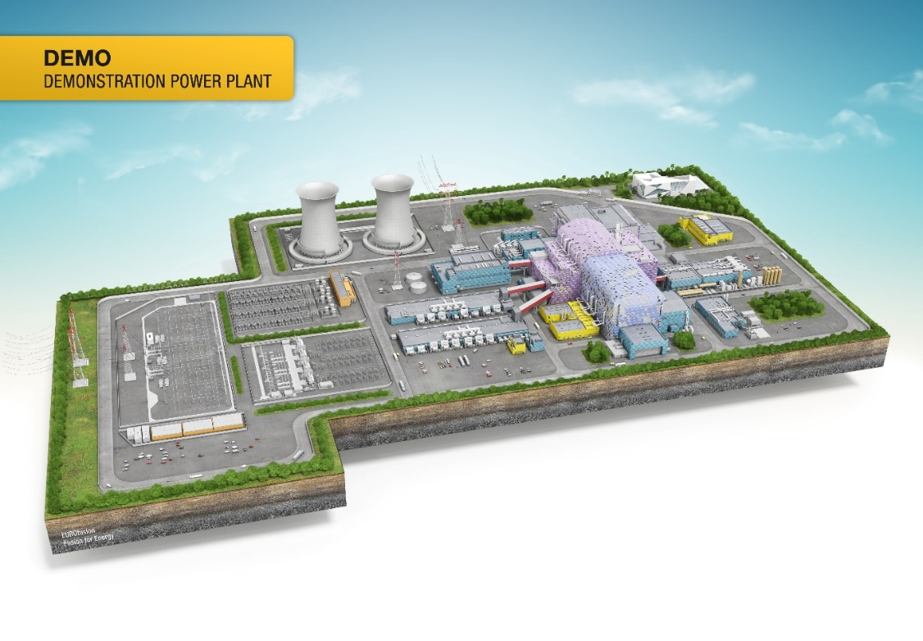

Introduction and background
DEMO must demonstrate the viability of fusion as an energy source:
Demonstrate reliable plasma operation
Tritium-self sufficiency
Several full power years
Fusion power plant relevance: Allow extrapolation of DEMO solutions to a fusion power plant
Conversion of heat into 100s of MW electricity
Minimize activation waste
Parameter | Unit | Quantity
Fusion power | MW | 2006
Major radius, R₀ | m | 9.0
Plasma current | MA | 20
Toroidal field, B₀ at R₀ | T | 4.9
Auxiliary heating power, P_{inj} | MW | 50
Auxiliary ramp-up power, P_{ramp-up} | MW | ~100
Pulse length | hr | 2
Dwell time | min | ~10
Notes:
The short-term goal of the ongoing fusion R&D activities is to create and control a burning plasma. For this purpose, there is the ITER project. Parallel to the ITER, a DEMOnstration power plant needs to be designed. The EU-DEMO must demonstrate the possibility to SAFELY generate electricity through nuclear fusion reactions.

Slide 4
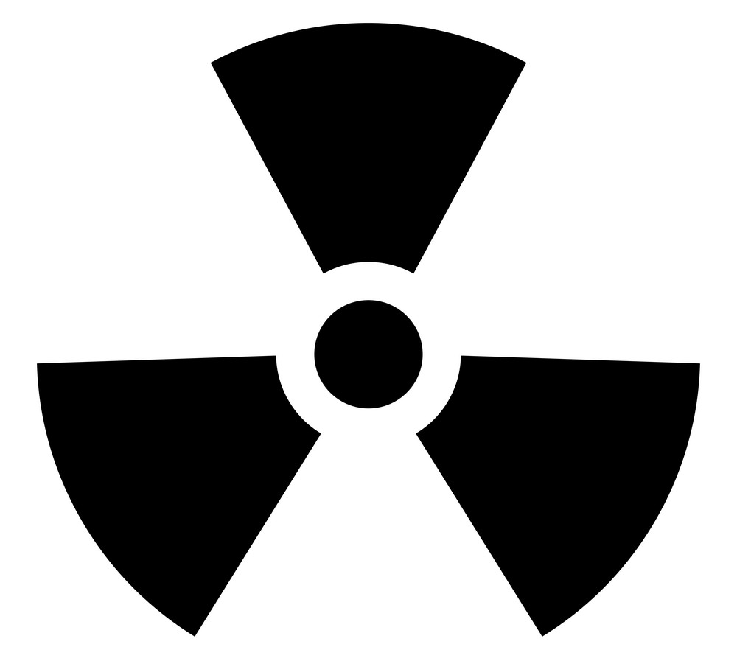
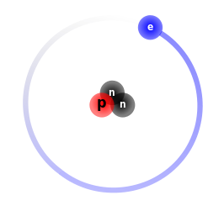
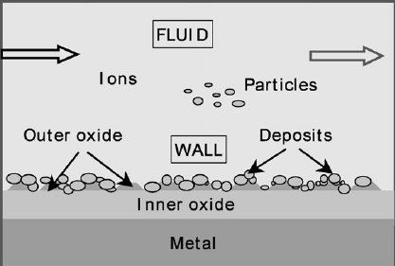
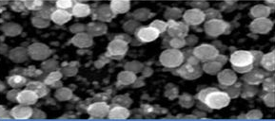
Fusion Power Safety issues
TRITIUM
Energy sources in EU-DEMO
Parameter
Plasma thermal energy
Plasma magnetic energy
Magnets system magnetic energy
Enthalpy in the first wall/blanket cooling channel
Enthalpy in the divertor cooling channel
Decay heat just after shut-down
Decay heat one day after the shut-down
Decay heat one month after the shut-down
Chemical potential energy with tungsten (W-steam reaction)
ACTIVATED
CORROSION
PRODUCTS
RADIOACTIVE
TUNGSTEN DUST
Notes:
The fusion power have some safety features that are attractive in spite of the its “nuclear” characteristic. For example the intrinsic tendency of the plasma to shut-down without the human intervention. However, the lack of the risk of a chain reaction does not mean the absence of any nuclear risk. In fact there is a source term into tokamaks that can be mobilized toward the enviorenment during an accident. The main source term are Tritium: b-emitter. The most dangerous compound that tritium can form is the tritiated water, because of its high solubility into human body fluids. Materials activated under nuclear loads, and in particular activate corrosion products. And activated dust. Tons of dust are in fact produced inside Tokamak machine mainly by plasma erosion.
Together with the source term there are also a lot of energy sources that can trigger an accident or that can mobilize the radioactive inventory. As you can see there is the energy from the plasma, the enthalpy energy in cooling loop, decay heat, and energy generated from exothermic chemical reactions. Moreover other safety issues.
So our goal is to perform safety studies to support the design of tokamak plants and to estimate accident consequences in terms of source term mobilization also in support a future licensing process.

Slide 5
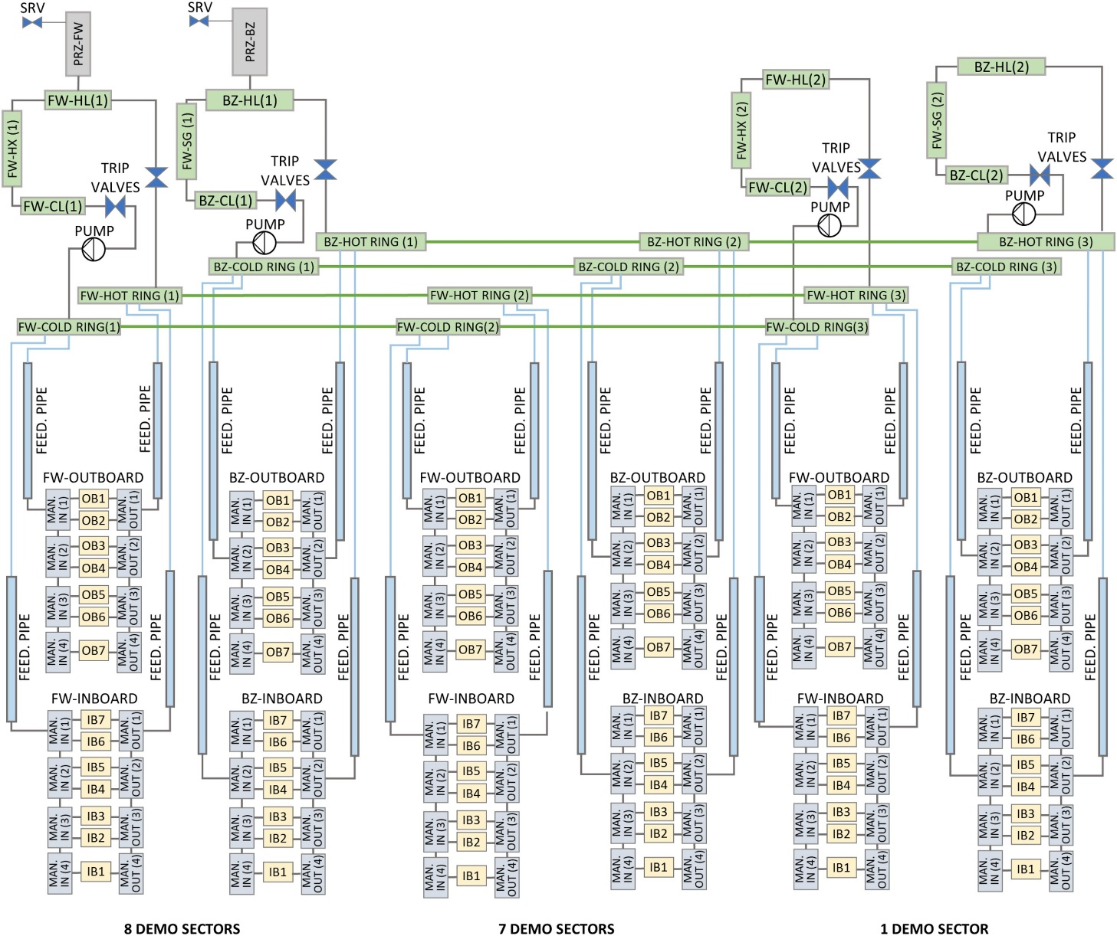
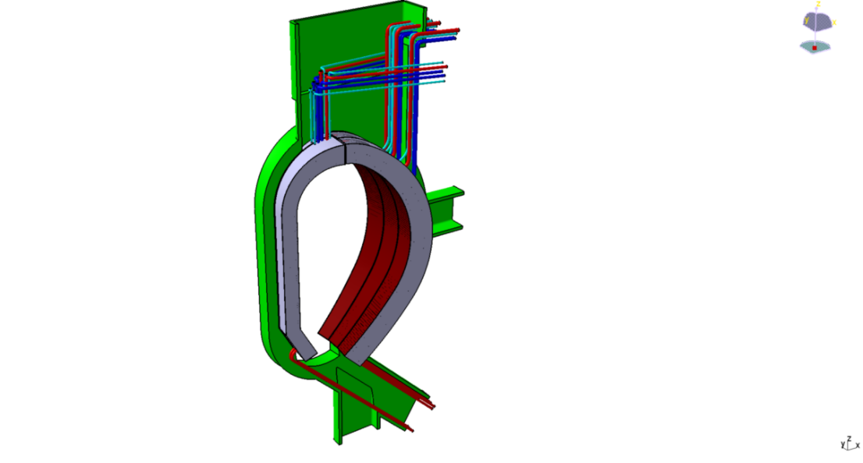
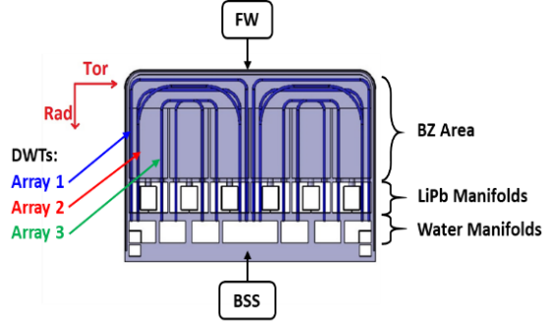
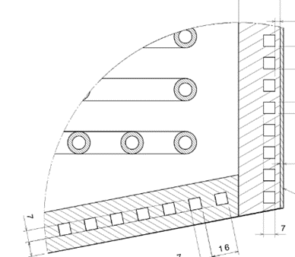
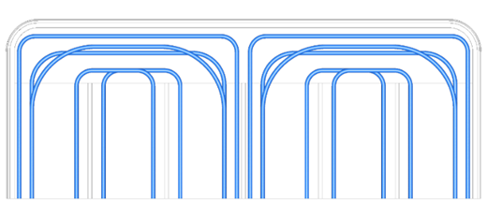
EU-DEMO PRIMARY HEAT TRANSFER SYSTEM TH MODEL
Water Cooled lead-lithium (WCLL)
Breeding Blanket Concept
16 sectors in the toroidal direction
Each sector includes 3 OB segment and 2 IB segments
The single segment is constituted of about 100 breeding cells
FW and BZ cooling system are independent
1 SECTOR
1 BREEDING CELL
FW COOLING CHANNELS
Notes:
The first component to be modeled is of course the primary heat transfer system. We here are referring to the Water-Cooled Lead Lithium blanket concept. The EU-DEMO design consists of 16 sectors in the toroidal direction. Each sector is composed by hundreds of breeding cells distributed along the poloidal direction. The breeding cells are cooled by two independent systems with water at typical PWR conditions.
On the right side you can see the nodalization scheme. The whole EU-DEMO has been modeled with the division in three different regions simulating respectively 1 sector, a group of 7 sectors (from sector 2 to sector 8), and a group of 8 sectors (from sector 9 to sector 16). It includes the FW and BZ cooling loops, the blanket manifolds, the feeding pipes, the ex-vessel collector rings, the pressurizers, the heat exchangers system.
The overall segments have been poloidally divided in seven different volumes (OB1 to OB7 and IB1 to IB7). Each sector has been modeled to investigate both inboard and outboard segments behavior during the accident sequences. FW and BZ manifolds distribute water to the modules.

Slide 6
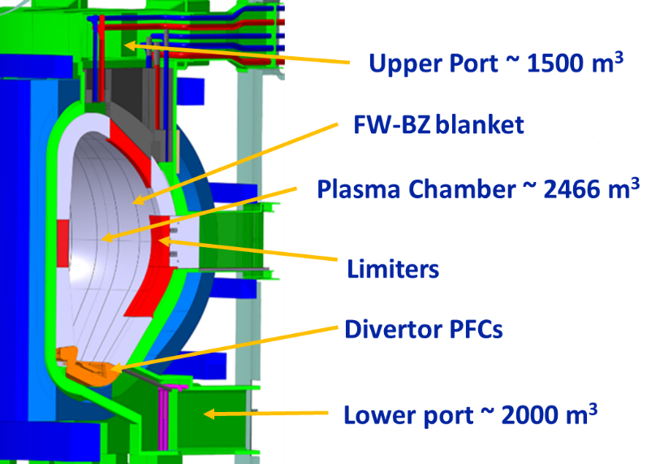
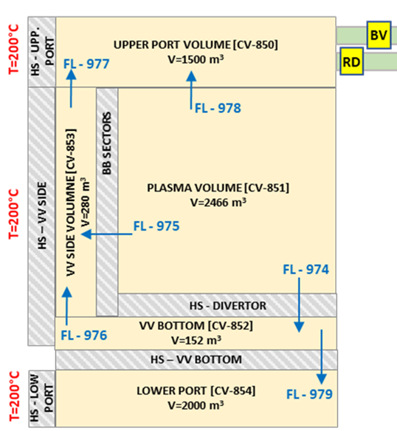
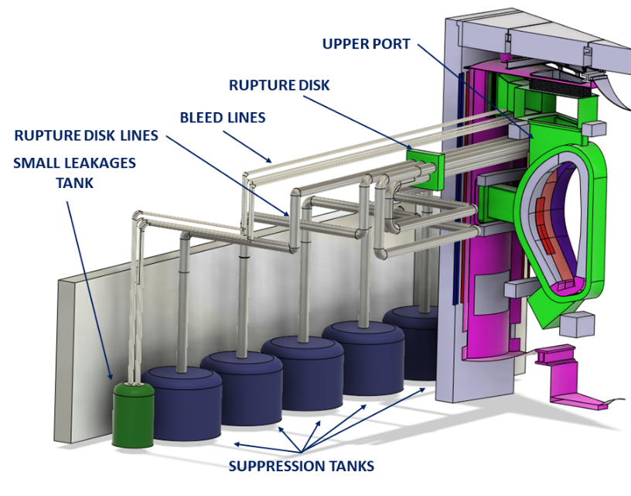
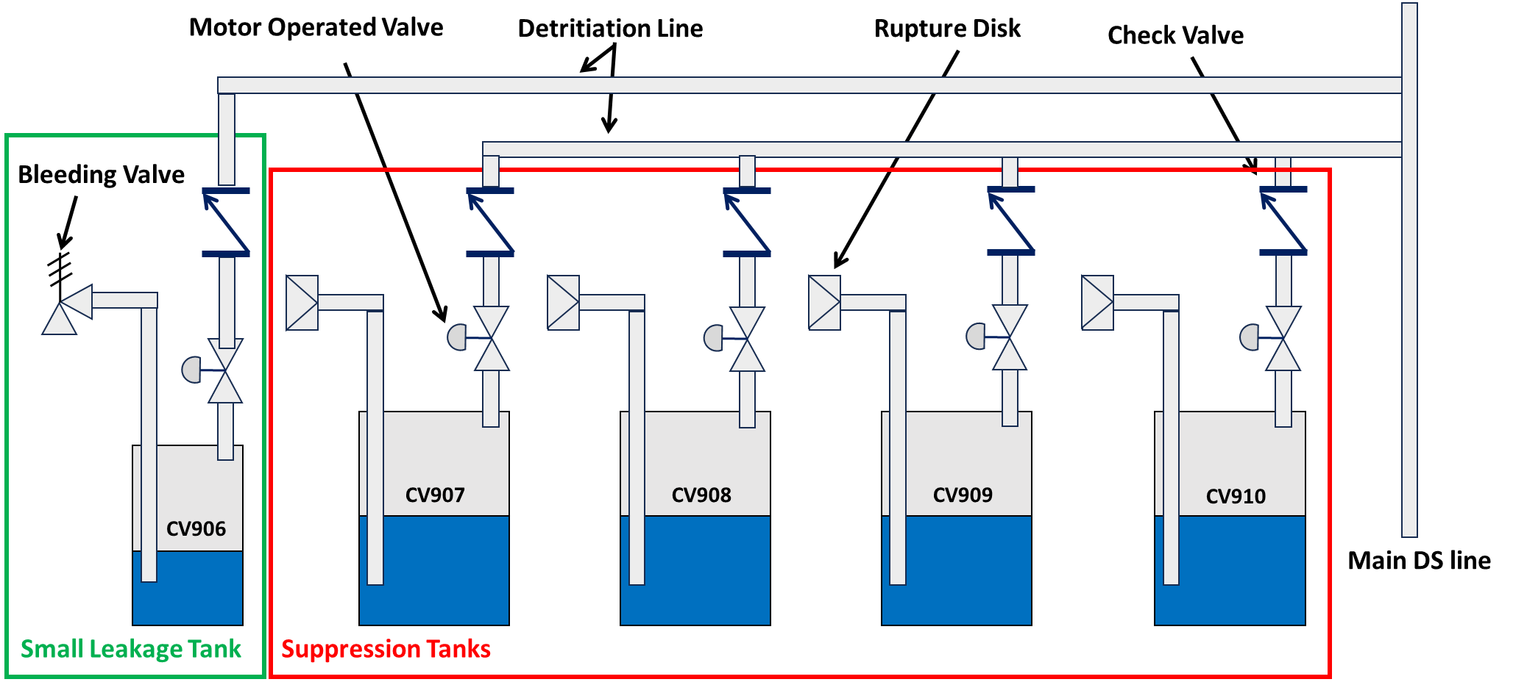
EU-DEMO VACUUM VESSEL & VVPSS TH MODEL
The VV volume is where nuclear fusion reactions take place.
The VV pressure suppression system is one of the most important safety passive systems to be foreseen in the DEMO plant.
Notes:
Other two important systems to be modeled are the VV and VVPSS, since they constitute the primary nuclear confinement barrier for the radioactive material.
The VV is the volume in which nuclear fusion reactions occur, but it is also the first volume available for steam expansion in the case of an in-vessel LOCA. For this reason it has been simulated in detail by modeling also different connections between different VV areas.
The VVPSS is one of the most important safety passive systems to be foreseen in the DEMO plant since it limits the VV pressure in the event of in-vessel LOCA and also confines radioactive sources in the system. Here you can see the nodalization with all the 6 different suppression tanks and also PAR that are installed to recombine hydrogen.

Slide 7
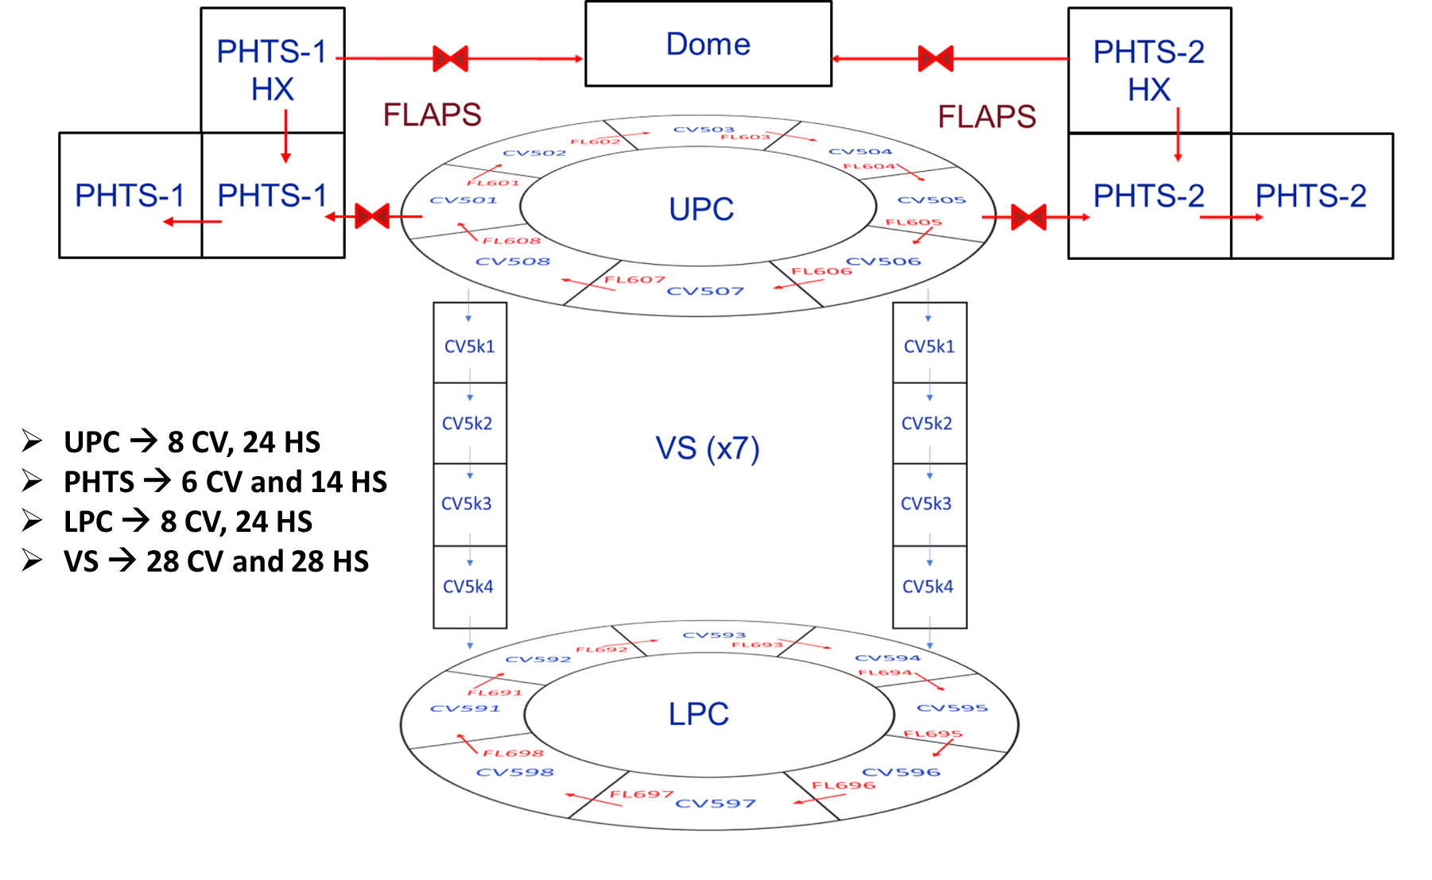
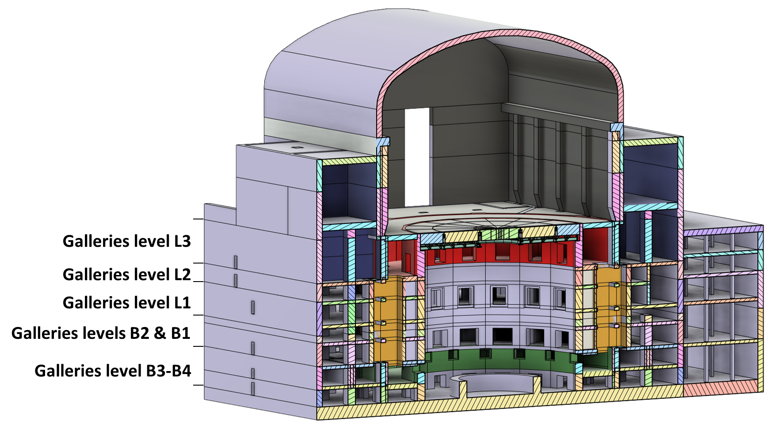
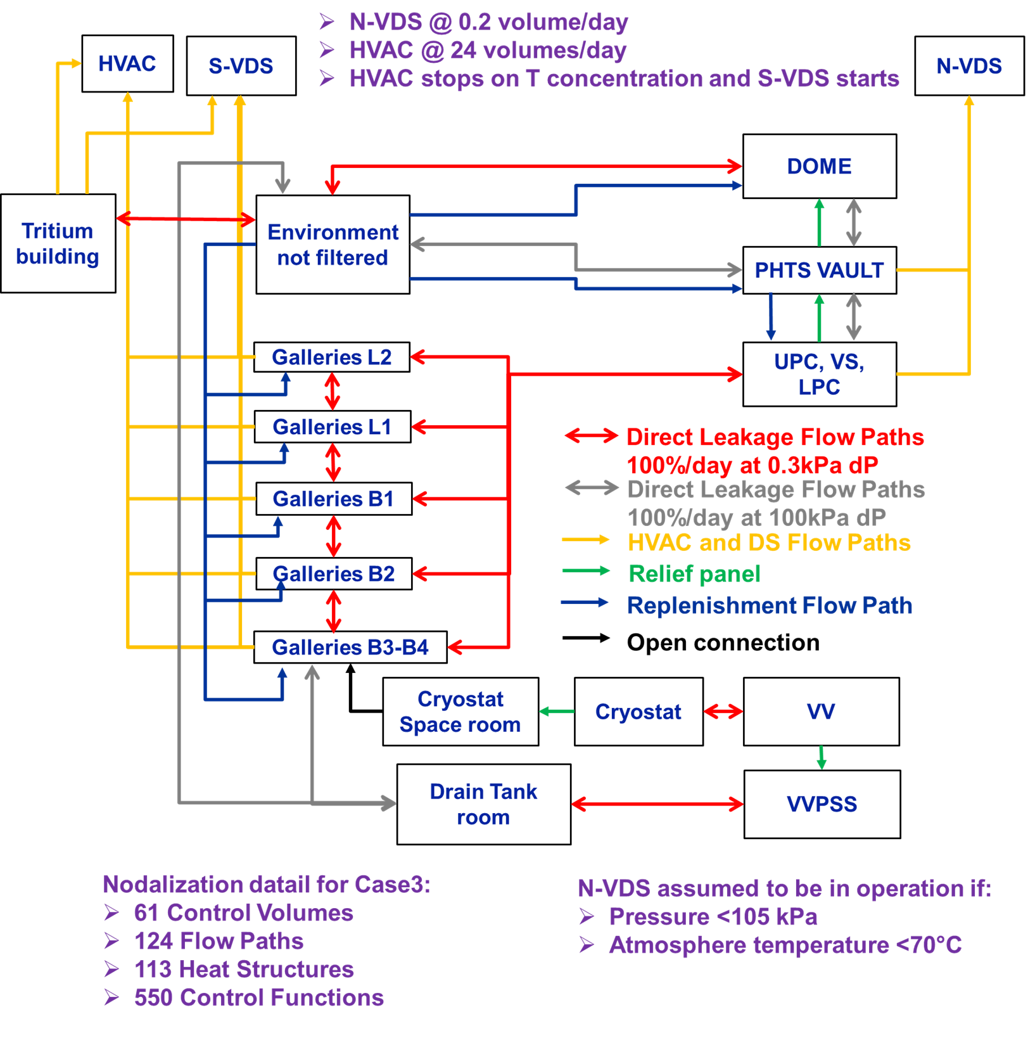
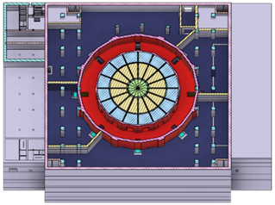
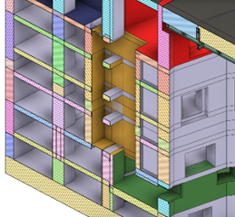
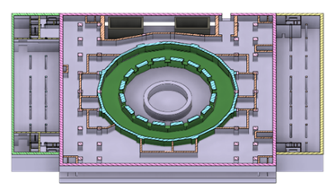
EU-DEMO tokamak BUILDING TH MELCOR MODEL
TH MODEL
Building Area | Free Volume
Dome | 205597 m³
Upper Pipe Chase | 9709 m³
Vertical Shaft | 1800 m³
Lower Pipe Chase | 6033 m³
PHTS Area | 49775 m³
LEAKS & DYNAMIC CONFINEMENT MODEL
*Values related to the current state of the design and could change in future
Upper Pipe Chase (UPC) & PHTS
Vertical Shafts (VS)
Lower Pipe Chase (LPC)
[Ref] D’Onorio et al. “Development of a Thermal-Hydraulic Model for the EU-DEMO Tokamak Building and LOCA Simulation”, (2023), Energies, 16(3), 1149
Notes:
The last fundamental system is the tokamak building which represents the secondary and ultimate nuclear confinement barrier for the radioactive material towards the environment and the public. So it must be modeled in performing safety analyses. The EU-DEMO building is very huge. Here you can see some numbers related to the free volume available for steam expansion. A detailed TH model of the EU-DEMO has been developed to evaluate the thermal hydraulic behavior of main tokamak compartments during ex-vessel LOCA scenarios. It is very important to study building phenomena, for this reason also the intervention of all active systems like the Heating, Ventilation and Air Conditioning but also the Normal and Stand By Venting Detritiation system has been modeled. This model required a lot of effort, in particular more that 500 CF to model all leaks and building paths.

Slide 8
ACCINDENT ANALYSIS PERFORMED
Safety studies have been performed in support of design improvements and to estimate accident consequences in terms of source term mobilization in view of a licensing process.
In-vessel loss of coolant accident from first wall and breeding zone PHTS
Ex-vessel LOCA from first wall and breeding zone PHTS
Ex-vessel LOCA without plasma shutdown from first wall and breeding zone PHTS (BDBA)
Loss of Heat Sink accident analysis for the WCLL concept
Loss of Vacuum Accident (LOVA)
In-box LOCA accident
Loss of flow accident in first wall and breeding zone PHTS
Hydrogen explosion analyses
Notes:
The models that I shown you, I have to say that are something very dynamic. In fact, around each year we have to update these models to be compliant with the design uptades. So, this is the model we use to perform safety analysis, now I can move to show you some analysis results.
Here you can see a list of some of the main accident that have been investigated for the WCLL concept of EU-DEMO. Of course there is not enough time to discuss everything so I am going to focus the attention only to some specific analysis.

Slide 9
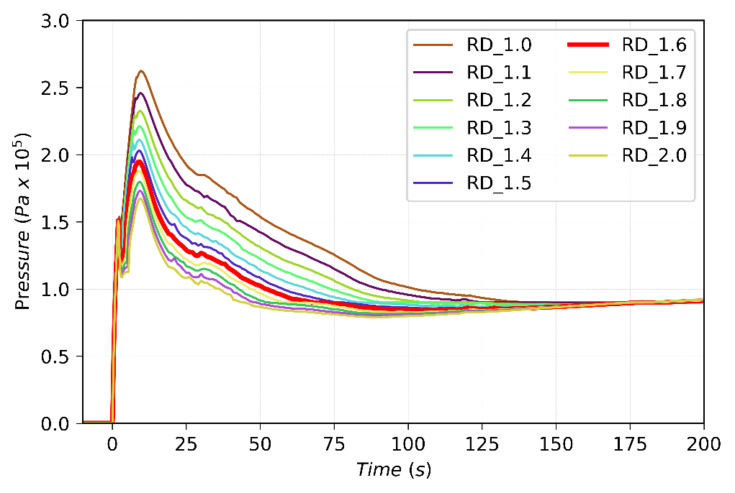
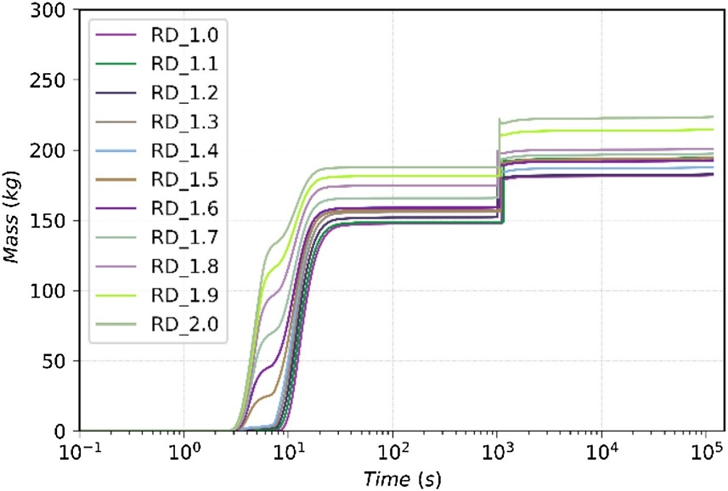
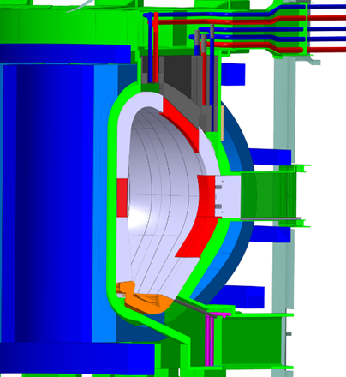
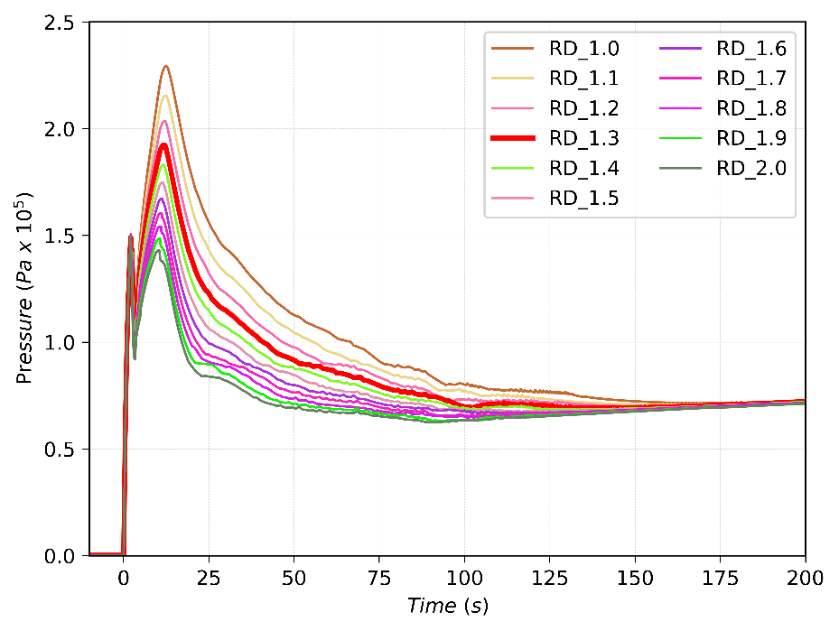
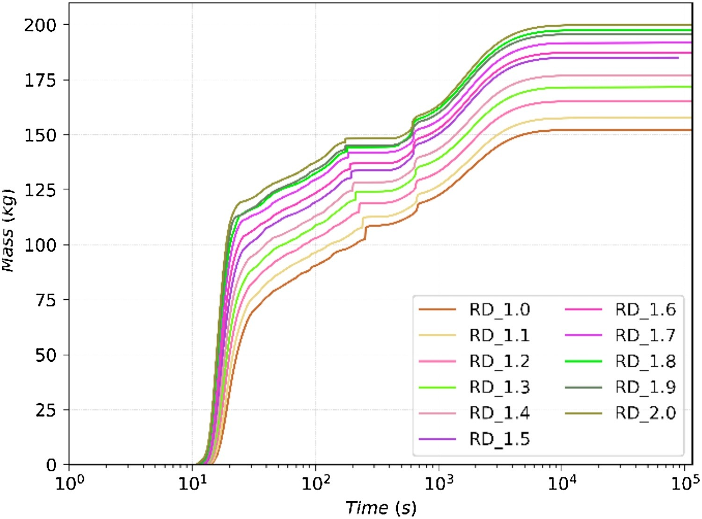
Multiple First Wall/Blanket PHTS pipe break inside the VV
WORST CASE SCENARIO (WC)
PIE: Double-ended of the BZ feeding pipe located inside the VV in the upper port region
An unmitigated plasma disruption occurs
Limiters fail to protect the plasma facing structure;
The PD causes the break of 262 FW channels, for a total break area of 0.02568 m²
BASELINE SCENARIO (BS)
PIE: Double-ended of the BZ feeding pipe located inside the VV in the upper port region
An unmitigated plasma disruption occurs
Limiters protect the FW plasma facing structure
WC: Upper port pressure for different rupture disks flow area
WC: Mass of tungsten dust in VVPSS
BC: Upper port pressure for different rupture disks flow area
BC: Mass of tungsten dust in VVPSS
BZ feeding pipe break
LIMITERS
FW break
[Ref] D'Onorio, M., Caruso, G., “Pressure suppression system inﬂuence on vacuum vessel thermal-hydraulics and on source term mobilization during a multiple ﬁrst Wall –Blanket pipe break”, (2021) Fusion Engineering and Design, 164, art. no. 112224,
Notes:
Here you can see for example two different in-vessel LOCA events classified as DBA, that were studied to define the needed flow area of VVPSS suppression pipework to limit the VV pressure below the limit of 2 bar imposed by safety requirements.
In both the scenarious, a pipe rupture was initiated by opening a connection between the BZ feeding pipe and the upper port volume. Water enters the VV inducing an unmitigated disruption. From this moment we have two different scenarios: a baseline case scenario in which FW channels are protected by limiters; and a worst case scenario in which limiters does not protect the FW and an additional LOCA occurs.
Thanks to this analysis I found out the flow area needed for each RD line in both cases, investigating also the effects on tungsten dust mobilization.

Slide 10

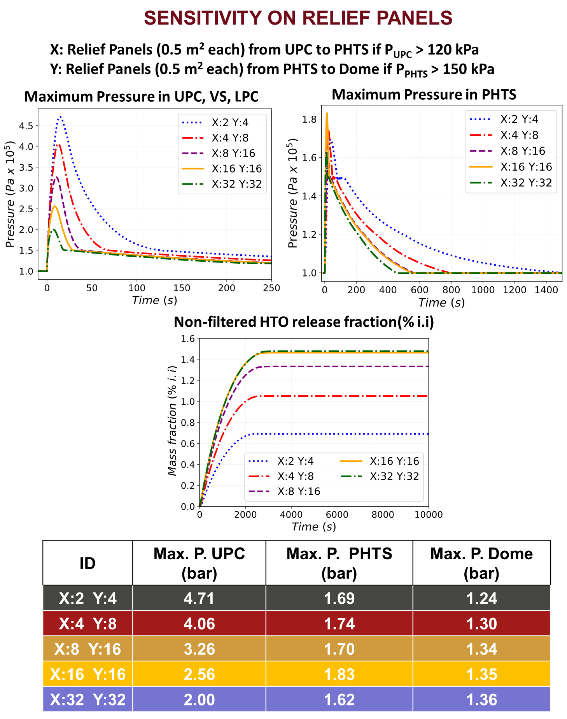
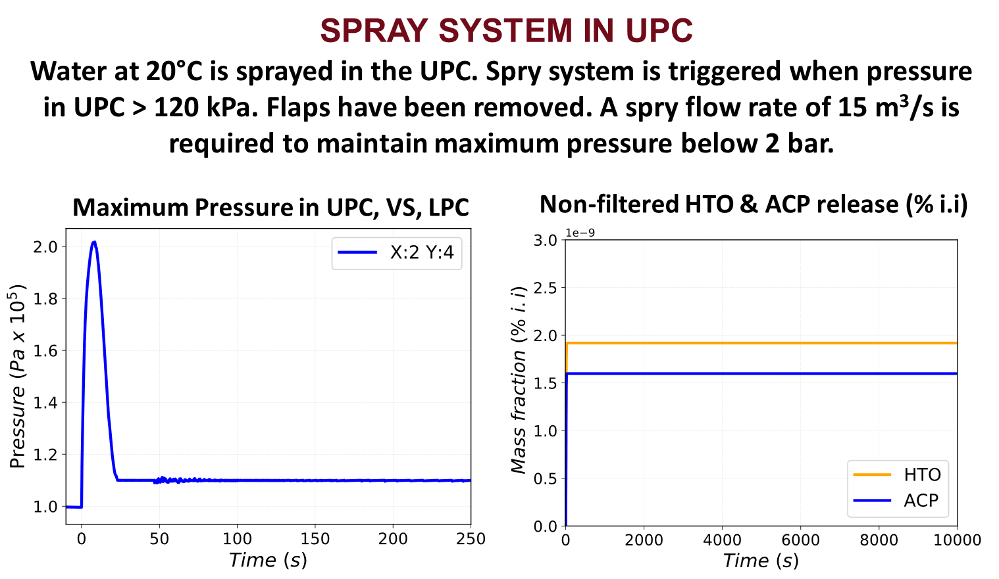
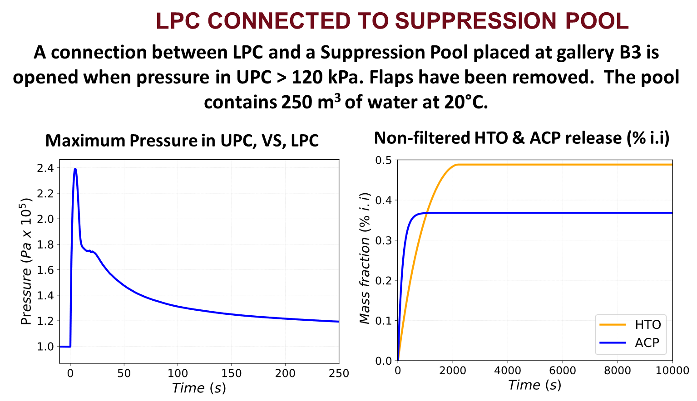

EX-VESSEL LOCA FROM FW/BZ-PHTS
Water at 20°C is sprayed in the UPC. Spray system is triggered when pressure in UPC > 120 kPa. Flaps have been removed. A spray flow rate of 15 m³ /s is required to maintain maximum pressure below 2 bar.
The PIE is a double guillotine break of a FW-PHTS distributor ring in the Upper Pipe Chase (red zone in figure)
Maximum pressure in building is around 4.5 bar in the UPC area
[Ref] D’Onorio et al. “Development of a Thermal-Hydraulic Model for the EU-DEMO Tokamak Building and LOCA Simulation”, (2023), Energies, 16(3), 1149
Notes:
Concerning ex-vessel studies, we should consider that up to now the design of the tokamak building has been developed neglecting safety aspects. But they should consider this at some point. In fact for a simple ex-vessel LOCA from the FW-phts into the UPC a pressure of 4.5 bar is reached in the building. And this value is quite higher if compare with the limit of 2 bars imposed by safety. In order to support design activities, exploratory sensitivity analysis on relief panels have been performed. Of course, an higher flow discharge towards the PHTS and Dome area causes an increase of unfiltered releases.
Moreover, two additional possible solutions to minimize building pressurization and release have been studied. A system of spray in the UPC and a steam suppression pool connected with LPC.
A combination of different systems (e.g., Spray and flaps) will be taken into account in the future for a final design of the tokamak building.

Slide 11
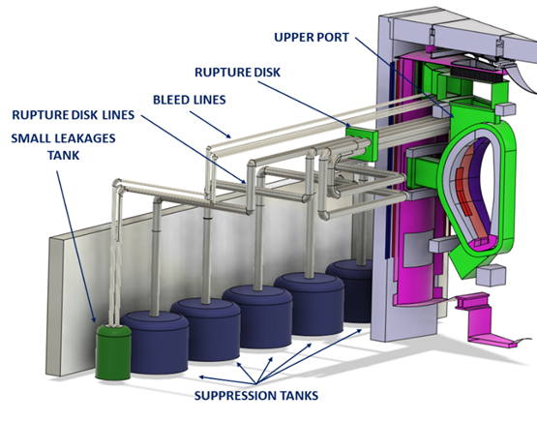
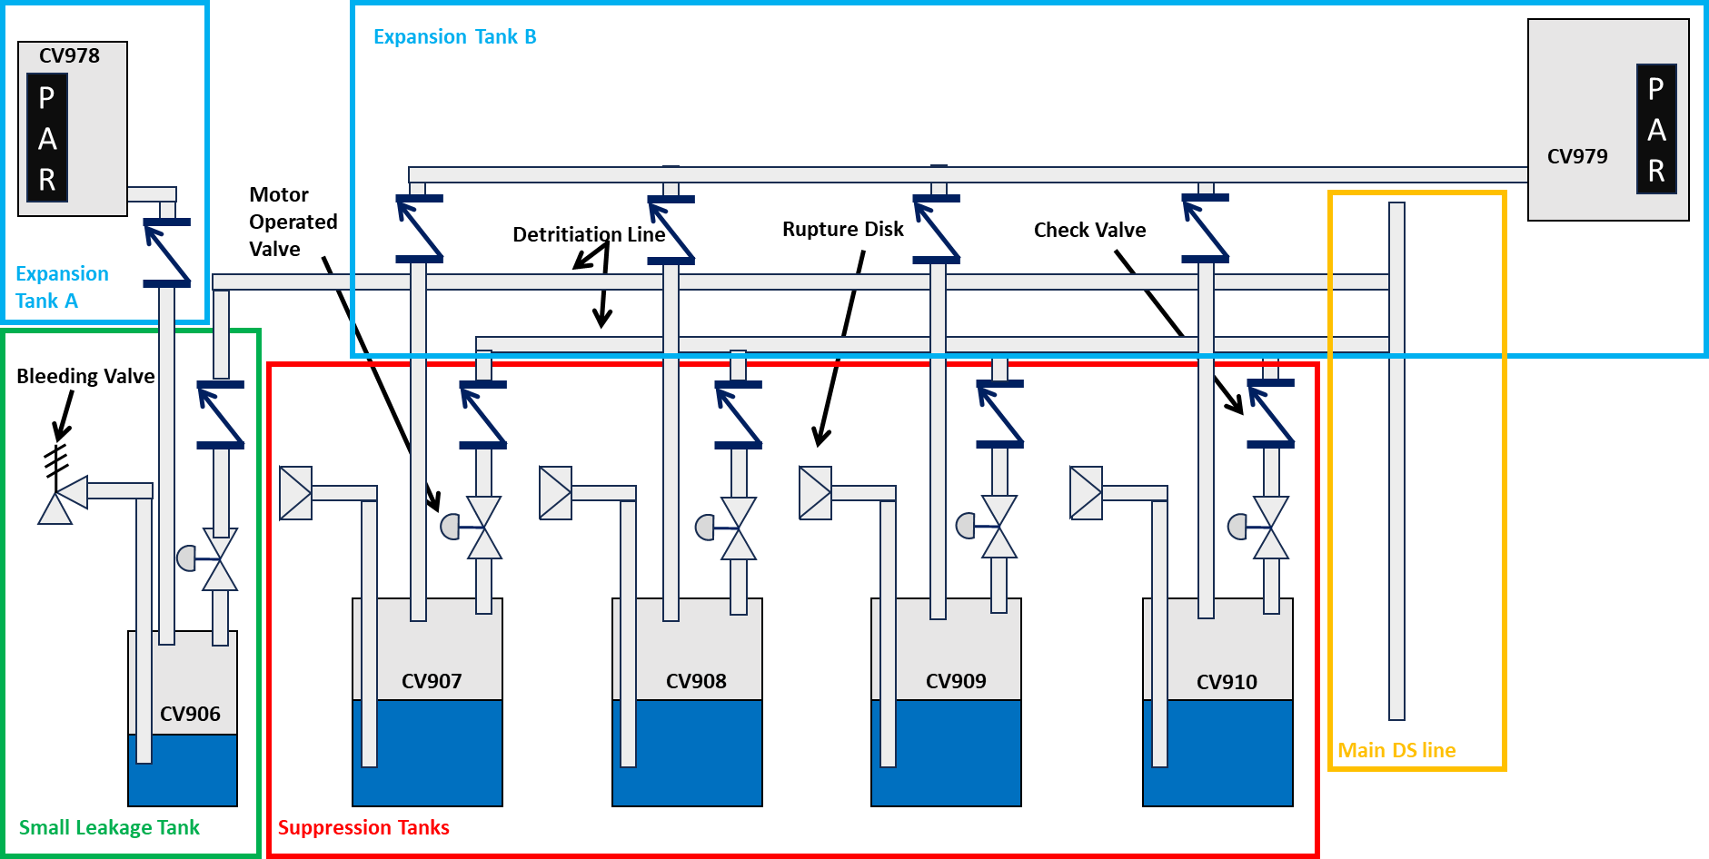
EU-DEMO HYDROGEN RECOMBINATION SYSTEM
Passive Autocatalytic Recombiner for the VVPSS
Preliminary simulations have been performed installing PAR in each ST assuming 150 kPa as setpoint for trigger of VVPSS-RDs and 90 kPa for the opening of bleed lines, and that each ST is filled with 60% of water.
Detritiation System for the VVPSS design
[Ref] D’Onorio, M., Glingler, T., Mazzini, G., Porfiri, M.T., Caruso, G., “Passive Hydrogen Recombination during a Beyond Design Basis Accident in a Fusion DEMO Plant”, (2023), Energies, 16(6), 2569
Notes:
Just to conclude this part on accident analyses for DEMO. I want to show you this activity that is made in collaboration with CVR research center of check replubic. We have to design a system for hydrogen recombination and for the mitigation of hydrogen explosion risk. As highlighted from THAI experiment the mass of hydrogen recombined by PAR depends on pressure. And this is quite important since the VVPSS is operated at pressure well below atmospheric one. MELCOR does not has a recombination model that depends on the pressure. And for this reason it has been developed by me using CF.
One of the first solution analysed was to install PARs into each suppression tank. We obtained good results in terms of hydrogen recombination. However, the problem is due to the risk of an hydrogen explosion, due to the reaching of flammability limits.
So, to overcome this problem, a new system has been proposed, adding two ETs and installing pars into these tanks. Results highlighted that this proposed solution, is more effective in terms of hydrogen explosion risk mitigation.

Slide 12
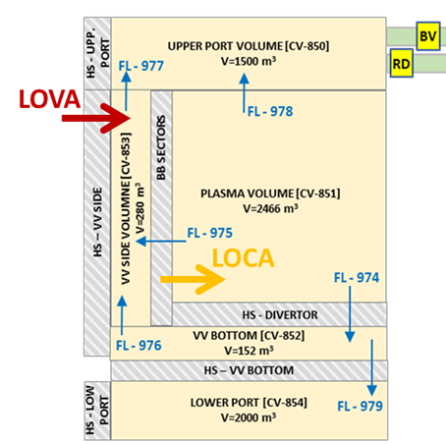
Bounding accident: PIE combination of LOVA and small in-vessel LOCA
Postulated Initiating Event: break of 0.002 m² of the Vacuum Vessel Side with consequent pressurization of VV and mobilization of air
Unmitigated plasma disruption
Aggravating failure of OB-FW cooling channels with resulting in-vessel LOCA.
Objective: explosion risk assessment in VV, VVPSS and DS
Assess the effectiveness of the VVPSS and suggest design improvements in terms of mitigation of the pressure transient in the Vacuum Vessel (VV) and mitigation of H₂ explosion in the whole system
Updated MELCOR model with venting of VVPSS tanks towards DS
Insights on the impact of PFC initial temperature

Slide 13
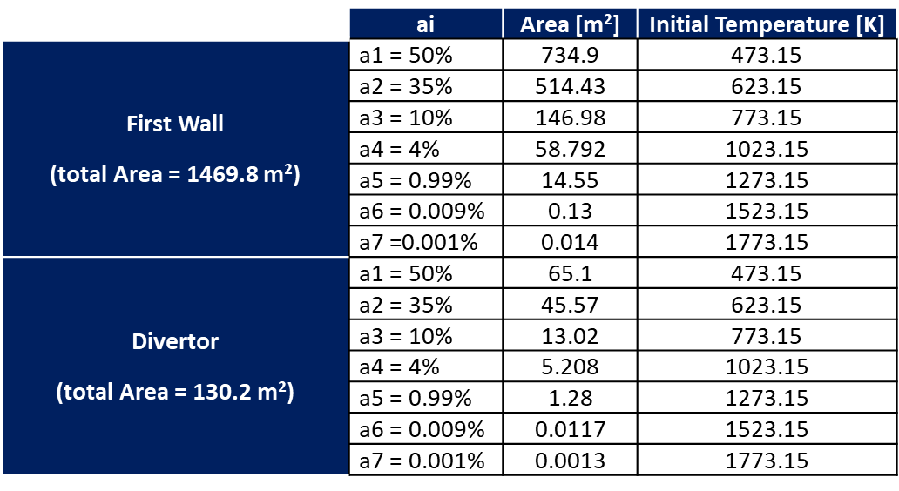
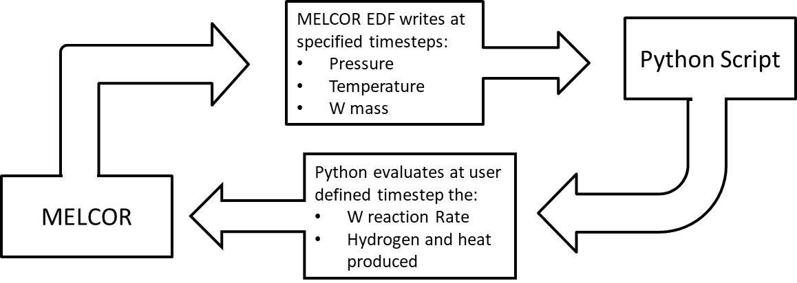
Modelling: Tungsten Dust oxidation
Modelling: PFC hotspots
The dust specific surface of 0.2524 m2/g has been implemented following @WPSAE.S.04.03-001-D008 Input data request 2Q29EK v2.0
W dust oxidation has been evaluated through an external script adopting @Updating of Safety Data List 2NUYCH v1.1
The total W-dust inventory in the VV is 1034 kg @Updating of Safety Data List 2NUYCH v1.1
A baseline case analysis focuses the impact of PFC hotspots on H₂ production.
3 different scenarios with increasing temperature of the hotspots have been studied. The initial PFC hotspots temperature presented in the Table below are increased respectively of 100.0 K, 150.0 K and 200.0 K
Tungsten-dust reaction rate:
${RR}_{W−H_{2}O}={(\frac{p}{p_{0}})}^{0.78}∗41.238∗e^{−\frac{33106.0}{R∗T}}$ [kg_{W}/m²*s]
Notes:
These hotspots range from 773.15 K to 1773.15 K with an area division based on 7 sections, according to the input data request.

Slide 14
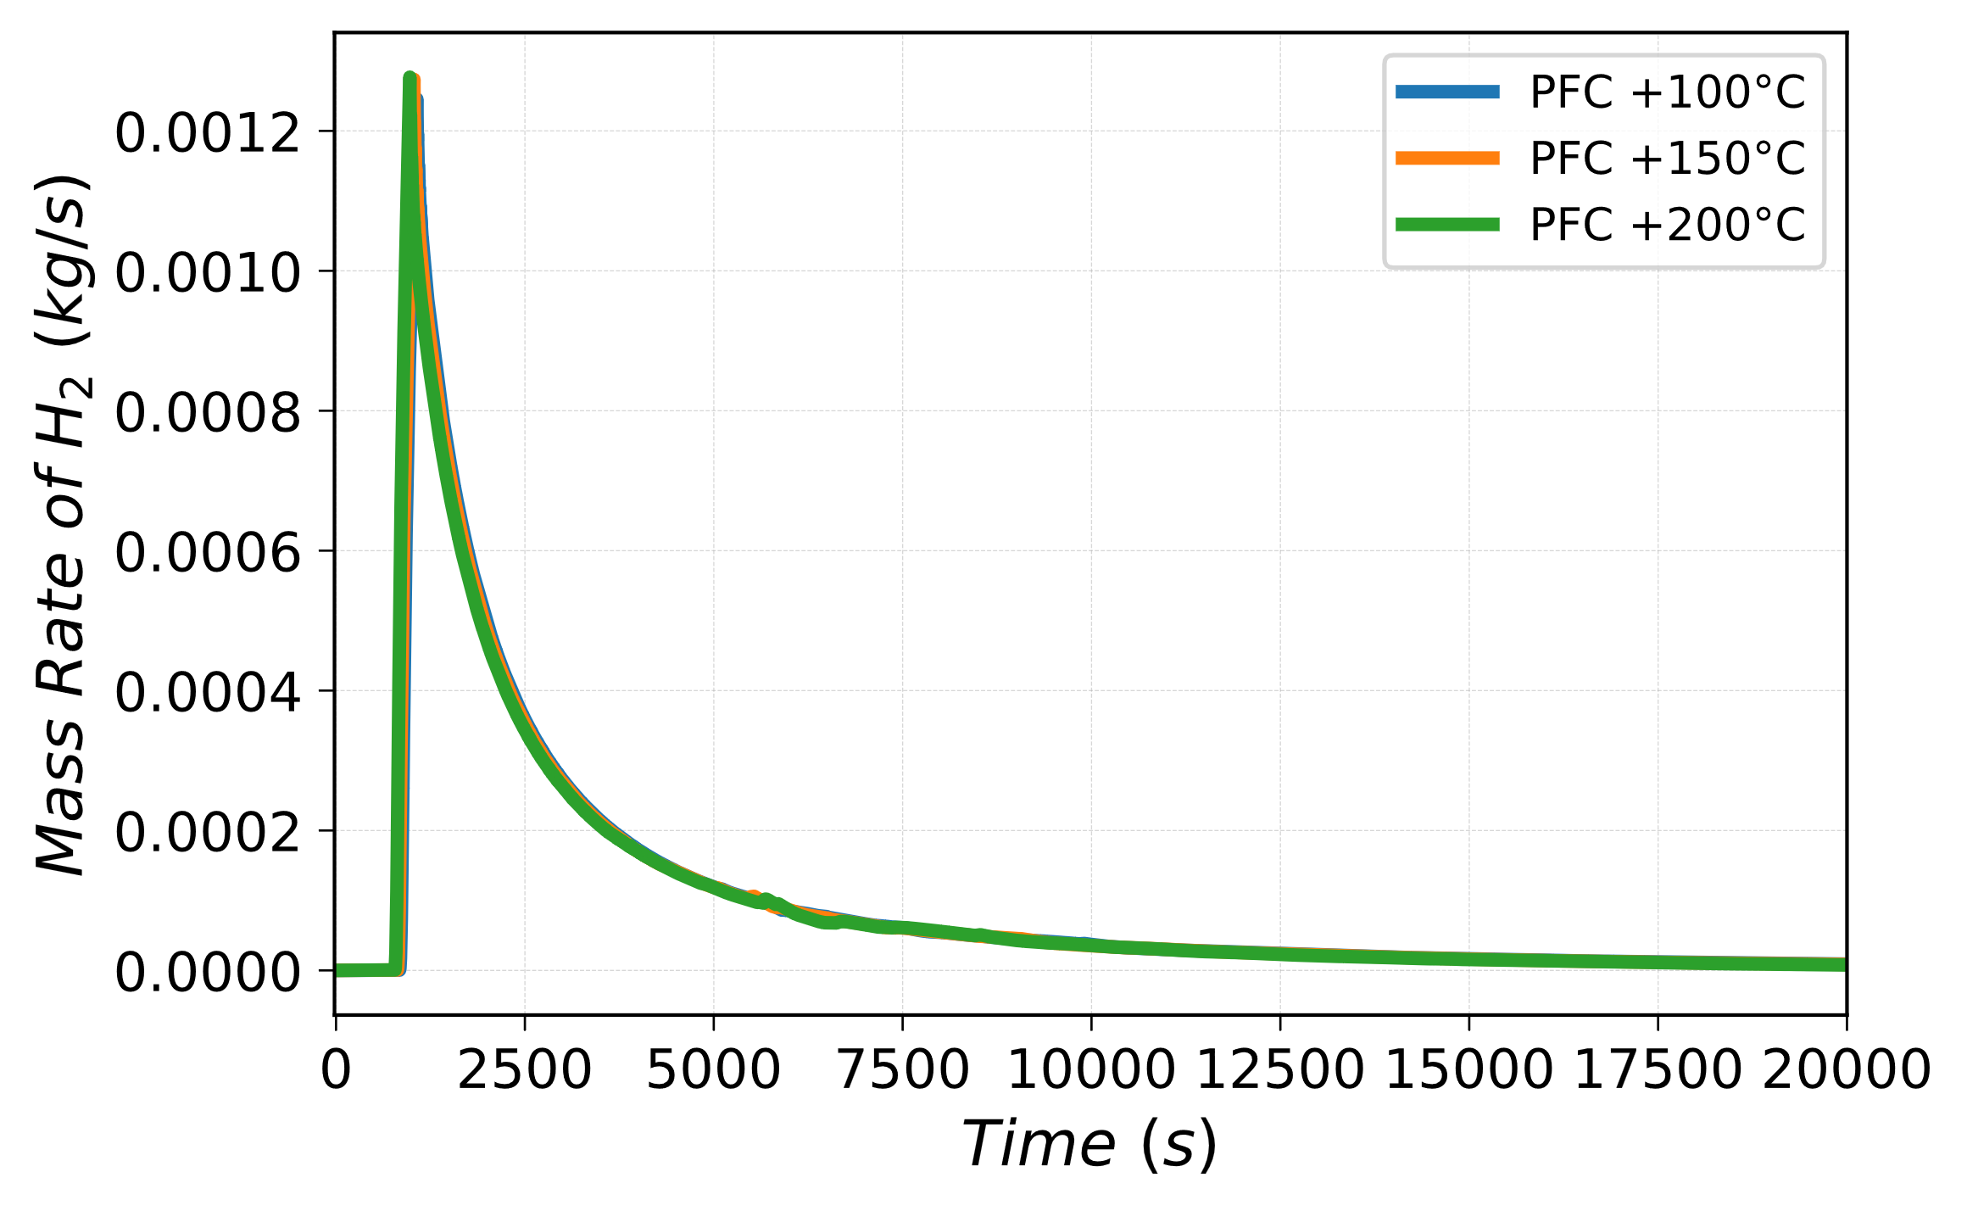
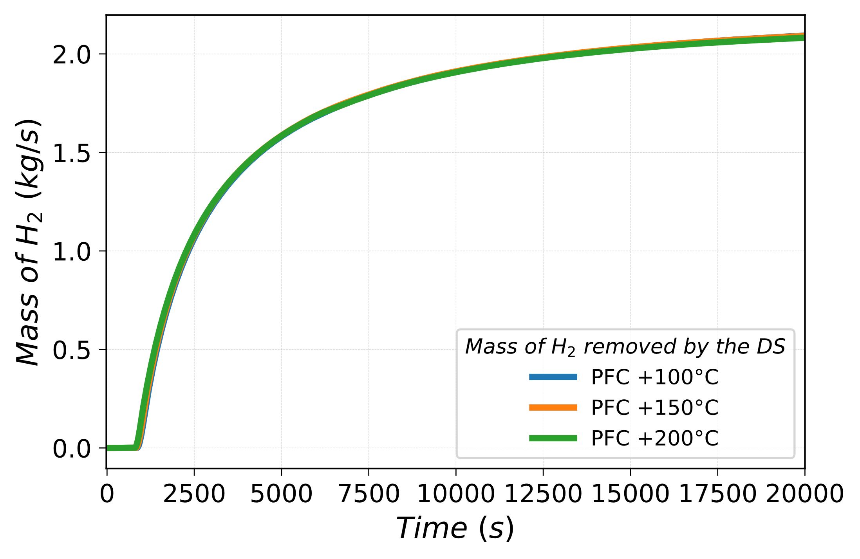
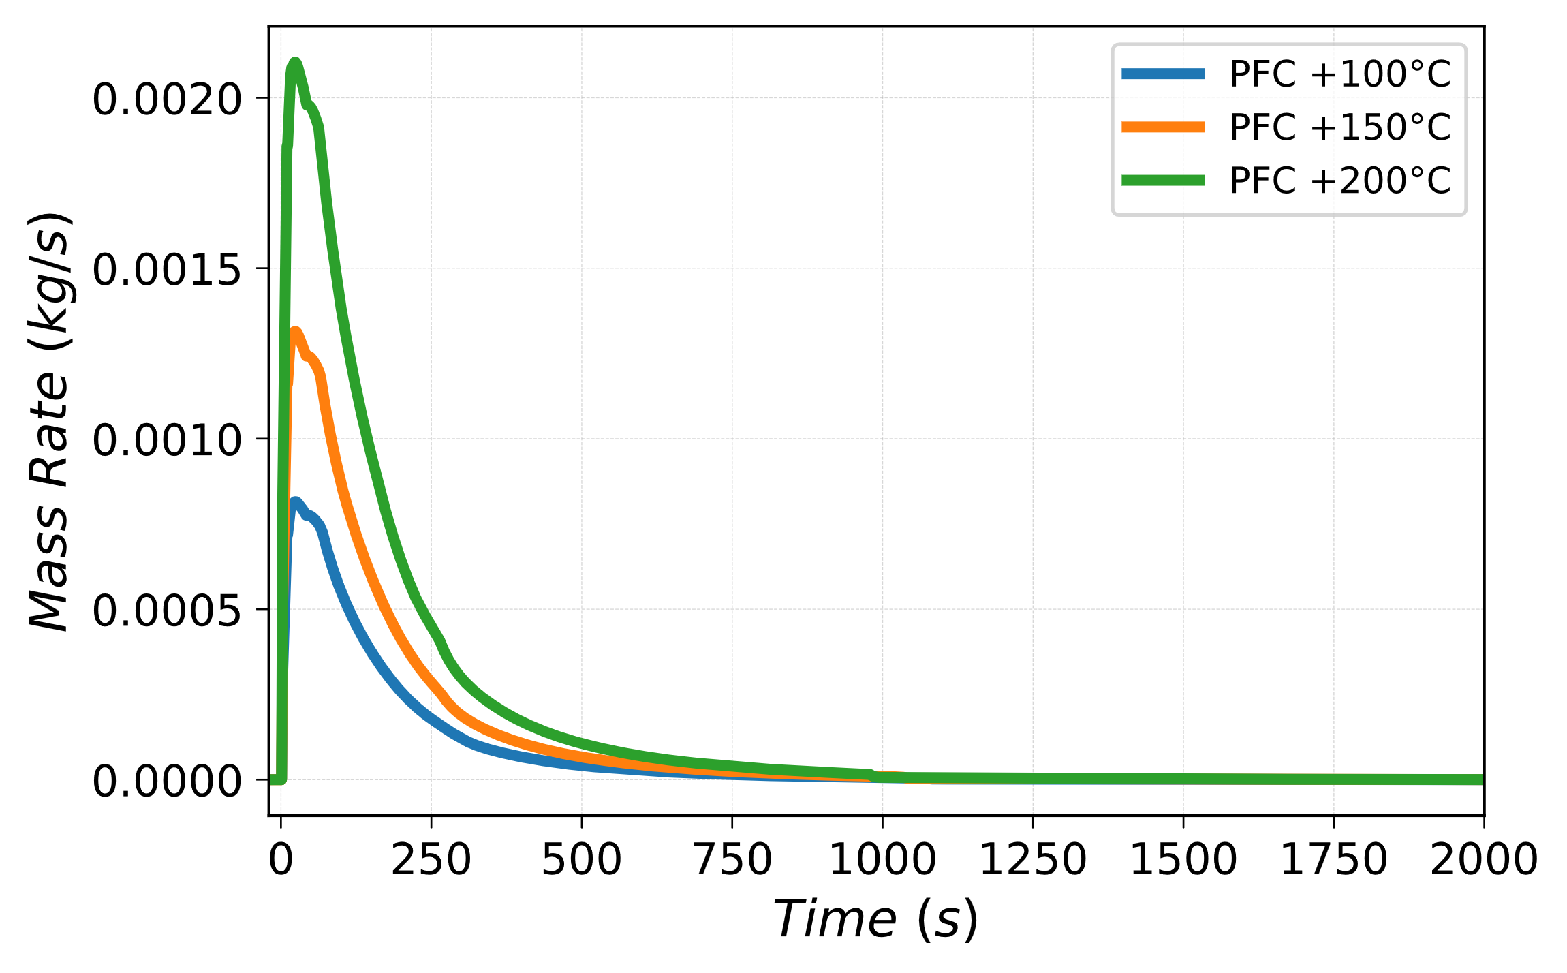
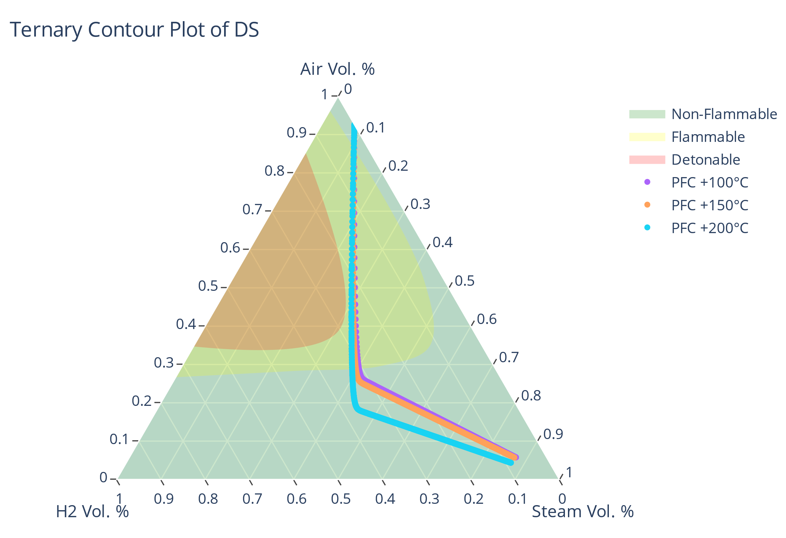
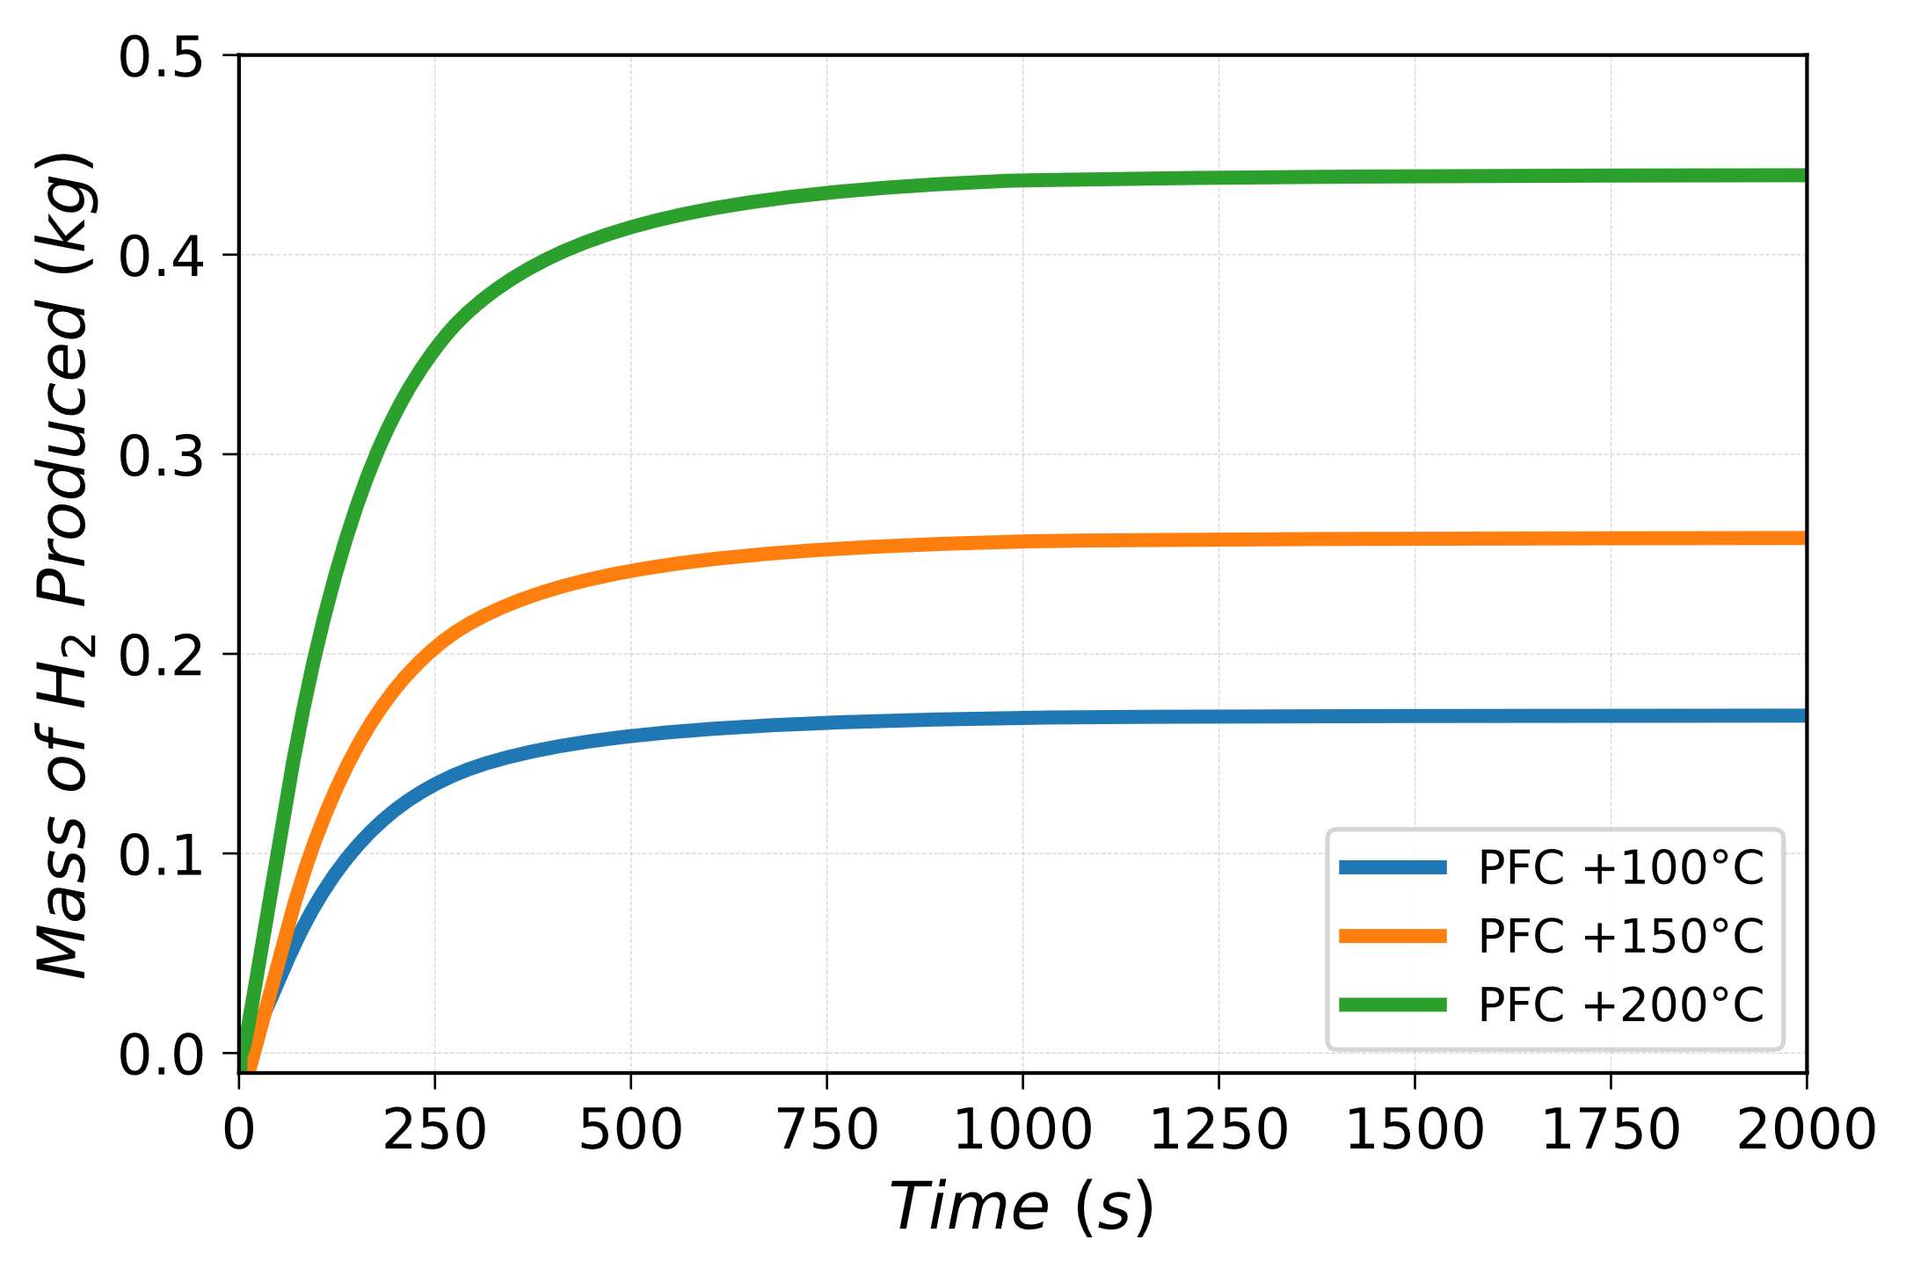
Detritiation System for the VVPSS design
Mass rate of hydrogen removed through venting
Integral amount of hydrogen removed through venting
Hydrogen production rate from tungsten dust reaction with steam

Slide 15

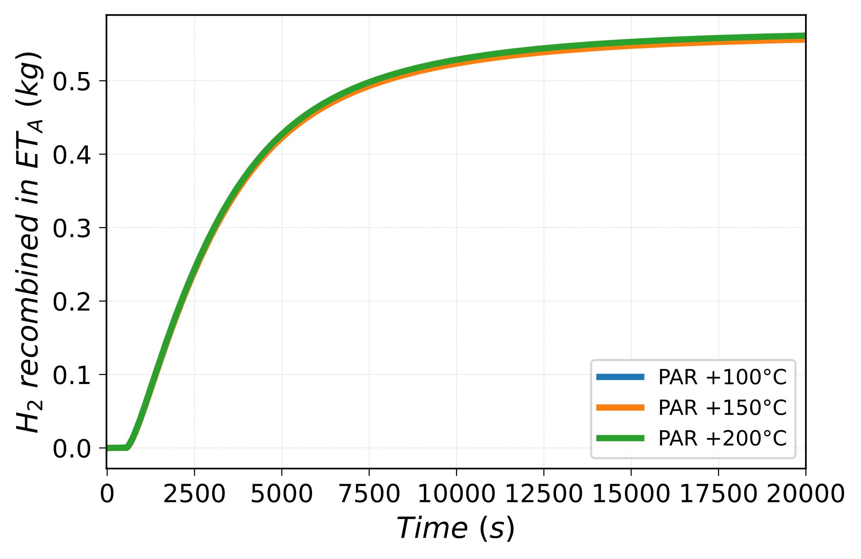
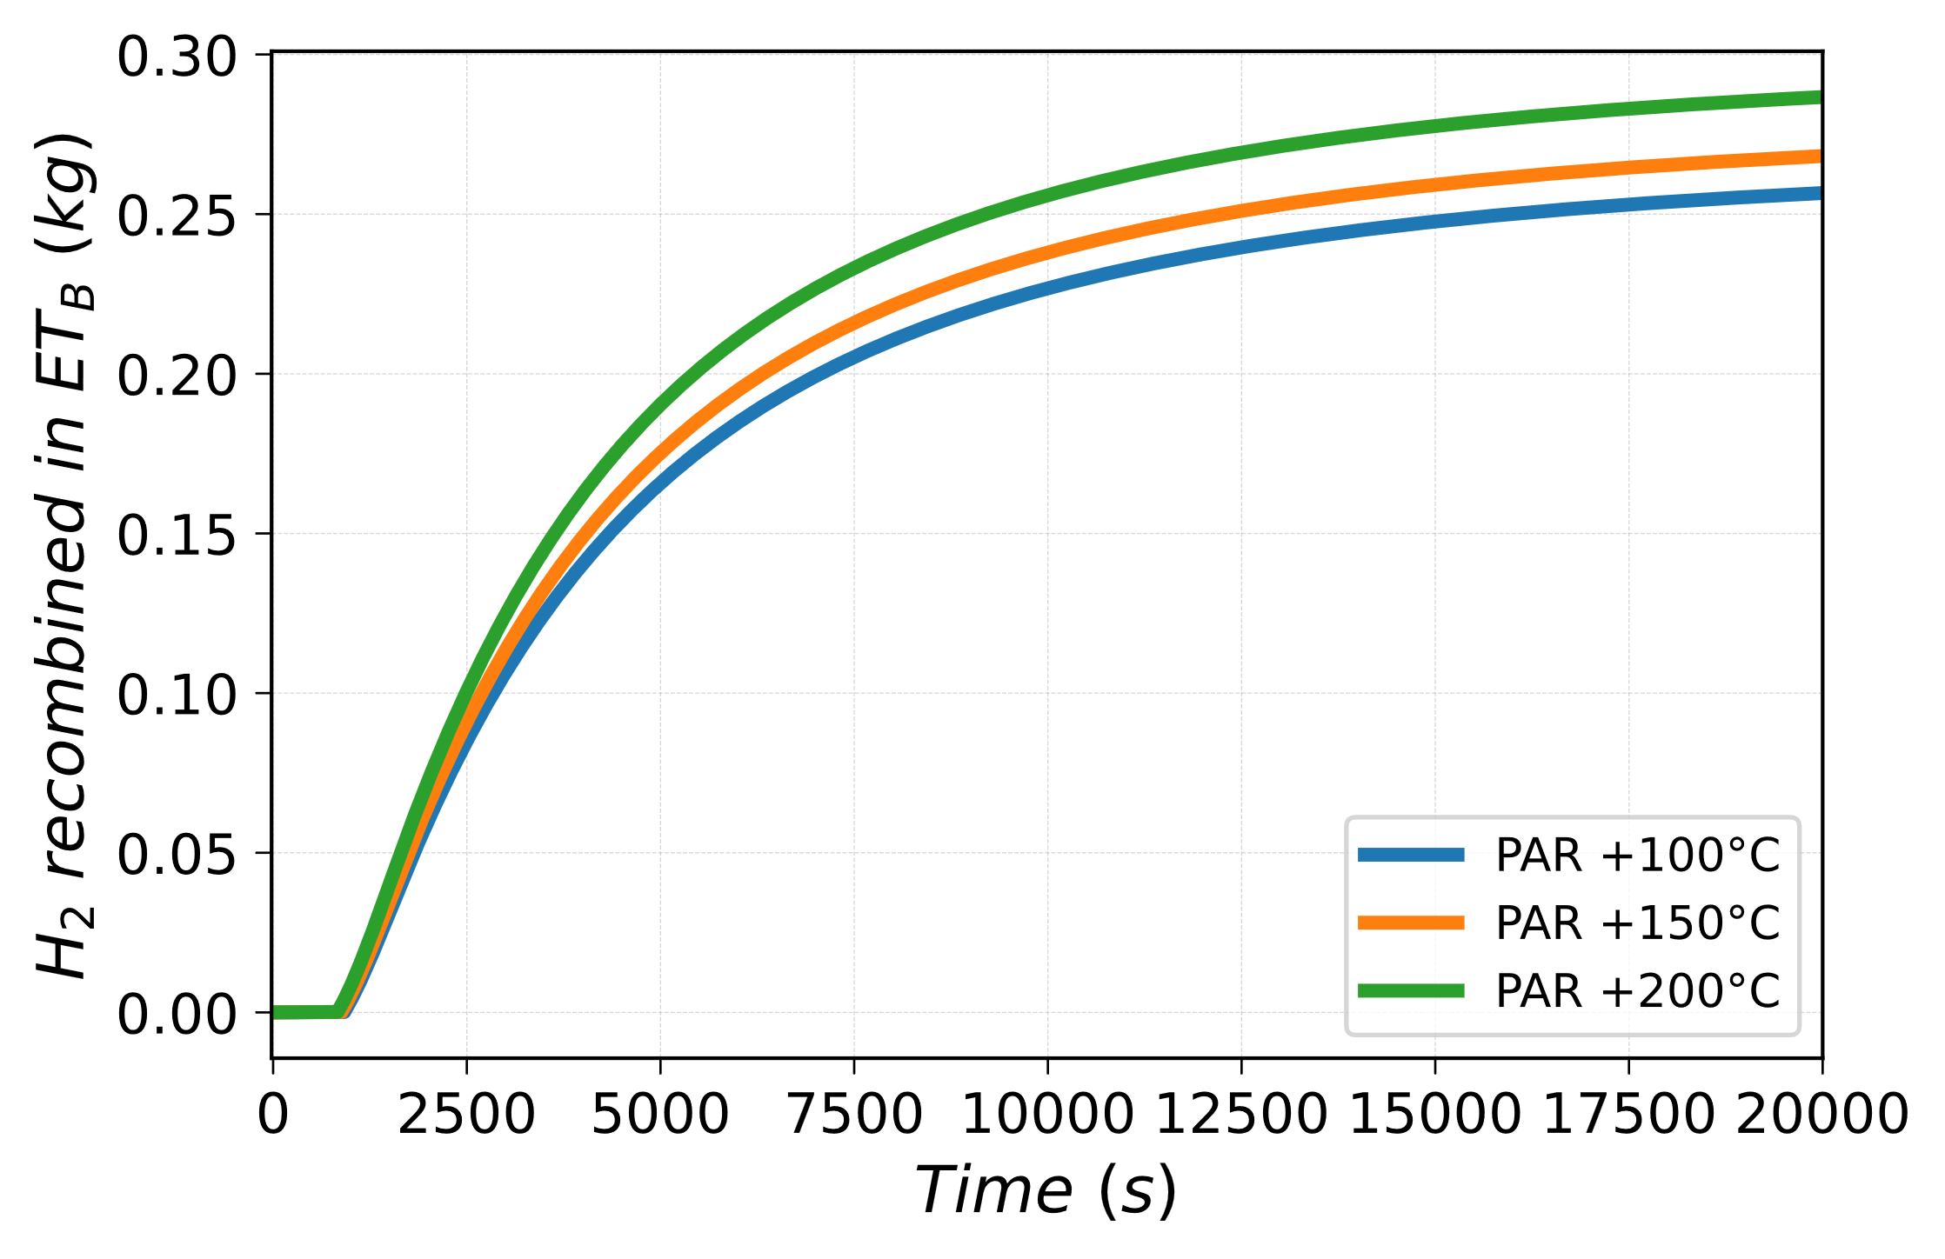
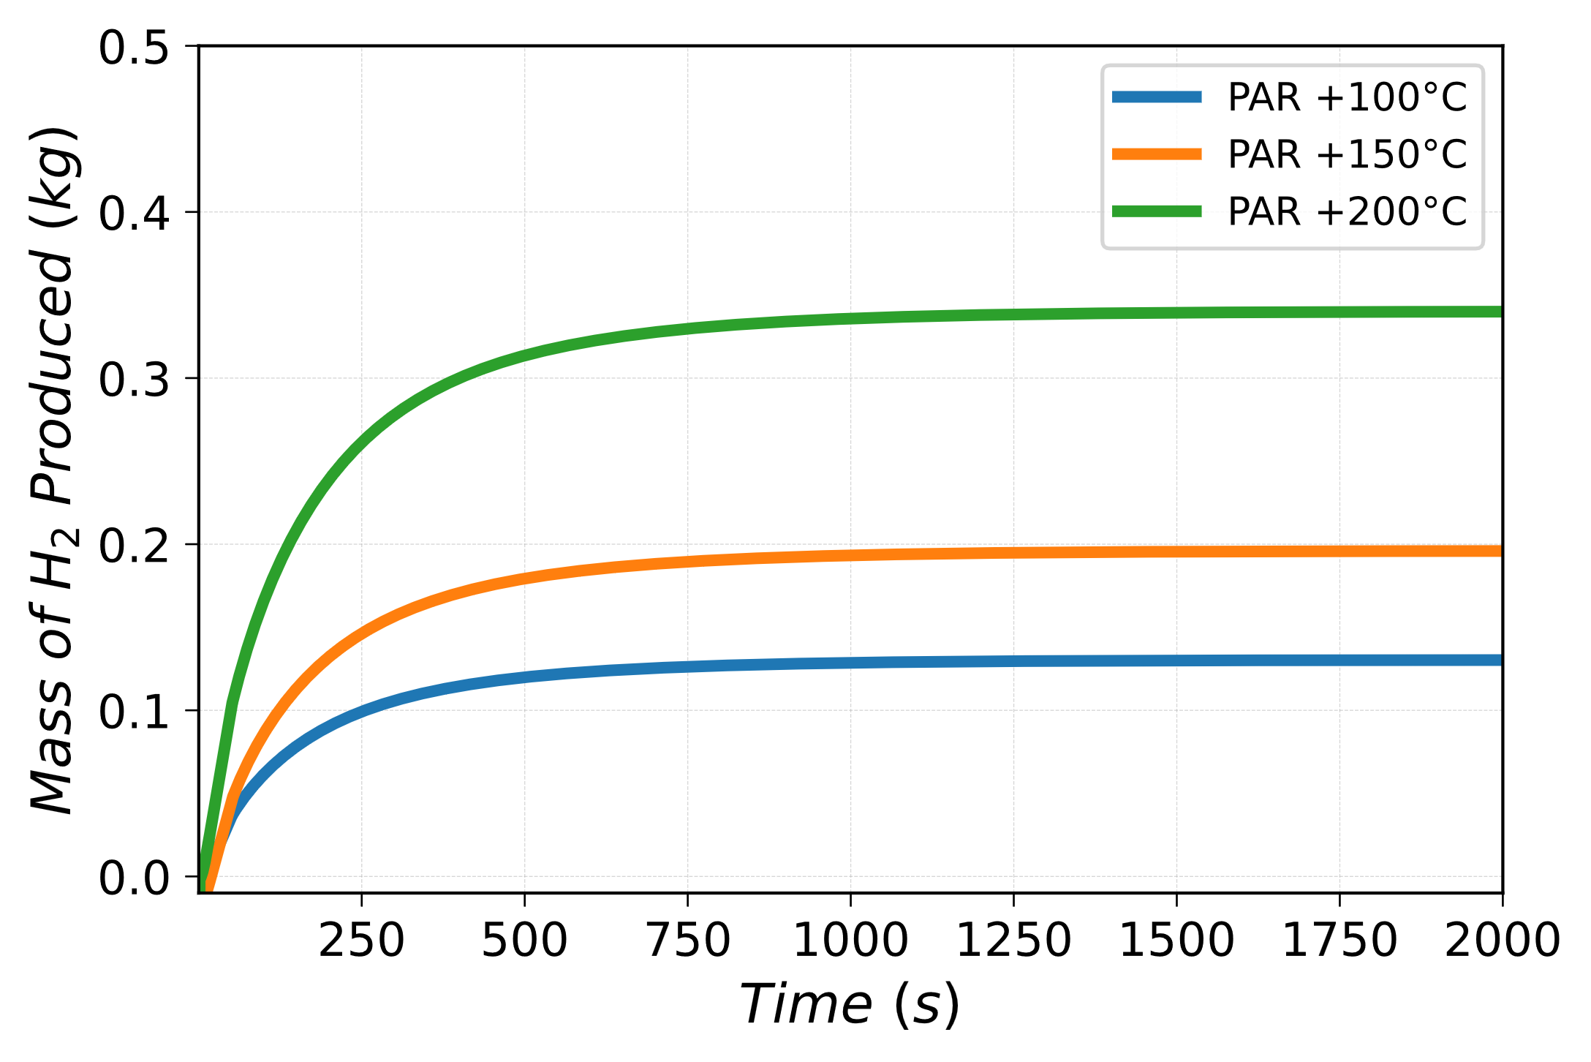
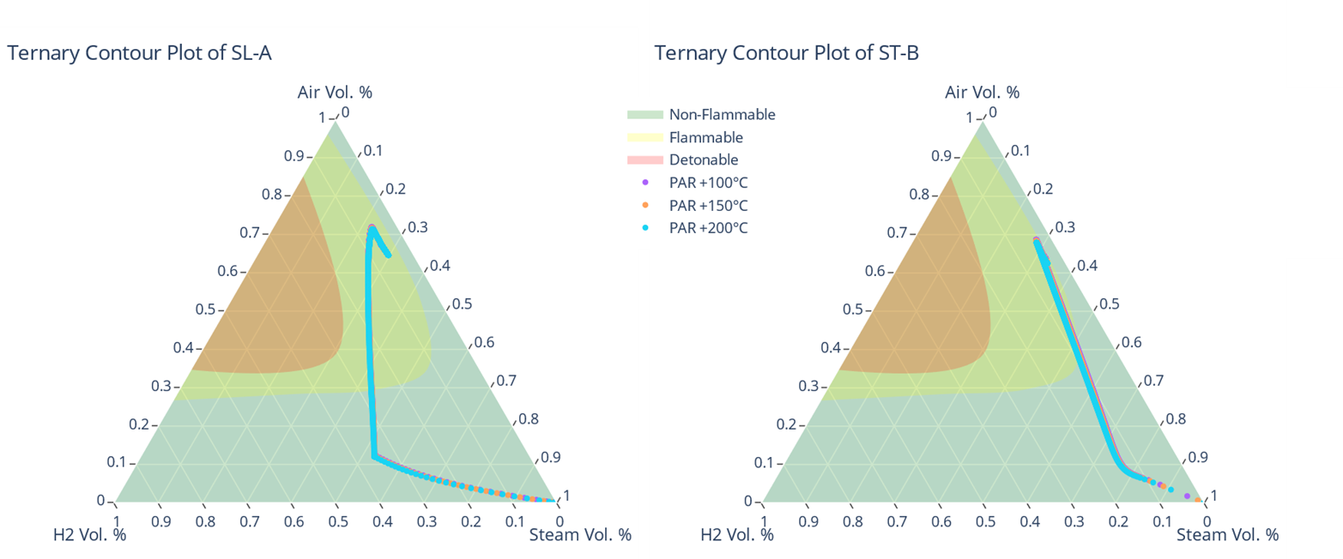
Passive Autocatalytic Recombiner for the VVPSS design
 | PFC at +100°C | PFC at +150°C | PFC at +200°C
Total amount of H₂ recombined [kg] | 0.796 | 0.811 | 0.834
H₂ discharged towards the ETs [kg] | 1.292 | 1.298 | 1.310
Hydrogen production rate from tungsten dust reaction with steam

Slide 16
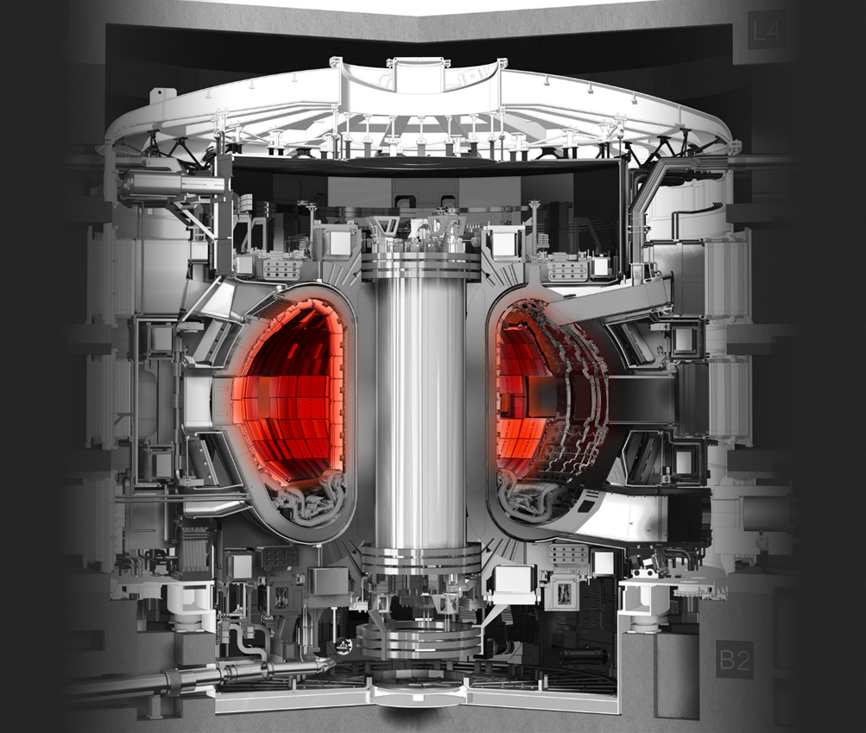
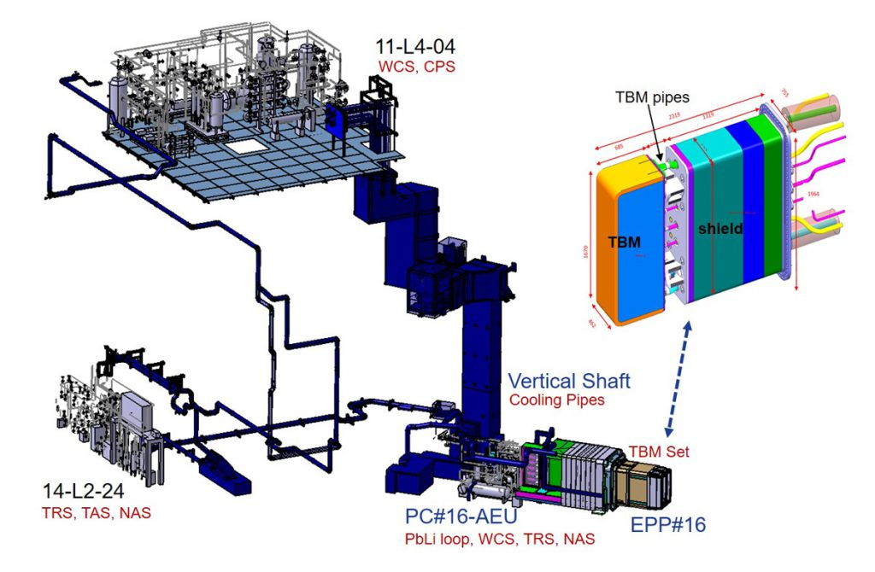
Preliminary analyses for ITER WCLL Test Blanket System with MELCOR
A
B
https://www.iter.org/
Notes:
These preliminary safety studies, performed in collaboration with ENEA and F4E agency, have been done to support the design and the integration of the WCLL TBSs into ITER.
This layout shows the deployment of the WCLL-TBS sub-systems in the different areas of Tokamak Complex.
Among all the main physical and engineering goals that should be achieved during the activity of the ITER machine one deals with testing and validating different design concepts of tritium breeding blankets (which will be used in fusion power producing reactors). The TBMs which will be installed in the ITER Equatorial Port #16. Where, are inserted in pairs, within a water-cooled stainless-steel frame which acts as an interface with the VV and the port structure. This frame together with two TBM-Sets forms the so called TBM Port Plug (TBM-PP).
The European Water-Cooled Lithium Lead Test Blanket Module (WCLL TBM) is one of the blanket concepts to be tested in ITER as a possible candidate for a future application in the EU-DEMO reactor.

Slide 17
MELCOR model of WCS
[Ref] D'Onorio, M. et al. “Supporting analysis for WCLL test blanket system safety”, (2021) Fusion Engineering and Design, 173, art. no. 112902
CCWS IN
CV-345
CCWS OUT
CV-346
A total number of 143 CVs have been modeled to correctly simulate the WCS
A heat structure is assigned to each pipework
The ITER Port Plug has been included in the model
TCWS Vault
CV-833
Primary Loop
Pressurizer
CV-89
Relief Tank
CV-90 TA-0003
SURGE LINE
CV-86 to CV-88
Secondary Loop
Shaft CV-834
VERT. SHAFT (2)
CV-14 to CV-17
SIC-2
TO HX1 TUBES
CV-19 to CV-24
HX3 SHELL
CV-339 to CV-342
HX1 SHELL
CV-71 to CV-76
HX-3 TUBES
CV-349 to CV-346
HX1 Tube Side
CV26 to CV31
TO HX2
CV-33 to CV-36
Delay tank
TA-0007
CV-13
To HT-0001
CV-77 to CV-82
HX2 SHELL
CV-124 to CV-125
TO HX2
CV-300 to CV-306
HX-2 TUBES
CV-37 to CV-42
TO PUMP SYSTEM
CV-307 to CV-309
ITER VV
Port cell CV-830
VERT. SHAFT (1)
CV-10 to CV-12
Electrical Heater HT-0001
CV-83
TO HX1 SHELL
CV-66 TO CV-70
TBM
Outlet pipe forest
CV-702 to CV-708
Delay tank
TA-0006
CV-2
To PC#16 outlet
CV-2 to CV-9
SIC-1
SURGE LINE
CV-334 to CV-337
PUMP SYSTEM
CV-310 to CV-327
To PC#16 inlet
CV-132 to CV-147
SIC-2
x2
BZ pipe forest
CV200 to CV204
PUMP SYSTEM
CV-48 to CV-65
TO PUMP SYSTEM
CV-43 to CV-47
To BZ TBM inlet
CV099 to CV101
SIC-1
To TBM inlet tee
CV91 to CV97
TO HX2 SHELL
CV-328 TO CV-333
FW pipe forest
CV210 to CV214
To FW TBM inlet
CV103 to CV108
CPS
CV-110 to CV-112
Pressurizer
CV-338
Total WCS water inventory: 3.9 m³
Notes:
Nodalization scheme for modelling the WCS pipe volume and components.
A total number of 143 1-D CVs have been modeled to correctly simulate the WCS pipe volume and components. A heat structure is assigned to each pipework CVH node. As a conservative assumption, an adiabatic boundary condition is imposed on the external side of each HSs to neglect heat transfer with environment.
The main function of the WCS is to extract the power produced in the TBM, this is accomplisched by two separate heat exchangers: an economizer (HX-01 in Figure 4) placed at the center of the loop and a heat exchanger between primary loop and secondary loop (HX-02 in Figure 4).
The ITER Port Plug has been included in the model to account for heat exchange by thermal radiation TBM depending on relative mutual temperature differences. Radiative heat transfer between the PP and TBM structure is modelled using a series of FUN1 functions, as well as for conduction between different PP frame HSs.

Slide 18
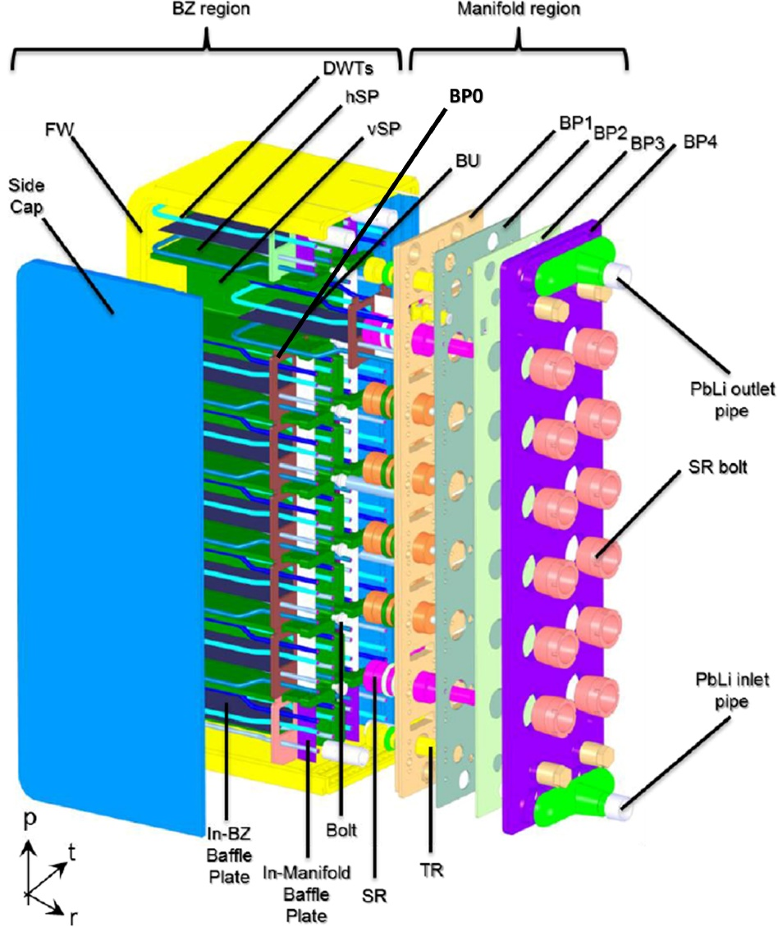
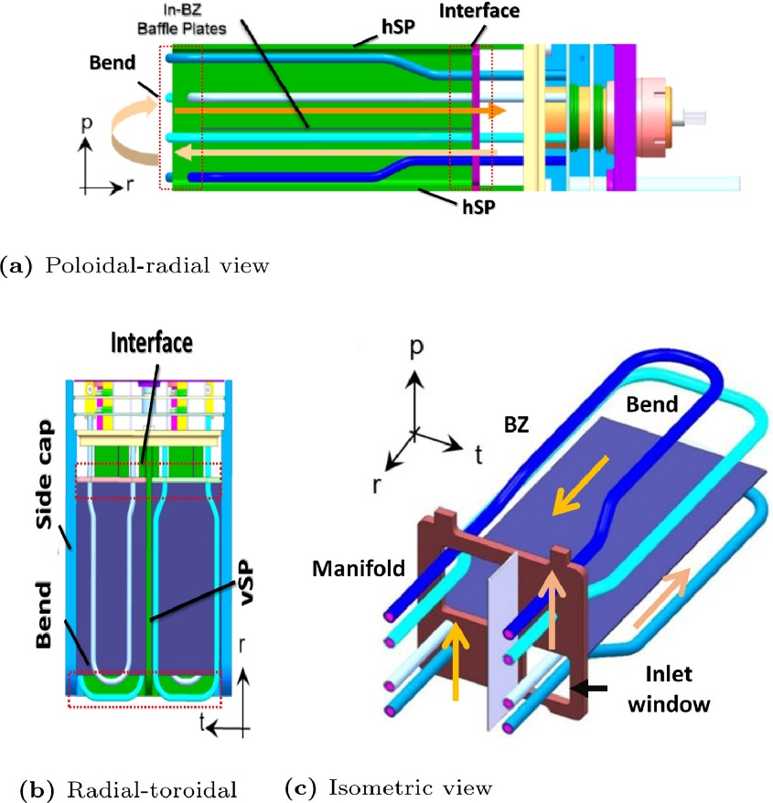
WCLL Test Blanket Module
Reduced Activation Ferritic Martensitic (RAFM) steel EUROFER-97 as structural material
Eutectic LiPb as tritium breeder and neutron multiplier
Water @15.5 MPa as coolant
16 separate channels called Breeder Units (BUs) in which lithium-lead circulates
Notes:
The Water-Cooled Lithium Lead Breeding Blanket is one of the most promising concepts to be used as key component in fusion power devices, as it provides tritium breeding and nuclear power conversion and extraction. It is characterized by the use of EUROFER-97 steel as structural material, the eutectic LiPb as tritium breeder and neutron multiplier.
The thermal power produced within the WCLL-TBM is removed by means of pressurized water circulating in cooling channels embedded in the FW stucture facing the plasma, as well as in the BZ DWT immersed in the liquid breeder. In nominal conditions the circuit is operated at 15.5 MPa.
The current conceptual design phase foresees a TBM box formed by a C-shaped first wall (FW) covering the upper, lower and frontal parts of the TBM. The two sides are closed by means of two non-cooled side caps (SC), while the rear part is closed by four steel plates delimiting manifolds for the distribution and collection of the water coolant inside the breeder blanket and inside the first wall.
Vertical and horizontal stiffening plates are provided to withstand the internal pressurization in case of accident. The resulting stiffening grid divides the box interior into 16 separate channels called Breeder Units (BUs) in which lithium-lead circulates for allowing extraction of the tritium in the port cell area. In each cell up to four radial-toroidal Double Wall Tubes (DWTs), are inserted and welded to a common back plate.

Slide 19
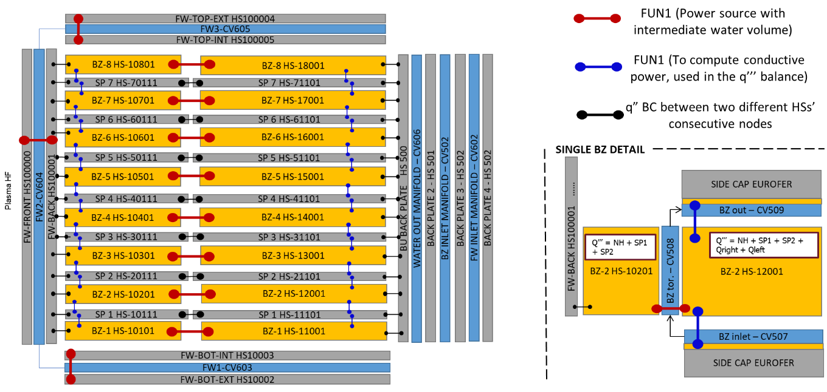
MELCOR model of TBM
The simultaneous presence of different working fluids cannot be achieved by the MELCOR code.
LiPb has been simulated with HSs components thermally coupled by FUN1
[Ref] D'Onorio, M. et al. “Supporting analysis for WCLL test blanket system safety”, (2021) Fusion Engineering and Design, 173, art. no. 112902
Notes:
An overview of the nodalisation of the WCLL-TBM is provided. Left figure is poloidal section view of the TBM nodalisation, showing breeding heat structure (BZ) and stiffening plates (SP) for each breeding unit level, but also FW, SW and manifold models.
Figure in the bottom right is a toroidal section of a single breeding unit mainly focused on showing DWTs CVs and the thermal coupling between Side Caps (SC) and breeding structures.
To limit the size of the model, the two parallel columns of breeding units divided by the vertical Stiffening Grid (SG), have been collapsed into a single column of BU modelling equivalent CVs, FLs and HSs.
FW/SW heat structure have been divided into two separated structures; conduction and thermal radiation heat transfer between the heat structures is modelled using MELCOR user-defined control functions ('FUN1’).
Manifold containing LiPb is modelled with a single heat structure together with breeding unit back plate and BP1.

Slide 20
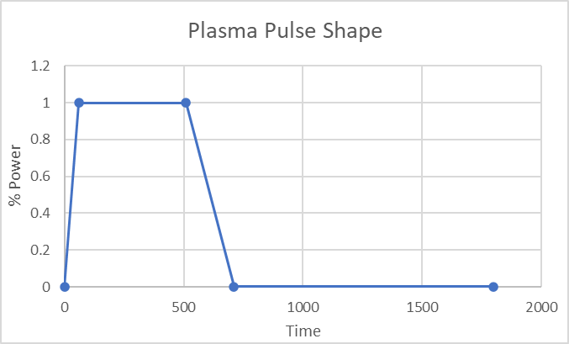
Preliminary parametric studies
Ex-vessel loss of cooling accident: Double-Ended Guillotine Break (DEGB) of the 3” TBM inlet WCS pipe during an ITER plasma burn phase
LOFA: WCS pumps seizure during an ITER plasma burn phase
PIE | CASE ID | Time of PIE | FPTS | SIC1 Valve closure | SIC2 Valve closure
Ex-vessel LOCA | 1 | 460 s | -- | -- | EPP (710 s)
 | 2 | 60 s | -- | -- | EPP (710 s)
 | 3 |  | -- | 80% Pn | 80% Pn
 | 4 | 460 s | 80% Pn | -- | 80% Pn
LOFA | 1 | 60 s | -- | -- | --
 | 2 | 60 s | Y (5s) | -- | --
 | 3 | 510 s | -- | Spurious closure at 510 s | --
[Ref] D'Onorio, M. et al. “Supporting analysis for WCLL test blanket system safety”, (2021) Fusion Engineering and Design, 173, art. no. 112902
Notes:
Concerning the ex-vessel loss of cooling accident, the postulated event is a Double-Ended Guillotine Break (DEGB) of the 3” TBM inlet WCS pipe during an ITER plasma burn phase, with resulting loss of water into the port cell. Break location has been set on the inlet line of WCS from TBM set, upstream the SIC-1 safety isolation valves (on the PC door side) to maximize water inventory potentially released in Port Cell.
Concerning the LOFA the initiating accident is a WCS pumps seizure.
Accident occurs during ITER normal operating state, when a pulsed plasma regime is foreseen. Plasma pulse pattern foresees the full plasma power to be reached within 60 s and, after 450 s of flat-top, the power is ramped down in 200 s. The dwell time between two consecutive plasma pulses is 1090s.
Parametric studies have been performed to gain insight in the relative impact of safety logic implementation for both LOCA and LOFA. In particular, some cases have been investigated by varying the time at which PIE occurs, the role of SIC safety isolation valves, the effects of plasma shut-down thermal loads.

Slide 21
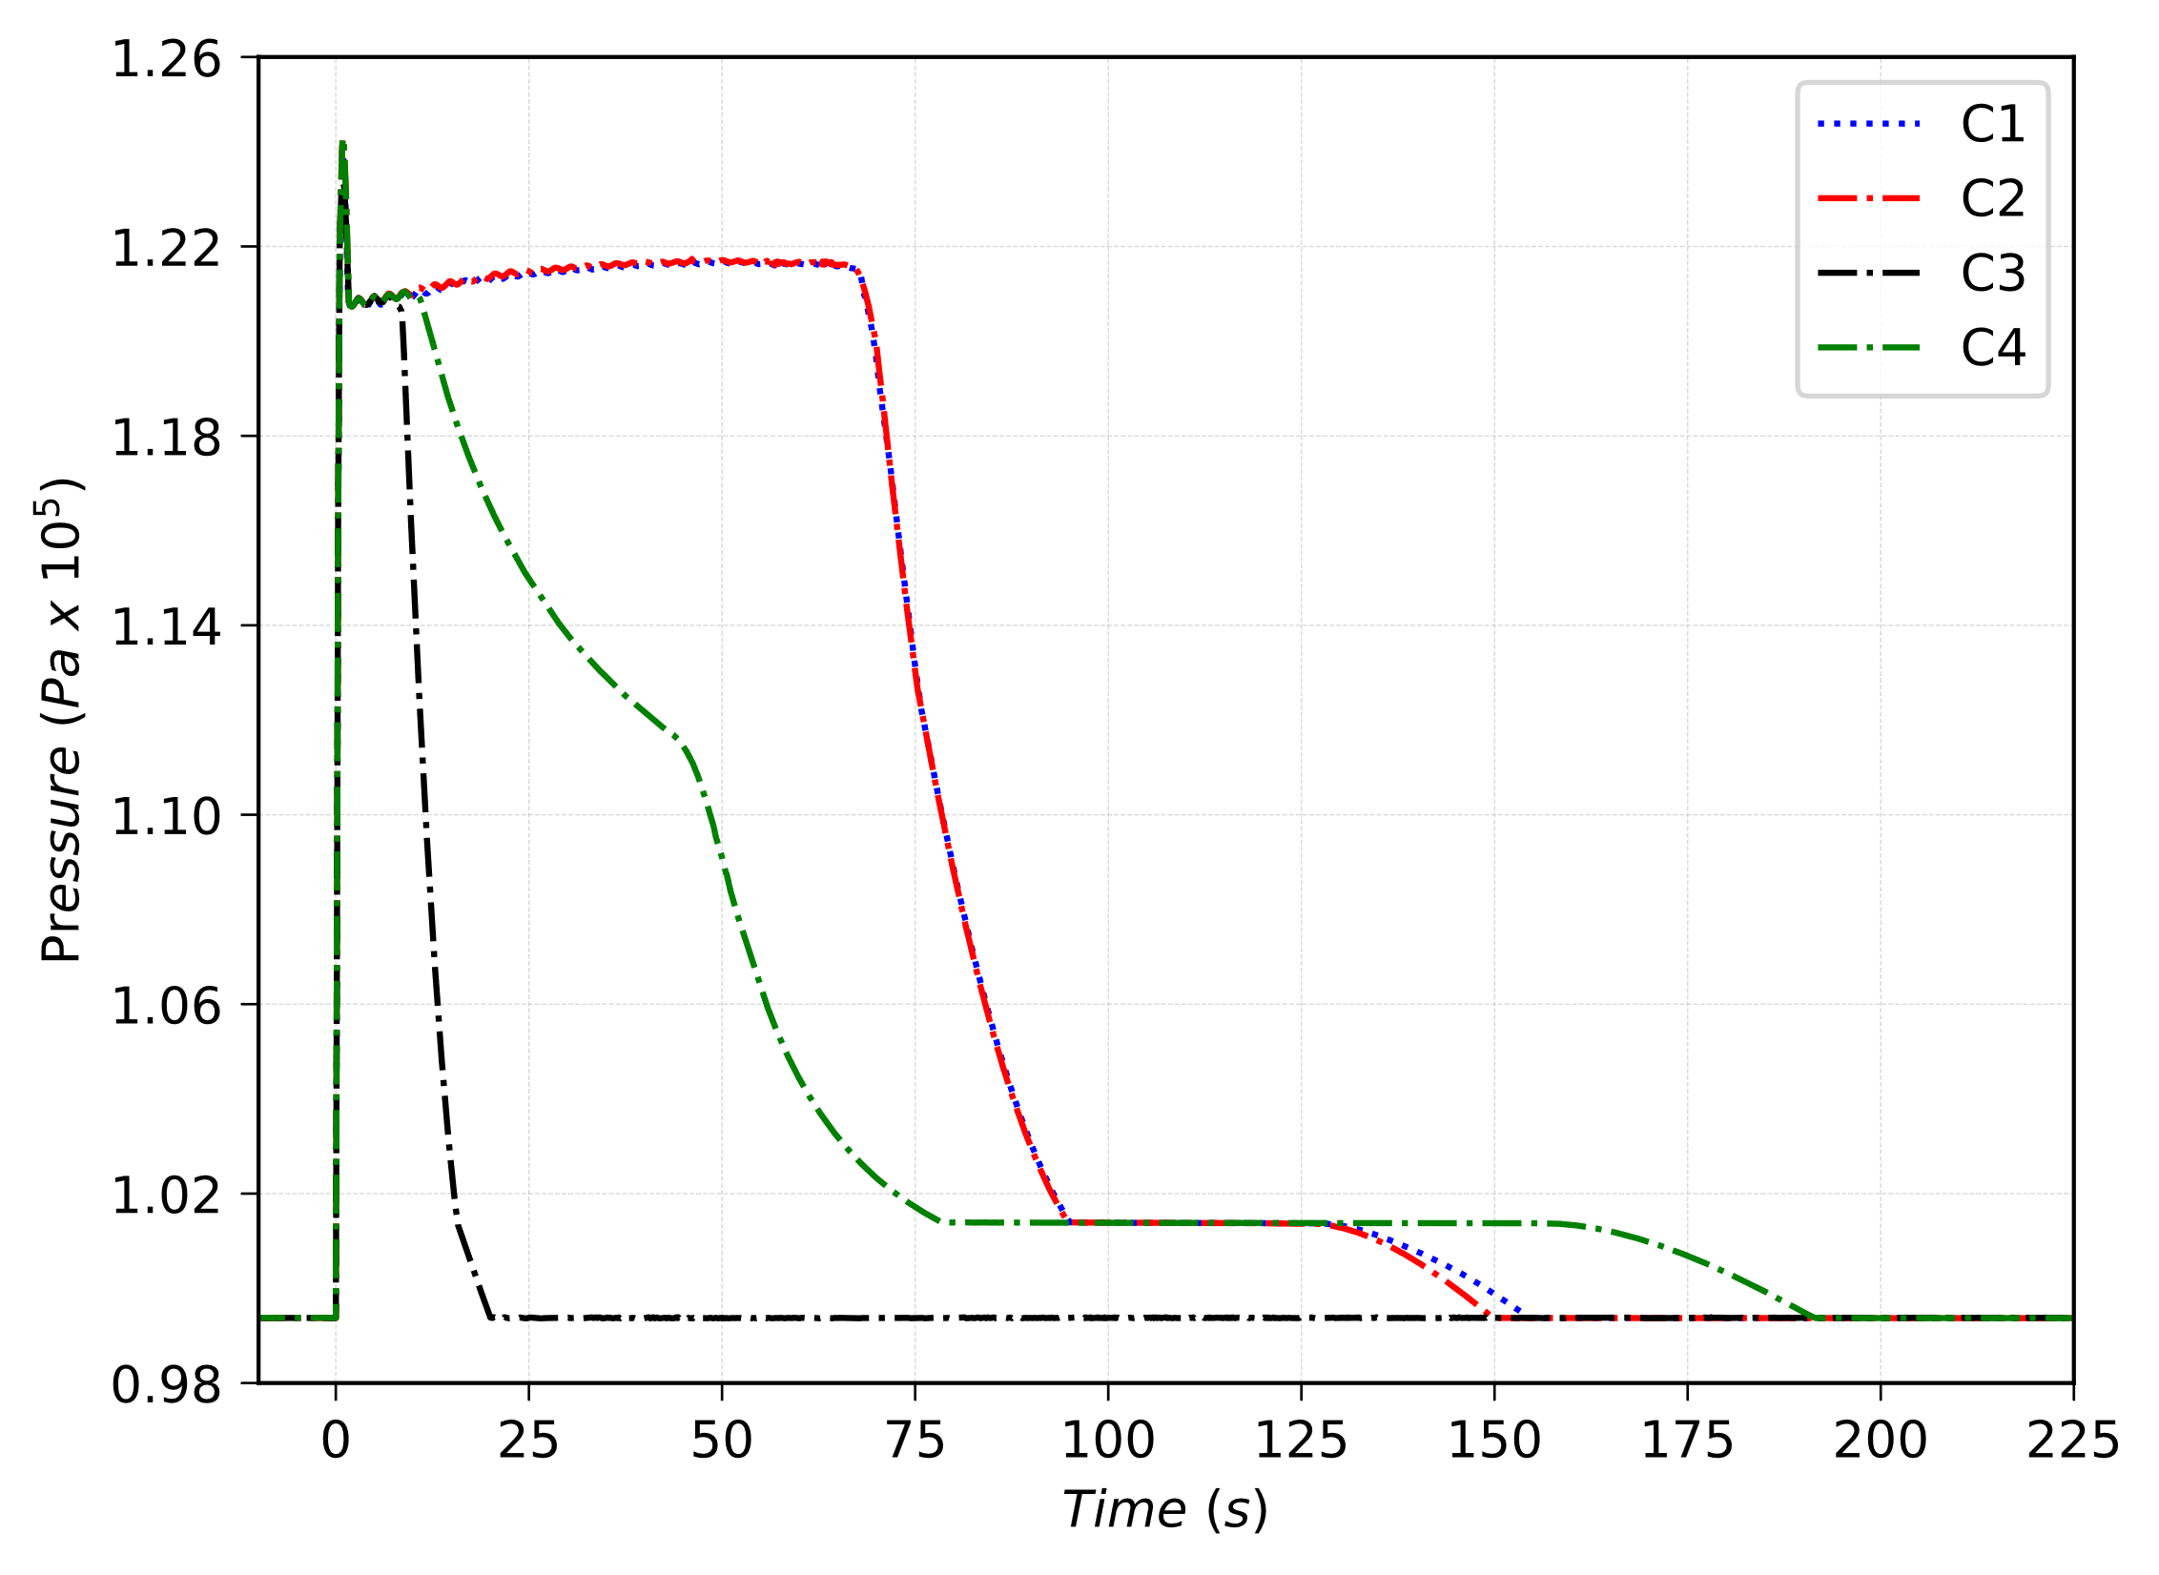
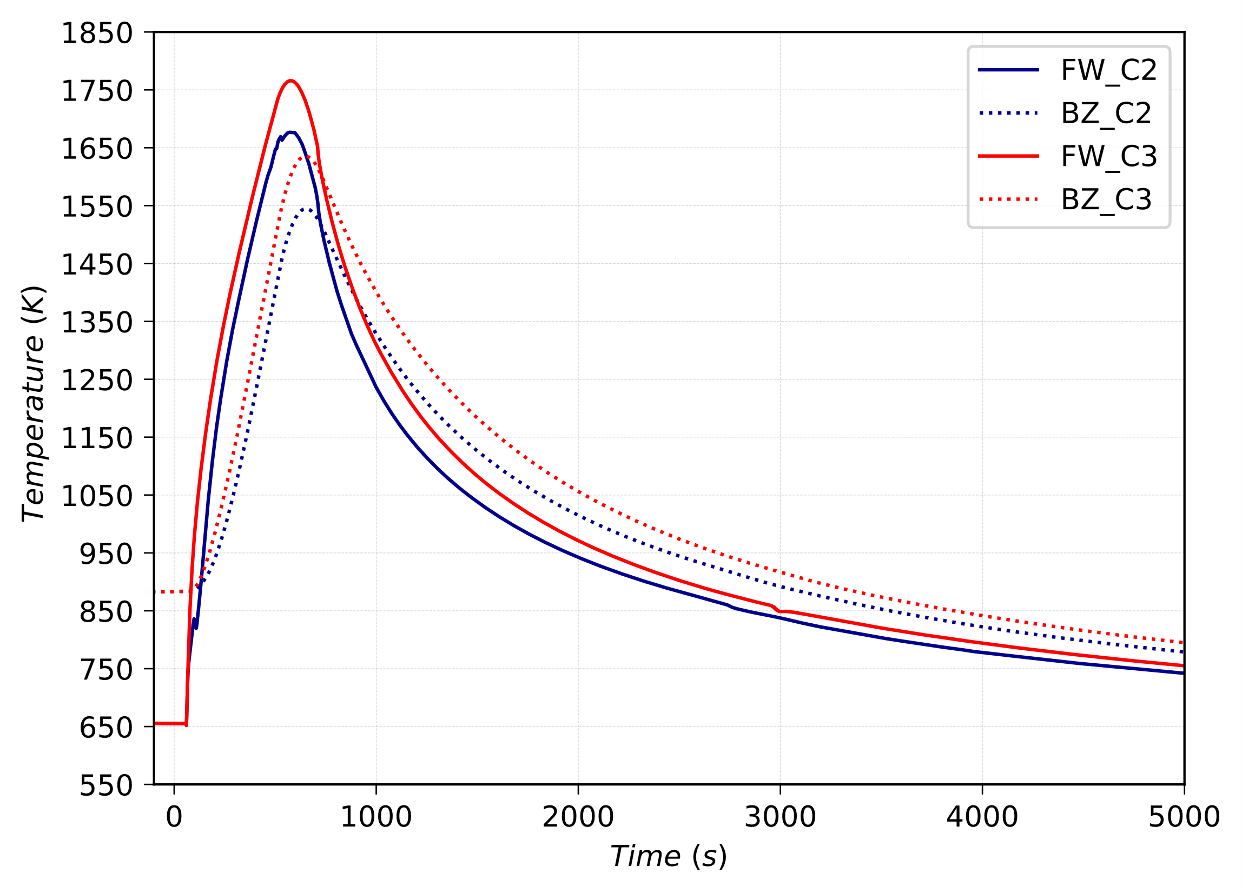

Preliminary parametric studies (LOCA)
Pressure in Port Cell (PIE at 0 s)
FW and BZ temperature transient in C2 C3
FW and BZ temperature transient in C1 C4
The LOCA results in a release of water in the port cell environment and subsequent pressurization. The pressure peak of 124 kPa is reached in the PC immediately after the LOCA.
The closure of SIC valves reduces the total inventory of water discharged in the PC, allowing also for a faster depressurization of PC volume, reducing HTO releases toward external environment.
Preliminary results of LOCA analyses highlight that the TBM-FW can reach temperatures up to around 1700 K for PIE occurring at the beginning of the flat-top phase.
[Ref] D'Onorio, M. et al. “Supporting analysis for WCLL test blanket system safety”, (2021) Fusion Engineering and Design, 173, art. no. 112902
Notes:
In all the simulations the relief panel connecting the PC to vertical shafts volume (FL814) acts 0.4 s after the PIE, when the pressure in PC is 20 kPa higher than that in shafts
The impact of fast plasma termination system has also been preliminary investigated by modelling the effects of a plasma disruption on the TBM FW. The disruption causes an increase of around 200 K on the FW surface, comparable to the effect of around 100 s of full-power plasma.

Slide 22



Preliminary parametric studies (LOFA)
Pressure transient in WCS pressurizer (PIE at 0 s)
FW temperature in all HS nodes for LOFA C1
FW temperature in all HS nodes for LOFA C3
The loss of coolant flow causes a rapid reduction in the rate of heat removal from the TBM, leading to temperature excursion of the TBM FW and pressurization of the WCS and TBM coolant.
The FW temperature rises from 657 K at 60.0 s to reach the maximum temperature of 1175 K at t=540 s, 480 s after the PIE.
It is still to be assessed which combined load conditions (structure temperature point combined with the related pressure load) would result into EUROFER structural integrity loss.
[Ref] D'Onorio, M. et al. “Supporting analysis for WCLL test blanket system safety”, (2021) Fusion Engineering and Design, 173, art. no. 112902
Notes:
In Case1 pressure in WCS and TBM systems increases to 17.7 MPa (set-point for PORV opening) in around 60 s. Steam is discharged from pressurizer into a small suppression relief tank through the PORVs and, if necessary, through the Safety Relief Valve (SRV). In Case 2 and Case 3, the maximum pressure inside the TBM is around 1.65 bar, and the intervention of PORV is never required. In Case 3, because of further reduced cooling capacity deriving from the spurious closure of the SIC-1, the FW structure experience a maximum temperature of around 1000 K.
Parameters’ variation effect of LOFA transient on FW temperature appear less significant if compared with the LOCA ones, however SRVs and PORVs opening set point should be accurately chosen to reduce the mechanical stress on structure.

Slide 23

MELCOR-RAVEN COUPLING FOR UNCERTAINTY QUANTIFICATION
RAVEN development has begun in early 2012.
The overall goal was to conceive a tool to enable Risk Informed Safety Margin Characterization (RISMC)
  Evaluating risk (uncertainty propagation)
  Understanding risk (limit surface, ranking, sensitivity, data mining)
  Mitigating risk (optimization)
RAVEN is open-source and can be downloaded from GITHUB:
  https://github.com/idaholab/raven
Multiple operative systems are supported (Windows, Linux and Mac)
RAVEN development is performed under a strict Software Quality Assurance process:
  NQ1 – Lvl. 2
  User manuals and guides, theory manuals, tests documentation
  Multiple level of peer-review process
  Automatic verification (testing) (~650 regression tests)
Notes:
RAVEN is an open source tool. It was born as a PRA code to perform parametric and probabilistic analysis based on the response of complex system codes
It is a modular or ‘plug-in’ tool that can be coupled with other computer code

Slide 24

MELCOR-RAVEN COUPLING
The coupling has been realized through a Python Interface integrated into the source code
The Interface is capable to:
  Generate a run command for MELGEN and MELCOR executable
  Convert binary plot file of MELCOR in CSV file
  Python module used: struct.
  This module performs conversions between Python values and C structs represented as Python strings. This can be used in handling binary data stored in files.
Initial Sampling of:
  Physical parameters
  Initial Conditions
  Transition Conditions, i.e., time of a transition event
Runs the system simulator using the values previously sampled and eventually applying a random noise to some parameters
Converts each .PTF file in csv. To overcome the handling of large datafiles the interface allows to create a CSV file with only variables required by the users. So is possible to obtain an HDF5 database which comprises variables from all MELCOR packages (CVH, FL, COR, RN etc.)
[Ref] D'Onorio, M., et. al "Severe accident sensitivity and uncertainty estimation using MELCOR and RAVEN", (2022) Journal of Physics: Conference Series, 2177 (1), art. no. 012021, 2022
[Ref] D'Onorio, M., et. al “Preliminary uncertainty quantiﬁcation of the core degradation models in predicting the Fukushima Daiichi unit 3 severe accident”, (2021) Nuclear Engineering and Design, 382, art. no. 111383
Notes:
One of the most difficult thing that I do for this activity is to develop the possibility to directly extract MELCOR information from the binary plot file. This has been successfully accomplished using the python struct module. Once the binary melcor plot file is converted in something readable by RAVEN (like a csv file or somelse python data structure like dataframe or dictionary) we can use RAVEN to enhance to outcomes of our safety studies. Her for example you can see the procedural framework adopted to perform un UQ analysis.

Slide 25


Optimization algorithms coupled with system codes: H2 recombination
Optimization based on the Gradient Descent method. It estimates the local gradient of an objective function, changing a set of predefined parameters.
To overcome entrapment in local minima, multiple initial parallel trajectories are needed to obtain a global solution
Objective function: Total mass of H2 recombined by both recombiners
The selected thermal-hydraulic and geometrical parameters to be optimized are:
  Rupture Disk pressure set point (Pa)
  Bleeding Line pressure set point (Pa)
  Liquid Level of Suppression Tank A (m)
  Liquid Level of Suppression Tank B (m)
  Expansion Tanks volume (m3)
Gradient approximation adopted - Central Difference
For the input space i = (x; y; z) and objective function f(i), then 6 perturbations are chosen, and the following perturbation points are evaluated:
The local gradient is evaluated:
Notes:
Another activity that we did using MELCOR and RAVEN is related to the solution of optimization problems. We have implemented in RAVEN a gradient descent method to find the optimal value of a goal function. This alghorithms works by estimating locally the gradient of the objective function, and when the gradient is approaching to zero it, of course, means that we are reaching a maximum or a minimum.

Slide 26






Optimization algorithms coupled with system codes: H2 recombination
Bleeding Line set point optimized
Liquid Level of Tank A optimized
Rupture Disk set point optimized
Liquid Level of Tank B optimized
Liquid Level of Tank A optimized
Final amount of H₂ estimated by the optimization algorithm (kg)
Trajectory | Final amount of H₂ estimated by the optimization algorithm (kg)
0 | 1.091
1 | 1.089
2 | 1.126
3 | 1.031
4 | 1.031
5 | 1.125
6 | 1.128
7 | 1.031
8 | 1.129
9 | 1.031
Expansion Tank volume optimized
Notes:
We tried to apply this method to optimize the mass of hydrogen recombined by the system we proposed for the EU-DEMO reactor. Thus our goal function is the total mass of hydrogen recombined. And we have selected some design parameter that we want to change to reach our goal. Thus RAVEN automatically explores this space input and runs MELCOR simulations to find out the maximum value. Here you can see for example, the results for converged scenarios. And we have that there are two values for the ET volume that can be used for our goal. Instead the liquid level in the ST-A doesn’t change over the iterations so it seems to do not have an impact on our goal function.

Slide 27
Conclusions
MELCOR code extensively used in the EUROfusion consortium to support the safety assessment of EU-DEMO and ITER TBS
Basic TH can be simulated using CVH-FL package
Some current needs
  Multi-fluid version could improve the analysis outcomes
  Dust mobilization/oxidation models
  Tritium (HTO not enough)

Slide 28

Thank you for your attention
The research activity is carried out by Sapienza University of Rome with the MELCOR code, in the framework of the DIAEE-ISIN agreement signed on 13/05/2020 as part of the General Arrangement between the United States Nuclear Regulatory Commission (US-NRC) and the Italian National Inspectorate for Nuclear Safety and Radiation Protection (ISIN).”
Matteo D’Onorio
matteo.donorio@uniroma1.it

