Slide 1
Latest Experiences with MELCOR 2.2:
An Overview of
Applications, Issues and Challenges
M. Garcia*, J. Fontanet, R. Iglesias, L. Vitores, L.E. Herranz
*monica.gmartin@ciemat.es
Unit of Nuclear Safety Research
Department of Nuclear Fission
CIEMAT
European MELCOR and MACCS USER Group, EMUG 2024
Sapienza University, Rome, 15th-18th April, 2024

Slide 2
Areas of Work:
01
Combustible gases management
02
Uncertainty and sensitivity analysis in SAs
03
1F1 Fukushima analysis

Slide 3
01
Combustible Gases Management

Slide 4
Combustible Gases Management
Frame
  - H2020 EURATOM AMHYCO project (2020-2024): Towards an enhanced accident management of the hydrogen/carbon monoxide combustion risk.
Objective
  - To optimize the management of H₂+CO in high combustion risk sequences.
Tool
  MELCOR 2.2_r2023
Scope
  PWR-W containment
  LBLOCA (double ended guillotine) & SBO
  FRAMATOME’s design PAR (Passive Autocatalytic Recombiner)

Slide 5
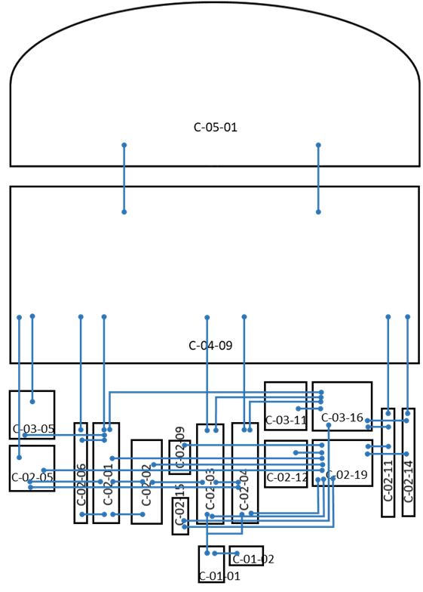
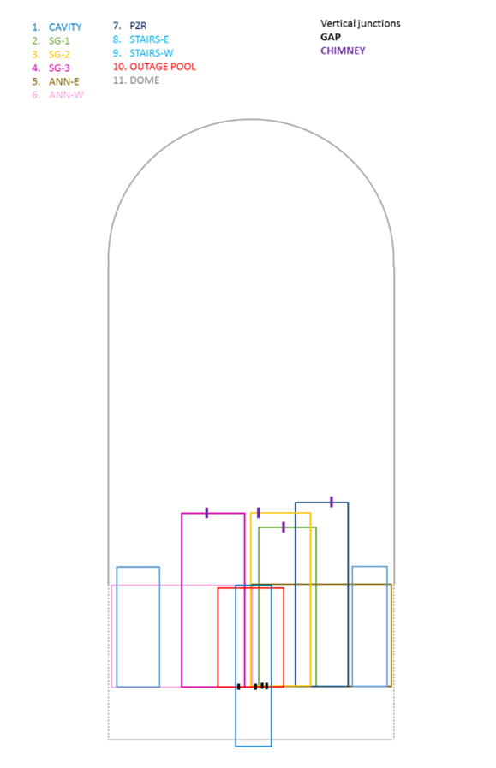
Combustible Gases Management
CODE EM (Evaluation Model)
Full reactor containment model
(WP2 – Sequence selection)
Containment “stand-alone” model
(WP4 – Full containment analysis)
LBLOCA
SBO
19 CVs
11 CVs

Slide 6
Combustible Gases Management
CODE EM (Evaluation Model)
Full reactor containment model
(WP2 – Sequence selection)
Containment “stand-alone” model
(WP4 – Full containment analysis)
Stand-alone approach:
  The possibility of running several calculations quickly by saving running time.
  Comparison of results from several codes: MELCOR, ASTEC and GOTHIC (which is exclusively focused on containment).
LBLOCA
SBO
19 CVs
11 CVs

Slide 7
Combustible Gases Management
CODE EM: Assessment of the Stand-Alone Model
Mass/Energy sources confirmation
  LBLOCA in the hot leg
  Objective: To ensure the correctness of the source’s definition taken from the full model, avoiding the foreseen effect of nodalization
  Approach: Sources injection as BCs into the isolated containment full model
  Sources:
      S1. RCS discharge: H_{2,}H₂O and H₂O_{(V)} into the SG room.
      S2. Vessel failure: H₂O and H₂O_{(V)} into the cavity.
      S3. MCCI gases generation: H_{2 ,}H₂O_{(V)},CO and CO₂ into the cavity.
      S1
      S2
      S4. HT from corium to cavity atmosphere
      S4
      S3

Slide 8
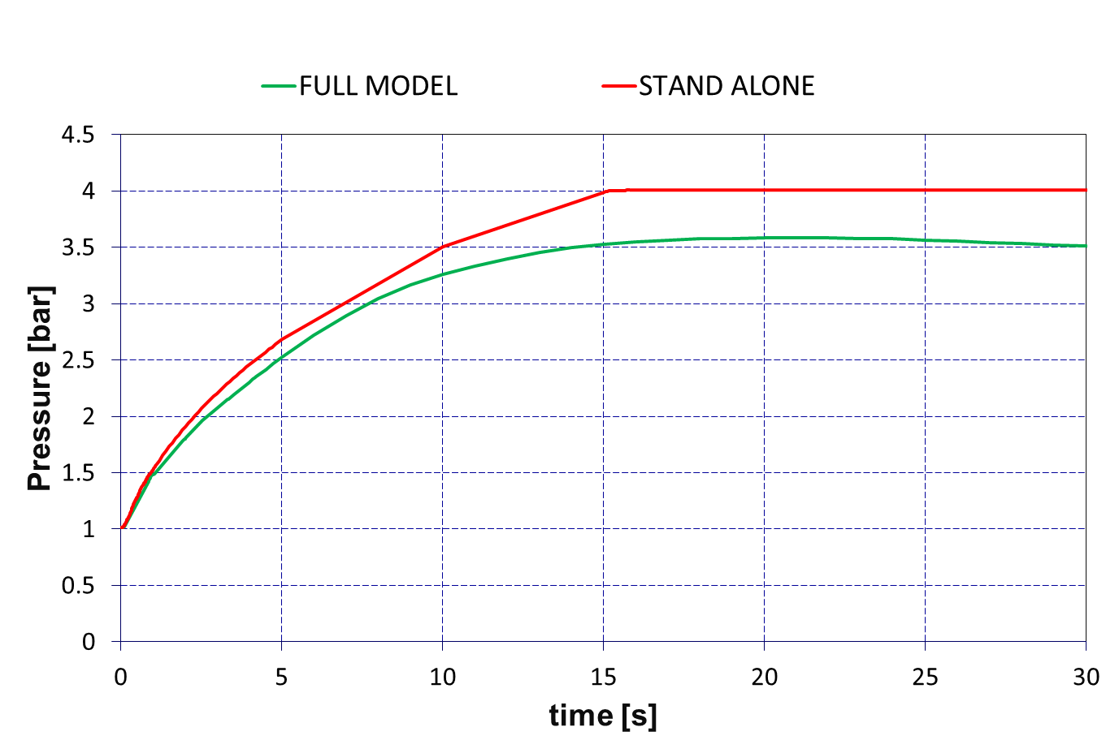
Combustible Gases Management
CODE EM: Assessment of the Stand-Alone Model
∼ 0.5 bar
Containmet pressure vs. time

Slide 9
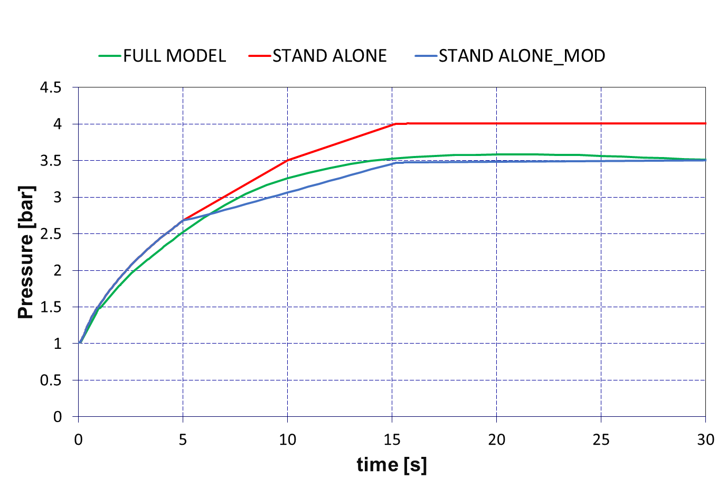
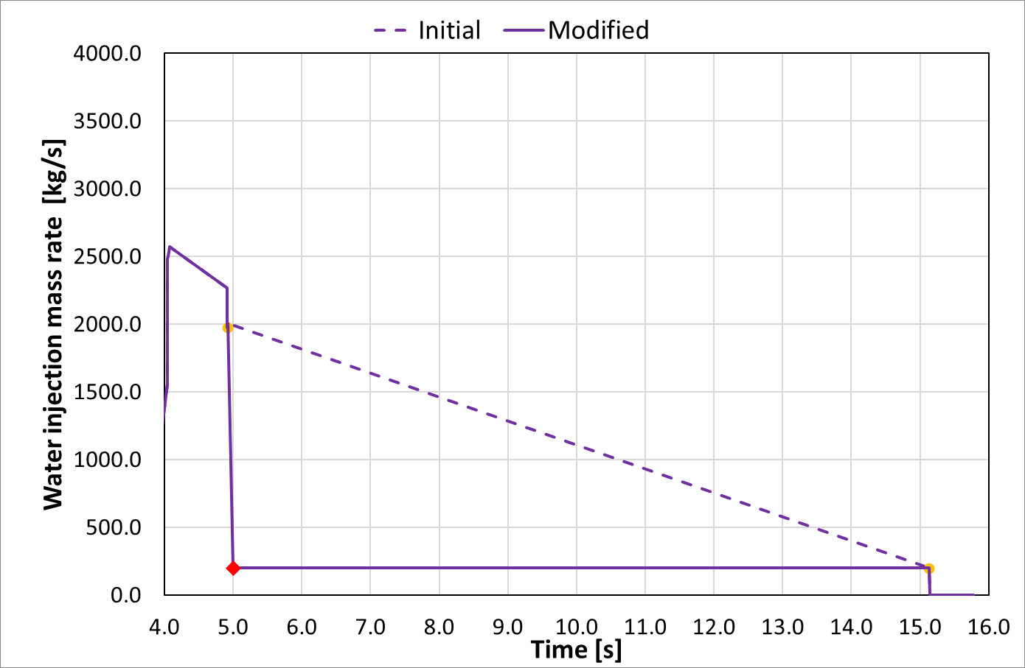
Combustible Gases Management
CODE EM: Assessment of the Stand-Alone Model
Stumble:
Lack of care in the selection of time-steps.
Consequence:
Temporary oversizing of the water source.
Water injection mass from RCS to SG room (S1)

Slide 10
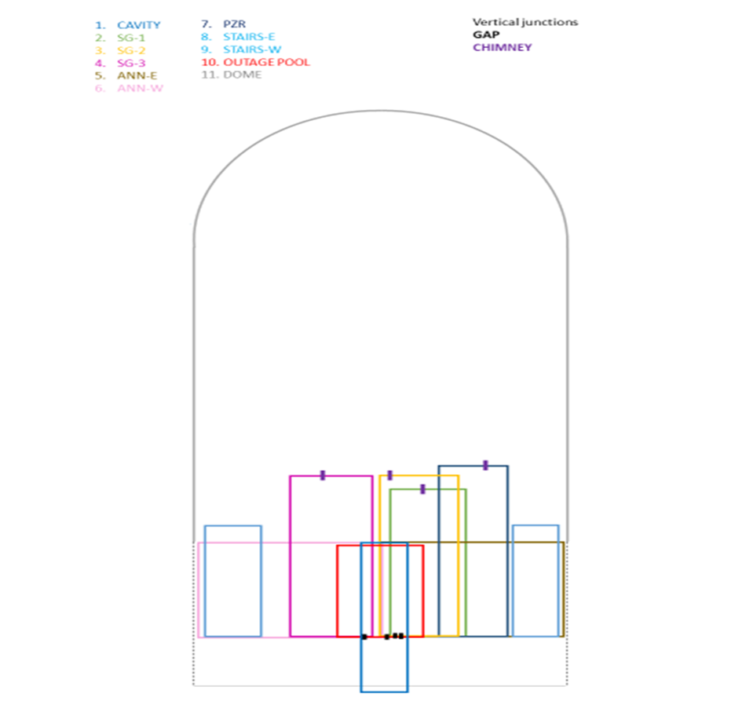
Combustible Gases Management
CODE EM: Assessment of the Stand-Alone Model
Mass/Energy sources confirmation
  LBLOCA in the hot leg
  Approach:
  Sources:
      Direct heat to cavity atmosphere (CAV-QSURF)
      HS with controlled T (CAV-T-lay)
      S1. RCS discharge: H_{2,}H₂O and H₂O_{(V)} into the SG room.
      S2. Vessel failure: H₂O and H₂O_{(V)} into the cavity.
      S3. MCCI gases generation: H_{2 ,}H₂O_{(V)},CO and CO₂ into the cavity.
      S4. HT from corium to cavity atmosphere
      S4

Slide 11
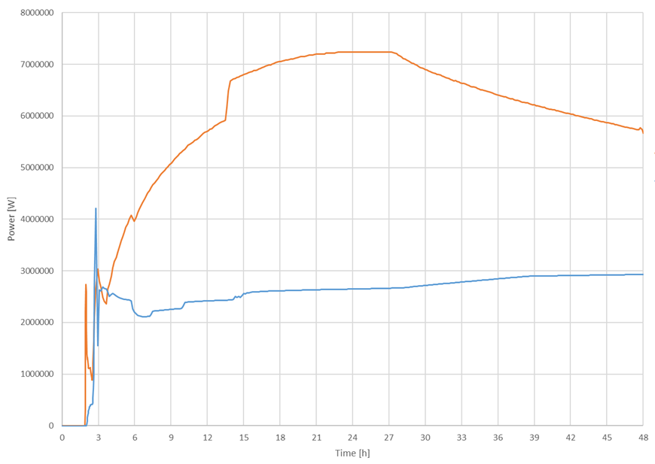
Combustible Gases Management
CODE EM: Assessment of the Stand-Alone Model
Difficulty:
Definition of the energy source from the corium in the cavity and to account correctly for the convection and radiation part, extract the data from the full model and introduce it in all the codes in an equivalent way.
Two approaches considered
DH_Ap
Direct Heat to Cavity approach (DH_Ap):
Overestimation of the heat to the atmosphere
Understimation of the indirect heat to the cavity structures
Heat Structure approach (HS_Ap):
Underestimation of the heat transfer to the atmosphere
Radiation to the considered cavity structures
HS_Ap
DH_Ap choice:
Conservative results in pressure
Easier to implement for different codes
Better capture of the MELCOR’s heat transfer
Power supply to the containment atmosphere

Slide 12
Combustible Gases Management
PAR’s modelling: correlation implementation
  FRAMATOME’s correlation
$R_{H2}∝C_{H2}·η·\left(k_{1}·P+k_{2}\right)·\tanh{(C_{H2}+C_{CO}−C_{min}})$∙C_{off}
‘Classical’ CF’s (> 30 per CV)
CF_FORMULA type record (12 per CV)
Significant reduction of workload
Simplification of input
Reduction of possible errors from user-effect

Slide 13
Conclusions/Remarks
Stand-alone containment model for a PWR-W containment developed for MELCOR
Assessment of sources
  In fast sequences special attention must be paid to the selection of time steps.
  Difficulties have been encountered in properly defining sources in the ex-vessel phase. The direct source into the atmosphere was accorded by AMHYCO’s partners due to the conservative results and its user-friendliness.
The use of CFs type ‘FORMULA’
  Has resulted in a significant simplification of the input deck and, therefore, in the reduction of possible user-errors.
  We very much appreciate the development effort of SNL and encourage them to continue in this line with e.g. the logical-valued CFs.

Slide 14
02
Uncertainty and Sensitivity Analysis in SAs

Slide 15
UaSAs in SAs
Frame
  H2020 EURATOM MUSA project (2019-2023): Towards an harmonized approach for the UaSA application to SAs.
Objective
  Uncertainty quantification in analysis & management of reactor accidents.
Scope (WP5)
  PWR-W 3 loops.
Tool
  MELCOR v2.2 code.

Slide 16
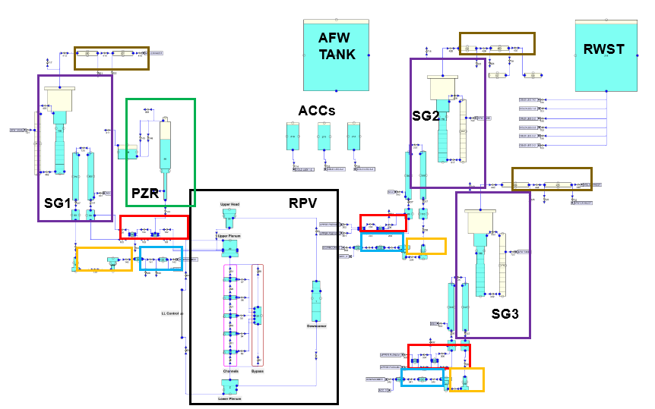
UaSAs in SAs
CODE EM (Evaluation Model)
RCS: 3 loops
RPV: 10 CVs
Core: 6 radial rings, 13 axial nodes
SSs: HPSI, LPSI, ACS
Containment: 30 CVs
NPP: 94 CVs, 178 FLs and 326 HSs
MELCOR 2.2.21402
Scenario
Unmitigated SBO
PWR-W 3 loops NPP
NPP MELCOR nodalization

Slide 17
UaSAs in SAs
CODE EM: Main assumptions
Reactor was operating at full power before the transient
Available safety systems
  Accumulators
  Turbo-pumps (2) for the Auxiliary Feed Water (AFW) system
  Batteries (6-hour duration)
  Safety valves (SGs and PZR) operation as design
Unavailable safety systems
  HPSI and LPSI systems
Failures included
  AFW (Auxiliary FeedWater) turbines: when the Main Steam Lines (MSLs) become flooded
  MSLs fail: when water level reaches half pipe height
  Hot Leg failure: due to creep (following the dedicated MELCOR model)
  Containment failure: over-pressure (P > 8 bar)
  Vessel failure: due to thermal creep
No severe accident management action was considered

Slide 18
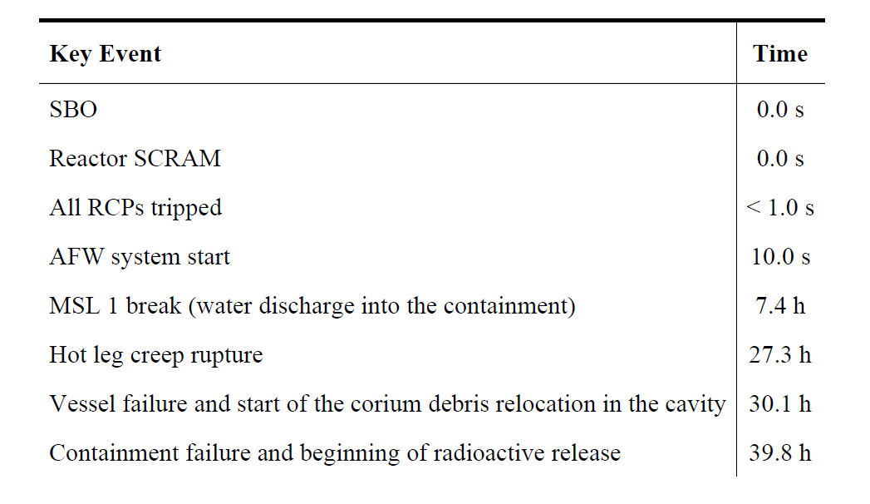
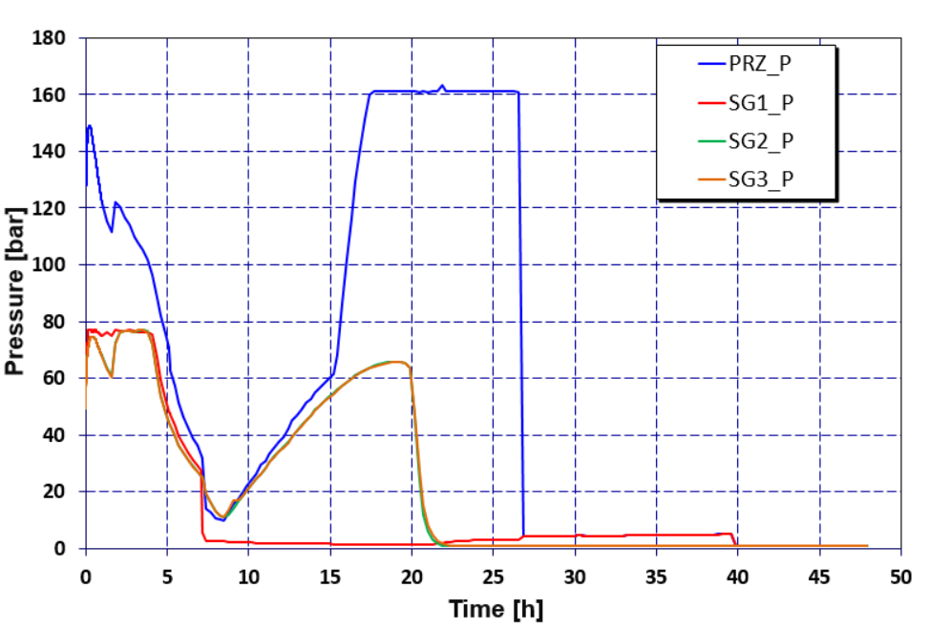
UaSAs in SAs
BE THs results
Evolution of the RCS and SGs pressure
Hot leg creep
MSL break
Cont. failure
MSL isolation
Time of the sequence: 48 h.

Slide 19
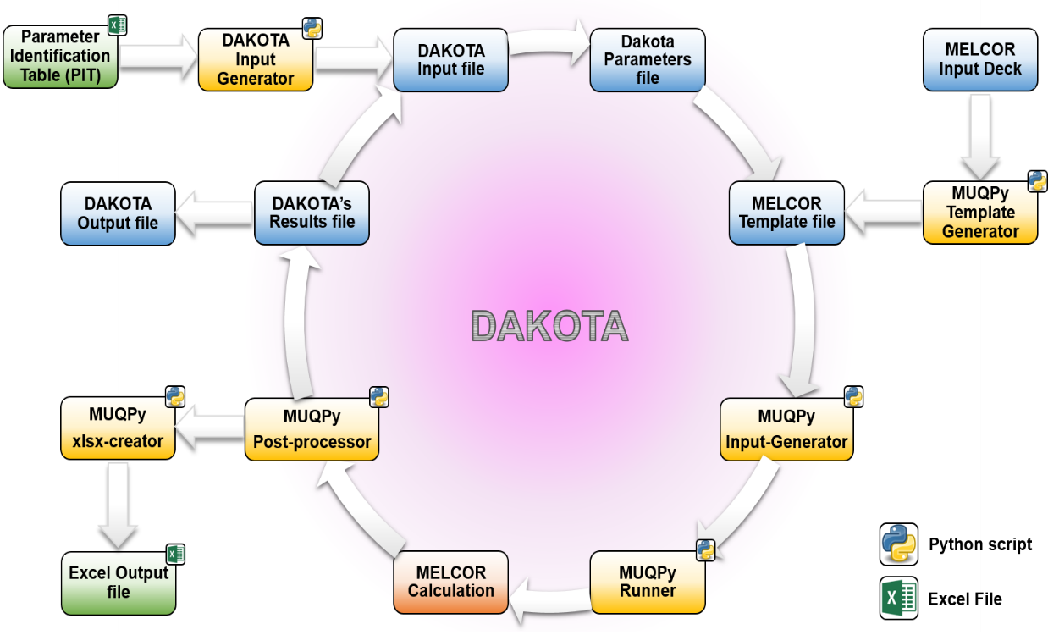
UaSAs in SAs
Uncertainty Methodology
Wilks – double side (95/95) – 93 runs – SRS method – 24 UPs
FOMs: I2, Cs, Nobles gases release & Containment failure time

Slide 20
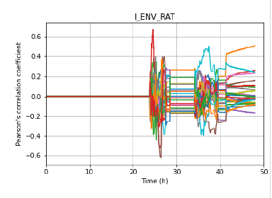
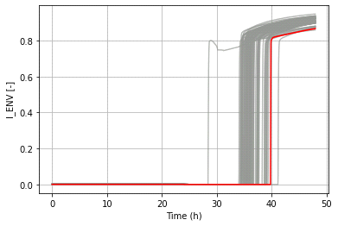
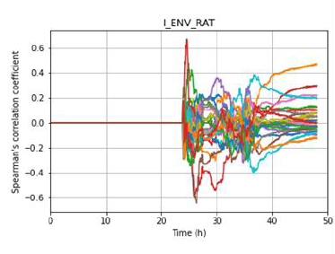
UaSAs in SAs
Uncertainty Quantification & Sensitivity Analysis Results
FPs_ENV_RAT
FPs_ENV [-]
Pearson’s coefficients for selected FOMs
FPs_ENV_RAT
Dispersion plot of FPs released to environment (fraction of i.i)
Spearman’s coefficients for selected FOMs

Slide 21
Conclusions
In the frame of the MUSA project, CIEMAT has faced the challenge of performing UaSAs calculations in the field of SA with MELCOR code.
For greater flexibility, the MELCOR/DAKOTA coupling, post-processing of data and the sensitivity analysis based on statistical correlation coefficients have been performed by building in-house PYTHON scripts
LESSONS LEARNED
Establishing a RC as robust as possible is an important part of UaSA analysis. It strongly depends on the point of interest and if there are some reference values.
A consistency screening of u.p. sets is highly recommended.
The sensitivity analysis is a helpful technique that enables to gain understanding of the behavior of a model and its coherence.
The management of failed cases has been a major challenge and will deserve special consideration in future works.

Slide 22
03
1F1 FUKUSHIMA ANALYSIS

Slide 23
1F1 Fukushima analysis
Frame
  - OECD/NEA FACE project (2022-2026): Fukushima-Daiichi Nuclear Power Station Accident Information, Collection and Evaluation project.
Objective
  - Fukushima-Daiichi accident analysis and preparation of the fuel debris retrieval operations.
Tool
  MELCOR 2.2
Scope
  Refining the interpretation of the 1F1 accident scenarios including the effects of accident management measures in consistency with insights obtained from plant investigations.
Focus
  Comparison among different versions of MELCOR.

Slide 24
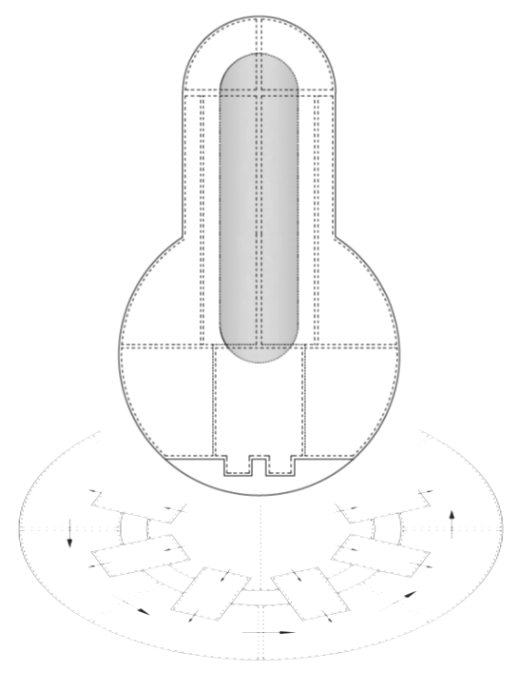
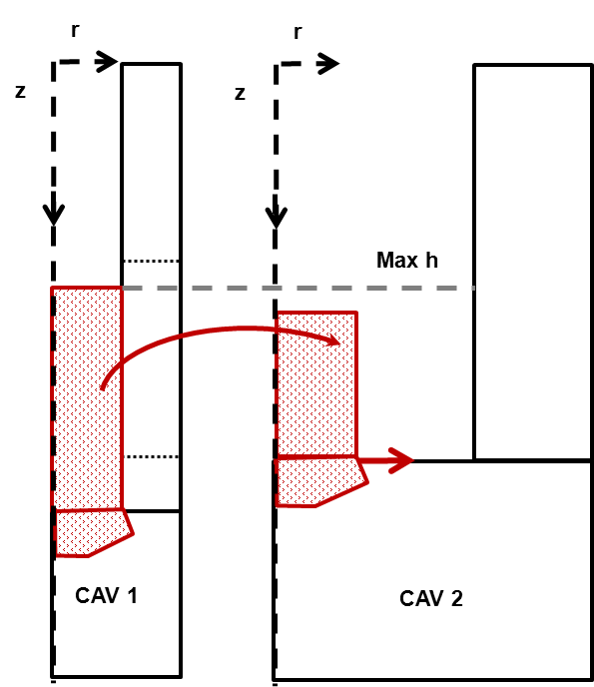
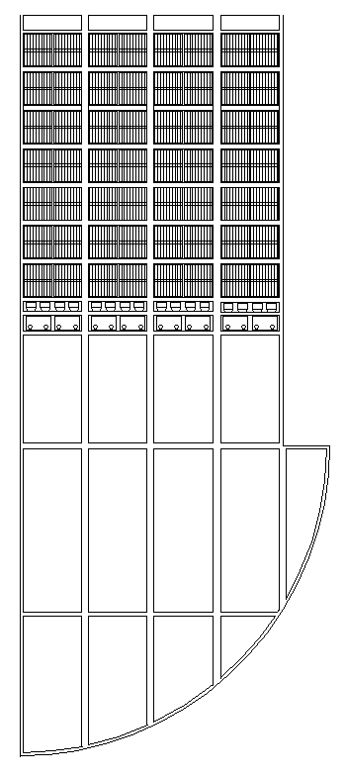
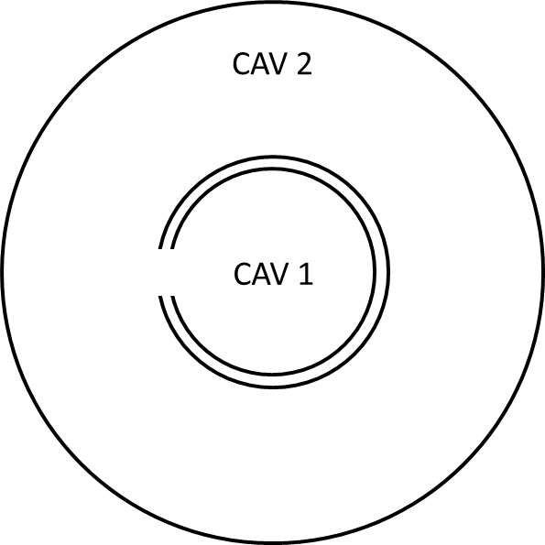
1F1 Fukushima analysis
CODE EM (Evaluation Model)
CORE
RPV
PCV
CAVITY
DW
10 CVs
RPV
6 CVs
CVH:
28 channel
4 bypass
1 LP
COR:
4 x 13
(7 FU levels)
WW
16 CVs

Slide 25
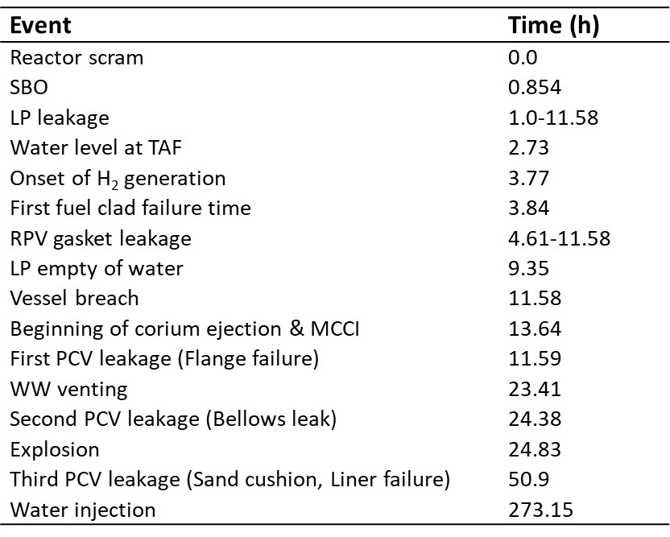
1F1 Fukushima analysis
Scenario
Main 1F1 simulation events

Slide 26
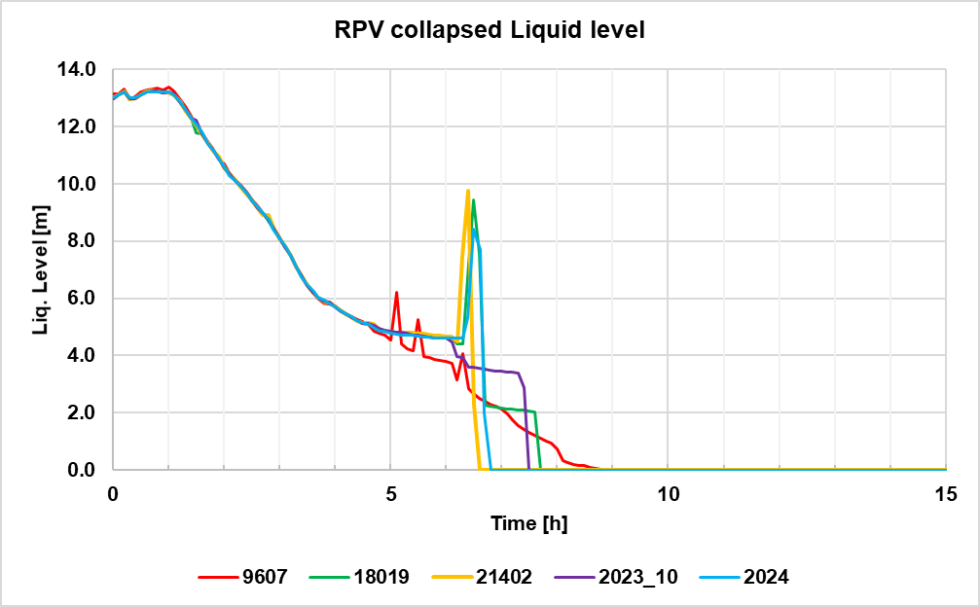
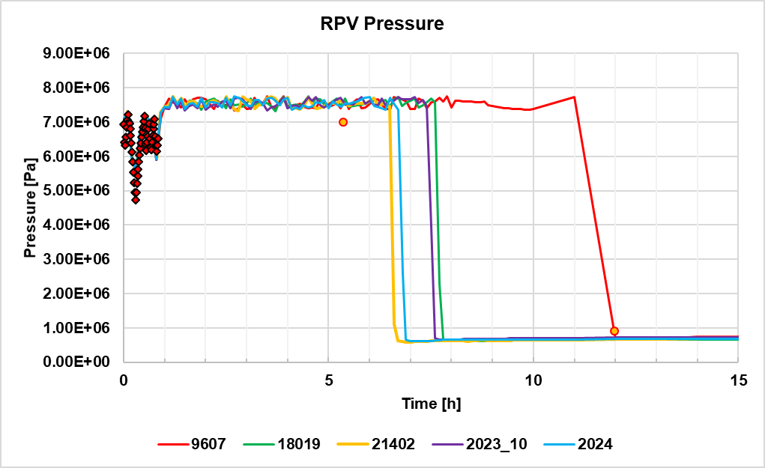
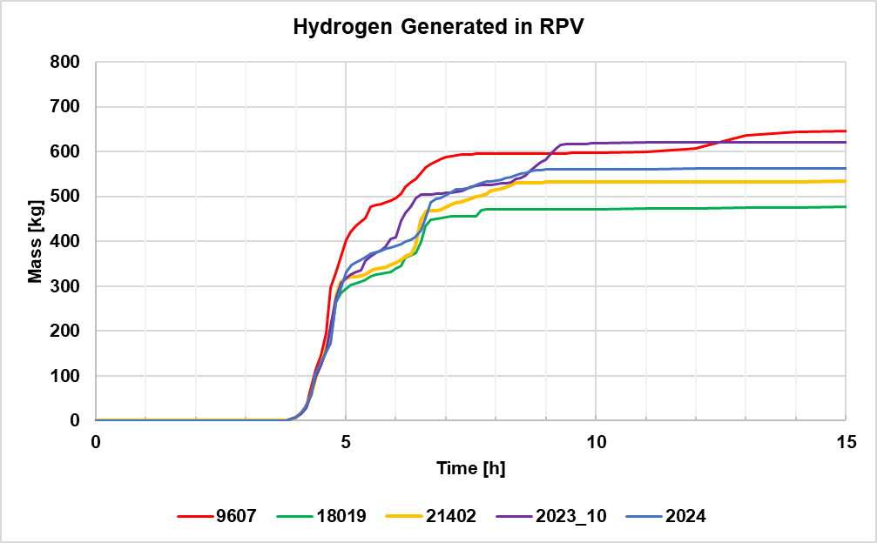
1F1 Fukushima analysis
Comparison among MELCOR versions
RPV THs
MELCOR_v22_r2023
MELCOR_v22_r2023.0.6.Patch
MELCOR_v22_r2023.0.8.Patch
MELCOR_v22_r2023.0.9.Patch
Model based on a small leakage from RPV to DW

Slide 27
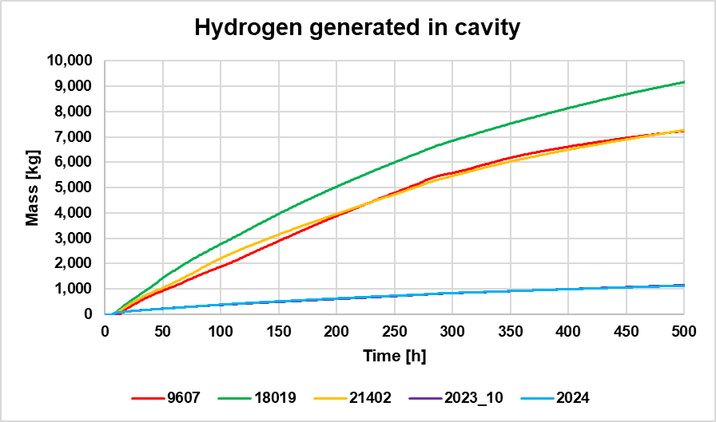
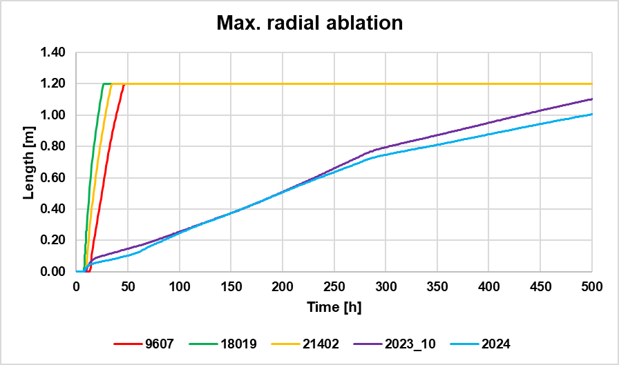
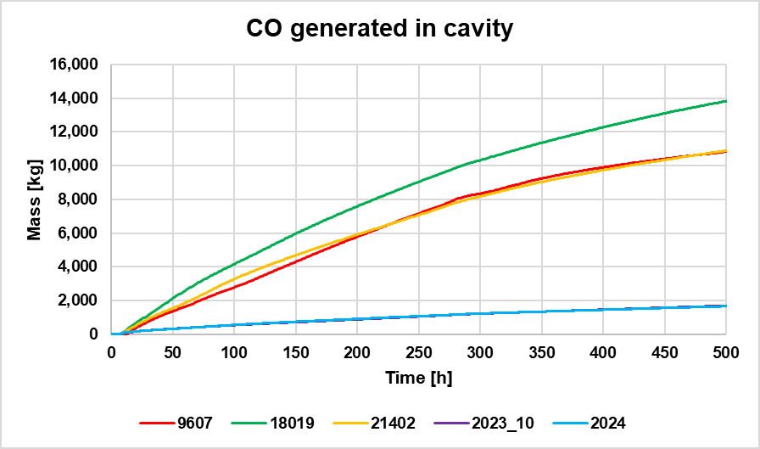
1F1 Fukushima analysis
Comparison among MELCOR versions
MCCI

Slide 28
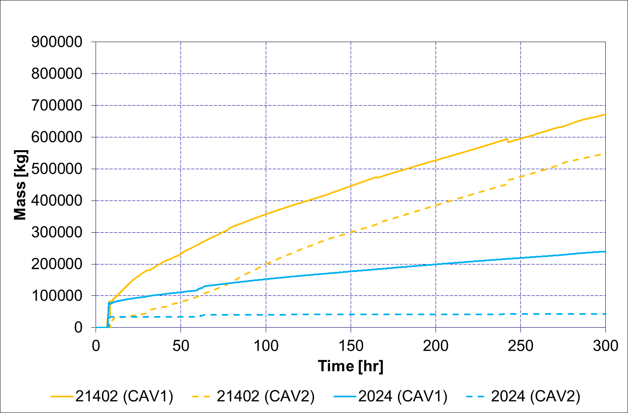
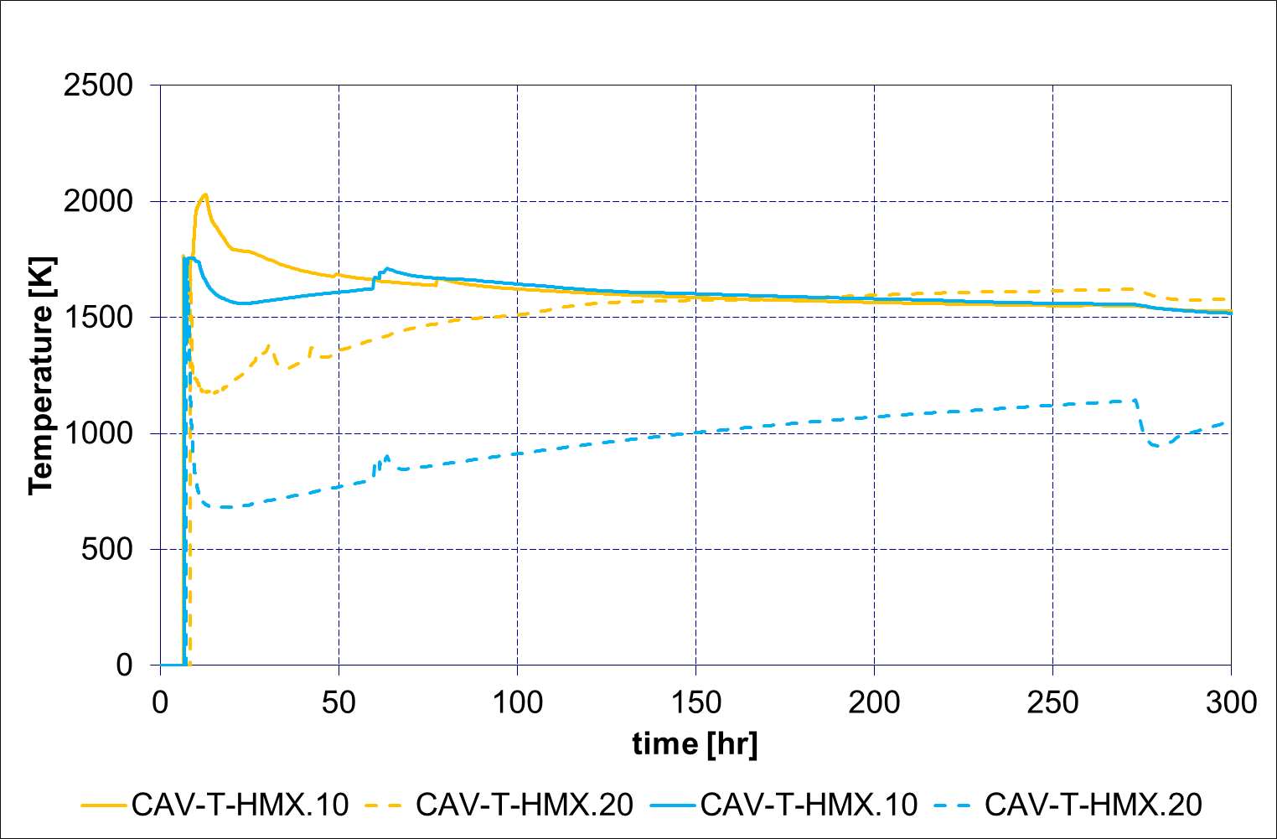
1F1 Fukushima analysis
Comparison among MELCOR versions
MCCI
Large differences found between version in terms of both corium mass and corium temperature
What is the cause of these differences?

Slide 29
Conclusions
  This work is currently ongoing.
  Large differences found among different versions of code.
  As future work, need for re-calibration of our approximation (small leak from RPV to DW) looking for a better agreement to available real data.
Collaboration agreement between CSN and CIEMAT on
Severe Accident Research (APIAS)

Slide 30
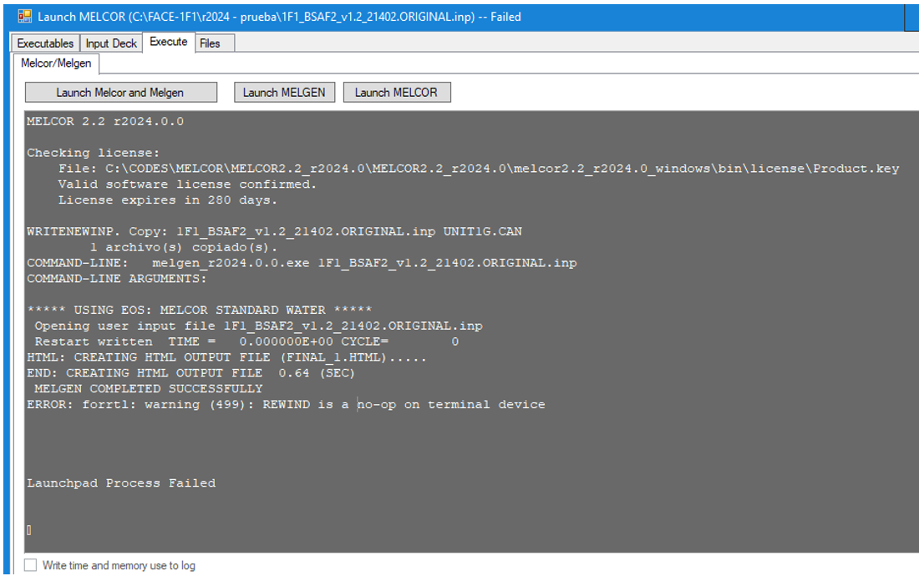
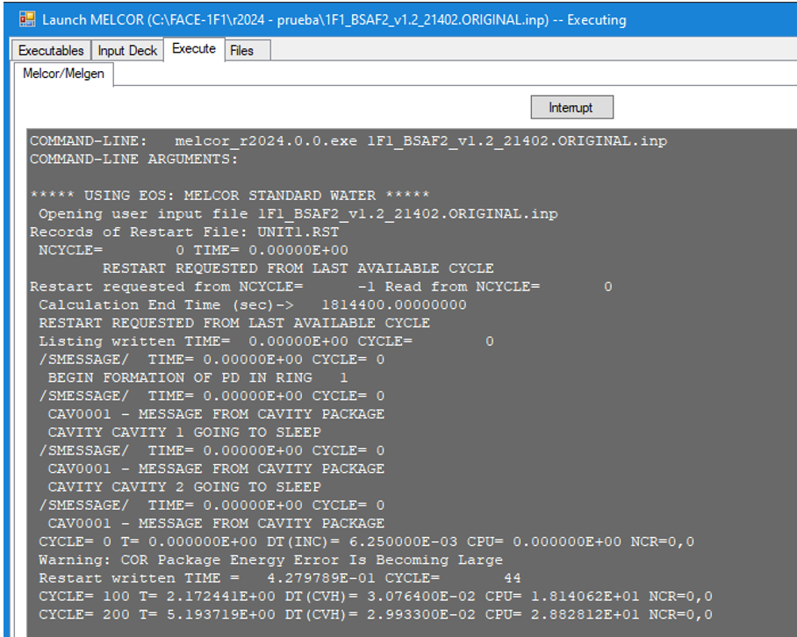
MELCOR_v22_r2024
MELCOR running

Slide 31
Final Remarks
  MELCOR has become an essential tool for CIEMAT in the area of LWR analysis.
  CIEMAT is profusely using MELCOR in research and application activities.
  MELCOR has been the backbone of CSN-CIEMAT agreements, and it will be again.
  New environments for CIEMAT use of MELCOR: Uncertainties, SFPs, DBA & DEC-A.
  CIEMAT’s expertise on SA analysis with MELCOR being used in other technologies.
  Our highest appreciation goes to:
  SNL colleagues for an exceptional work & USNRC for their continuous support to it
  CSN for making MELCOR accessible through its bilateral agreement with USNRC

Slide 32
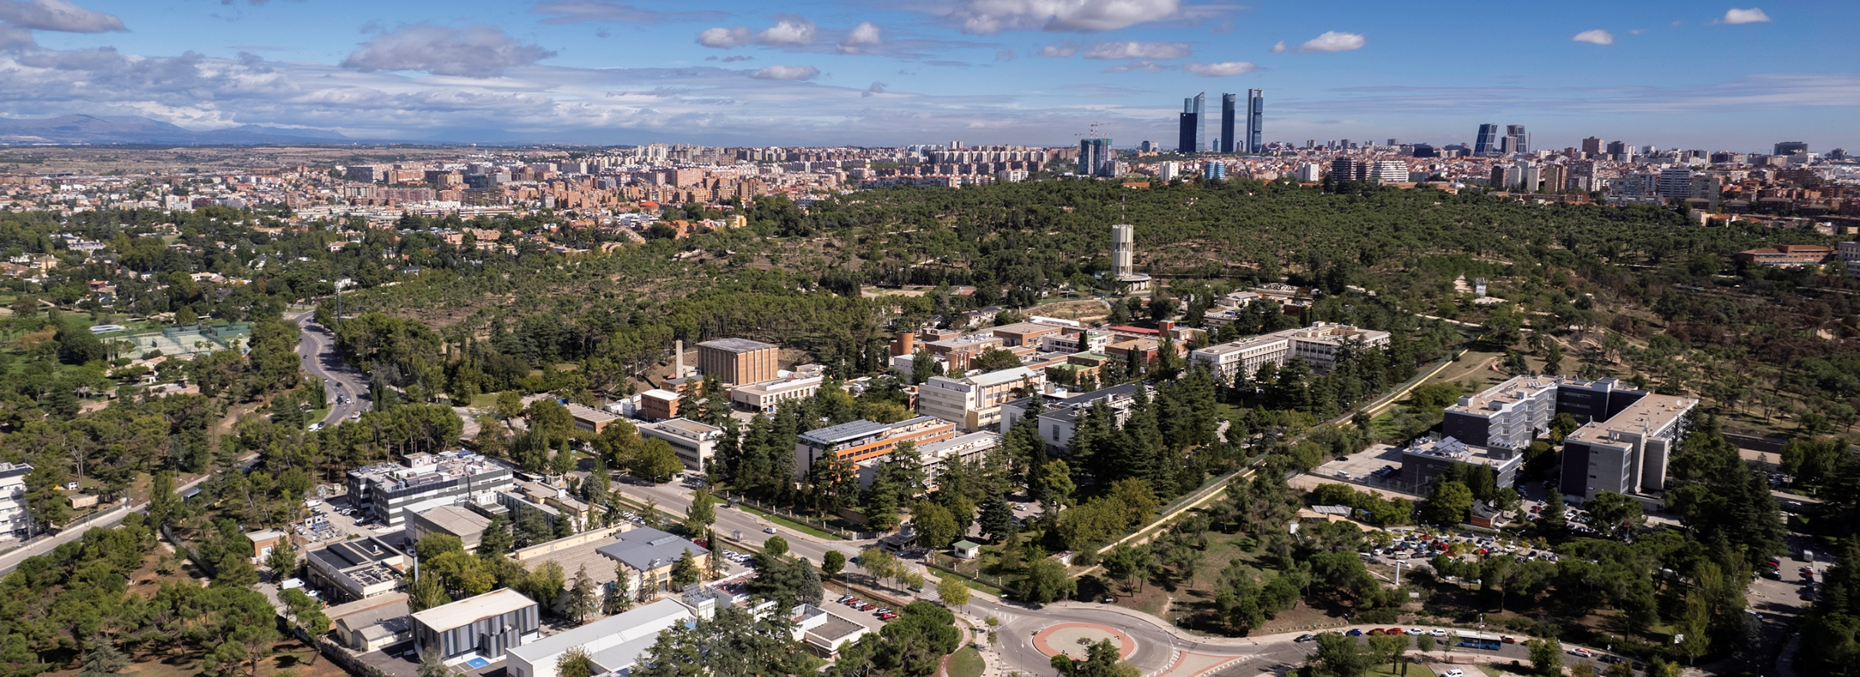
Thank you for your attention!
Unit of Nuclear Safety Research
Department of Nuclear Fission
CIEMAT
monica.gmartin@ciemat.es

