Slide 1
EDF MAAP Activities
Jeremy Bittan
Electricité de France (EDF)
jeremy.bittan@edf.fr
E-MUG Meeting - Rome – 2024, April 15-18th

Slide 2
Outline
MAAP5/MAAP6 Numerical stability studies
MAAP5 comparison to ASTECv3 for the e-SMR (ELSMOR project)

Slide 3
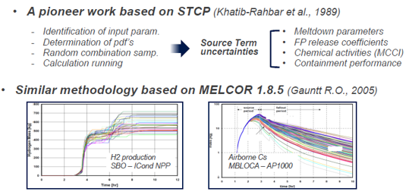
1- MAAP5/MAAP6 Numerical stability studies
Motivation for the studies
Feedbacks from using SA codes show that when uncertainties are propagated in a transient it is sometimes difficult to explain physically the discrepancies between the runs: small input discrepancies can lead to large discrepancies in the FoM:

Slide 4
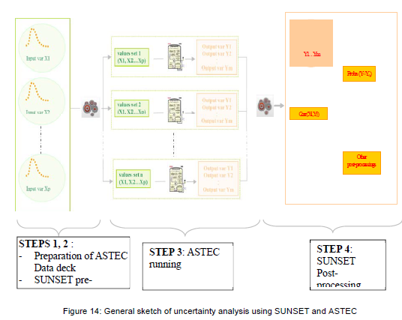
1- MAAP5/MAAP6 Numerical stability studies
Motivation for the studies
https://musa-h2020.eu/wp-content/uploads/2023/05/D3_1_review_of_uncertainty_methodologies_and_tools_applicable_to_SA_codes_for_the_prediction_of_ST_V1.pdf).

Slide 5
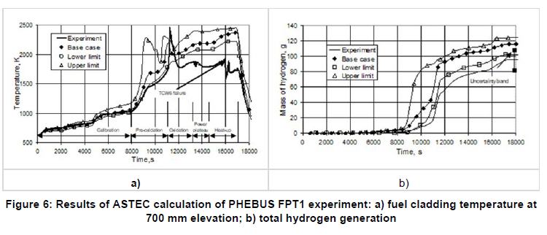
1- MAAP5/MAAP6 Numerical stability studies
Motivation for the studies
https://musa-h2020.eu/wp-content/uploads/2023/05/D3_1_review_of_uncertainty_methodologies_and_tools_applicable_to_SA_codes_for_the_prediction_of_ST_V1.pdf).

Slide 6
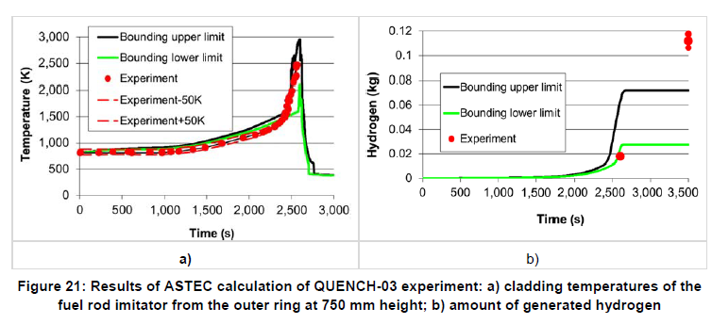
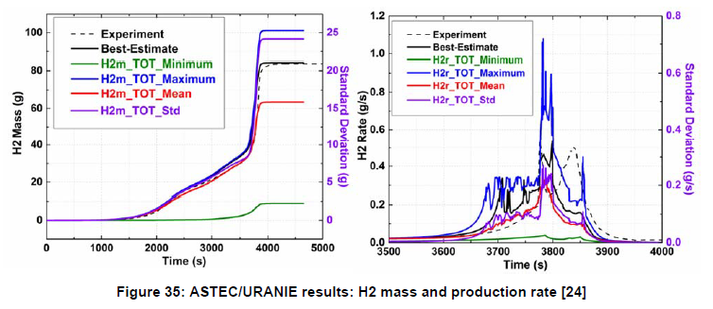
1- MAAP5/MAAP6 Numerical stability studies
Motivation for the studies

Slide 7
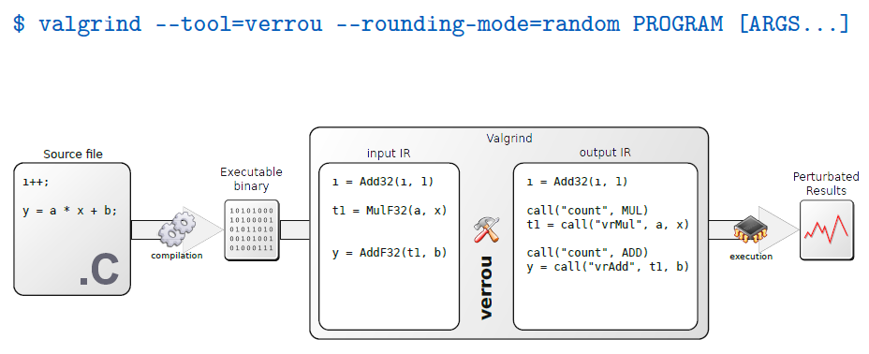
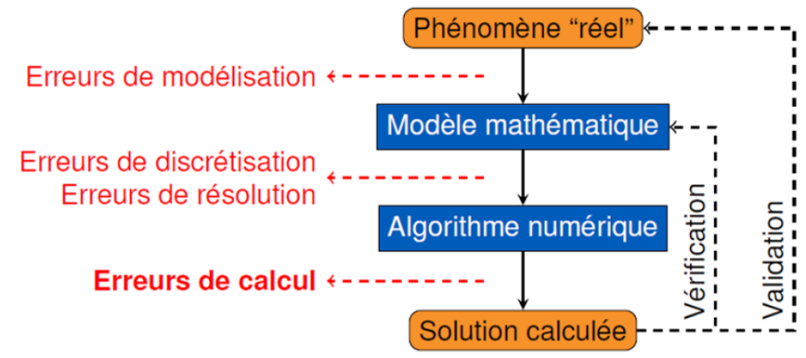
1- MAAP5/MAAP6 Numerical stability studies
Introducing VERROU
The physics of the SA are of course nonlinear and could explain some parts of the discrepancies.
EDF has developed a tool – called VERROU – that evaluates the round-off error of a code (SA code or not).
No need to have access to the source code, only an executable is necessary

Slide 8
1- MAAP5/MAAP6 Numerical stability studies
Introducing VERROU
VERROU modifies each floating-point operation to add a different rounding of the results (random by default).
Original code with two arithmetic operations MWEXP=MWR+FMWR*DTR | Result MWEXP=593.
Modified code (rounded upward) by Verrou MWEXP=(MWR+(FMWR*DTR)+Δ)+Δ | Result MWEXP=593.00000000000006
For types Float64, Δ perturbation is 10⁻¹⁶ = ± 0.0000000000000001
If the code has low floating-point errors, the significant digits of the results should be robust to a random rounding. If not, the numerical noise increases over time, the code is then unstable which may have impacts on the global results

Slide 9
Introducing VERROU
1- MAAP5/MAAP6 Numerical stability studies
VERROU can be used as a diagnostic tool to know whether a code is stable or not.
Running the same calculation of MAAP several times with VERROU (random rounding):
  valgrind --tool=verrou --rounding-mode=random ${MAAP} ${INP}
  valgrind --tool=verrou --rounding-mode=random ${MAAP} ${INP}
  valgrind --tool=verrou --rounding-mode=random ${MAAP} ${INP}
  valgrind --tool=verrou --rounding-mode=random ${MAAP} ${INP}
  valgrind --tool=verrou --rounding-mode=random ${MAAP} ${INP}
  valgrind --tool=verrou --rounding-mode=random ${MAAP} ${INP}
  valgrind --tool=verrou --rounding-mode=random ${MAAP} ${INP}
  valgrind --tool=verrou --rounding-mode=random ${MAAP} ${INP}
  valgrind --tool=verrou --rounding-mode=random ${MAAP} ${INP}
Analyzing parameter of interest discrepancy

Slide 10
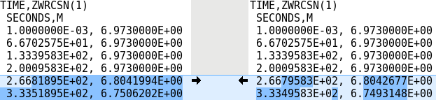
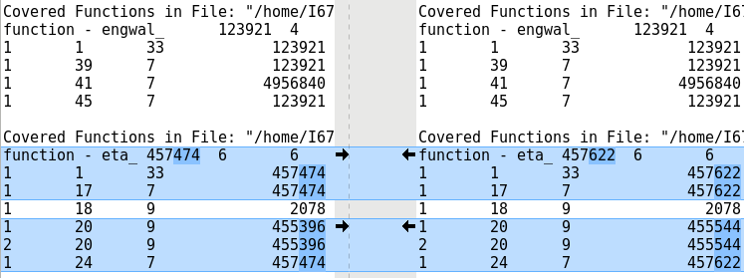
Software tools and methods
1- MAAP5/MAAP6 Numerical stability studies
How to know whether a calculation with VERROU is stable or not?
Comparing parameters of interest (significant digits versus round-off error)
Comparing code coverages
  (beware of false positives)

Slide 11


Software tools and methods
1- MAAP5/MAAP6 Numerical stability studies
A more sophisticated use of VERROU allows to go further in finding the line of the code creating a high discrepancy (a trigger).
This method (named delta-debug) is based on a selective rounding (instrumenting) of certain code lines. Comparing calculations with different instrumented lines, it is possible to find the trigger line.
Instrumented lines
LOW discrepancy calc
Not Instrumented lines
Instrumented lines
HIGH discrepancy calc
Not Instrumented lines
This is the trigger line

Slide 12
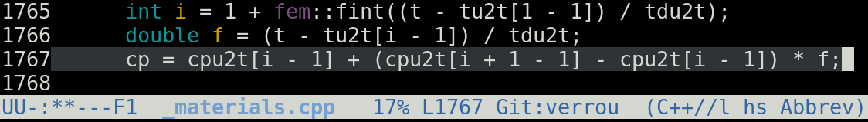
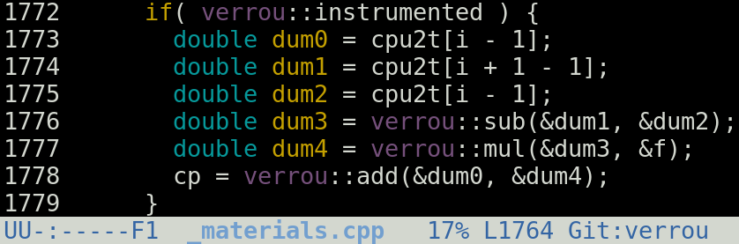


Software tools and methods
1- MAAP5/MAAP6 Numerical stability studies
VERROU is not designed to find how the error propagates and amplifies.
Using a debugger allows to follow the propagation of instability. It requires the “unstable” line to be replaced with an instrumented code.
Original code
Instrumented code
$$A+\left(B−C\right)∗D$$
$$A+\left(B−C\right)∗D ±e^{−16}$$

Slide 13
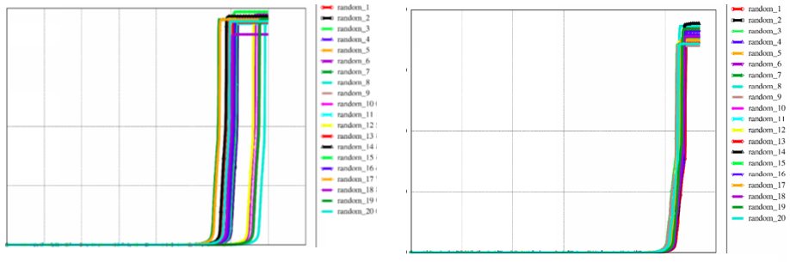
Example of improvements
1- MAAP5/MAAP6 Numerical stability studies
  Original MAAP5 “Stabilized” MAAP5

Slide 14
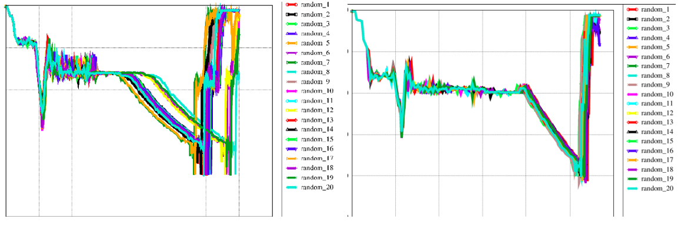
1- MAAP5/MAAP6 Numerical stability studies
Example of improvements
  Original MAAP5 “Stabilized” MAAP5

Slide 15
1- MAAP5/MAAP6 Numerical stability studies
Conclusion
  VERROU could be applied at least as a diagnostic tool on MELCOR and could potentially lead to stability improvements in the simulation of SA transients
  It would also enable to have a more accurate appreciation of the uncertainty studies
  VERROU can be downloaded for free:
https://github.com/edf-hpc/verrou

Slide 16
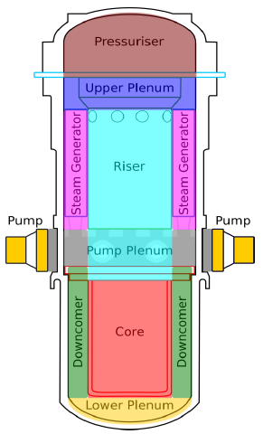
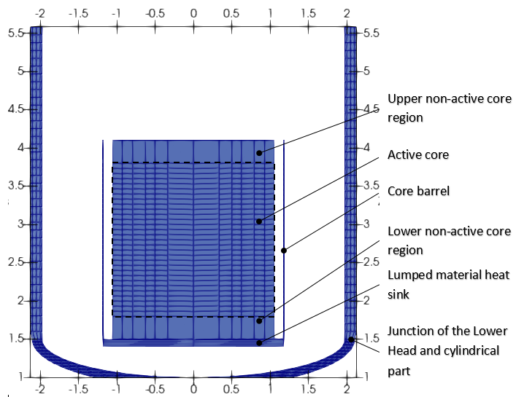
2. MAAP5 comparison to ASTECv3 for the e-SMR
In the frame of the ELSMOR EU project (2019-2023), EDF MAAP5.04 has been compared to ASTECv3 (an IRSN developer used the code) on a e-SMR
The ELSMOR RCS design has been built thanks to the use of a datasheet
Those data allow to model most of the RCS
Dataset
EDF MAAP5
ASTECV3
ERMSAR 2024 – J. Bittan, N. Bakouta (EDF), J-A. Zambaux, L. Carénini (IRSN)

Slide 17
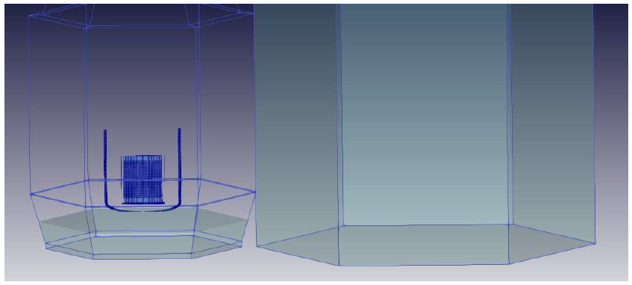
2. MAAP5 comparison to ASTECv3 for the e-SMR
Containment and outside “water wall”
EDF MAAP5
ASTECV3

Slide 18
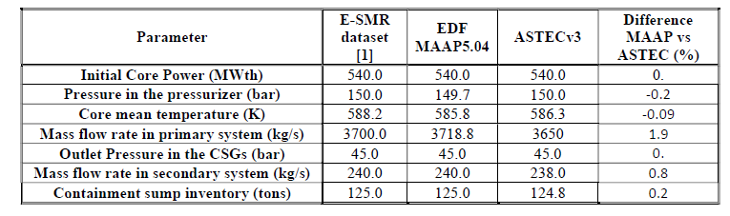
2. MAAP5 comparison to ASTECv3 for the e-SMR
Steady-state

Slide 19
2. MAAP5 comparison to ASTECv3 for the e-SMR
Transient simulated
The SBO transient is initiated at full power. This leads instantly to:
a reactor scram,
the loss of the Reactor Coolant Pumps (RCPs),
the loss of the Main Feed Water (MFW) to all the CSGs (5s after the scram),
The closing of the Main Steam Isolation Lines (MSIVs) concomitantly to the loss of MFW.
It is considered that the passive S-CSGs fail to start, which is a highly conservative assumption. The operator initiates a primary circuit depressurization through the Pressurizer Relief Valves (RVs), one hour after noticing that the S-CSGs fail to remove any decay heat from the RCS.
Two accumulators ensure core reflooding before being emptied.
A DC battery enables reflooding of the reactor vessel through the water from the water wall with a constant flow of 5 kg/s. This system, called RNU, is activated on a pressure threshold in the RCS (80 bar).
The large amount of water in the water wall allows delaying the core uncovery and ultimate core degradation. This happens when the battery is fully discharged, 12 hours after the battery first solicitation, and the RCS is progressively emptied by evaporation (core decay heat removal).

Slide 20
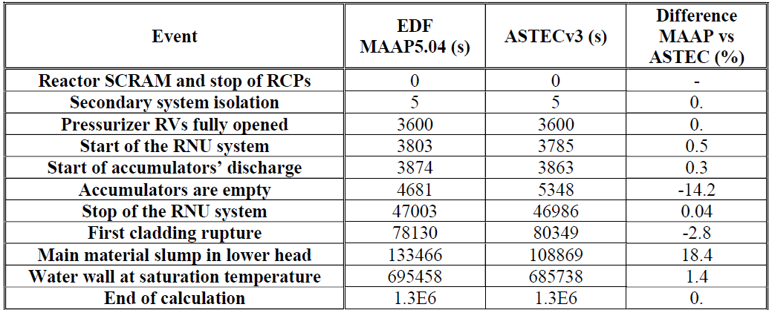
2. MAAP5 comparison to ASTECv3 for the e-SMR
Main results

Slide 21
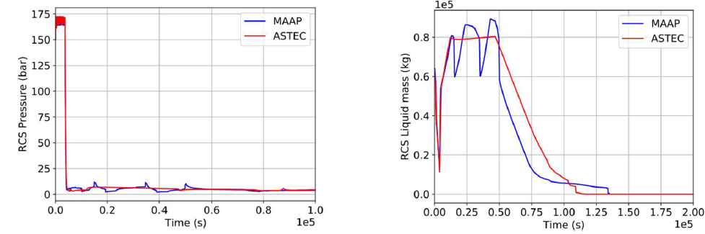
2. MAAP5 comparison to ASTECv3 for the e-SMR
Results
Thermal-hydraulics in the RCS

Slide 22
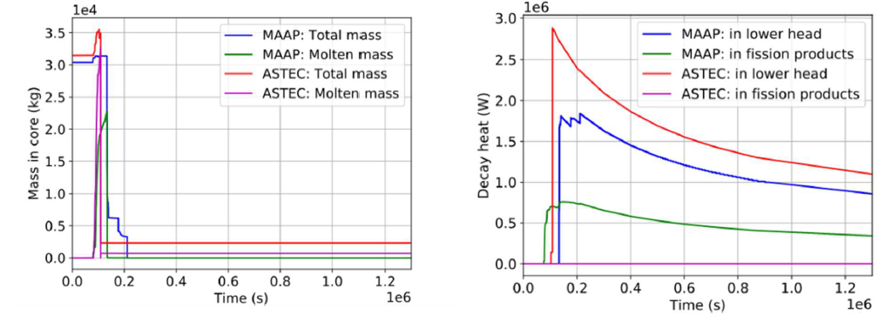
2. MAAP5 comparison to ASTECv3 for the e-SMR
Results
Degradation Phase

Slide 23
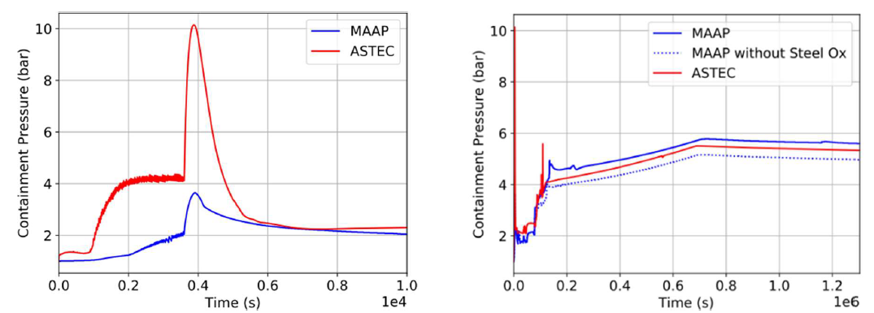
2. MAAP5 comparison to ASTECv3 for the e-SMR
Results
Containment behavior

Slide 24
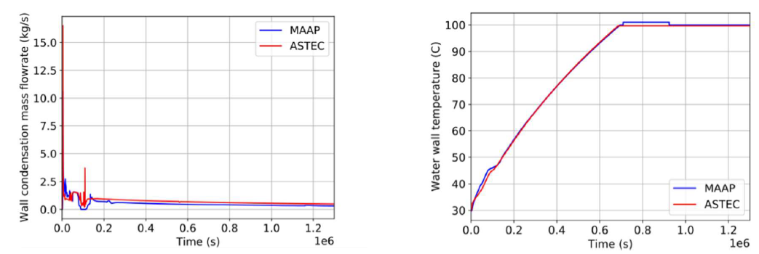
2. MAAP5 comparison to ASTECv3 for the e-SMR
Results
Containment behavior and External water wall behavior

Slide 25
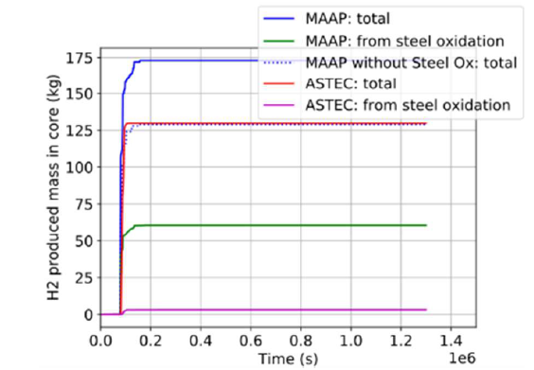
2. MAAP5 comparison to ASTECv3 for the e-SMR
Results
Hydrogen production

Slide 26
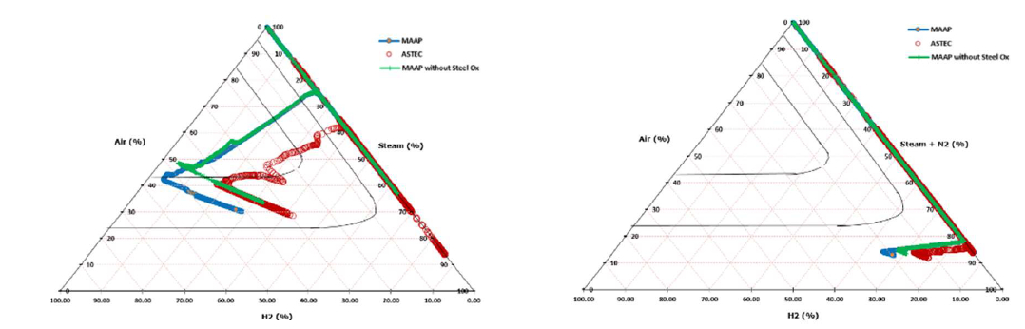
2. MAAP5 comparison to ASTECv3 for the e-SMR
Results
(left) Shapiro diagram without N2 injection (right) with N2 injection

Slide 27
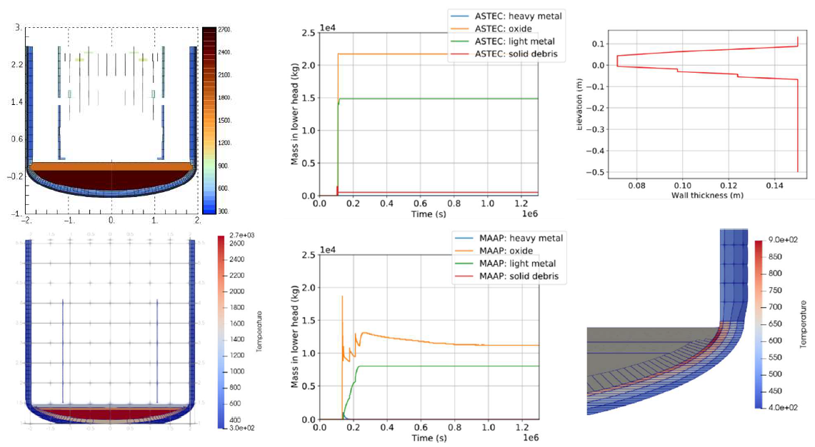
2. MAAP5 comparison to ASTECv3 for the e-SMR
Results
In-vessel melt retention (IVMR)

Slide 28
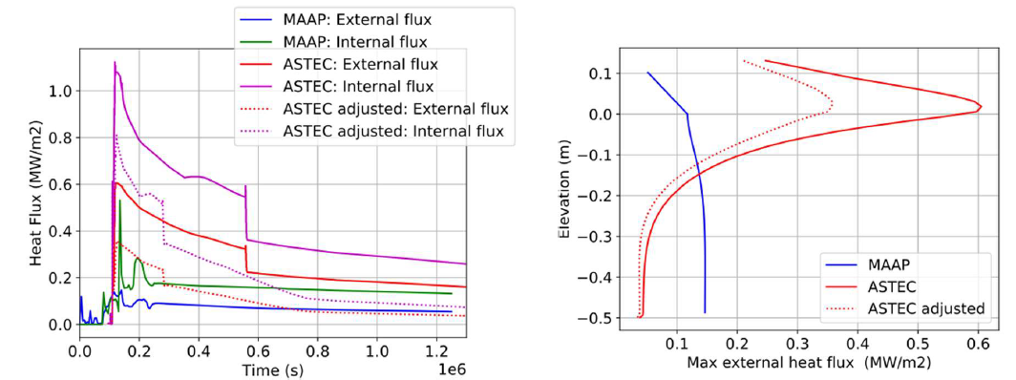
2. MAAP5 comparison to ASTECv3 for the e-SMR
Results
In-vessel melt retention (IVMR)

Slide 29
2. MAAP5 comparison to ASTECv3 for the e-SMR
Conclusion
Both EDF MAAP5.04 and ASTECv3 enable to fully model the SBO transient as well as sensitivity analyses
No vessel failure is evaluated for all the transients except the extremely conservative scenario with no safety systems – for both codes
Results are very similar between the codes for TH, H₂ production, and IVR especially when the same assumptions are considered (decay heat in FP for ASTEC, realistic conductivity for the liner for MAAP…)
No source term evaluation (release and sedimentation) has been considered in this analysis and should be performed in the future.
Condensation models on the walls would also need some deeper validations especially for scenarios with a high fraction of non condensable gases (with N₂ injection)

