Slide 2
Uncertainty Analysis of Severe Accident in Krško NPP
Matjaž Leskovar
Jožef Stefan Institute
Ljubljana, Slovenia
EMUG, Rome • April 15–18, 2024

Slide 3
Outline
Introduction
Analyzed SA scenario and applied codes
Krško NPP MELCOR model
RN chemistry modelling approach
Uncertainty and sensitivity analysis
Uncertain input model parameters
Simulation results
Focus on radiological variables
Conclusions

Slide 4
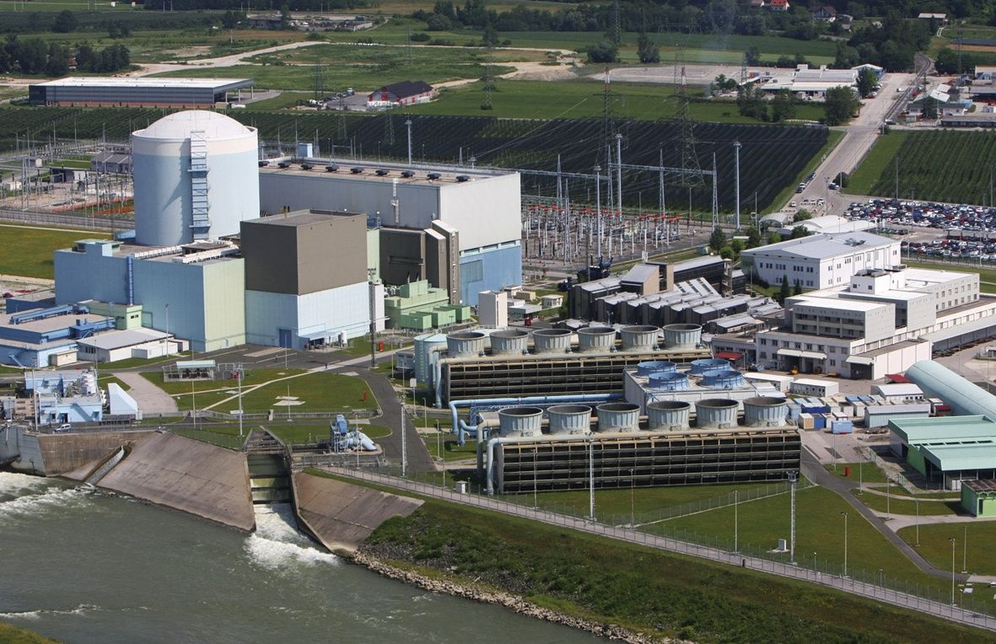
Krško NPP
2-loop Westinghouse PWR with 1,994 MW_{th} and 696 MW_{el}

Slide 5
Analyzed SA scenario and applied codes
Initial event strong earthquake → simultaneous SBO and LBLOCA
Only passive safety systems available
MELCOR 2.2 R2023.0
Uncertainty and sensitivity analyses with SUSA (GRS)
AptPlot (results extraction from MELCOR plot files)
Python scripts (preparing AptPlot command file, formatting AptPlot output for SUSA, results extraction from SUSA output, plotting results)

Slide 6
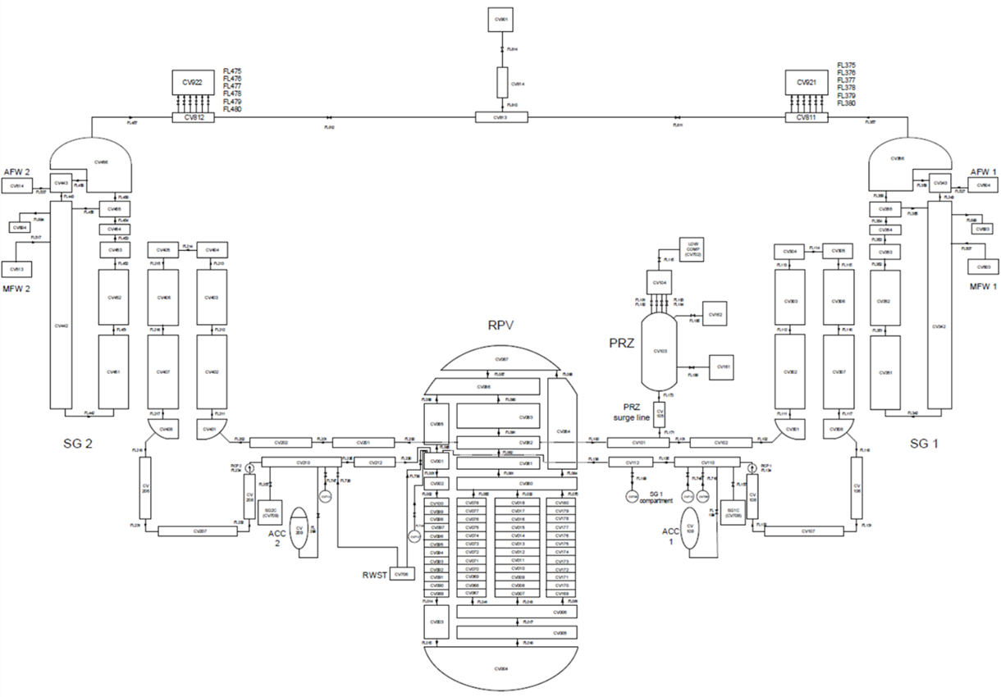
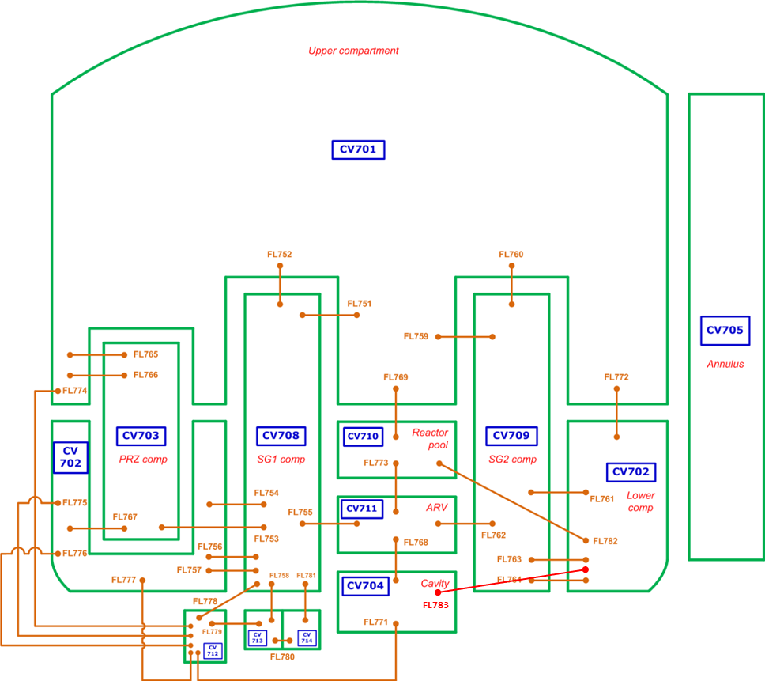
Krško NPP nodalization

Slide 7
RN chemistry modelling approach
In MELCOR chemical reactions of RN can not be properly modelled directly
Compounds may be defined, e.g. Cs + I → CsI, Cs + Mo → CsM ⇒ all available material will react ⇒ e.g. (nearly) no gaseous I
Chemical reactions considered by adjusting inventory of RN classes Cs, I2, CsI, Mo and CsM
1.7 % I in vapour form I2
98.3 % I as CsI
80 % Cs (not as CsI) as CsM
20 % Cs (not as CsI) as Cs

Slide 8
Uncertain input model parameters
Based on SOARCA Uncertainty Analysis for Surry NPP
Par 1 - Zircaloy melt breakout temperature (beta distribution, mode 2360 K, min 2100 K, max 2540 K; ref 2400 K)
Par 2 - Molten clad drainage rate (log. triangular, mode 0.2 kg/m·s, min 0.1 kg/m·s, max 2 kg/m·s; ref 1 kg/m·s)
Par 3 - Effective melting temperature of eutectic formed with ZrO2 and UO2 (normal, avg 2479 K, sigma 83 K; ref 2500 K)
Par 4 - Mass of gaseous iodine (fraction) (log. triangular, mode 0.146 kg (1.7 %), min 0.0172 kg (0.2 %), max 0.603 kg (7 %); ref 0.146 kg (1.7 %))
Par 5 – Mass of class CsM (fraction) (beta, mode 111.7 kg (80 %), min 0 kg (0 %), max 139.6 kg (100%); ref 111.7 kg (80 %))

Slide 9
Uncertainty and sensitivity analysis
With SUSA 100 input models created
MELCOR simulations run on HPC cluster in parallel
300.000 s (~3.5 days) of SA simulated
16 successful calculations
84 stopped during core degradation (<3.500 s from start)
Switched of eutectic model for core melt ⇒ 87 successful
With SUSA created 20 additional input models
Total 120 simulations, 105 successful
> required 93 (95%/95%) − Wilks formula

Slide 10
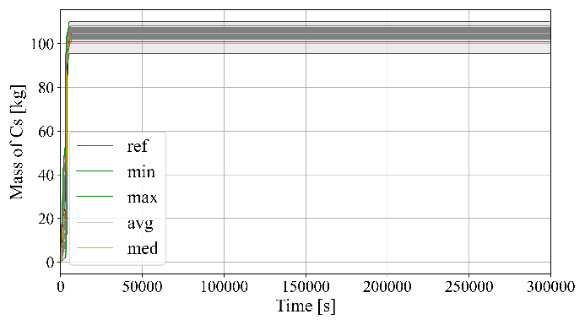
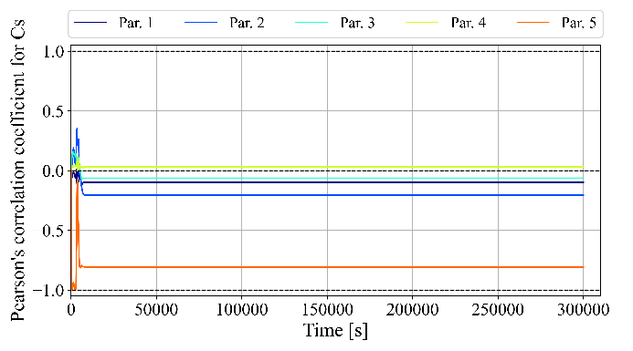
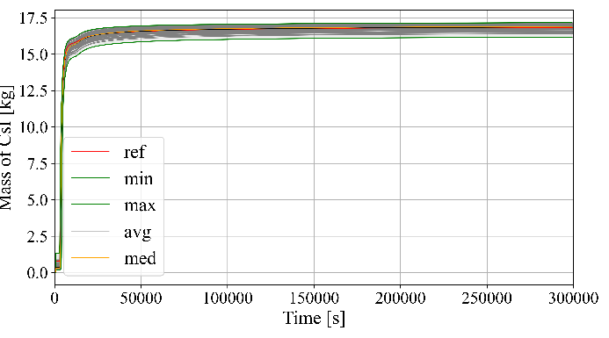
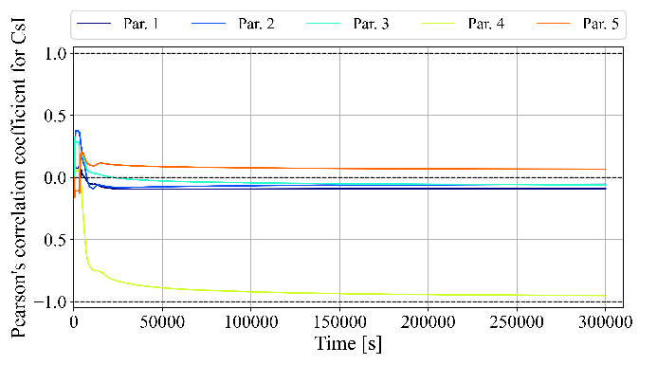
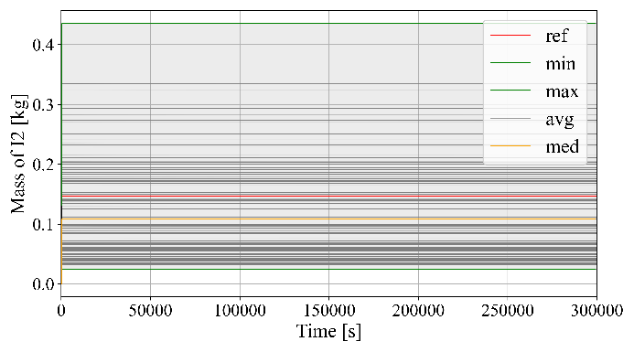
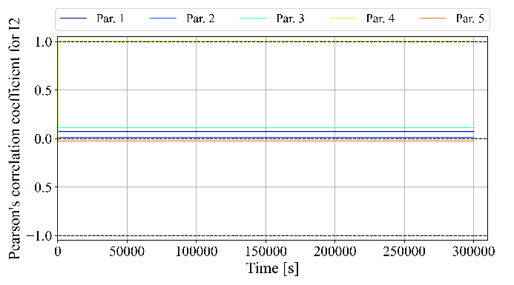
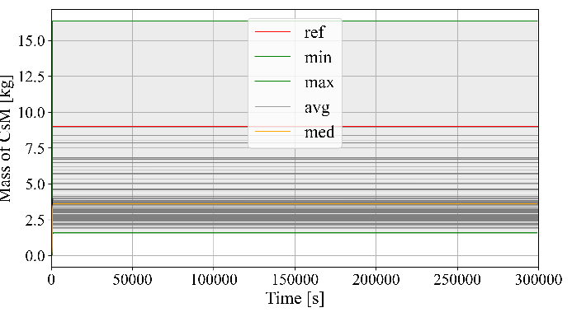
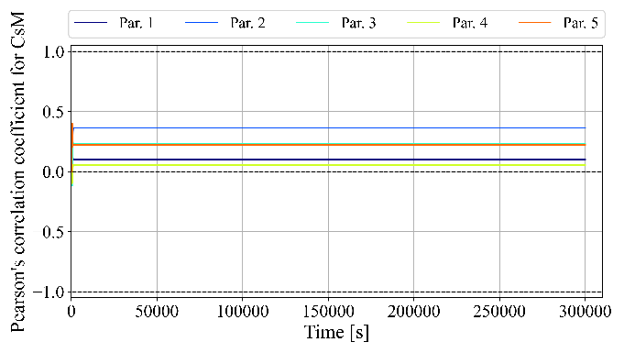
Mass of released RN from fuel
Cs CsI
Fraction of CsM
Fraction of I2
I2 CsM
Fraction of I2
Released Cs ~100 kg > initial inventory ~20 kg, released CsM ~10 kg < initial inventory ~110 kg
VANESA release model from debris in cavity does not model CsM, but decomposes into Cs and Mo

Slide 11
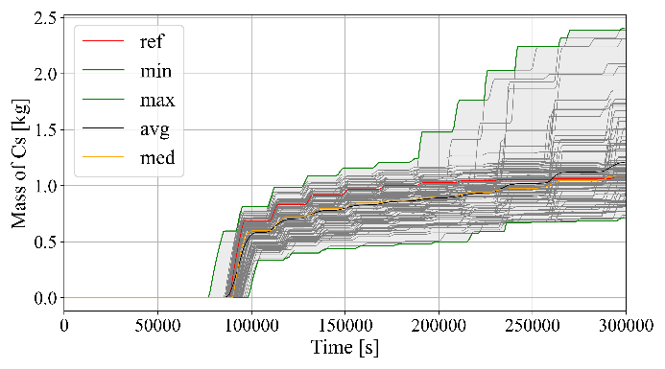
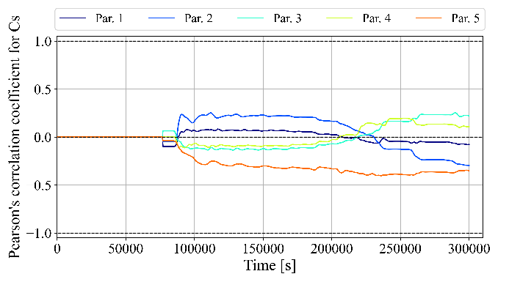
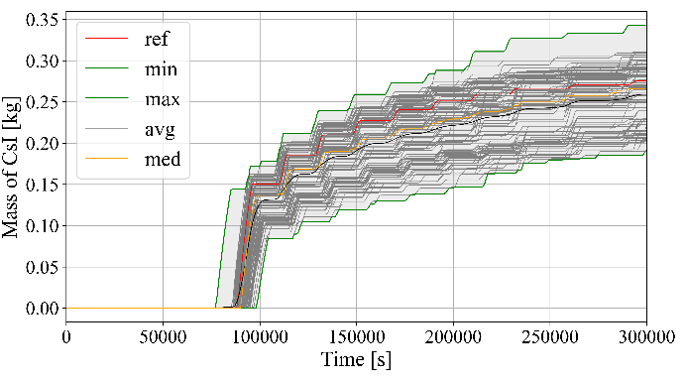
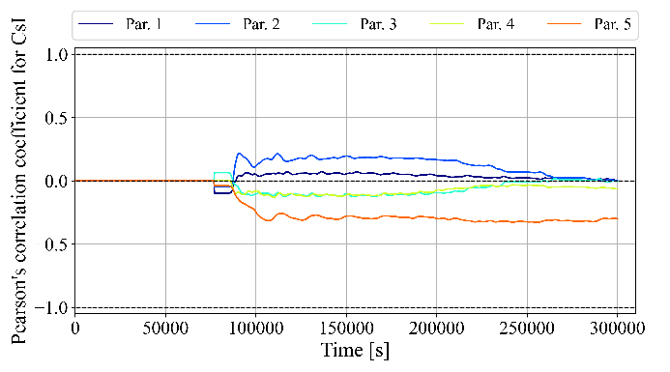
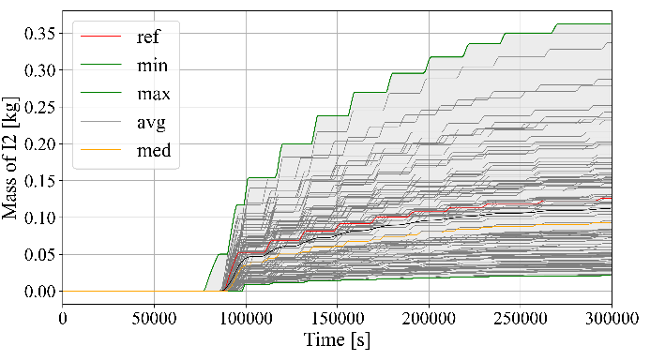
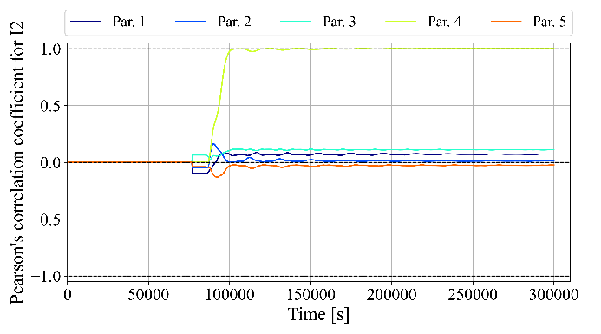
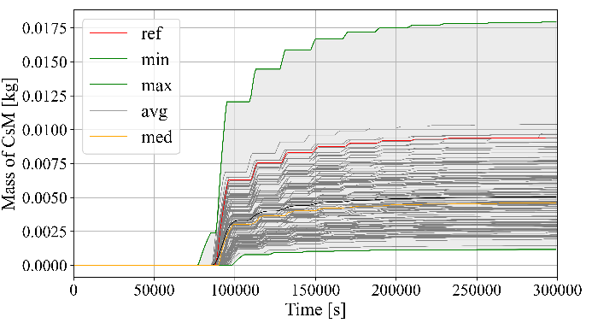
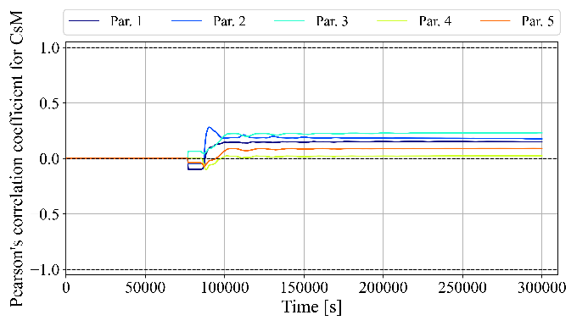
Mass of RN on containment venting filters
Cs CsI
I2 CsM
Fraction of I2
Cs, CsI filter scatter larger than fuel release sc., Pearson c.c. low ⇒ num. variance or stoch. influence
I2 filter mass similar to fuel release mass ⇒ during repeated containment depressurization almost all I2 flows through filters

Slide 12
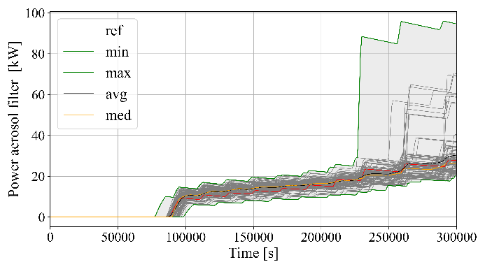
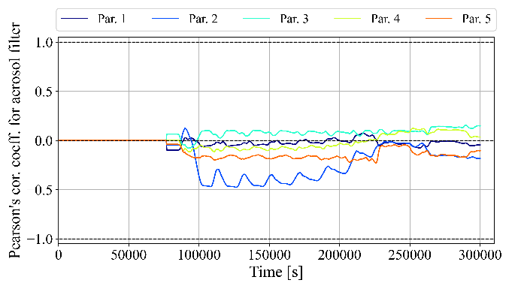
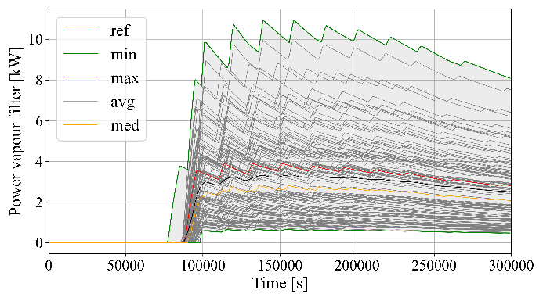
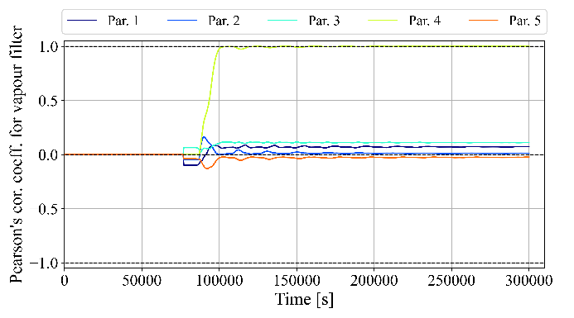
Decay heat release on containment filters
Aerosol filter
Larger scatter for aerosol filter, Pearson c.c. low ⇒ num. variance or stochastic influence
Large scatter for iodine filter consistent with assumed probabilistic distribution of I2
Aerosol filter designed for a heat load of 170 kW, iodine filter for 20 kW
Calculated heat loads on filters do not exceed the design values in any calculation
Iodine filter
Fraction of I2

Slide 13
Conclusions
Uncertainty analysis of unmitigated SBO with LBLOCA in Krško NPP was performed
Analysis covers only considered uncertain model parameters → actual uncertainty of results is expected to be larger
Chemical reactions of RN considered by adjusting inventory of RN classes
VANESA model for RN releases from debris in cavity does not model CsM, but decomposes into Cs and Mo
Typically key RN released during in-vessel core degradation → not problem
Our scenario rapid failure of reactor vessel → benefits from considering Cs-Mo chemical reaction mainly lost
Scatter of results reflects scatter of uncertain model parameters
For some results it is much larger → numerical variance or stochastic influence significantly contribute to scatter
Calculated heat loads on filters do not exceed design values

