Slide 1
Core Modelling,
Collapse, and Slumping in an EPR Reactor
BRAUN, Matthias
Rome, 15th – 18th April 2024
C0 – Unrestricted
AL:N, ECCN:N

Slide 2
N
N

Slide 3
Content
1
2
3
4
Fuel Assembly Support
Core Support
Perception based on Output

Slide 4
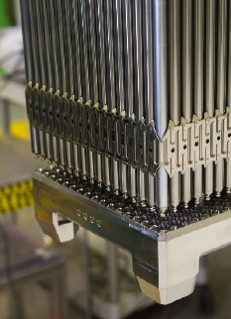
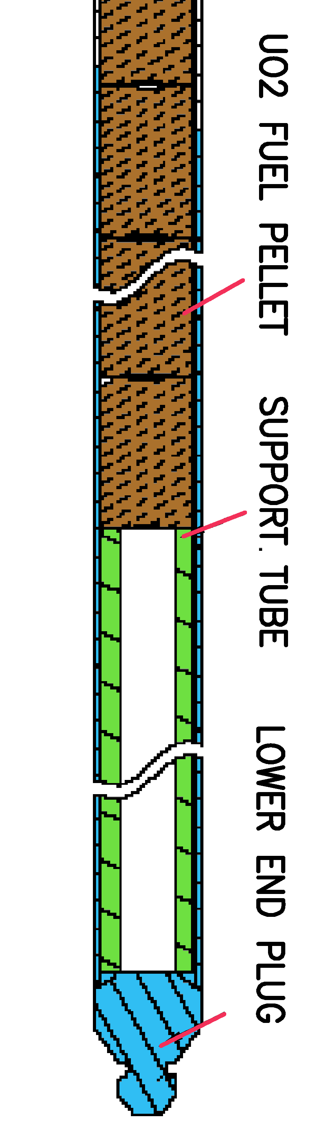
1) Fuel Assembly Support
[4]
[3]
Fuel Assembly Lower End
Bottom active fuel
Fuel load carrying
  Fuel in the rod supported by steel standpipe
  insulation tablet in rod bottom
  Load transferred to cladding
  Cladding friction-held by grid spacer
  Spacer attached to CR guide tubes
  Expansion gap between fuel rods bottom, nozzle
  Guide tubes attached to bottom nozzle
  Bottom nozzle stands on core support plate
Realistically, MELCOR cant capture every detail
  What is a realistic description of fuel rod support loss
  and converting the assembly into particulate debris?
  What describes the axial-downward heat transfer from
  the fuel to the core support plate?
[3] https://www.framatome.com/medias/framatomes-gaia-enhanced-accident
-tolerant-fuel-completes-second-cycle-at-vogtle-unit/
[4] https://www.nrc.gov/docs/ML1322/ML13220A677.pdf

Slide 5
1) Fuel Assembly Support
[4]
Fuel Rod Lower End
When the steel standpipe melts, will the fuel drop down within the rod?
  Probably unlikely in its totality (fuel cracking & expanding due to burnup)
  Partial downward drop maybe ... (remember for later)
What to do with the empty space in the standpipe?
  Small space per rod times many rods adds up to ~1m³ for the entire core
  Ignoring the volume would reduce the interface area of core melt on top to the support structure below
  → act as indestructible perfect thermal insulator
  Filling it with COR material (FU?) would falsify core mass
  Add the volume to the free volume
  → overestimating the volume of water in the core seems to make the smallest modelling error
[4] https://www.nrc.gov/docs/ML1322/ML13220A677.pdf

Slide 6
1) Fuel Assembly Support
[3]
Modelling Approach 1
Conceptionally, it would be nice to have COR axial levels which correspond
to the sections with distinct thermal-hydraulic properties (COR_ZP <-> FL_SEG)
  COR_Z corresponds to a FL_SEG
  Very small axial levels → numerically challenging
Example of other issues: Grid spacer in level 3 has a high surface area & low mass
  candling Zr lead to failure
  entire fuel assembly was converted early into PD
Reminder: Structure failure rules
  Levels with FU → CORROD time-to-failure criterion (rather late)
  Levels without fuel → Temperature and/or metallic thickness criterion (early)

Slide 7
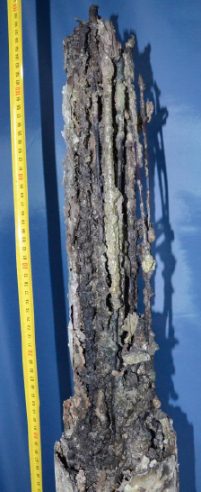
1) Fuel Assembly Support
Quench-18 [5]
[3]
Fuel assembly lower End
Does the failing of fuel support really justify the conversion of the
entire fuel assembly above from FU/CL into PD?
  When core support plate fails → yes
  When CR guide tubes or grids fail → rods drop by ~2 cm
  When bottom nozzle fails → drop by ~10 cm
Change of FU/CL into PD significantly changes properties
  Relocates downward by gravity
  Blocks / encumbers thermal hydraulic flow
  Contact-heat transfer to other structures
→ Opinion: failing bottom nozzle should not be interpreted as
converting a FA into debris (which can be debated)
[5] https://publikationen.bibliothek.kit.edu/1000131350

Slide 8
1) Fuel Assembly Support
[3]
Modelling Approach 2
Be “less” exact, merge all lower FA components into one axial level
  Less numerical demanding
  Less crash prone
Add some of the FU from Level 2 to Level 1
  Describe possible in-rod relocation
  Apply CORROD failure criterion to Level 1
→ FA support follows similar failure criteria than the fuel above

Slide 9
Content
1
2
3
4
Fuel Assembly Support
Core Support
Perception based on output

Slide 10
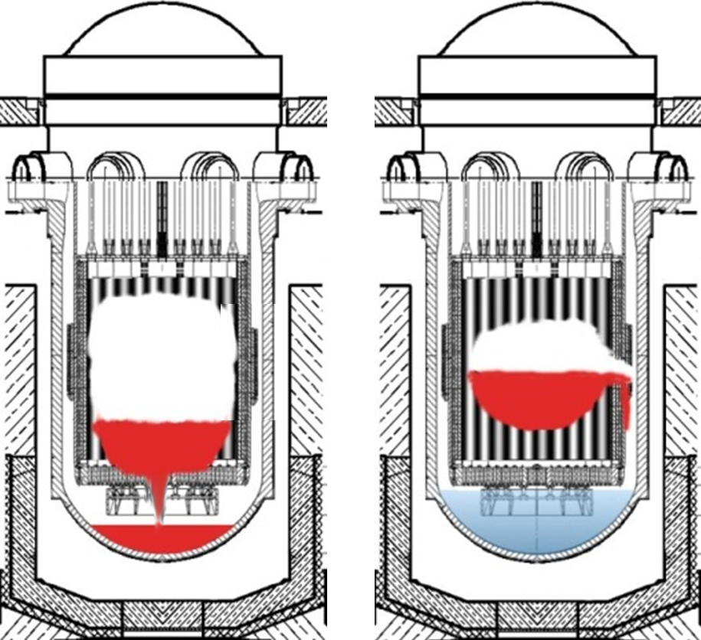
2) Core Support and Support-Failure
Two possible Pathways
Axial failure of the core support plate
  Low neutron leakage core load
  (low power in outer region)
  Light core support plate
  Complete core relocation
  → bounding RCS pressure transient
  Relatively late relocation
  → late RPV failure
Radial failure of core barrel
  Flat power distribution / usage of heavy reflector
  Heavy-duty core support plate
  Partial core relocation
  → low pressure RCS transient
  Early relocation
  → faster RPV failure

Slide 11
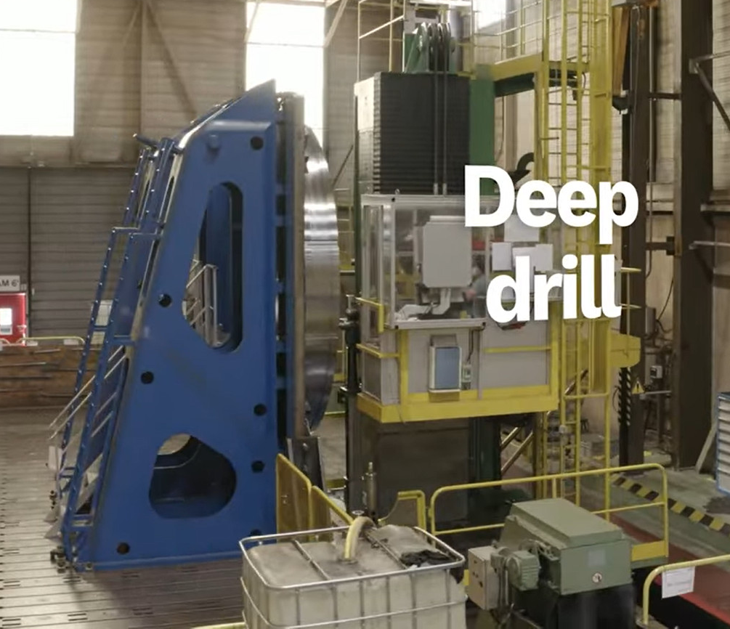
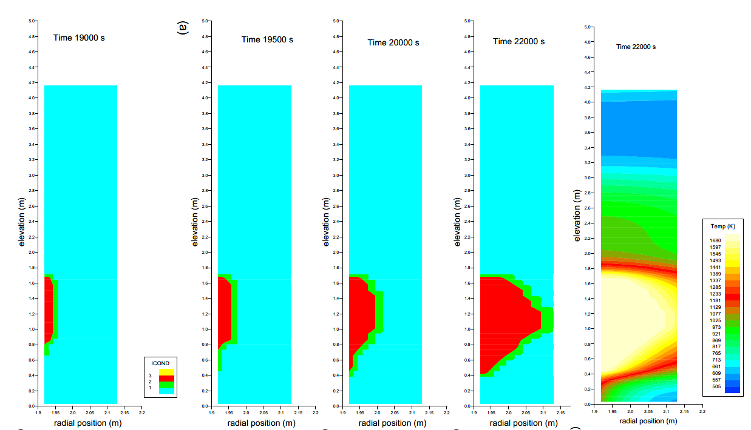
2) Core Support and Support-Failure
[1]
EPR
EPR core support plate (~0.5 m thickness) machined from solid forging
  Improved stiffness
  Higher material homogeneity / no welding / easier NDT
  No bolts / nuts / parts which could become loosed
EPR core used radially flat power profile
  Optimized for power-output vs. core diameter
  Usage of heavy reflector to reduce radial neutron flux loss
Simulation prediction that heavy reflector / core barrel
radially fail prior core support plate [2]
  Calculated in ASTEC
  Predicted in structure-mechanical codes using MELCOR as B.C.
  Implied in MAAP (not independent opinion)
→ EPR design likely favors radial core barrel penetration over axial support plate failure
[2]
Reference [8]
[1] https://www.youtube.com/watch?v=I_JtfpBPXQM
[2] FZKA6315 https://katalog.bibliothek.kit.edu/cgi-bin/koha/opac-detail.pl?biblionumber=829557

Slide 12
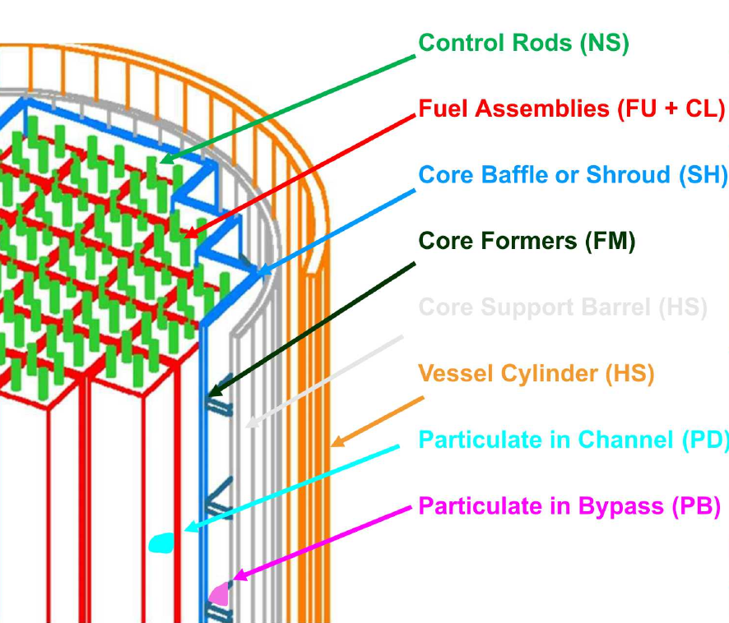
2) Core Support and Support-Failure
https://www.psi.ch/sites/default/files/import/emug/WS2019EN/WS_2019_02.pdf
Representation in MELCOR
To model TMI2, MELCOR allows
  Definition of a bypass in the outermost core ring, separated from the channel by a shroud (SH)
  After SH failure, PD and MP can relocate from the channel into bypass
  MB and PB drop down if not supported by core former sheets (FM)
MELCOR does
  Allows melt/debris relocation though bypass after
  failed core shroud/former (→TMI2)
  Does not allow melt/debris relocation in downcomer
  after failure of core barrel (HS)
Can one effectively model a core barrel pentation
via the MELCOR bypass? → not really

Slide 13
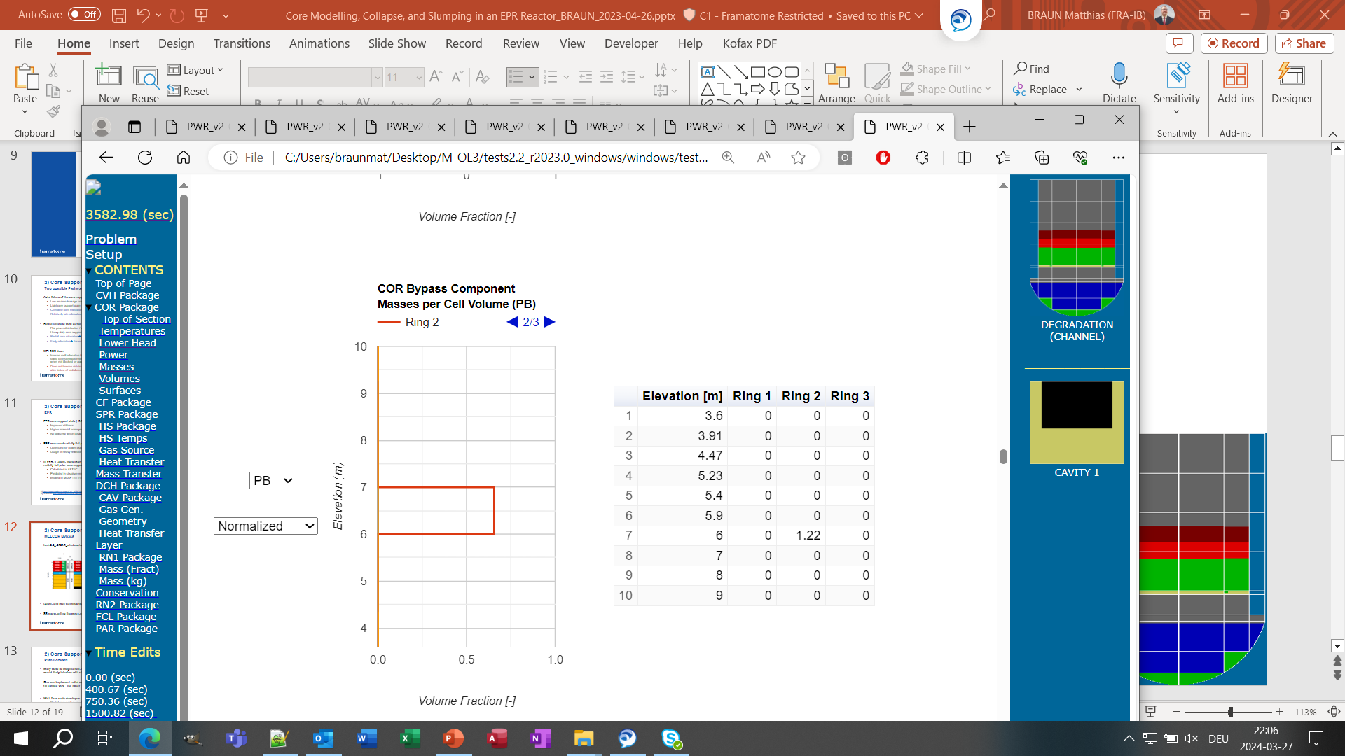

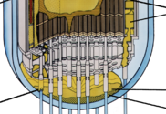
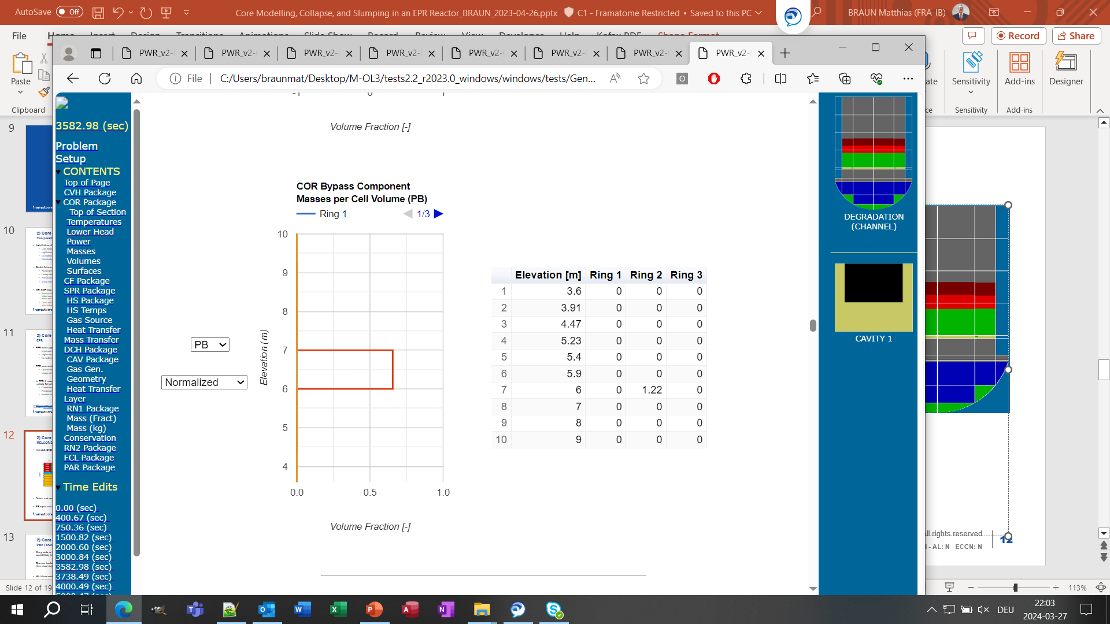
2) Core Support and Support-Failure
melcor2.2_r2023.0.exe
MELCOR COR Bypass
3582.98 (sec)
Not only FM hold up debris, but also SS (core support plate)
  MELCOR has (W, B&W) PWR core support structures in mind
  Core bypass ends on top of core support plate
Consequences for MELCOR
  After shroud failure, melt may drain into lower plenum
  With time, debris piles up in bypass → Melt cant drain anymore
  Melt pool expands radially reaching up to core barrel
  (which cannot fail by definition)
https://en.wikipedia.org/wiki/Three_Mile_Island_accident
tests2.2_r2023.0_windows\windows\tests\General_Access\_ShorterRuns\PlantDecks\PWR

Slide 14
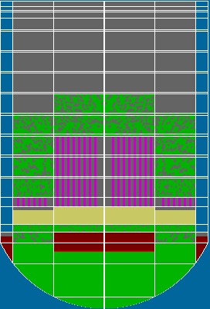
2) Core Support and Support-Failure
Path Forward
One can implement radial core enclosure failure via SH in MELCOR
(in a ‘creative’ way)
Wish for code development
  SS which have a clearer association to either channel or bypass
  (space occupied, hold-up behavior)
  Radial core enclosure which has
    an internal radial heat gradient & can gradually melt (like HS),
    failure allows melt/debris transfer out of core (like SH), and
    can candle (like e.g. SS)
  Clear explanation of the difference between HR and SH component
  (manual is there quite thin)

Slide 15
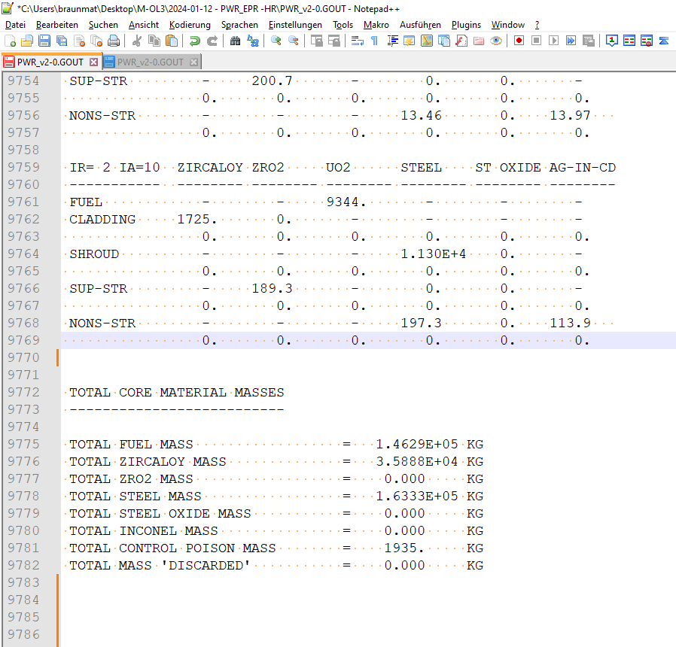
2) Core Support and Support-Failure
Heavy Reflector
Beside the manual, usage of HR-component has
another roadblock for us to use it
COR_RT = PWR-HR does convert Zr-SS
into ZRO2-SS and doesn’t tell anybody ...
Communicated 2024-01-15 to melcorbugs

Slide 16
Content
1
2
3
4
Fuel Assembly Support
Core Support
Perception based on Output

Slide 17
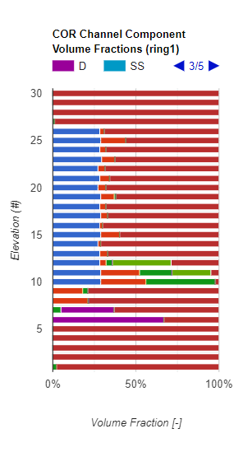
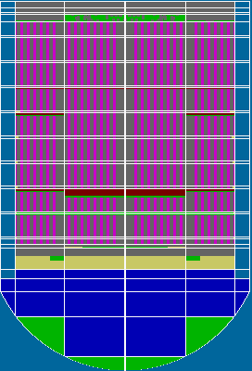
3) Perception based on Output
HTML vs PTFREAD
PTFREAD is great
  Easy to use, also for new people
  You don't have to know what you are exactly looking for
  Compatibility and long-term usability
  (office365 ....)
In the PTFREAD graphical representation of the
core degradation, not much happens until FU/CL-> PD
  Shaped my personal perception of a core
  degradation for a long time
HTML-Output shows a slightly different story
  Even before fuel rods collapse, formation of
  massive core blockages due to candling/refreezing
  agglomerated debris
  Within the core (depending on water level)
  On top of core support plate
Be aware what you perceive /
use multiple output pipes

Slide 18
Legal Notice
Editor and Copyright 2022: Framatome GmbH – Paul-Gossen-Straße 100 – 91052 Erlangen, Germany. It is forbidden to reproduce the present publication entirely or partially without prior consent in whatever form. Legal action may be taken against any infringer and/or any person breaching the aforementioned conditions.
Subject to change and error without notice. Illustrations may differ from the original. The contained statements and information are for advertising purposes only and do not constitute an offer of contract. They shall neither be construed as a guarantee of quality or durability, nor as warranties of merchantability or fitness for a particular purpose. These statements, even if they are future-oriented, are based on information that was available to us at the date of publication. Type, quantity and characteristics of goods and services are subject to formal individual formal contracts.

Slide 19
Thank you for your attention!
To discover more about how we can help, visit us at www.framatome.com/solutions-portfolio

